Slide 1

Abstract Classes and Interfaces

Slide 2
abstract Classes and Methods
Abstract classes: some methods are only declared, but no concrete implementations are provided.
Those methods called abstract methods and they need to be implemented by the extending classes.

Slide 3
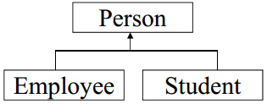
abstract class Person {
protected String name;
. . .
public abstract String getDescription() ;
. . .
}
Class Student extends Person {
private String major;
. . .
public String getDescription() {
return name + “ a student major in “ + major;
}
}
Class Employee extends Person {
private float salary;
. . .
public String getDescription() {
return name + “ an employee with a salary of $ “ + salary;
}
}

Slide 4
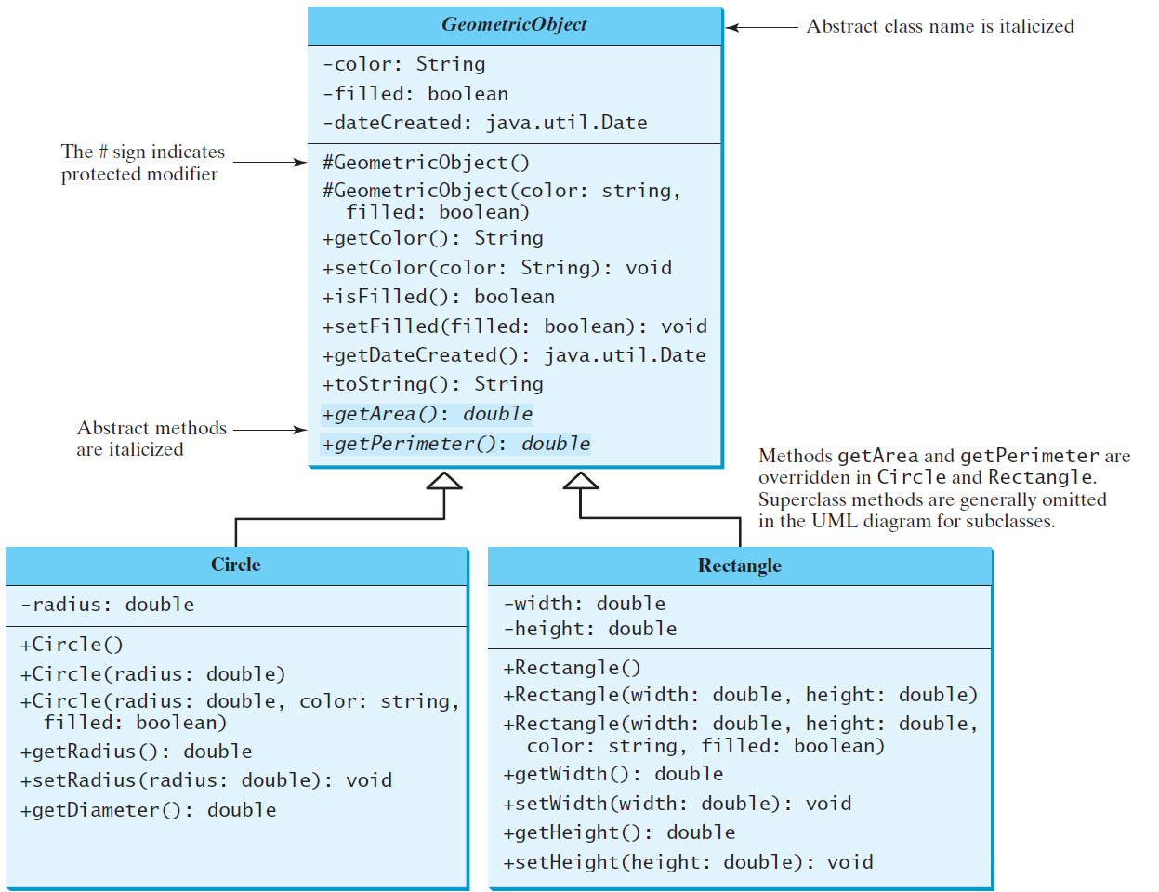
abstract Classes and abstract Methods

Slide 5
abstract Method in abstract Class
An abstract method cannot be contained in a non-abstract class.
If a subclass of an abstract superclass does not implement all the abstract methods, the subclass must be defined abstract.
In other words, in a nonabstract subclass extended from an abstract class, all the abstract methods must be implemented, even if they are not used in the subclass.

Slide 6
Object Can't be Created from abstract Class
An abstract class can't be instantiated using the new operator, but you can still define its constructors, which are invoked in the constructors of its subclasses.
For instance, the constructors of GeometricObject are invoked in the Circle class and the Rectangle class.

Slide 7
Abstract Class without Abstract Method
A class that contains abstract methods must be abstract.
However, it is possible to define an abstract class that contains no abstract methods.
In this case, you cannot create instances of the class using the new operator.
This class is used as a base class for defining a new subclass.

Slide 8
Superclass of abstract Class may be Concrete
A subclass can be abstract even if its superclass is concrete.
For example, the Object class is concrete, but its subclasses, such as GeometricObject, may be abstract.

Slide 9
Concrete Method Overridden to be abstract
A subclass can override a method from its superclass to define it abstract.
This is rare, but useful when the implementation of the method in the superclass becomes invalid in the subclass. In this case, the subclass must be defined abstract.

Slide 10
abstract Class as Type
You can’t create an instance from an abstract class using the new operator, but an abstract class can be used as a data type.
Therefore, the following statement, which creates an array whose elements are of GeometricObject type, is correct:
GeometricObject[] geo = new GeometricObject[10];

Slide 11
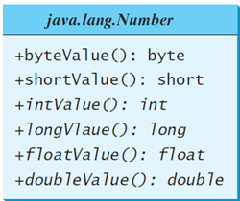

Case Study: The Abstract Number Class
11

Slide 12
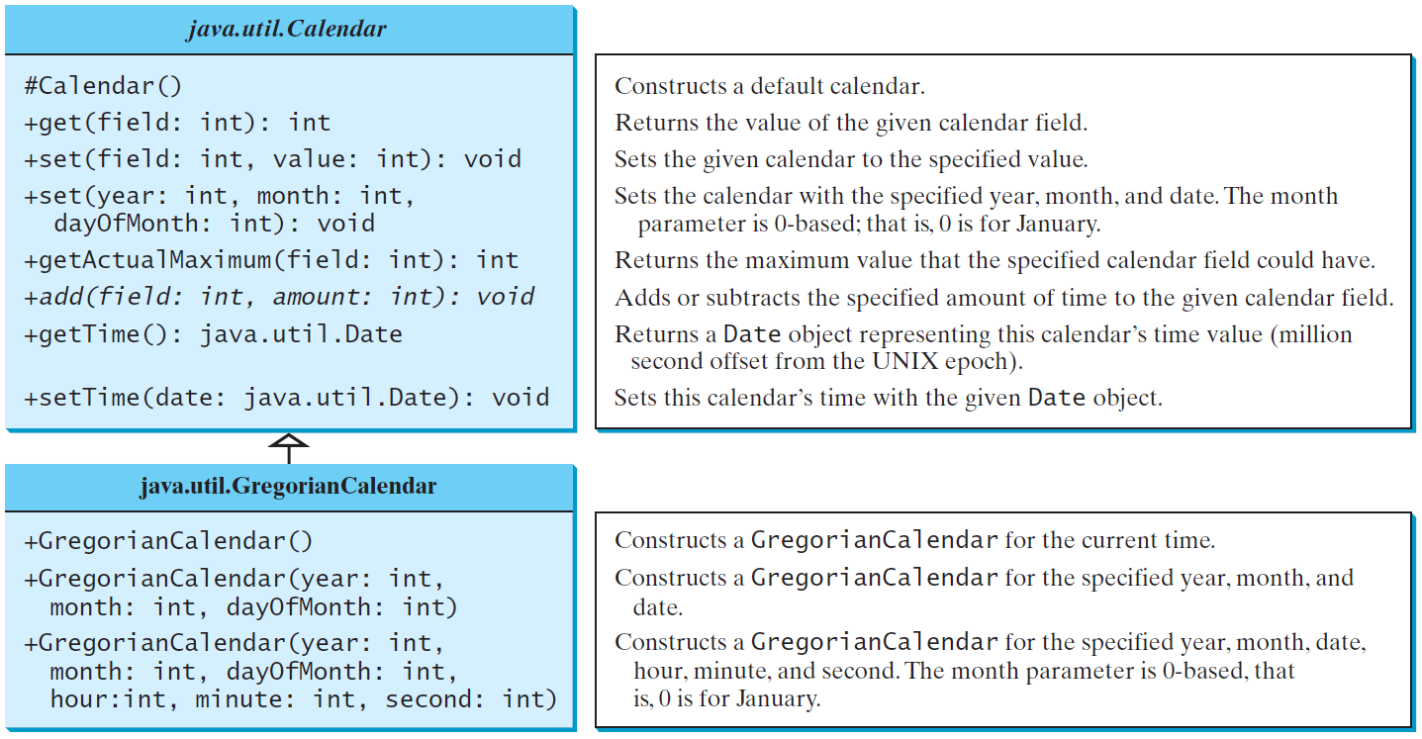
The Abstract Calendar Class and Its GregorianCalendar subclass

Slide 13
GregorianCalendar subclass
An instance of java.util.Date represents a specific instant in time with millisecond precision.
java.util.Calendar is an abstract base class for extracting detailed information such as year, month, date, hour, minute and second from a Date object.
Subclasses of Calendar can implement specific calendar systems such as Gregorian calendar, Lunar Calendar and Jewish calendar.
Currently, java.util.GregorianCalendar for the Gregorian calendar is supported in the Java API.

Slide 14
The GregorianCalendar Class
You can use new GregorianCalendar() to construct a default GregorianCalendar with the current time
Use new GregorianCalendar(year, month, date) to construct a GregorianCalendar with the specified year, month, and date.
The month parameter is 0-based, i.e., 0 is for January.

Slide 15
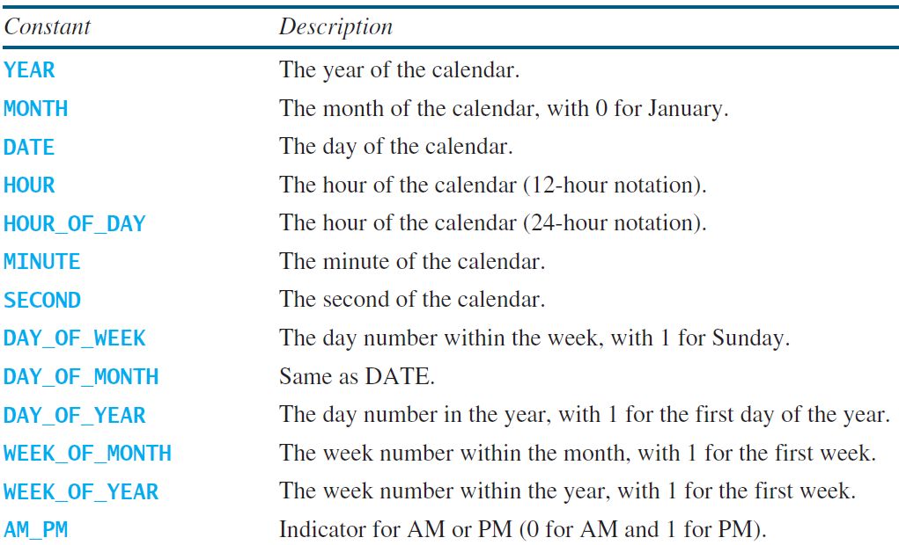
The get Method in Calendar Class
The get(int field) method defined in the Calendar class is useful to extract the date and time information from a Calendar object. The fields are defined as constants, as shown in the following.

Slide 16
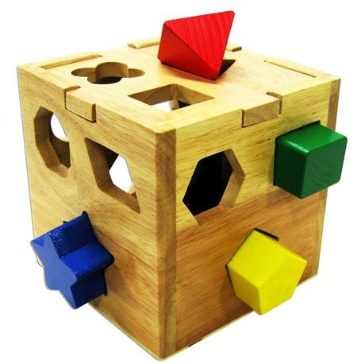
Interfaces
An interface is a way to describe what classes should do, without specifying how they should do it.
It is not a class but a set of requirements for classes that want to conform to the interface.

Slide 17
What is an interface?
An interface is a class-like construct that contains only constants and abstract methods.
In many ways, an interface is similar to an abstract class, but the intent of an interface is to specify common behavior for objects.
For example, you can specify that the objects are comparable, edible, cloneable using appropriate interfaces.

Slide 18
Define an interface
To distinguish an interface from a class, Java uses the following syntax to define an interface:
public interface InterfaceName {
// constant declarations;
// method signatures;
}
Example:
public interface Edible {
/** Describe how to eat */
public abstract String howToEat();
}

Slide 19
Interface is a Special Class
An interface is treated like a special class in Java.
Each interface is compiled into a separate bytecode file, just like a regular class.
Like an abstract class, you cannot create an instance from an interface using the new operator, but in most cases you can use an interface more or less the same way you use an abstract class.
For example, you can use an interface as a data type for variable, as the result of casting, and so on.

Slide 20
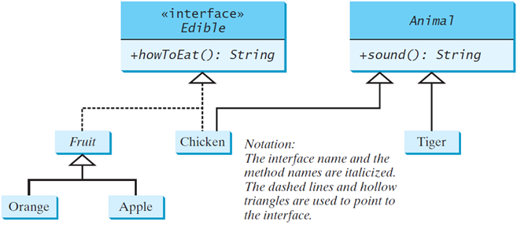
Example
You can now use the Edible interface to specify whether an object is edible.
This is accomplished by letting the class implement this interface using the implements keyword.
For example, the classes Chicken and Fruit implement the Edible interface.

Slide 21
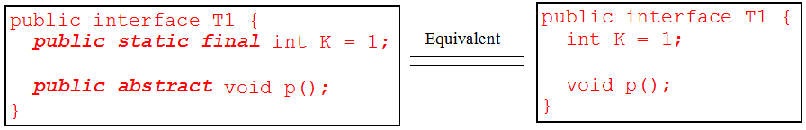
Omitting Modifiers in Interfaces
All data fields are public final static and all methods are public abstract in an interface.
For this reason, these modifiers can be omitted, as shown below:
A constant defined in an interface can be accessed using syntax:
InterfaceName.CONSTANT_NAME

Slide 22
Example: The Comparable Interface
// This interface is defined in
// java.lang package
package java.lang;
public interface Comparable<E> {
public int compareTo(E o);
}

Slide 23
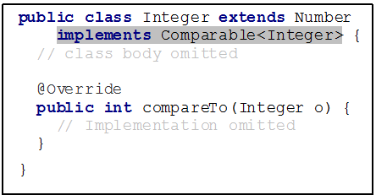
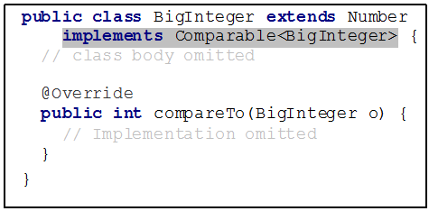
Integer and BigInteger Classes

Slide 24
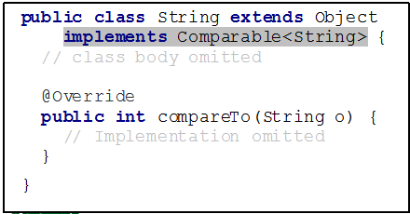
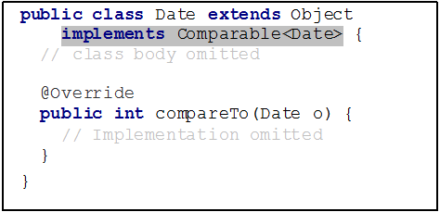
String and Date Classes

Slide 25
Examples
Integer i1 = new Integer(3), i2 = new Integer(3);
System.out.println(i1.compareTo( i2 ));
System.out.println("ABC".compareTo("ABE"));
Date date1 = new Date(2013, 1, 1);
Date date2 = new Date(2012, 1, 1);
System.out.println(date1.compareTo(date2));

Slide 26



instanceof
Let n be an Integer object, s be a String object, and d be a Date object.
All the following expressions are true:

Slide 27
The toString, equals, and hashCode Methods
Each wrapper class overrides the toString, equals, and hashCode methods defined in the Object class.
Since all the numeric wrapper classes and the Character class implement the Comparable interface, the compareTo method is implemented in these classes.
27

Slide 28
Generic sort Method
java.util.Arrays.sort(array)
This method requires that the elements in an array are instances of Comparable<E>.
28

Slide 29
Extending Interfaces
Interfaces support multiple inheritance: an interface can extend more than one interface.
Superinterfaces and subinterfaces.
Example:
public interface SerializableRunnable extends
java.io.Serializable , Runnable {
. . .
}

Slide 30
Extending Interfaces – Constants
If a superinterface and a subinterface contain two constants with the same name, then the one belonging to the superinterface is hidden:
interface X {
int val = 1;
}
interface Y extends X {
int val = 2;
int sum = val + X.val;
}

Slide 31
Extending Interfaces – Methods
If a declared method in a subinterface has the same signature as an inherited method and the same return type, then the new declaration overrides the inherited method in its superinterface.
If the only difference is in the return type, then there will be a compile-time error.

Slide 32
The Cloneable Interface
A class that implements the Cloneable interface is marked cloneable, and its objects can be cloned using the clone() method defined in the Object class.
clone method returns a new object whose initial state is a copy of the current state of the object on which clone was invoked.
Subsequent changes to the new clone object should not affect the state of the original object.
package java.lang;
public interface Cloneable {
}

Slide 33
Examples
Many classes (e.g., Date and Calendar) implement Cloneable. Thus, the instances of these classes can be cloned. For example:
Calendar calendar = new GregorianCalendar(2003, 2, 1);
Calendar calendarCopy = (Calendar)calendar.clone();
System.out.println("calendar == calendarCopy is " +
(calendar == calendarCopy));
System.out.println("calendar.equals(calendarCopy) is " +
calendar.equals(calendarCopy));
calendar == calendarCopy is false
calendar.equals(calendarCopy) is true
Notes:
33

Slide 34
Implementing Cloneable Interface
To define a custom class that implements the Cloneable interface, the class must override the clone() method in the Object class.
The following code defines a class named House that implements Cloneable and Comparable.
Notes:
34

Slide 35
public class House implements Cloneable, Comparable<House> {
private int id;
private double area;
private java.util.Date whenBuilt;
public House(int id, double area) {
this.id = id;
this.area = area;
whenBuilt = new java.util.Date();
}
public int getId() { return id; }
public double getArea() { return area; }
public java.util.Date getWhenBuilt() { return whenBuilt; }

Notes:
35

Slide 36
@Override // Override the clone method defined in the Object class
public Object clone() {
return super.clone();
}
@Override // Implement the compareTo method defined in Comparable
public int compareTo(House o) {
if (area > o.area)
return 1;
else if (area < o.area)
return -1;
else
return 0;
}
}
Notes:
36

Slide 37
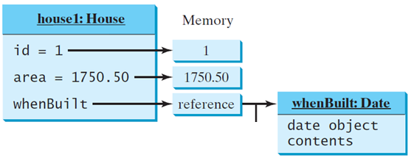
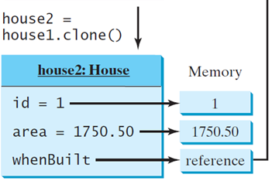
Shallow vs. Deep Copy
House house1 = new House(1, 1750.50);
House house2 = (House)house1.clone();
Shallow Copy
Notes:
37

Slide 38
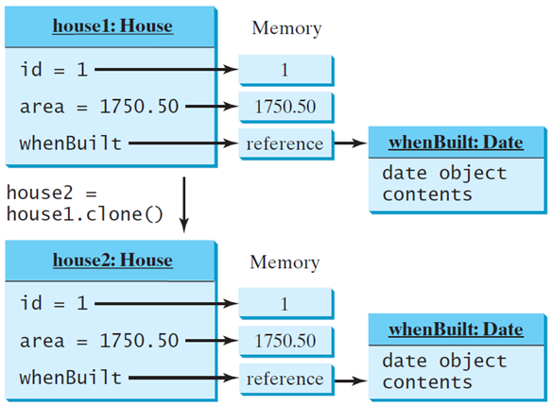
Shallow vs. Deep Copy
Deep Copy
Notes:
38

Slide 39
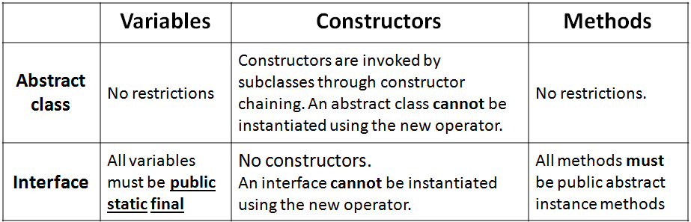
Interfaces vs. Abstract Classes
In an interface, the data must be constants; an abstract class can have all types of data.
Each method in an interface has only a signature without implementation; an abstract class can have concrete methods.

Slide 40
Interfaces vs. Abstract Classes cont.
All classes share a single root, the Object class, but there is no single root for interfaces.
Like a class, an interface also defines a type. A variable of an interface type can reference any instance of the class that implements the interface.
If a class extends an interface, this interface plays the same role as a superclass.
You can use an interface as a data type and cast a variable of an interface type to its subclass, and vice versa.

Slide 41
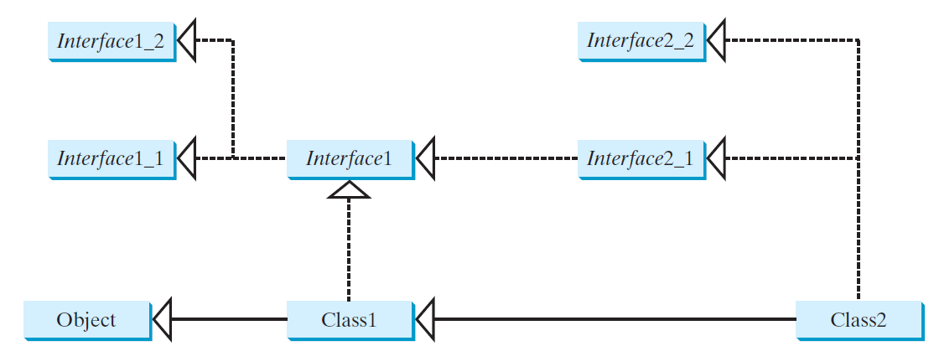
instanceof
Suppose that c is an instance of Class2.
c is also an instance of Object, Class1, Interface1, Interface1_1, Interface1_2, Interface2_1, and Interface2_2.

Slide 42
Caution: conflict interfaces
In rare occasions, a class may implement two interfaces with conflict information (e.g., two same constants with different values or two methods with same signature but different return type). This type of errors will be detected by the compiler.

Slide 43
Whether to use an interface or a class?
Abstract classes and interfaces can both be used to model common features.
How do you decide whether to use an interface or a class?
In general, a strong is-a relationship that clearly describes a parent-child relationship should be modeled using classes.
For example, a staff member is a person.

Slide 44
Whether to use an interface or a class?
A weak is-a relationship, also known as an is-kind-of relationship, indicates that an object possesses a certain property.
A weak is-a relationship can be modeled using interfaces.
For example, all strings are comparable, so the String class implements the Comparable interface.
You can also use interfaces to circumvent single inheritance restriction if multiple inheritance is desired.
In the case of multiple inheritance, you have to design one as a superclass, and others as interface.
44

