Slide 1
FLEXBOX (FlexibleBox)

Slide 2
WHAT IS A FLEXBOX ? Flexbox: is an easy and clean way to arrange an items within a container

Slide 3
ADVANTAGES OF FLEXBOX…
- Responsive and mobile friendly
- Positioning child elements is MUCH easier
- Order of elements can easily be changed without editing the source HTML

Slide 4
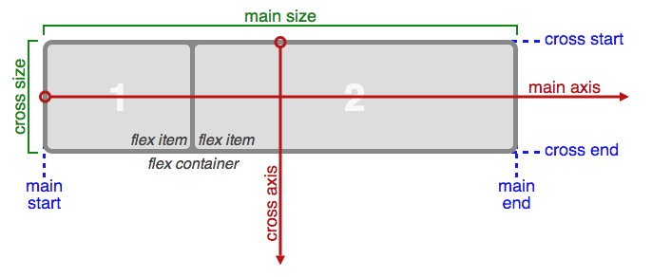
Basics &Terminology

Slide 5
The main axis of a flex container is the primary axis along which flex items are laid out. Beware, it is not necessarily horizontal; it depends on the flex-direction property main-start | main-end - The flex items are placed within the container starting from main-start and going to main-end main size - A flex item's width or height cross axis - The axis perpendicular to the main axis is called the cross axis. Its direction depends on the main axis direction. cross-start | cross-end - Flex lines are filled with items and placed into the container starting on the cross-start side of the flex container and going toward the cross-end side. cross size - The width or height of a flex item

Slide 6
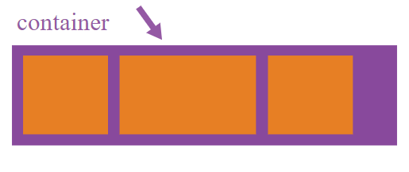
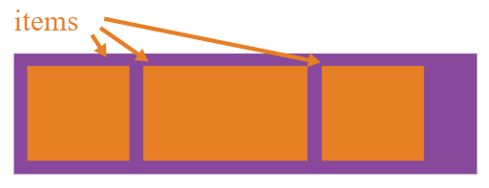

Slide 7
Properties for the Parent (flex container)
1- Flex-direction
2- Flex-wrap
3- Justify-content
4- Align-items
5- Align-content

Slide 8
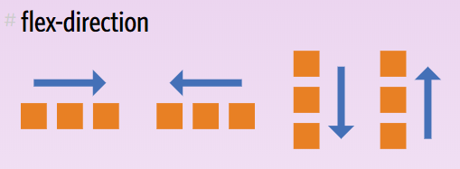
FLEX-DIRETION
.container {
flex-direction: row | row-reverse | column | column-reverse;
}
Default

Slide 9
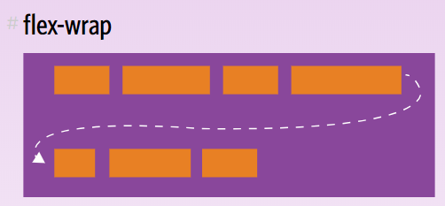
FLEX-WRAP
.container{
flex-wrap: nowrap | wrap | wrap-reverse;
}
(default): all flex items will be on one line
flex items will wrap onto multiple lines, from top to bottom.
flex items will wrap onto multiple lines from bottom to top.

Slide 10
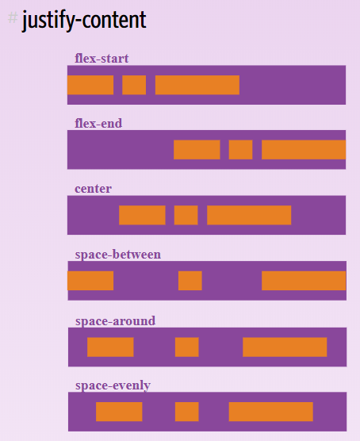
JUSTIFY-CONTENT
.container {
justify-content: flex-start | flex-end | center | space-between | space-around | space-evenly;
}
Default
→ This defines the alignment along the main axis.

Slide 11
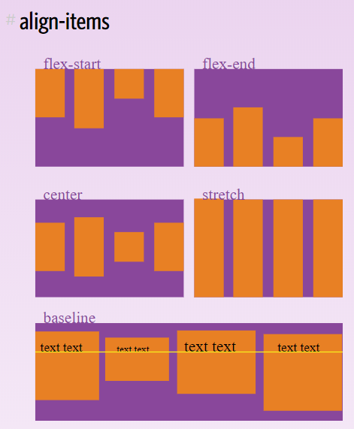
ALIGN-ITEMS
.container {
align-items: flex-start | flex-end | center | baseline | stretch;
}
This defines the default behavior for how flex items are laid out along the cross axis on the current line.
Think of it as the justify-content version for the cross-axis (perpendicular to the main-axis).

Slide 12
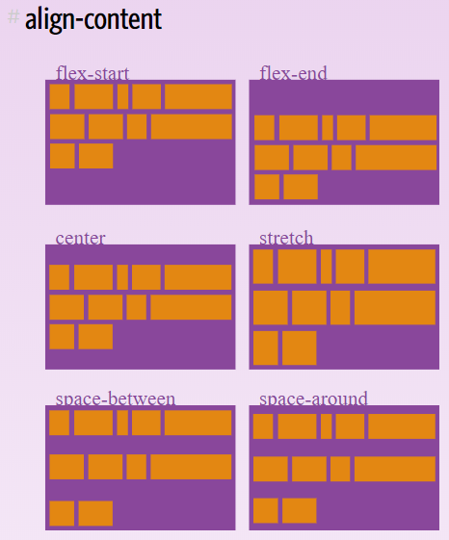
ALIGN-CONTENT
.container {
align-content: flex-start | flex-end | center | space- between | space-around | stretch;
}
This aligns a flex container's lines within when there is extra space in
the cross-axis, similar to how justify-content aligns individual
items within the main-axis.
→ Note: this property has no effect when there is only one line of flex items.

Slide 13
Properties for the Children (flex items)
1- Order
2- Flex-grow
3- Flex-shrink
4- Align-self

Slide 14
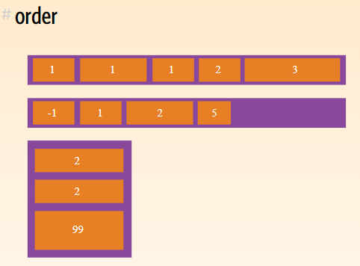
ORDER
.item {
order: <integer>; /* default is 0 */
}
The order property specifies the order of a flexible item relative to the rest of the flexible items inside the same container.
→ Note: If the element is not a flexible item, the order property has no effect.

Slide 15
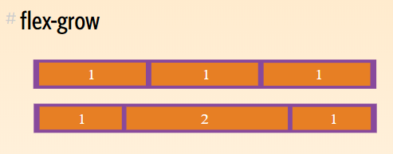
FLEX-GROW
.item {
flex-grow: <number>; /* default 0 */
}
The flex-grow property specifies how much the item will grow relative to the rest of the flexible items inside the same container.
Note: If the element is not a flexible item, the flex-grow property has no effect.
Negative numbers are invalid !

Slide 16
FLEX-SHRINK
.item {
flex-shrink: <number>; /* default 1 */
}
This defines the ability for a flex item to shrink if necessary.
Negative numbers are invalid

Slide 17
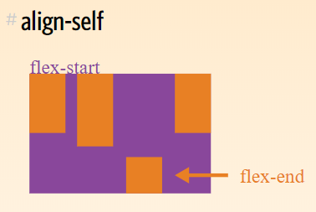
ALIGN-SELF
.item {
align-self: auto | flex-start | flex-end |
center | baseline | stretch;
}
This allows the default alignment (or the one specified by align-items)
to be overridden for individual flex items.

