Slide 1
1H[¹³Ced] quantitation test
3/8/23

Slide 2
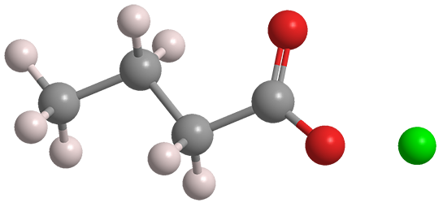
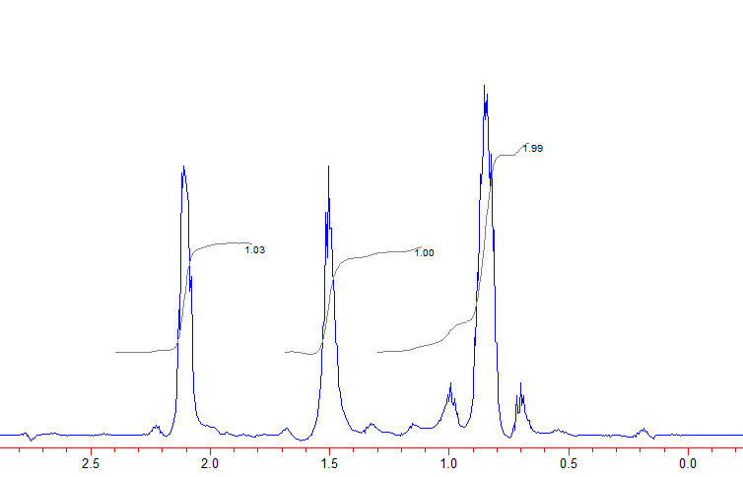
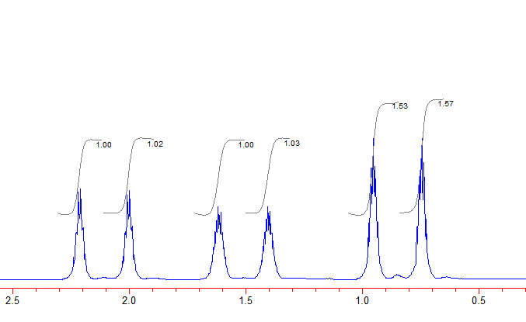
Butyrate
Purpose: assess quantitativeness of 1H[13Ced] NMR in
a molecule with protons in similar molecular contexts
2
2
3
¹H[¹³C-ed]
Expected 2:2:3
1
1
2?
¹H
2
2
3

Slide 3
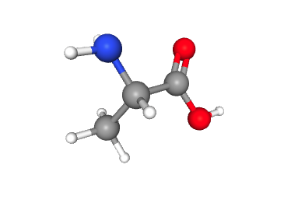
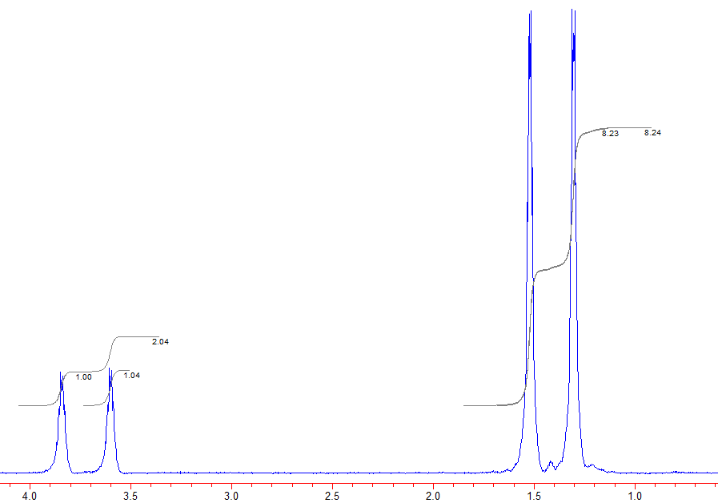
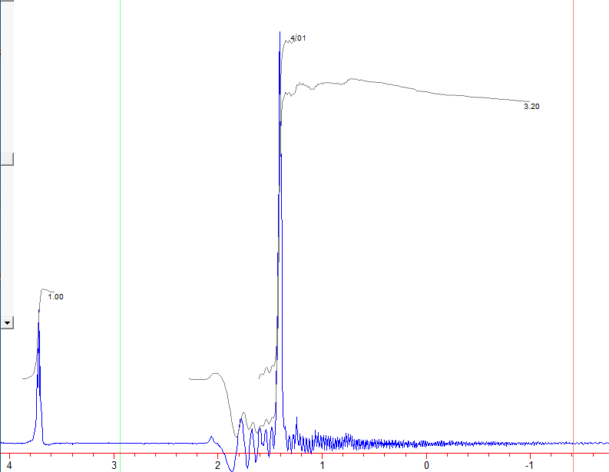
Purpose: assess quantitativeness of 1H[13Ced] NMR in
a molecule with protons in different molecular contexts
Alanine
Expected 1:3
¹H[¹³C-ed]
1
3
4?
4?
¹H
1
1
?

