Slide 1
Capstone Engagement
Assessment, Analysis, and Hardening of a Vulnerable System

Slide 2
Table of Contents
This document contains the following sections:
Network Topology
01
02
Red Team: Security Assessment
03
Blue Team: Log Analysis and Attack Characterization
Hardening: Proposed Alarms and Mitigation Strategies
04

Slide 3
Network Topology

Slide 4
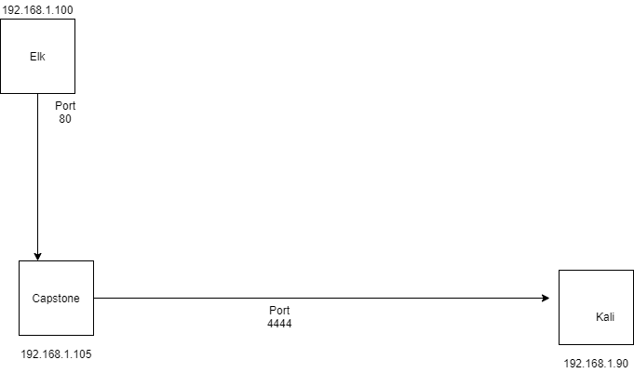
Network Topology
[Insert Here]
Use draw.io to create a diagram of the network.
Add your diagram to this slide and fill out the data in the sidebar.
Network
Address Range: 192.168.1.0-254
Netmask:/24
Gateway: 192.168.1.1
Machines
IPv4: 192.168.1.90
OS: Linux
Hostname:Kali
IPv4:192.168.1.105
OS:Linux
Hostname:Capstone
IPv4: 192.168.1.100
OS: Linux
Hostname: ELK
IPv4: 192.168.1.1
OS: Windows
Hostname: HyperV host

Slide 5

Red Team
Security Assessment

Slide 6
Recon: Describing the Target
Nmap identified the following hosts on the network:
Hostname | IP Address | Role on Network
Elk | 198.168.1.100 | Kibana machine
Capstone | 198.168. 1. 105 | Target machine
Kali | 198.168.1.90 | Attacker machine

Slide 7
Vulnerability Assessment
The assessment uncovered the following critical vulnerabilities in the target:
Vulnerability | Description | Impact
Use the CVE number if it exists. Otherwise, use the common name. | Describe the vulnerability. | Describe what this vulnerability allows the attacker to do.
Directory listing enabled with apache. | We can see the folders of the capstone through the browser. | We were able to get through all the files.
Stronger password was needed. | Avoid brute force attack with stronger password. | An attacker can find the password to open the secret folder.
Shell php file upload | It allows reverse shell | An attacker could use it to gain access to the web server via shell.

Slide 8
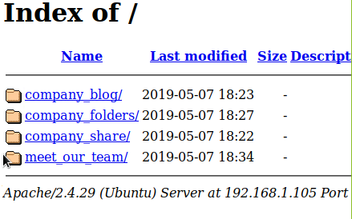
Exploitation: [Listing on Apache]
01
02
03
Tools & Processes
How did you exploit the vulnerability? I put the capstone ip address on the browser of kali.Which tool (Nmap, etc.) or techniques (XSS, etc.) did you use? I used Web browser.
Achievements
What did the exploit achieve? I got access to the folders of the server.For example: Did it grant you a user shell, root access, etc.? I can see the folders and files on any browser
[INSERT: screenshot or command output illustrating the exploit.]

Slide 9
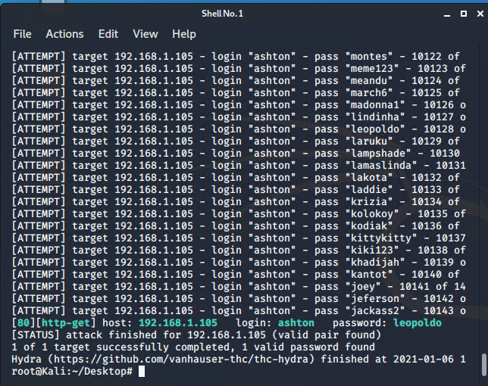
Exploitation: [Hashcat]
01
02
03
Tools & Processes
How did you exploit the vulnerability? I used brute force to gain access to the secret folder.Which tool (Nmap, etc.) or techniques (XSS, etc.) did you use? I used hydra.
Achievements
What did the exploit achieve? Access to the secret folder.For example: Did it grant you a user shell, root access, etc.? Access to the secret folder protected by the password.
[INSERT: screenshot or command output illustrating the exploit.]

Slide 10
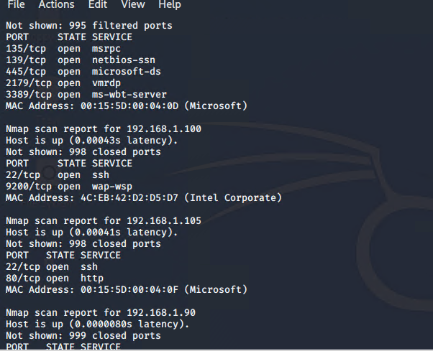
Exploitation: [Nmap]
01
02
03
Tools & Processes
How did you exploit the vulnerability? I used nmap to see which open ports were open. And which ips were on the network.Which tool (Nmap, etc.) or techniques (XSS, etc.) did you use? Nmap.
Achievements
What did the exploit achieve? I saw port 80 opened. This is the most important port that needs to be closed! For example: Did it grant you a user shell, root access, etc.? No it is just reconnaissance.
[INSERT: screenshot or command output illustrating the exploit.]

Slide 11
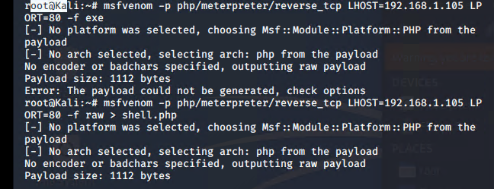
Exploitation: [reverse shell]
01
02
03
Tools & Processes
How did you exploit the vulnerability? I used nmap to see which open ports were open. And which ips were on the network.Which tool (Nmap, etc.) or techniques (XSS, etc.) did you use? msfvenom
Achievements
What did the exploit achieve?:
remote control the target machine
Did it grant you a user shell, root access, etc.?
Grant access to a root directory
[INSERT: screenshot or command output illustrating the exploit.]

Slide 12

Blue Team
Log Analysis and
Attack Characterization

Slide 13

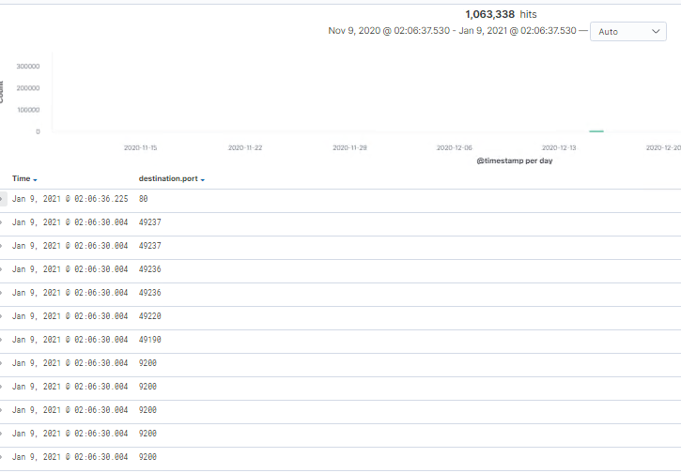
Analysis: Identifying the Port Scan
Answer the following questions in bullet points under the screenshot if space allows.
Otherwise, add the answers to speaker notes.
What time did the port scan occur?
How many packets were sent, and from which IP?
What indicates that this was a port scan?
The port scan occurred at 2am.
I saw different ip addresses including the kali ip address.

Slide 14
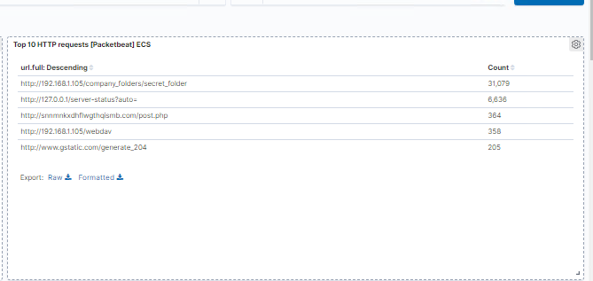
Analysis: Finding the Request for the Hidden Directory
Answer the following questions in bullet points under the screenshot if space allows.
Otherwise, add the answers to speaker notes.
What time did the request occur? How many requests were made?
Which files were requested? What did they contain?
[Insert Here]
Include a screenshot of Kibana logs depicting the request for the hidden directory.
There was 31,079 request made.
The secret folder.

Slide 15
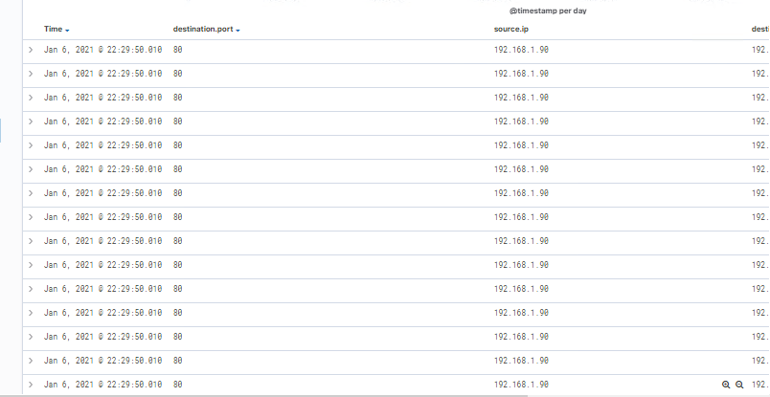
Analysis: Uncovering the Brute Force Attack
Answer the following questions in bullet points under the screenshot if space allows.
Otherwise, add the answers to speaker notes.
How many requests were made in the attack?
How many requests had been made before the attacker
discovered the password?
[Insert Here]
Include a screenshot of Kibana logs depicting the brute force attack.
There is a lot of request from the same ip address and same open port 80

Slide 16
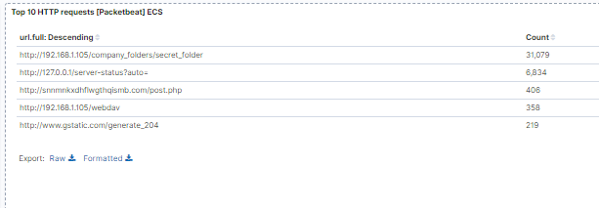
Analysis: Finding the WebDAV Connection
Answer the following questions in bullet points under the screenshot if space allows.
Otherwise, add the answers to speaker notes.
How many requests were made to this directory?
Which files were requested?
[Insert Here]
Add a screenshot of Kibana logs depicting the WebDAV connection.
There was 358 request made to the directory. The file that was requested was WebDAV.

Slide 17
Blue Team
Proposed Alarms and
Mitigation Strategies

Slide 18
Mitigation: Blocking the Port Scan
What kind of alarm can be set to detect future port scans?
We need filter port 80.
What threshold would you set to activate this alarm? Set to not more than a thousand requests in 30 mins.
What configurations can be set on the host to mitigate port scans? Set Kibana threshold alert.
Describe the solution. If possible, provide required command lines. Put a firewall that scans the traffic, and monitor kibana.

Slide 19
Mitigation: Finding the Request for the Hidden Directory
What kind of alarm can be set to detect future unauthorized access?
Allow only capstone to access the files.
What threshold would you set to activate this alarm?
Each time anyone else try to access the file, trigger an alert.
What configuration can be set on the host to block unwanted access?
A strong password system is needed.
Describe the solution. If possible, provide required command lines.
Add the ip of capstone in the httpd.conf file.

Slide 20
Mitigation: Preventing Brute Force Attacks
What kind of alarm can be set to detect future brute force attacks?
If you have too many password attempt, then block the ip address.
What threshold would you set to activate this alarm?
Not more than 15 attempt in 30 mins.
What configuration can be set on the host to block brute force attacks?
Use a strong password.
Describe the solution. If possible, provide the required command line(s).
Use special characters and use more than 10 characters.

Slide 21
Mitigation: Detecting the WebDAV Connection
What kind of alarm can be set to detect future access to this directory?
Each time another machine, then capstone try to access this secure folder.
What threshold would you set to activate this alarm?
Each time will have a connection that is not from capstone, create an alert.
What configuration can be set on the host to control access?
Only allow the ip of capstone in the configuration file
Describe the solution. If possible, provide the required command line(s).
Modify the /var/www/webdav to allow only capstone.

Slide 22
Mitigation: Identifying Reverse Shell Uploads
What kind of alarm can be set to detect future file uploads?
Create an alert when a php file is downloaded.
What threshold would you set to activate this alarm? Trigger an alert anytime a suspicious file is downloaded.
What configuration can be set on the host to block file uploads?
We need access to this folder, by filtering the ip address.
Describe the solution. If possible, provide the required command line. Denied get post and head requests from everyone.

