Slide 1
Multivariate Analysis and Statistical Learning Backfitting process in Generalized Additive Model
Massimiliano Mancini
October, 14 2022

Slide 2
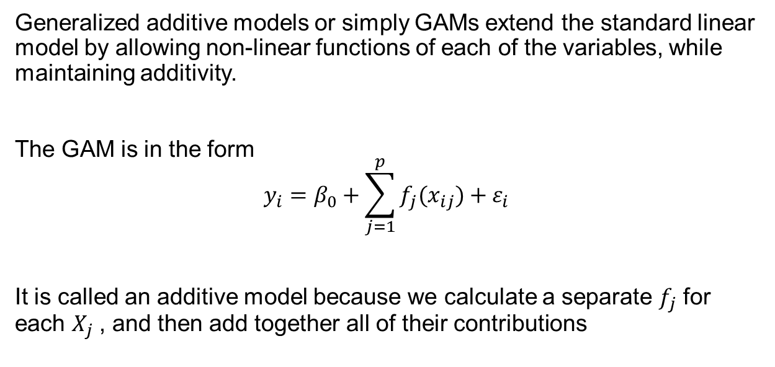
Generalized Additive Model
Generalized additive models or simply GAMs extend the standard linear model by allowing non-linear functions of each of the variables, while maintaining additivity.
The GAM is in the form
$$y_{i}=β_{0}+\sum_{j=1}^{p}{f_{j}(x_{ij})}+ε_{i}$$
It is called an additive model because we calculate a separate $f_{j}$ for each $X_{j}$ , and then add together all of their contributions
Backfitting process in Generalized Additive Model

Slide 3
Backfitting
Standard software such as the gam() function in R can be used to fit GAMs using smoothing splines, via an approach known as backfitting.
This method fits a model involving multiple predictors by backfitting repeatedly updating the fit for each predictor in turn, holding the others fixed.
To understand the backfitting process, we can simulate it on a traditional linear model.
Algoritmi su grafo IMDB

Slide 4
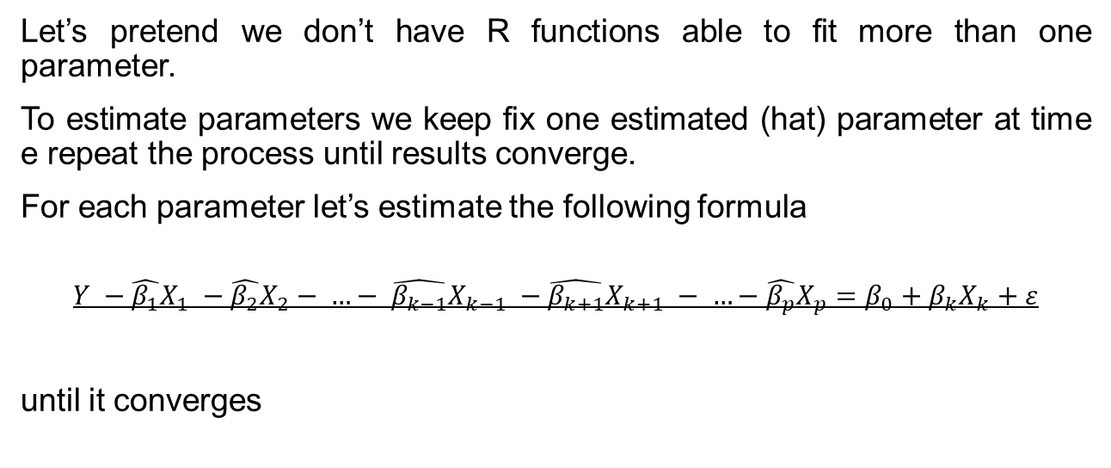
Backfitting
Let’s pretend we don’t have R functions able to fit more than one parameter.
To estimate parameters we keep fix one estimated (hat) parameter at time e repeat the process until results converge.
For each parameter let’s estimate the following formula
$$Y −\hat{β_{1}}X_{1} −\hat{β_{2}}X_{2}− …− \hat{β_{k−1}}X_{k−1} −\hat{β_{k+1}}X_{k+1} − …−\hat{β_{p}}X_{p}=β_{0}+β_{k}X_{k}+ε$$
until it converges
Algoritmi su grafo IMDB

Slide 5
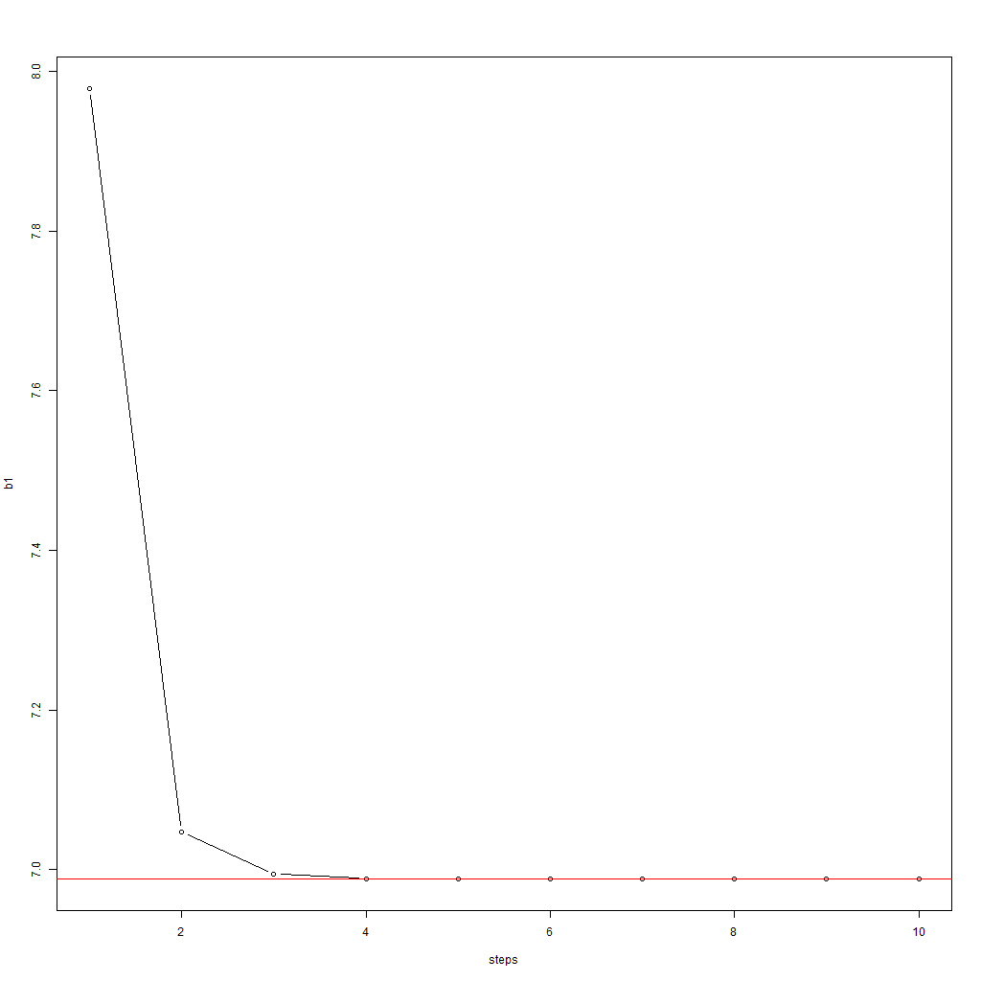
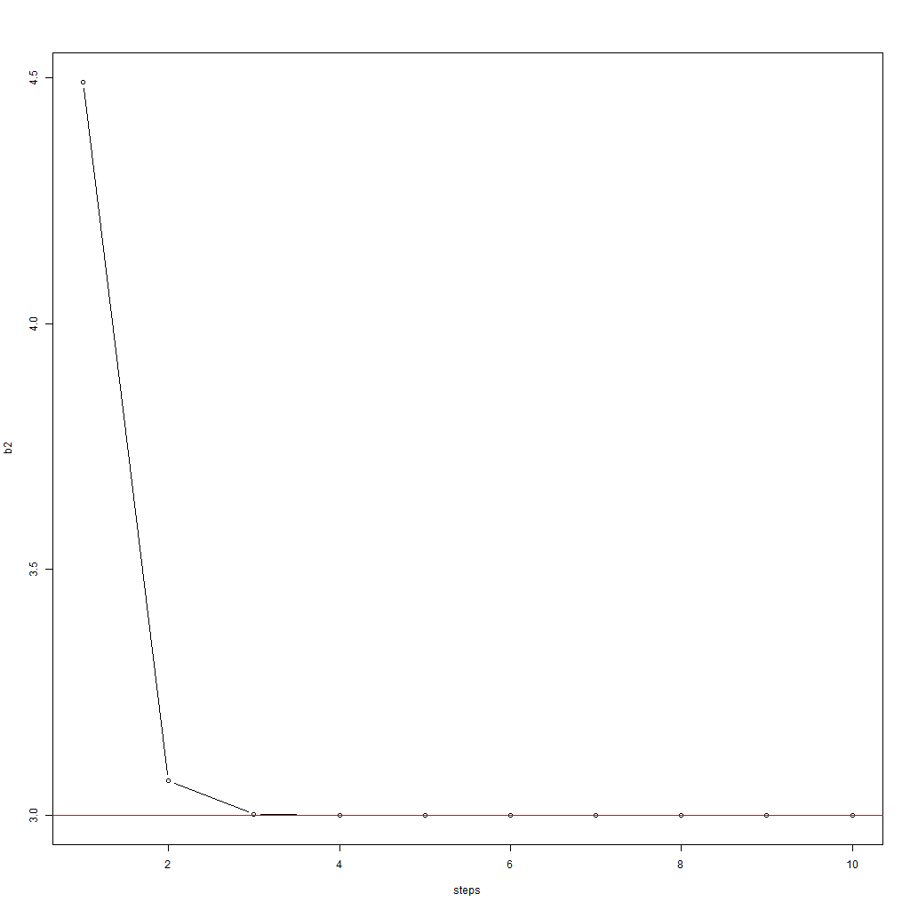
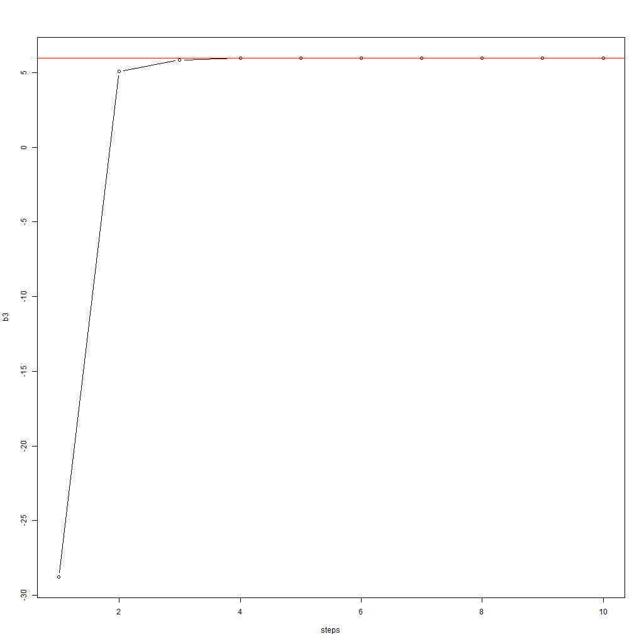
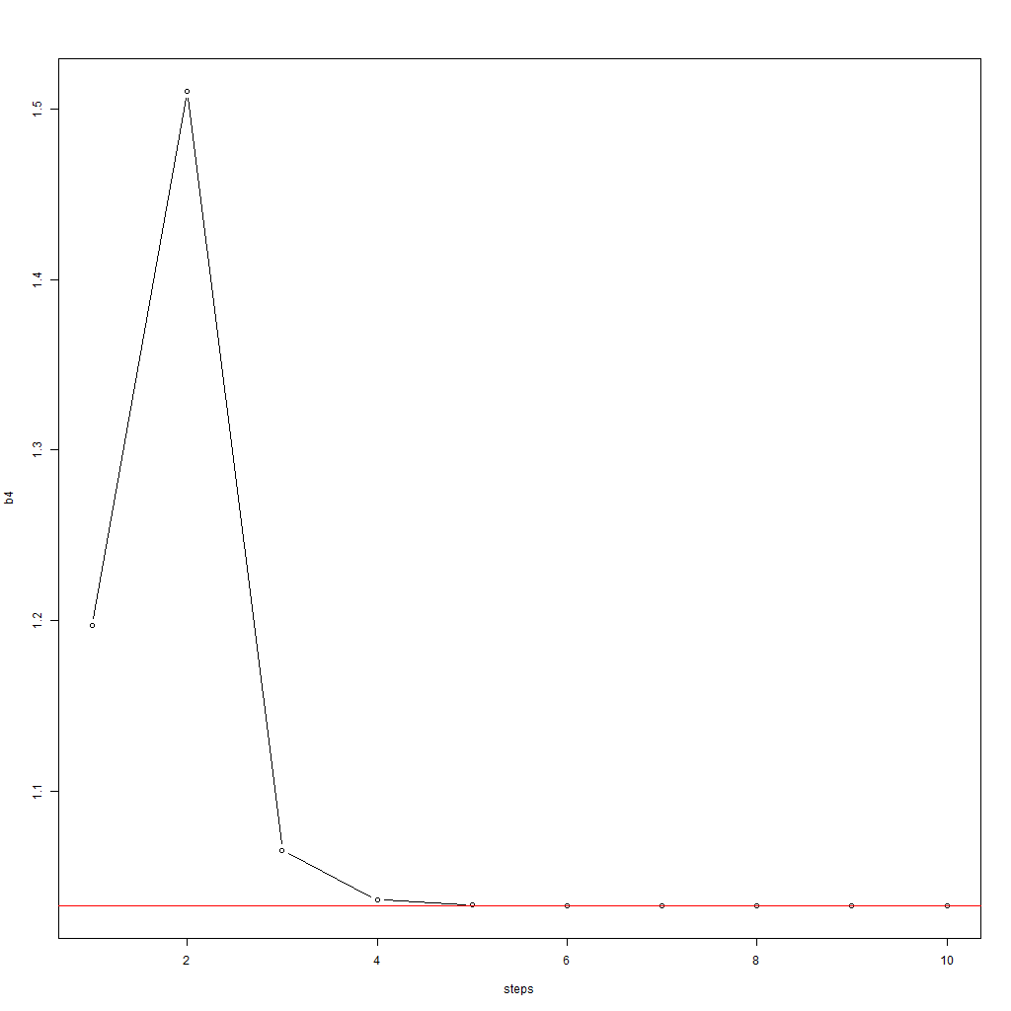
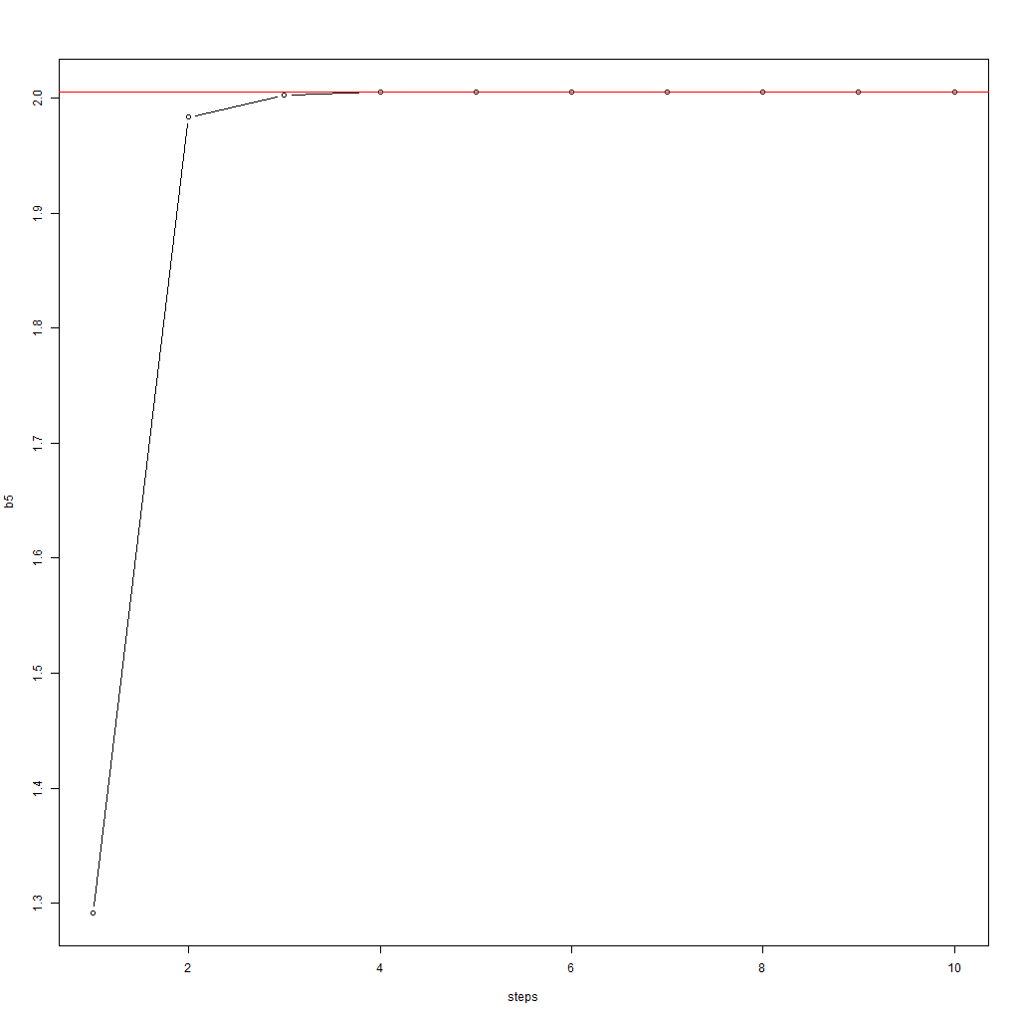
Results
In few steps all five parameters are found even if we start from random values.
In the same way, parameters in GAM are found one by one, using backfitting
Algoritmi su grafo IMDB

Slide 6
References
G. James, D. Witten, T. Hastie, R. Tibshirani
An Introduction to Statistical Learning with Applications in R
Second Edition
Algoritmi su grafo IMDB

