Slide 1
Multivariate Analysis and Statistical Learning Monte Carlo Simulation on Binomial Random Graph
Massimiliano Mancini
September, 28 2022

Slide 2
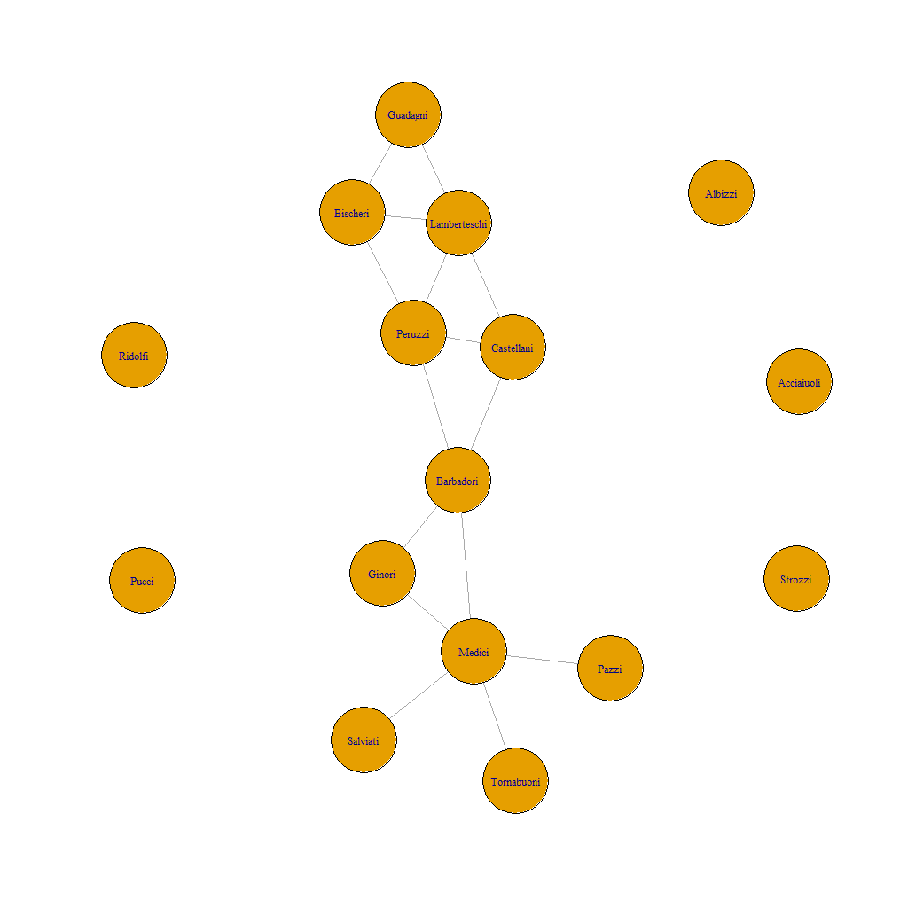
The problem
Simulate graphs that correctly catch features and characteristics of the observed network.
The observed network represents business among Renaissance Florentine Families
Algoritmi su grafo IMDB

Slide 3
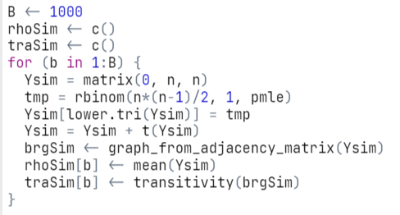
Monte Carlo Simulation
We take the density of the observed graph (pmle) and simulate B graphs with the same density. To show usefulness and limits of Monte Carlo simulation let’s check results against two statistics: density and transitivity
Algoritmi su grafo IMDB

Slide 4
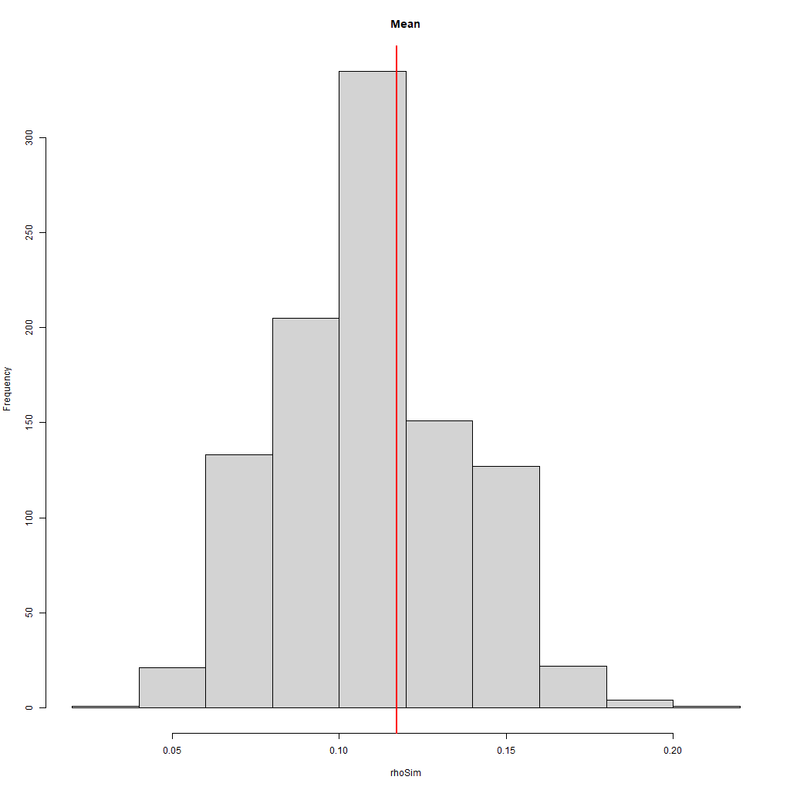
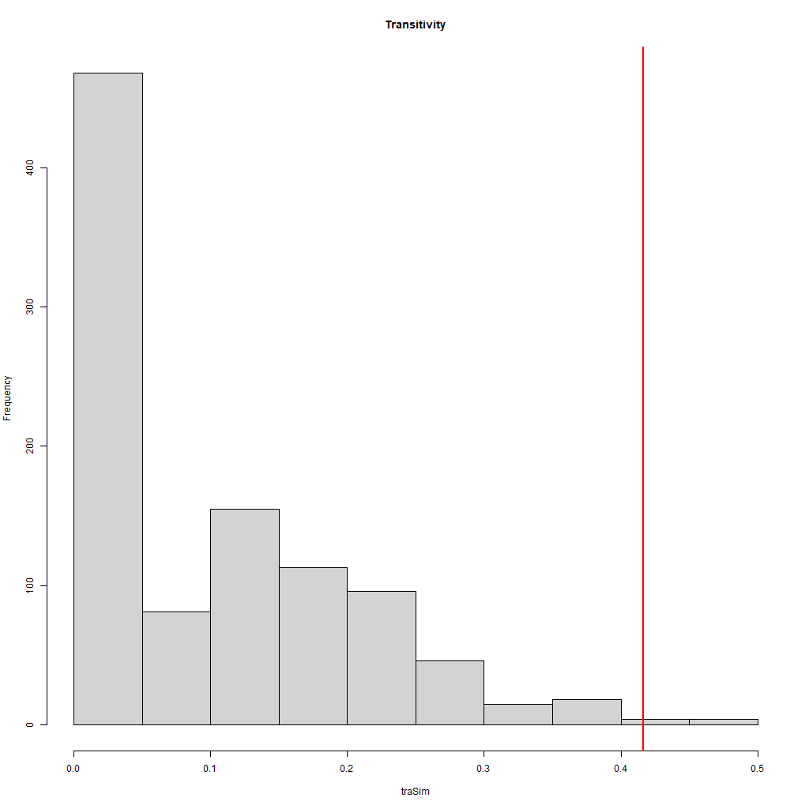
Results
Density
Transitivity
Algoritmi su grafo IMDB

Slide 5
Conclusions
Monte Carlo simulation is a powerful tool in the toolbox of statisticians and data scientists, but remember that the power is not in the tools but in those who know how to use them.
To be in control you need to know the usefulness and limitations of your tools.
Algoritmi su grafo IMDB

Slide 6
References
Mark Newman (2018)
Networks: an introduction
M. E. J. Newman, D. J. Watts, and S. H. Strogatz (2010)
Random graph models of social networks
Algoritmi su grafo IMDB

