Slide 1

TicTaToe
An experiment by Massimo Cappelli

Slide 2
TicTacToe
Start
Select Mode
Select Algorithm for P1
Select player
Select Algorithm for P2
Select Algorithm PC
Start

Slide 3
TicTacToe
checkPlayerTurn
Select move
checkValidMove
updateGameBoard
checkGameStatus
saveGameStats
updateGameBoard

Slide 4
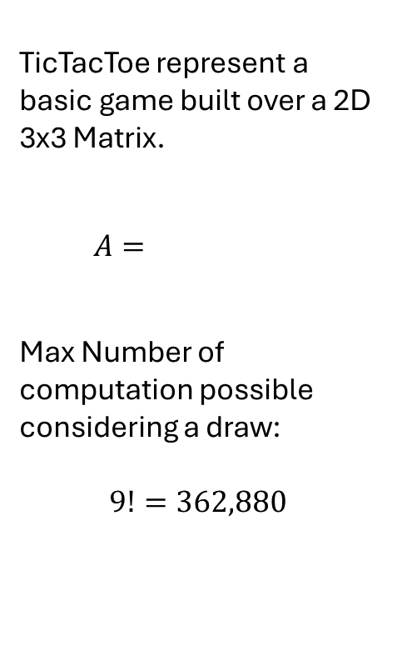
TicTacToe
TicTacToe represent a basic game built over a 2D 3x3 Matrix.
$$A=\begin{matrix} & & \\ & & \\ & & \end{matrix}$$
Max Number of computation possible considering a draw:
$$9!=362,880$$

Slide 5
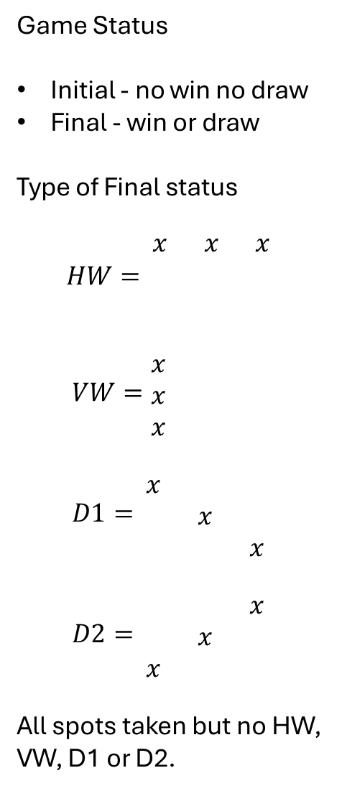
TicTacToe
Game Status
Initial - no win no draw
Final - win or draw
Type of Final status
$$HW=\begin{matrix}x & x & x \\ & & \\ & & \end{matrix}$$
$$VW=\begin{matrix}x & & \\ x & & \\ x & & \end{matrix}$$
$$D1=\begin{matrix}x & & \\ & x & \\ & & x\end{matrix}$$
$$D2=\begin{matrix} & & x \\ & x & \\ x & & \end{matrix}$$
All spots taken but no HW, VW, D1 or D2.

Slide 6
MinMaxAlgoritm
checkPossibleMoves
anyMove
selectMove
anyMove
updateGameBoard
checkGameStatus
calculateValue
checkPossibleMoves
updateGameBoard

