Slide 1

MyChe
For a better world ☺

Slide 2


Slide 3
LOGIC MODEL: MyChe
INPUTS
OUTPUTS
OUTCOMES
Activities: IAR
Participants
Resources:
Articles
Journals
Books
Lectures
Videos
Time:
one semester
Assistance:
Professors
Market analysis
Companies and strategies around the world
Challenges
The challenges that ridesharing companies, users and government are and will have to solve
Technology analysis
The technological tools being used and that can be improved
Transportation analysis
Law and Public policy
Social awareness
Efficient transportation
Traffic flow and reduction of CO2 emissions. Reduce transportation cost.
Market – Economic
Develop the market of ridesharing and help new companies to take better decisions and strategies.
Social Impact
Understand the behavior and practice of people who do ridesharing
Policies
Development of policies in order to regulate and increase the users of ridesharing.
Improve security in ridesharing
The team members
Professors
Teacher assistant
Classmates
ASSUMPTIONS
External analysis report
Most part of statistics about ridesharing are based in USA info.
EXTERNAL FACTORS
Government laws
Public transportation
Price of energy
Security

Slide 4
Data collection
Market analysis
    Articles from different journals describing the market.
    Videos from specialists explaining a possible evolution.
  Technology analysis
    Study from MIT related to new technologies in transportation.
    Study from Centrale Lille about distribution network in transportation.

Slide 5
Data collection
Transportation analysis
    Statistics from French ministry of ecology.
    ADEME study about mobility of people.
  Social awareness
    Statistics INSEE from a sample of 20231 people.
    Ipsos &Cetelem 2013 study about the motivation and the habits of people.

Slide 6
Data collection
Public policy and Law
  US code.
  French transportation regulation.

Slide 7
Variables
Funding Received
Number of ridesharing users
Countries with ridesharing
Internet access
Smartphones users
Cars per capita

Slide 8
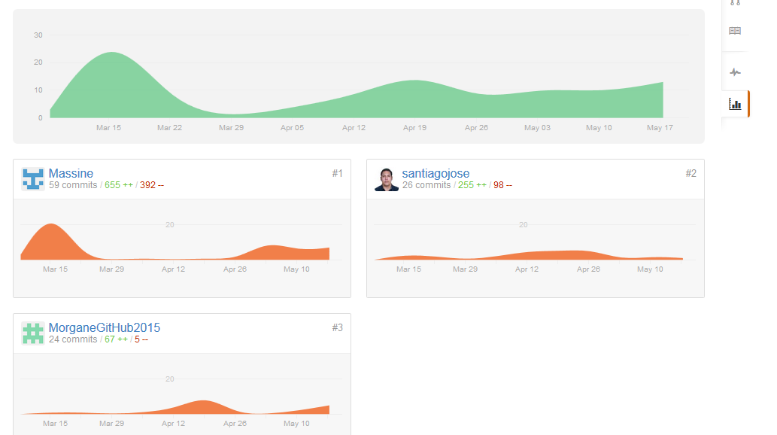
Github

Slide 9

Thanks for your attention

