Slide 1


MyChe
For a better world ☺

Slide 2
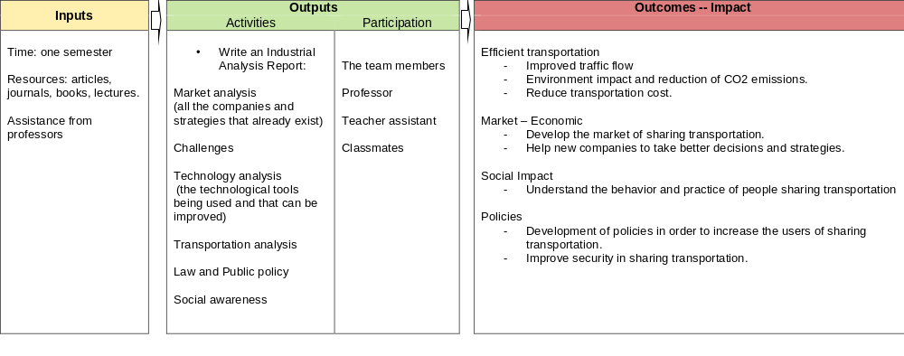
Logic Model

Slide 3
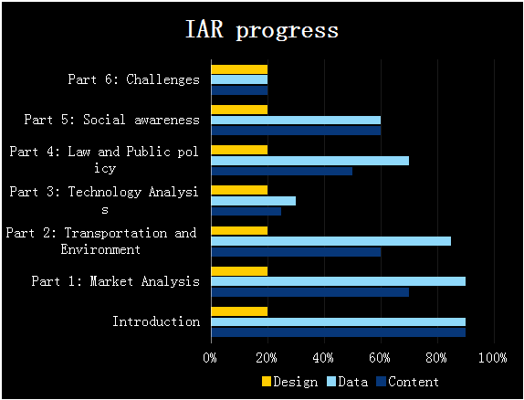
Progress overview

Slide 4

Introduction
What we have done
  Explanations about the concept of carpooling/Ride-sharing.
  Evolution of the ride sharing over the years.
  Ride sharing statistics in some countries
What we have to do
  Design

Slide 5
Market analysis
What we have done
  Ride sharing market
  Overview of the business model
  Latest move and strategies on the market across the world
What we have to do
  Previsions of the market evolution. The future
  Benchmark of some carpooling companies (Uber, Lift, Blablacar, Sidecar)
  Ideas toward develop the market: Multilevel marketing between users
  Design

Slide 6
Transportation and Environment analysis
What we have done
  Environment impacts
  Cost impacts
What we have to do
  Impact on the traffic and time reduction
  Design

Slide 7
Technology Analysis
What we have done
  Collecting data and reading articles
What we have to do
  The used technology
  How the new technologies can help this market from the point of view of security and flexibility
  Design

Slide 8
Technology Analysis
Why we are late
  The collected data are not statistics
  The articles giving subjective point of view

Slide 9
Law and Public policy
What we have done
  Carpooling policies in some countries
  Possible Government actions
What we have to do
  Government actions to protect the users
  Government actions to protect transportation professions
  New rules for this emerging business model
  Design

Slide 10
Social awareness
What we have done
  Typical users of car pooling
  People’s motivations to use car pooling
  Why people avoid carpooling
What we have to do
  This new social and economy interaction
  Design

Slide 11
Challenges
What we have done
What we have to do
  Possibility to link carpooling systems
  International law encouraging carpooling
  Market and government working together
  Electronic Carbon emission trading
  Design

Slide 12
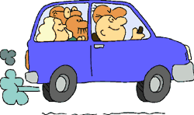
Thanks for your attention

