Slide 1
MyChe
For a better world ☺

Slide 2
Logic Model

Slide 3
Progress overview

Slide 4
Introduction
What we have done
Explanations about the concept of carpooling/Ride-sharing.
Evolution of the initial concept over the years.
What we have to do
Design

Slide 5
Market analysis
What we have done
Explanations about the concept of carpooling/Ride-sharing.
Evolution of the initial concept over the years.
What we have to do
Design

Slide 6
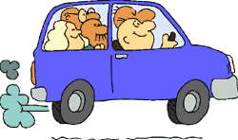
Thanks for your attention

