Slide 1
SALES MONITORING SYSTEM
GROUP 7 MENTOR Jayavibhava
Aakash Sivakumar
Guru Shankar
Rudhresh
Sanjai
Saravanakumar
Siddharth
Notes:
Add instructor notes here.

Slide 2

SALES MONITORING SYSTEM
GREEN FERT LTD
Notes:
Add instructor notes here.

Slide 3
SCOPE OF THE PROJECT
A fertilizer is any material of natural or synthetic origin that is applied to soils or to plant tissues to supply one or more plant nutrients essential to the growth of plants.
The aim of this project is to examine the fertilizers sales performance reports for “GREEN FERT LTD” company.
In our project, the analysis is performed based on 5 years of sales data.

Slide 4
SCOPE OF THE PROJECT(CONTINUED)…
The analysis has been done by taking into account the various entities like Retailers, Products, and Salesperson.
During the analysis, first design the Data warehouse model by using the various aspects of dimensional modelling after ETL tool.

Slide 5
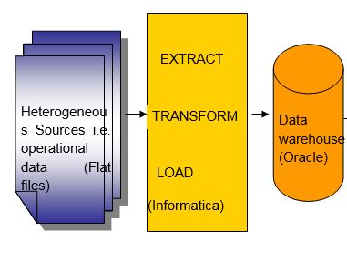
ARCHITECTURE

Slide 6
TECHNOLOGY USED
HARDWARE:
Intel Core™ i5 CPU
Microsoft Windows 7 Enterprise
Memory and OS: 8GB RAM and 64 Bit Operating System
SOFTWARE:
Oracle 11g (Database)
Informatica PowerCenter 9.6.0 (ETL Tool)
BusinessObjects XI Release 4

Slide 7
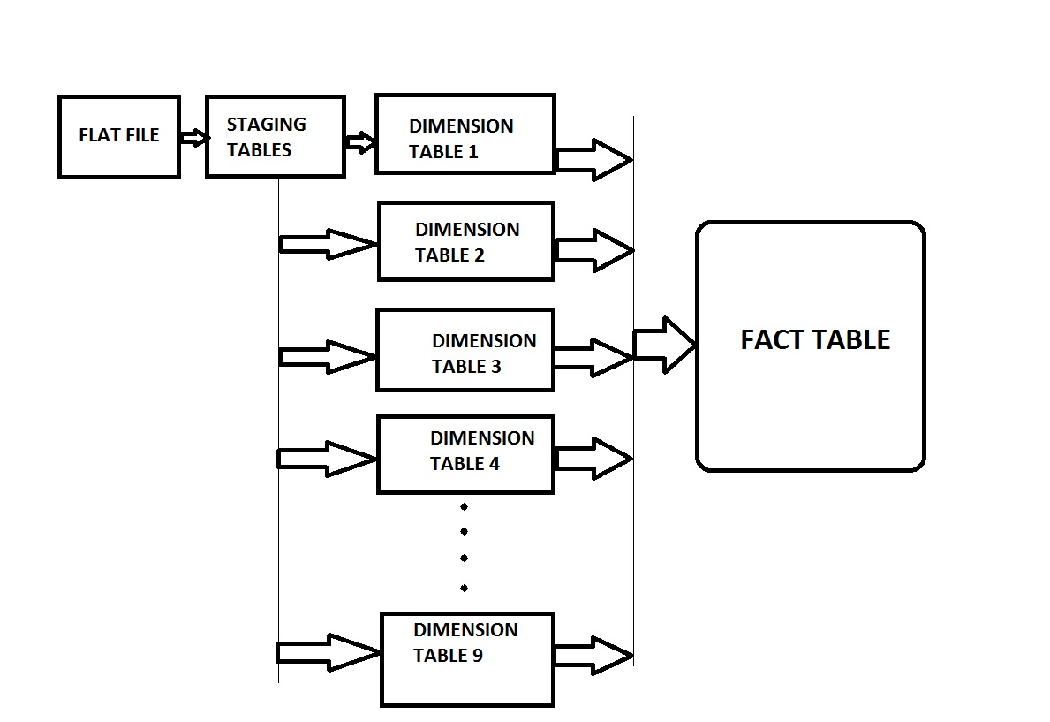
FLOW CHART

Slide 8
ETL PROCESS
ETL (Extract, Transform and Load) is a process in data warehousing responsible for pulling data out of the source systems and placing it into a data warehouse. ETL involves the following tasks.
Extracting the data from source systems, data from different source systems is converted into one consolidated data warehouse format which is ready for transformation processing.
Transforming the data may involve the following tasks:
filtering (e.g., selecting only certain columns to load),
splitting a column into multiple columns and vice versa,
joining together data from multiple sources (e.g., lookup, merge),
transposing rows and columns.
Loading the data into a data warehouse or data repository other reporting applications.
Notes:
Add instructor notes here.

Slide 9
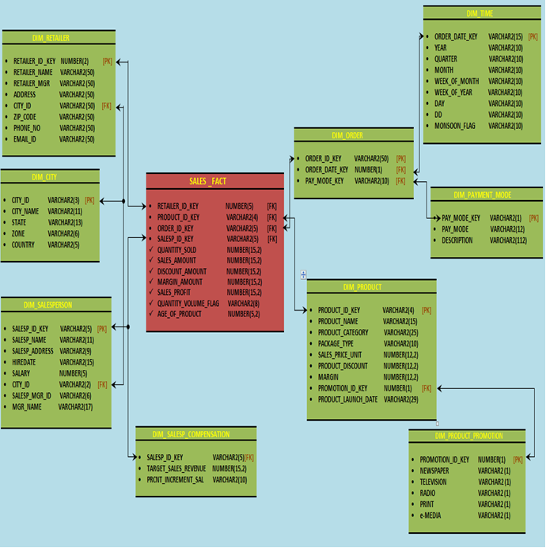
Star Schema
Notes:
Add instructor notes here.

Slide 10
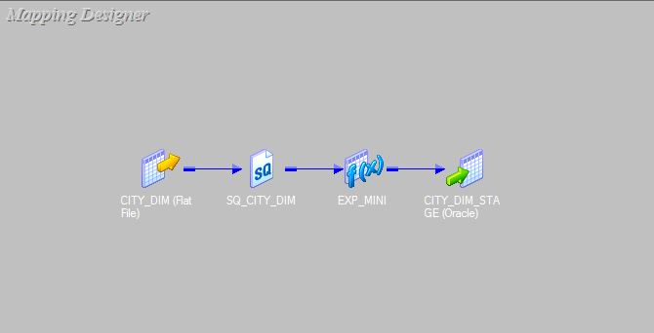
STAGING TABLE - CITY

Slide 11
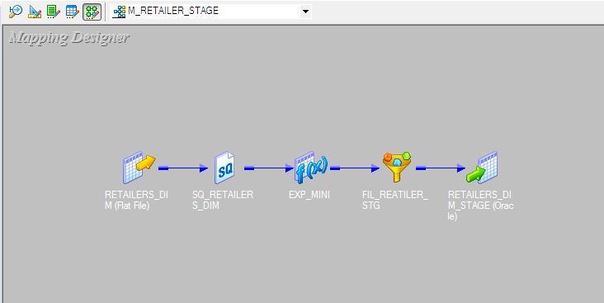
STAGING TABLE - RETAILER

Slide 12
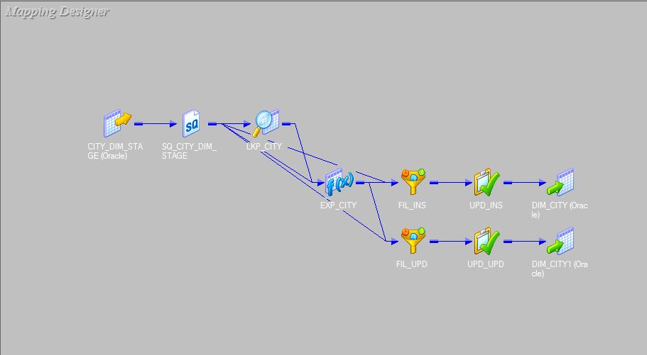
DIMENSION TABLE - CITY
Notes:
Add the notes here.
Add instructor notes here.

Slide 13
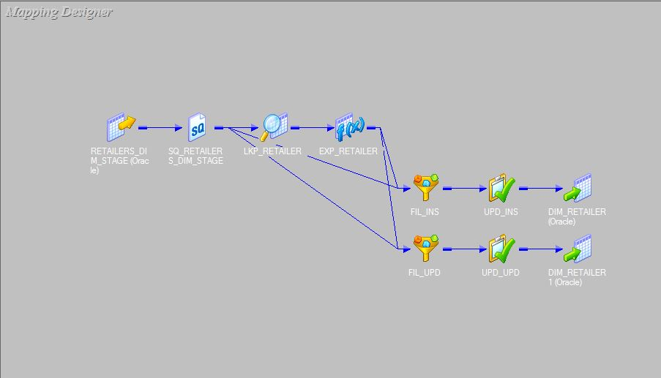
DIMENSION TABLE - RETAILER

Slide 14
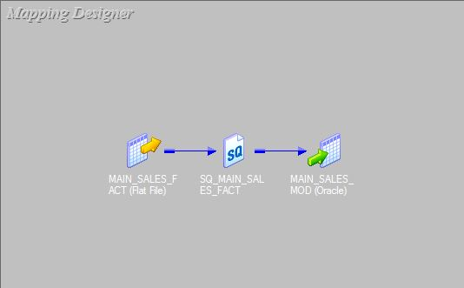
FACT TABLE MODEL

Slide 15
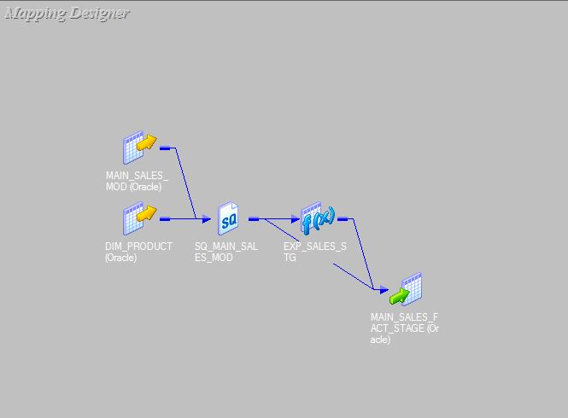
FACT TABLE - STAGING

Slide 16
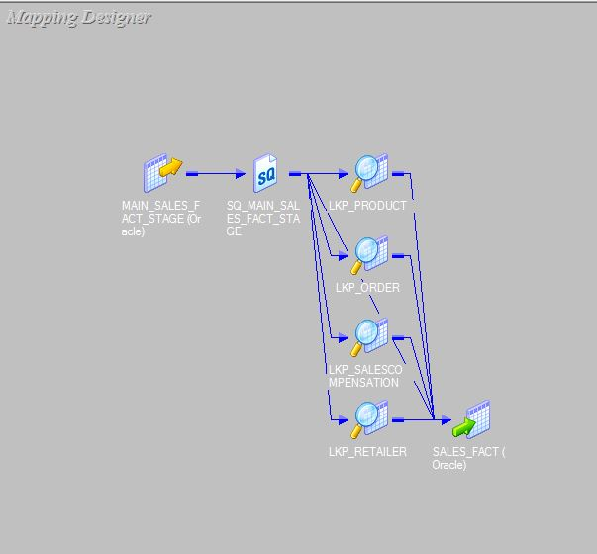
FACT TABLE
Notes:
Add the notes here.
Add instructor notes here.

Slide 17
THANK YOU
Notes:
Add the notes here.
Add instructor notes here.

