Slide 1
KEY PERFORMANCE INDICATORS
Key Performance Indicators are also known as Key Success Indicators, they help an organization to evaluate success and when we use KPI we should follow Smart Approach.
The Key performance Indicator is a metric calculation to measure how well an organization performing as both individually and as in competitive market.
Capgemini Internal

Slide 2
KPI MEASUREMENTS
Key Performance Indicators has the following measurements:
  Specific – a well defined goal that is clearly understood by everyone.
  Measurable – we can track the your progress towards the goal.
  Agreed – The employer and employee must agree on what the goals are.
  Realistic – we can achieve the goals with the resource provided by the organization.
  Time Related – It should be time related.
Capgemini Internal

Slide 3
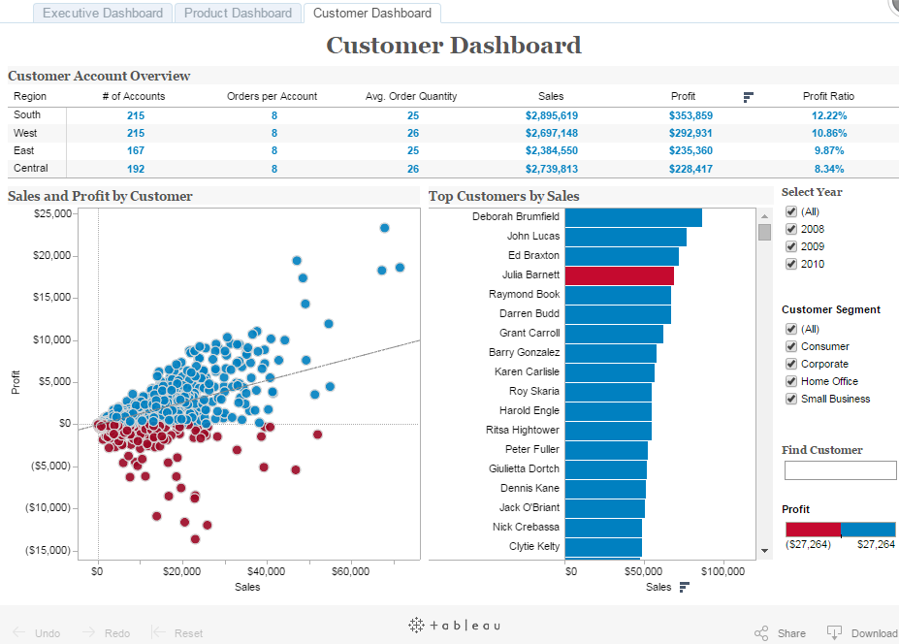
KPI TESTING
Notes:
Add the notes here.
Add instructor notes here.

