Slide 1

REAL ESTATE
MENTOR:- MR. JAYVIBHAVA
GROUP MEMBERS:-
1.ARUN VIJAYAN
2.POOJA G. LIKHAR
3.RAMAKANT GADEPALLI
4.ROOPESH NARAYANAN KUMAR
5.SHIVALI M. WAGHMARE
6.VAISHALI H. BOPCHE

Slide 2
INDEX:-
Scope Of Project
Project Flow
ETL Basics
Minimum System Requirements
Star Schema
Mappings
Workflow Manager
Workflow Monitor
Reference
Capgemini Internal
Notes:
Add instructor notes here.

Slide 3
SCOPE OF REAL ESTATE PROJECT:-
Comparision of different companies
Total Revenue on area purchased
Development of cities residentially and commercially
Purchase Trends
Citi wise ranking of developers
Number of purchases in cities
City wise price trends
City wise assessment of Investments
Number of Investors annually for every City

Slide 4
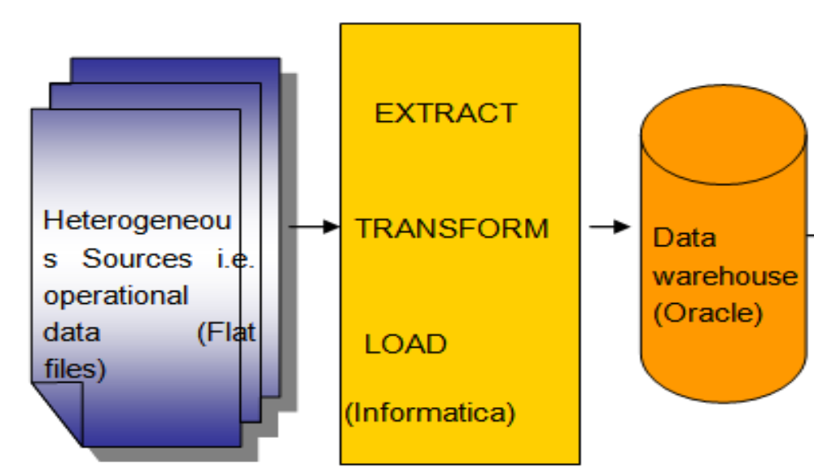
PROJECT FLOW:-

Slide 5
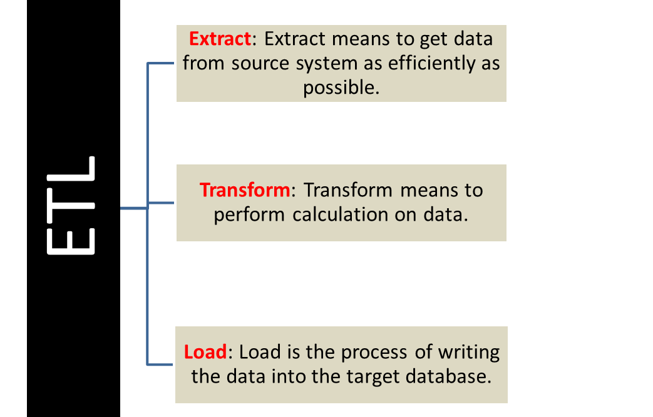
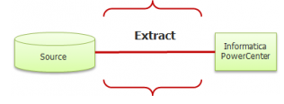
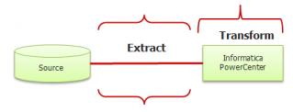

ETL BASICS:-
Notes:
Add instructor notes here.

Slide 6
MINIMUM SYSTEM REQUIREMENTS:-
ETL TOOL: Informatica 9.6.0
Intel Pentium 90 or higher (P166 recommended)
Microsoft Windows 95, 98, or NT 4.0, 2k, XP, Windows 2007.
Memory: 32MB of RAM (64MB or more recommended)
Internet Explorer 6.0 or higher
Oracle 9i client and access to oracle 9i server or SQL Server Client and access to SQL Server

Slide 7
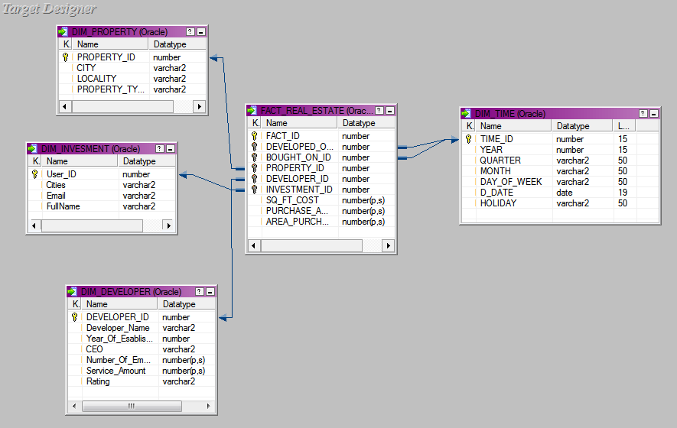
STAR SCHEMA:-

Slide 8
MAPPINGS:-
STAGE MAPPING
D:\Ramakant Gadepalli\Project\presentation
PROPERTY MAPPING
D:\Ramakant Gadepalli\Project\presentation
DEVELOPER MAPPING
D:\Ramakant Gadepalli\Project\presentation
INVESTOR MAPPING
D:\Ramakant Gadepalli\Project\presentation
TIME MAPPING
D:\Ramakant Gadepalli\Project\presentation
FACT TABLE MAPPING
D:\Ramakant Gadepalli\Project\presentation

Slide 9
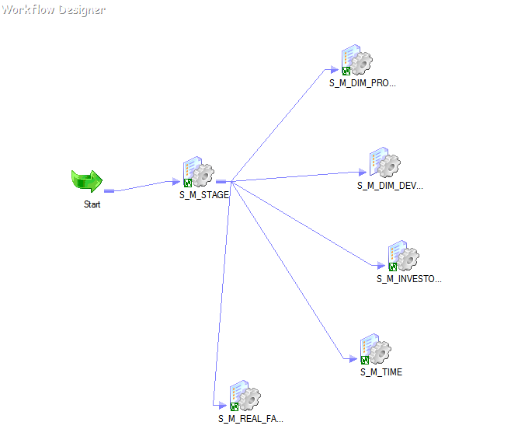
WORKFLOW:-

Slide 10
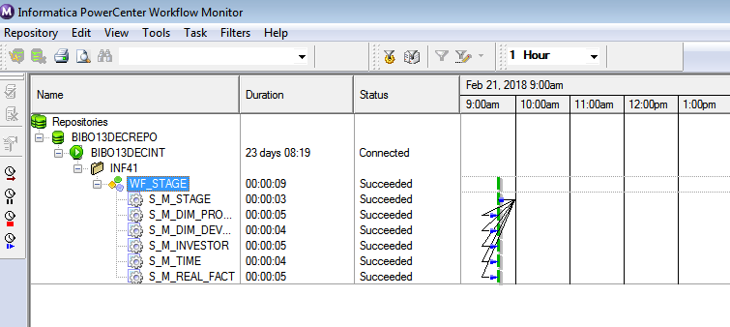
WORKFLOW MONITOR:-

Slide 11
Reference:-
Module PDFs.
https://www.edureka.co/blog/what-is-informatica/
https://www.guru99.com/informatica-tutorials.html

Slide 12
THANK-YOU
Capgemini Internal
Notes:
Add the notes here.
Add instructor notes here.

