Slide 1

Industry
February 23, 2018
Capgemini Internal
Notes:
Add the notes here.
Add instructor notes here.

Slide 2
INDUSTRY ANALYSIS
PROJECT BY:
PRATIK VASWANI (142974)
HENIL DASONDI (142397)
PRASIDDH MAKADIYA (142747)
PALASH SONKUSARE (142693)
BIJENDRA SINGH (142301)
IN GUIDANCE OF :
T. JAYAVIBHAVA
Capgemini Internal

Slide 3
TABLE OF CONTENTS:
1. Scope of Project.
2. Informatica Client Tool
2.1 What is Informatica ?
2.2 Transformation types in Informatica.
3. ETL Basics
3.1 Architecture
3.2 ETL Process
4. Star Schema Diagram.
5. Mappings.
6. System Configuration.

Slide 4
SCOPE OF PROJECT
Is the Industry Growing? Stable? Declining?
Current Trends

Slide 5
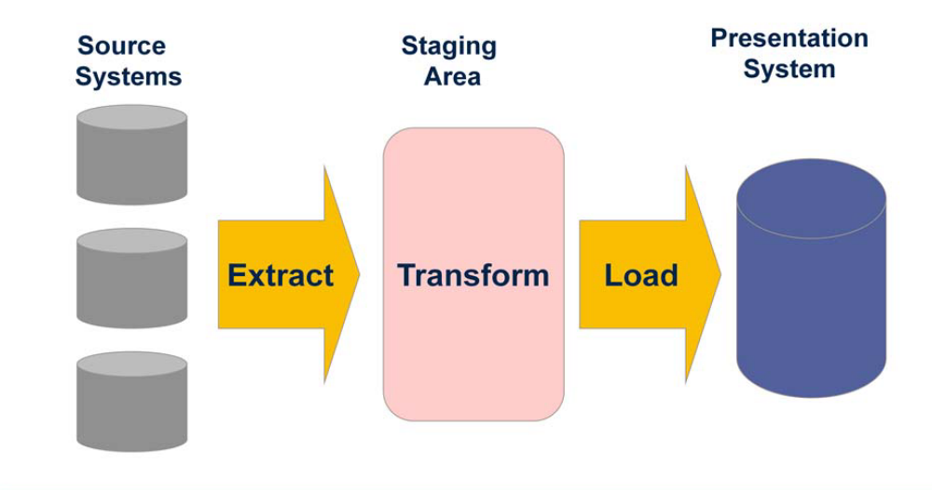
ETL PROCESS
Architecture
Data Warehouse
Data Source

Slide 6
WHAT IS INFORMATICA?
Allows you to Load Data into a centralized location, such as a Data Warehouse
ETL Tool
  Extract data from multiple sources
  Transform the data according to business logic and needs
  Load the transformed data into file and relational targets
Capgemini Internal
Notes:
Add instructor notes here.

Slide 7
ETL BASICS
Extract
  Extract relevant data
Transform
  Transform data to DW format
  Build keys, etc.
  Cleansing of data
Load
  Load data into DW
  Build aggregates, etc.

Slide 8
TRANSFORMATION TYPES
Source Qualifier | Represents all Data Queried From the Source
Normalizer | Normalizes Records From Relational Sources
Expression | Performs Simple Calculations
Filter | Serves as a Conditional Filter
Aggregator | Performs Aggregate Calculations
Rank | Limits Records to Top or Bottom Range
Update Strategy | Allows for Logic to Insert, Update, Delete, or Reject Data
Lookup | Looks Up Values and Passes to Other Objects
Stored Procedure | Calls a Stored Procedure and Captures Return Values
External Procedure | Calls a Procedure Defined in a Shared Library
Sequence Generator | Generates Unique ID Values
Joiner | Allows for Heterogeneous Joins

Slide 9
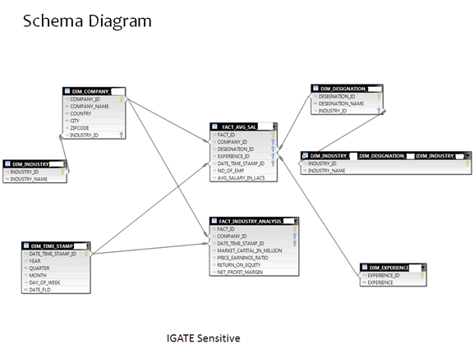

Slide 10

MAPPINGS
DIM_INDUSTRY
DIM_EXPIRIENCE
DIM_TIME_STAMP
DIM_COMPANY
DIM_DESIGNATION
FACT_INDUSTRY_NALYSIS
FACT_AVG_SAL
OUTPUTS

Slide 11
SYSTEM CONFIGURATION
Intel Pentium 90 or higher (P166 recommended)
Microsoft Windows 95, 98, or NT 4.0, 2k, XP, Windows 2007.
Memory: 32MB of RAM (64MB or more recommended)
Internet Explorer 6.0 or higher
Oracle 11g Client and Access to Oracle 11g Server
ETL Tool: Informatica 9.6.1

Slide 12
THANK YOU !!
February 23, 2018

