Slide 1

Kinetic Modeling of Phenol Steam Reforming
in a Fixed Bed Reactor
- CP302
-Guided by:
Dr. Tarak Mondal
Presented by:
Sayed Musaraf Ali
2022CHB1057

Slide 2
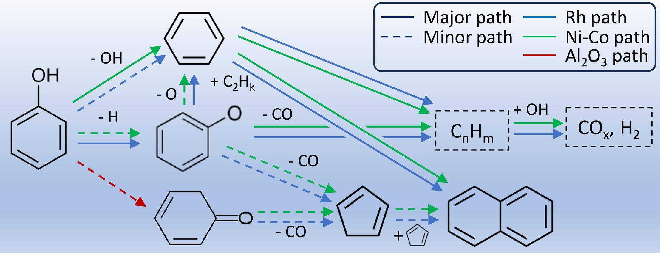
Introduction
Phenol steam reforming (PSR) is a promising route for hydrogen production.
Kinetic modeling is essential for reactor design and optimization.
Why Kinetic Modelling?
  Provides quantitative understanding of reaction rates.
  Essential for reactor design, scale-up, and process optimization.
  Enables comparison of different catalytic systems.

Slide 3
Project Objectives
Review the kinetics of phenol steam reforming and identify suitable models.
Develop kinetic models for phenol steam reforming in a fixed-bed reactor.
Estimate kinetic parameters from experimental data by different regression techniques.
Validate model using statistical & residual analysis.

Slide 4

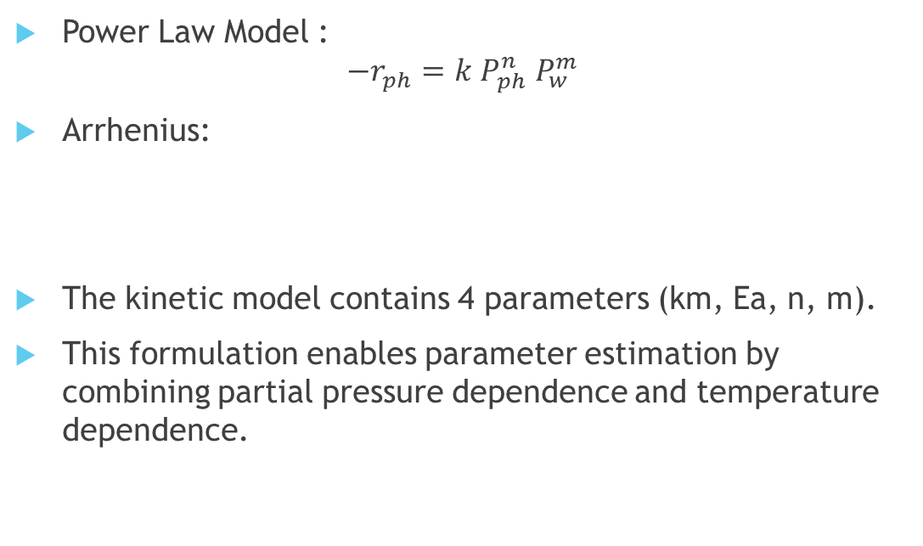
Kinetic Models Considered
Power Law Model :
$$−r_{ph}=k P_{ph}^{n} P_{w}^{m}$$
Arrhenius:
The kinetic model contains 4 parameters (km, Ea, n, m).
This formulation enables parameter estimation by combining partial pressure dependence and temperature dependence.

Slide 5
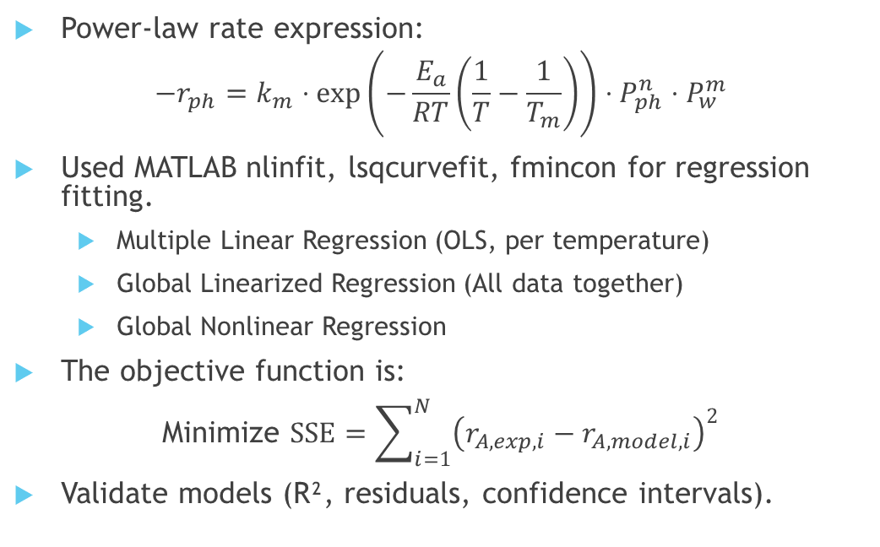
Estimation of Kinetic Model Parameters
Power-law rate expression:
$$−r_{ph}=k_{m}⋅\exp\left(−\frac{E_{a}}{RT}\left(\frac{1}{T}−\frac{1}{T_{m}}\right)\right)⋅P_{ph}^{n}⋅P_{w}^{m}$$
Used MATLAB nlinfit, lsqcurvefit, fmincon for regression fitting.
  Multiple Linear Regression (OLS, per temperature)
  Global Linearized Regression (All data together)
  Global Nonlinear Regression
The objective function is:
Minimize $\text{S}\text{S}E=\sum_{i=1}^{N}{{\left(r_{A,exp,i}−r_{A,model,i}\right)}^{2}}$
Validate models (R², residuals, confidence intervals).

Slide 6
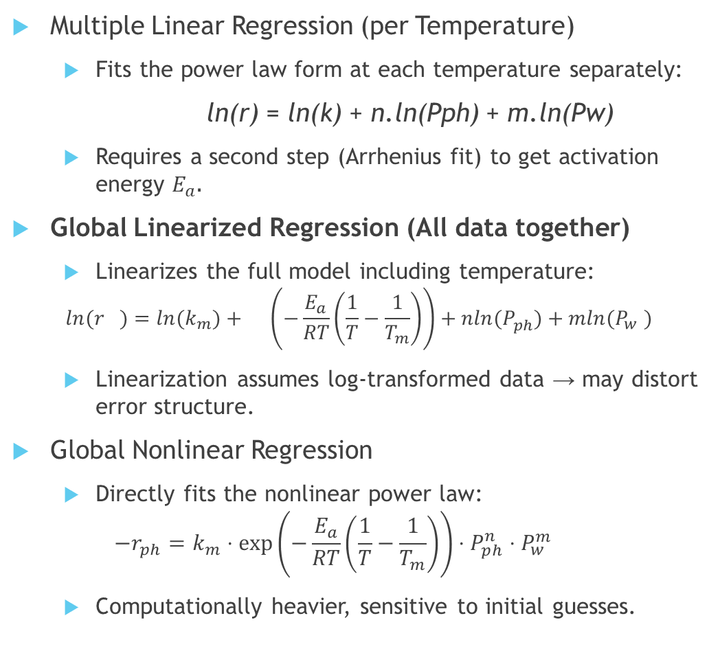
Regression Techniques
Multiple Linear Regression (per Temperature)
  Fits the power law form at each temperature separately:
ln(r​) = ln(k) + n.ln(Pph) + m.ln(Pw​)
  Requires a second step (Arrhenius fit) to get activation energy $E_{a}$.
Global Linearized Regression (All data together)
  Linearizes the full model including temperature:
$$ln⁡(r_{})={ln⁡(k}_{m})+\left(−\frac{E_{a}}{RT}\left(\frac{1}{T}−\frac{1}{T_{m}}\right)\right)+nln(P_{ph}^{})+mln(P_{w}^{})$$
  Linearization assumes log-transformed data → may distort error structure.
Global Nonlinear Regression
  Directly fits the nonlinear power law:
  $$−r_{ph}=k_{m}⋅\exp\left(−\frac{E_{a}}{RT}\left(\frac{1}{T}−\frac{1}{T_{m}}\right)\right)⋅P_{ph}^{n}⋅P_{w}^{m}$$
  Computationally heavier, sensitive to initial guesses.

Slide 7

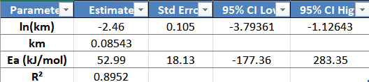
Results
Multiple Linear Regression
Estimated Parameters at each Temperature:
From Arrhenius Fit Plot:
Slope = -Ea/R | y-intercept = ln(km)

Slide 8
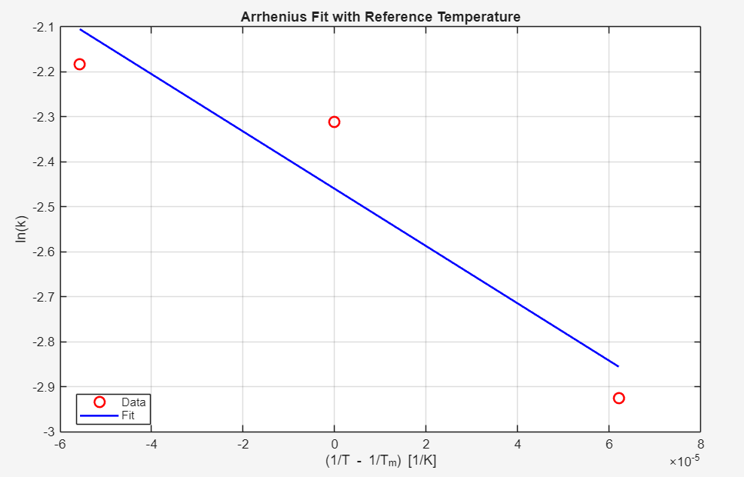

Slide 9
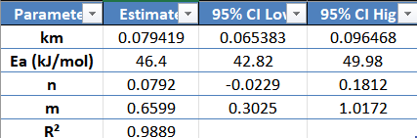
Results
Global Linear Regression
Estimated Parameters in one shot.

Slide 10
Results
Non-Linear Regression
Optimized parameters (by fmincon):
Parameters | Value
km | 0.15232
Ea | 80 KJ/mol
n | 0
m | 1.87
R2 | 0.6117

Slide 11
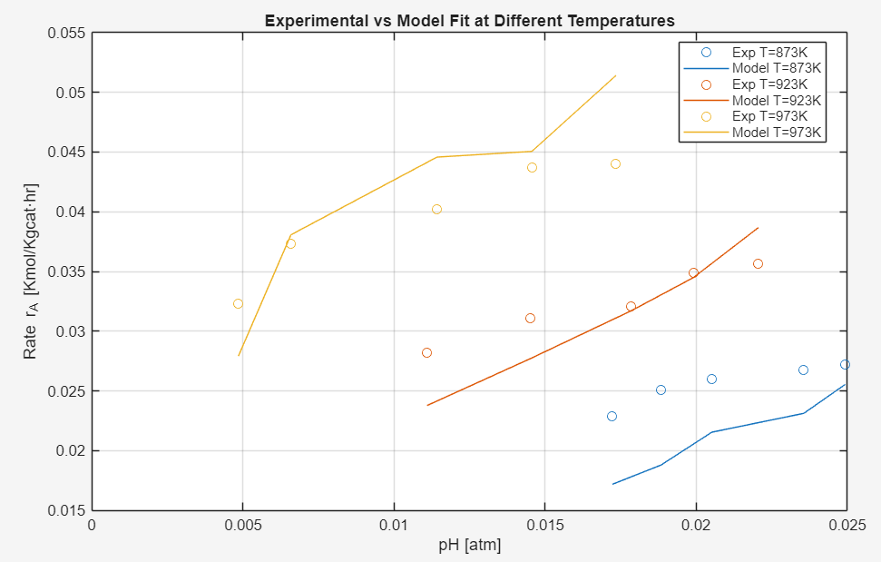

Slide 12
Results
Non-Linear Regression
Optimized parameters (by lsqcurvefit):
Parameters | Values | SE
km | 0.07695 | 0.00637
Ea | 46.218 KJ/mol | 1.7822
n | 0.06755 | 0.04712
m | 0.68055 | 0.1785
R2 | 0.9876

Slide 13
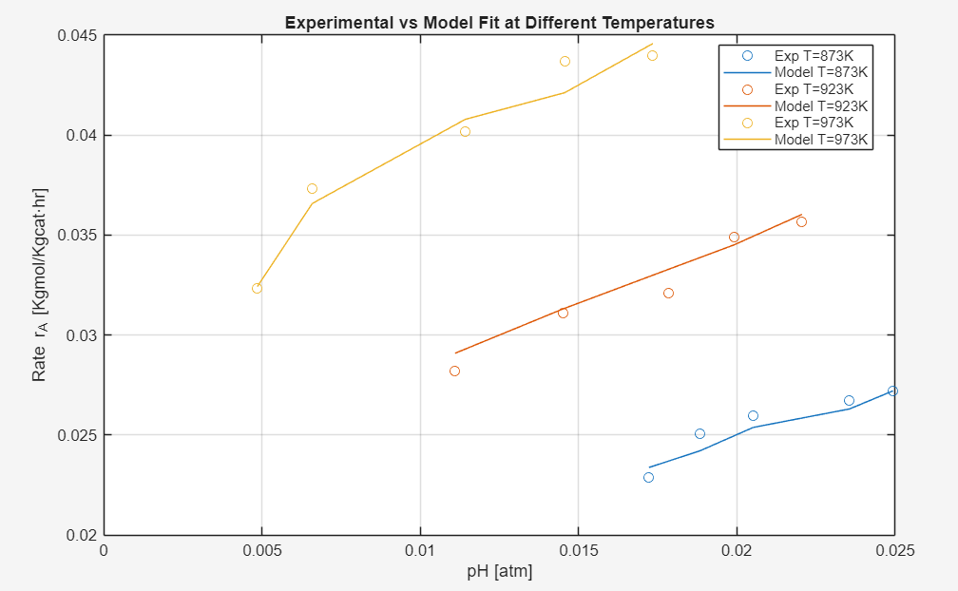

Slide 14
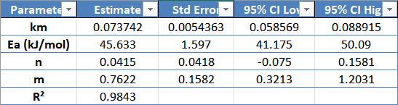
Results
Non-Linear Regression
Optimized parameters (by nlinfit):

Slide 15
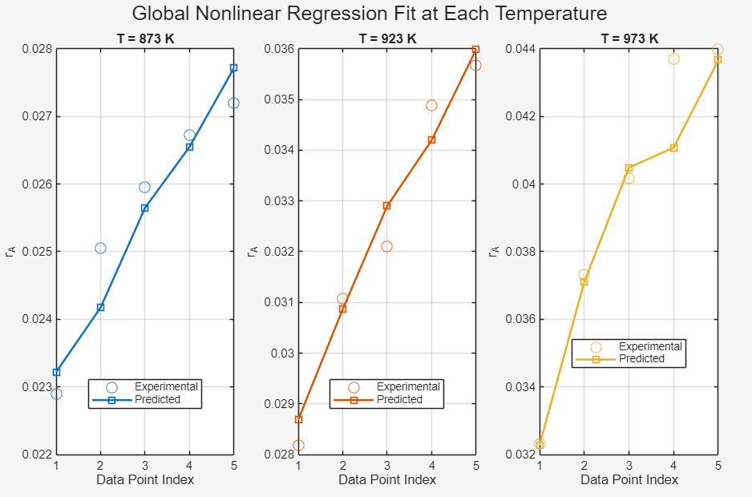

Slide 16
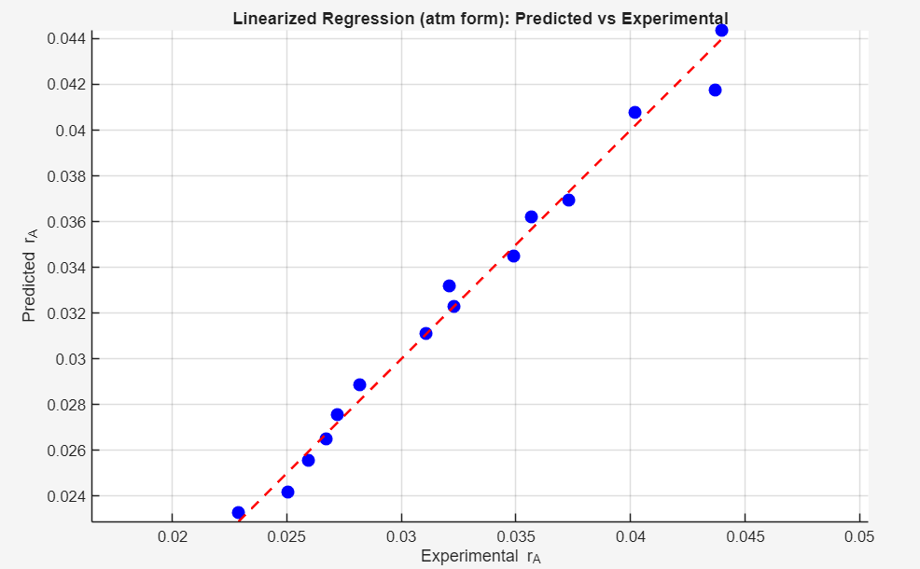
Model Validation
Goodness of Fit, R2 = 0.9889

Slide 17
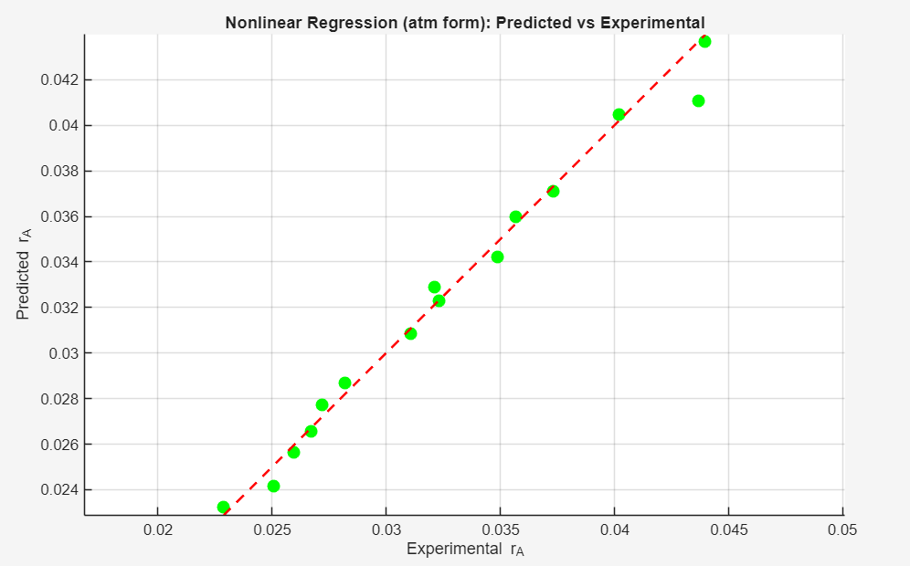
Model Validation
Goodness of Fit by nlinfit, R2 = 0.9843

Slide 18
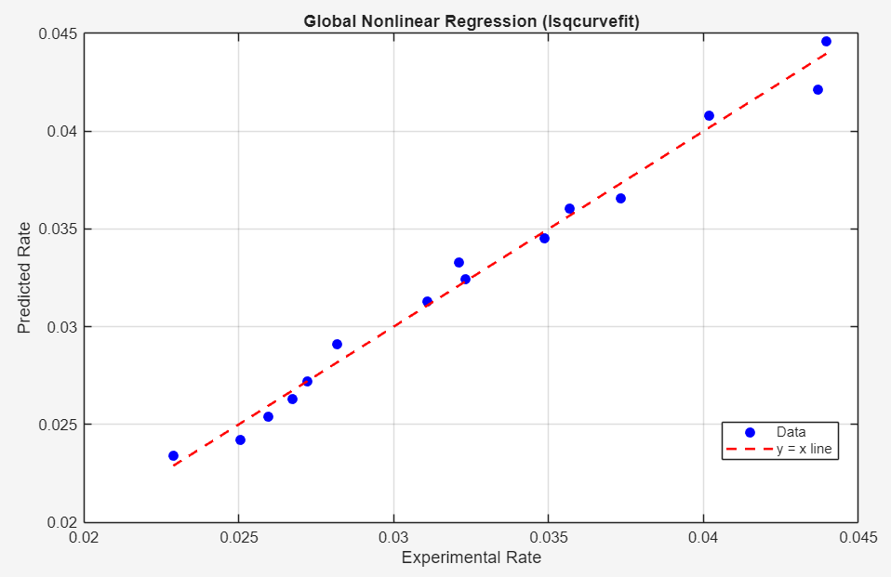
Model Validation
Goodness of Fit, R2 = 0.9876

Slide 19
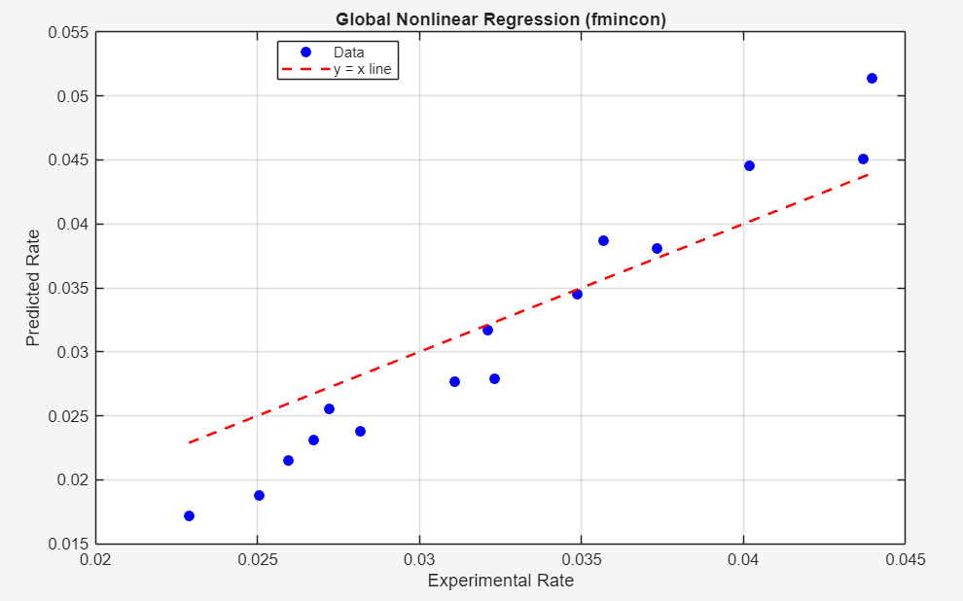
Model Validation
Goodness of Fit, R2 = 0.6117

Slide 20
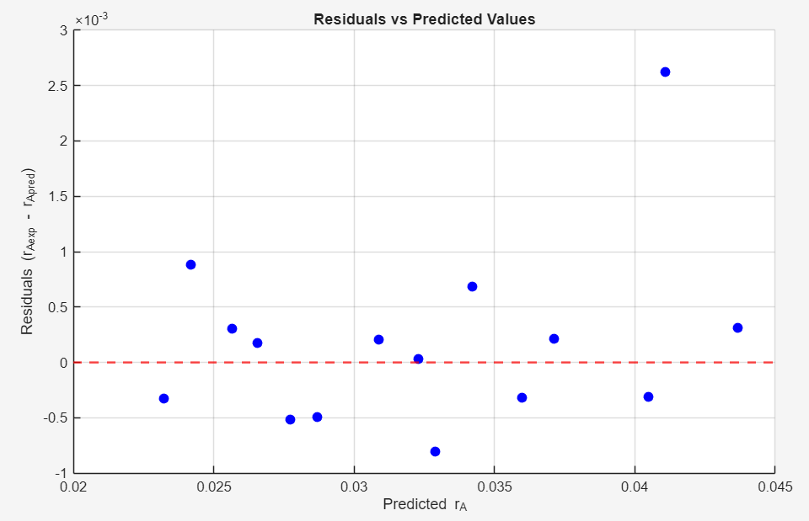
Error Distributions

Slide 21
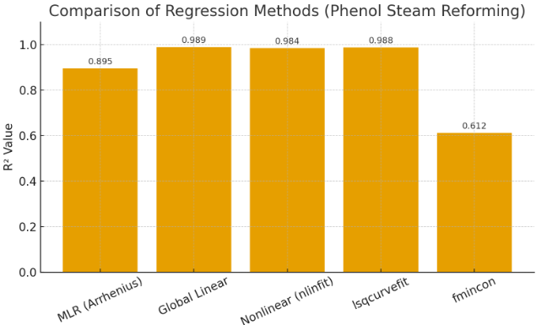
Model Comparison
Global Linear, Non-Linear (nlinfit,lsqcurvefit) are the best fits.
nlinfit is more appropriate that of lsqcurvefit -> More Compact St Error and CI.

Slide 22
Summary and Conclusion
Successfully estimated Kinetic Parameters using multiple regression techniques.
  Best fits shown for non-linear regression (nlinfit and lsqcurvefit) R2 ~ 0.99
  Provides robust parameter estimation with small uncertainty for km (~0.077), Ea (~46 KJ/mol)
  High uncertainity for reaction orders n (~ 0.06) and m (~ 0.7).
  Overall reaction order (~ 0.8)
Model Validation: Statistical analysis confirms reliability; residuals are random

Slide 23
LHHW Model Overview
Why go beyond Power Law?
Power-law kinetics is empirical → good statistical fit but no mechanistic insight.
Cannot explain:
  Competitive adsorption
  Surface reaction mechanism
  Product inhibition
  Effect of site coverage
LHHW provides a mechanistic, surface-kinetics-based framework.
Used when:
  Rate-controlling step is surface reaction
  Reactants adsorb on active sites
  Surface coverage influences rate

Slide 24
LHHW Model
Key Assumptions of LHHW:
  Reaction occurs on active catalyst sites.
  Phenol (P) and Steam (W) adsorb via Langmuir isotherms.
  A single surface-reaction step is rate-controlling.
  No external/internal mass-transfer limitations.
  Catalyst does not deactivate during experiments.
  Ideal-gas behaviour.
We have total of 8 Models (4 Single-site and 4 Dual-sites)
  Both Ph and Steam dissociative.
  Both Ph and Steam non-dissociative.
  Only one dissociative and other non-dissociative and vice-versa.

Slide 25
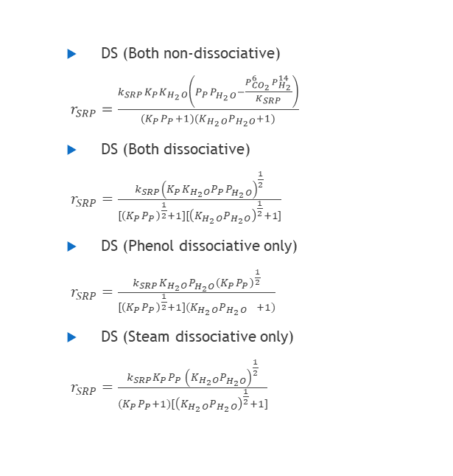
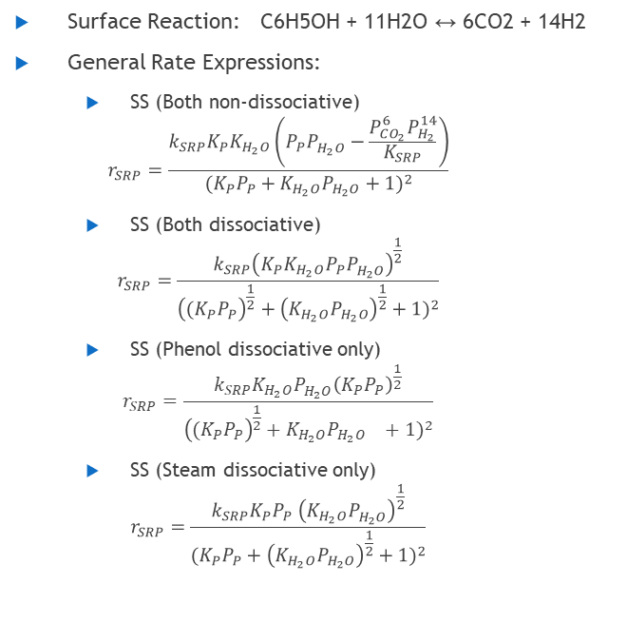
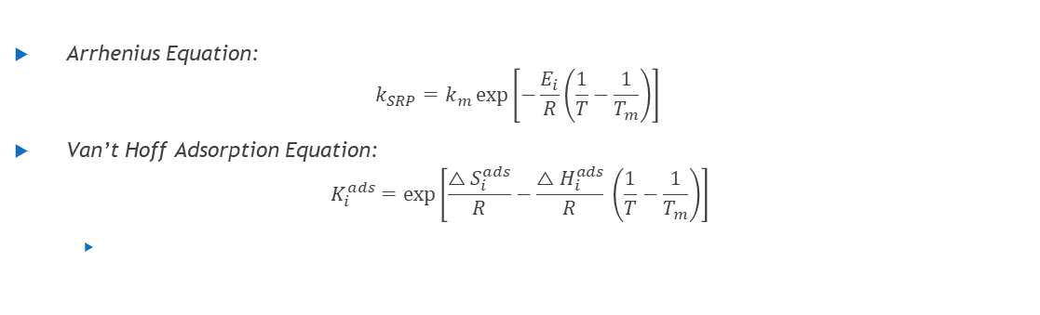
LHHW Model
Surface Reaction: C6H5OH + 11H2O ↔ 6CO2 + 14H2
General Rate Expressions:
  SS (Both non-dissociative)
  $$r_{SRP}=\frac{k_{SRP}K_{P}K_{H_{2}O}\left(P_{P}P_{H_{2}O}^{}−\frac{P_{CO_{2}}^{6}P_{H_{2}}^{14}}{K_{SRP}}\right)}{(K_{P}P_{P}+K_{H_{2}O}P_{H_{2}O}+1)^{2}}$$
  SS (Both dissociative)
  $$r_{SRP}=\frac{k_{SRP}{\left(K_{P}K_{H_{2}O}P_{P}P_{H_{2}O}^{}\right)}^{\frac{1}{2}}}{{\left({(K}_{P}P_{P}\right)}^{\frac{1}{2}}+{\left(K_{H_{2}O}P_{H_{2}O}\right)}^{\frac{1}{2}}+1)^{2}}$$
  SS (Phenol dissociative only)
  $$r_{SRP}=\frac{k_{SRP}{K_{H_{2}O}P_{H_{2}O}^{}\left(K_{P}P_{P}\right)}^{\frac{1}{2}}}{{\left({(K}_{P}P_{P}\right)}^{\frac{1}{2}}+{K_{H_{2}O}P_{H_{2}O}}^{}+1)^{2}}$$
  SS (Steam dissociative only)
  $$r_{SRP}=\frac{k_{SRP}{K_{P}P_{P} \left(K_{H_{2}O}P_{H_{2}O}^{}\right)}^{\frac{1}{2}}}{{(K}_{P}P_{P}+{\left(K_{H_{2}O}P_{H_{2}O}\right)}^{\frac{1}{2}}+1)^{2}}$$
  DS (Both non-dissociative)
  $r_{SRP}=\frac{k_{SRP}K_{P}K_{H_{2}O}\left(P_{P}P_{H_{2}O}^{}−\frac{P_{CO_{2}}^{6}P_{H_{2}}^{14}}{K_{SRP}}\right)}{(K_{P}P_{P}+1)(K_{H_{2}O}P_{H_{2}O}+1)}$
  DS (Both dissociative)
  $r_{SRP}=\frac{k_{SRP}{\left(K_{P}K_{H_{2}O}P_{P}P_{H_{2}O}^{}\right)}^{\frac{1}{2}}}{{[\left(K_{P}P_{P}\right)}^{\frac{1}{2}}+1][{\left(K_{H_{2}O}P_{H_{2}O}\right)}^{\frac{1}{2}}+1]}$
  DS (Phenol dissociative only)
  $r_{SRP}=\frac{k_{SRP}{K_{H_{2}O}P_{H_{2}O}^{}\left(K_{P}P_{P}\right)}^{\frac{1}{2}}}{{[\left(K_{P}P_{P}\right)}^{\frac{1}{2}}+1]({K_{H_{2}O}P_{H_{2}O}}^{}+1)}$
  DS (Steam dissociative only)
  $r_{SRP}=\frac{k_{SRP}{K_{P}P_{P} \left(K_{H_{2}O}P_{H_{2}O}^{}\right)}^{\frac{1}{2}}}{{(K}_{P}P_{P}+1)[{\left(K_{H_{2}O}P_{H_{2}O}\right)}^{\frac{1}{2}}+1]}$
Arrhenius Equation:
$$k_{SRP}=k_{m}\exp\left[−\frac{E_{i}}{R}\left(\frac{1}{T}−\frac{1}{T_{m}}\right)\right]$$
Van’t Hoff Adsorption Equation:
$$K_{i}^{ads}=\exp\left[\frac{△S_{i}^{ads}}{R}−\frac{△H_{i}^{ads}}{R} \left(\frac{1}{T}−\frac{1}{T_{m}}\right)\right]$$

Slide 26
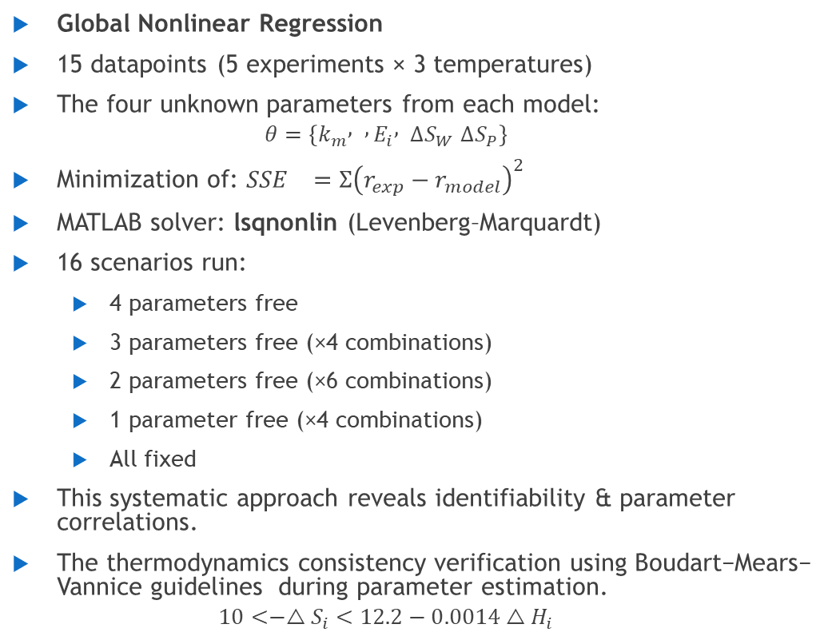
Estimation Technique
Global Nonlinear Regression
15 datapoints (5 experiments × 3 temperatures)
The four unknown parameters from each model:
  $$θ=\left\{k_{m} , , E_{i} , ΔS_{W} ΔS_{P}\right\}$$
Minimization of: ${SSE}_{}=Ʃ{\left(r_{exp}−r_{model}\right)}^{2}$
MATLAB solver: lsqnonlin (Levenberg–Marquardt)
16 scenarios run:
  4 parameters free
  3 parameters free (×4 combinations)
  2 parameters free (×6 combinations)
  1 parameter free (×4 combinations)
  All fixed
This systematic approach reveals identifiability & parameter correlations.
The thermodynamics consistency verification using Boudart−Mears− Vannice guidelines during parameter estimation.
  $$10<−△S_{i}<12.2−0.0014△H_{i}$$

Slide 27
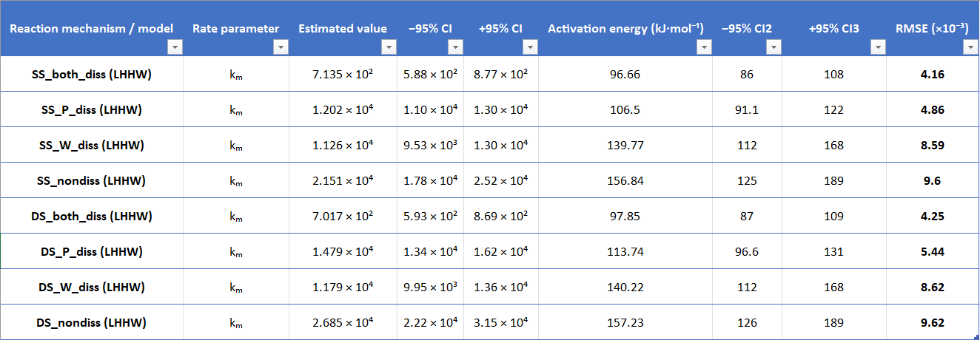
Results
Table 1 (Arrhenius params)

Slide 28
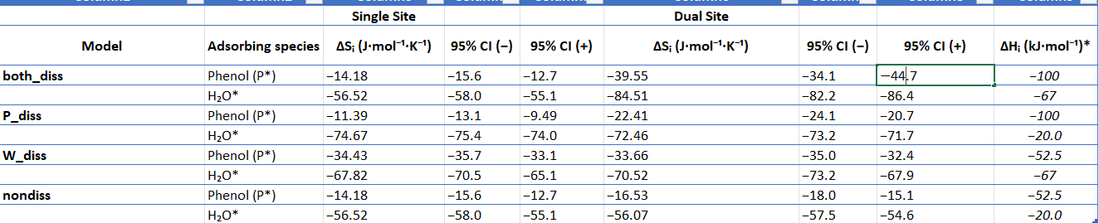
Results
Table 2 (Adsorption params)
Note: Change in enthalpy written in italics are known from literatures.

Slide 29
Interpretation of Parameters
Model Selection
  Lowest RMSE obtained for both-dissociative models (SS_both_diss & DS_both_diss ~4.2×10⁻³)
  Indicates that dissociative adsorption of both phenol and steam best represents the reaction mechanism.
Activation Energy (Ea) Trends
  Ea increases in order:
  both_diss (~97 kJ/mol) < P_diss (~110 kJ/mol) < W_diss (~140 kJ/mol) < nondiss (~157 kJ/mol)
  Lower Ea for both_diss models → more realistic and kinetically favorable pathway.
Pre-exponential Factor (kₘ)
  Dissociative models show lower kₘ values, indicating better mechanistic representation.
Thermodynamic Consistency
  ΔS values are negative for all cases - confirms entropy loss during adsorption.
  Water shows more negative ΔS than phenol - stronger surface interaction of steam.
The reaction is best described by a LHHW mechanism with dissociative adsorption of both phenol and H₂O, followed by surface reaction as the rate-controlling step.

Slide 30
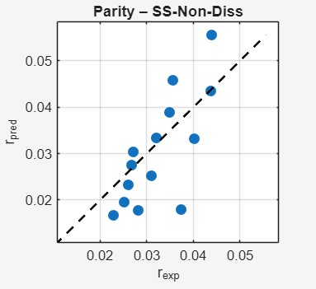
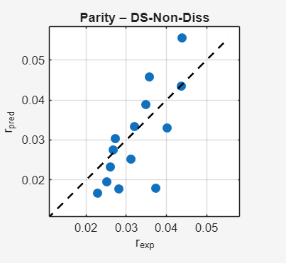
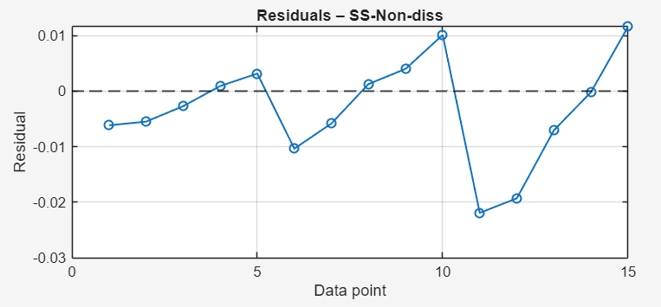
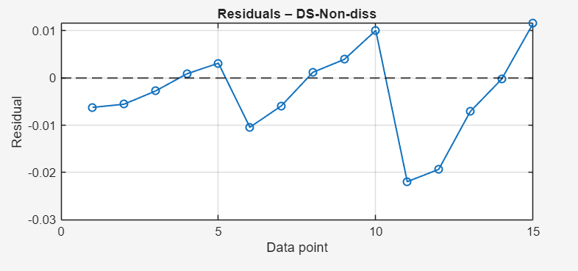
Parity and Residual Plots

Slide 31
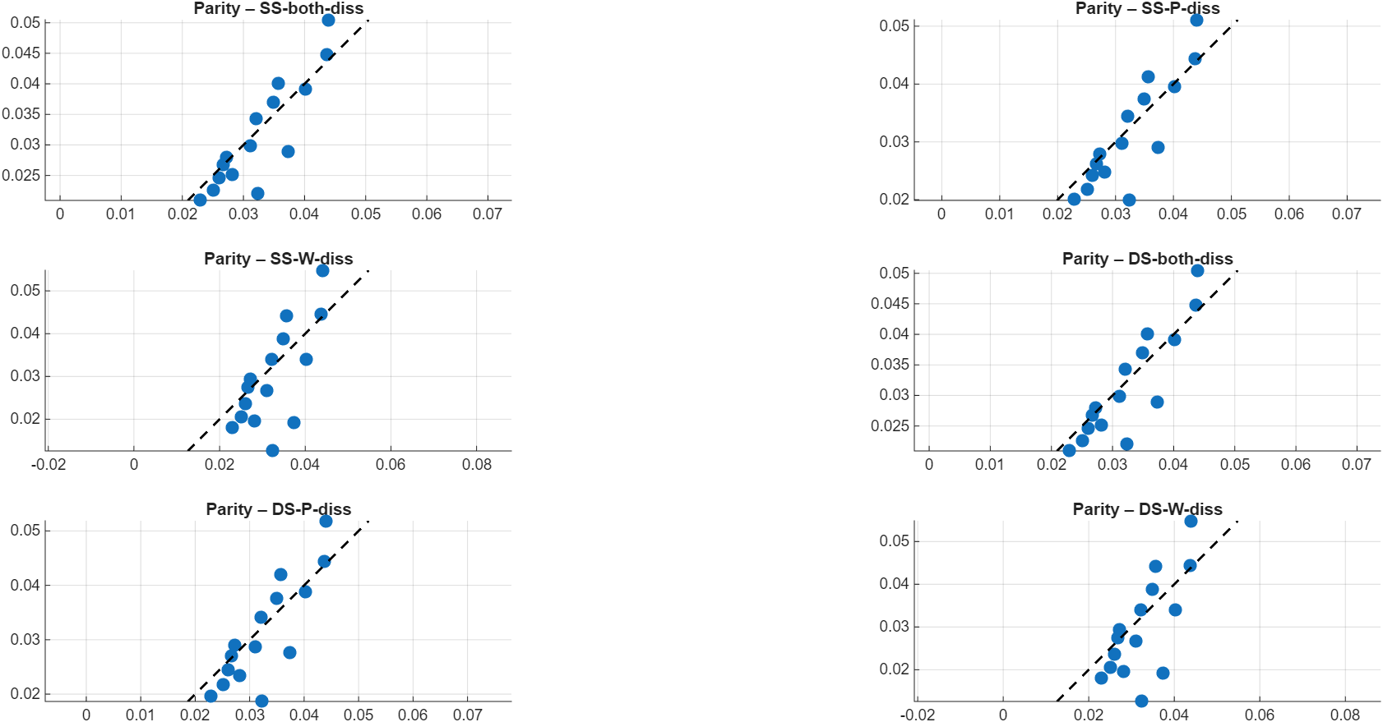
Parity Plots

Slide 32
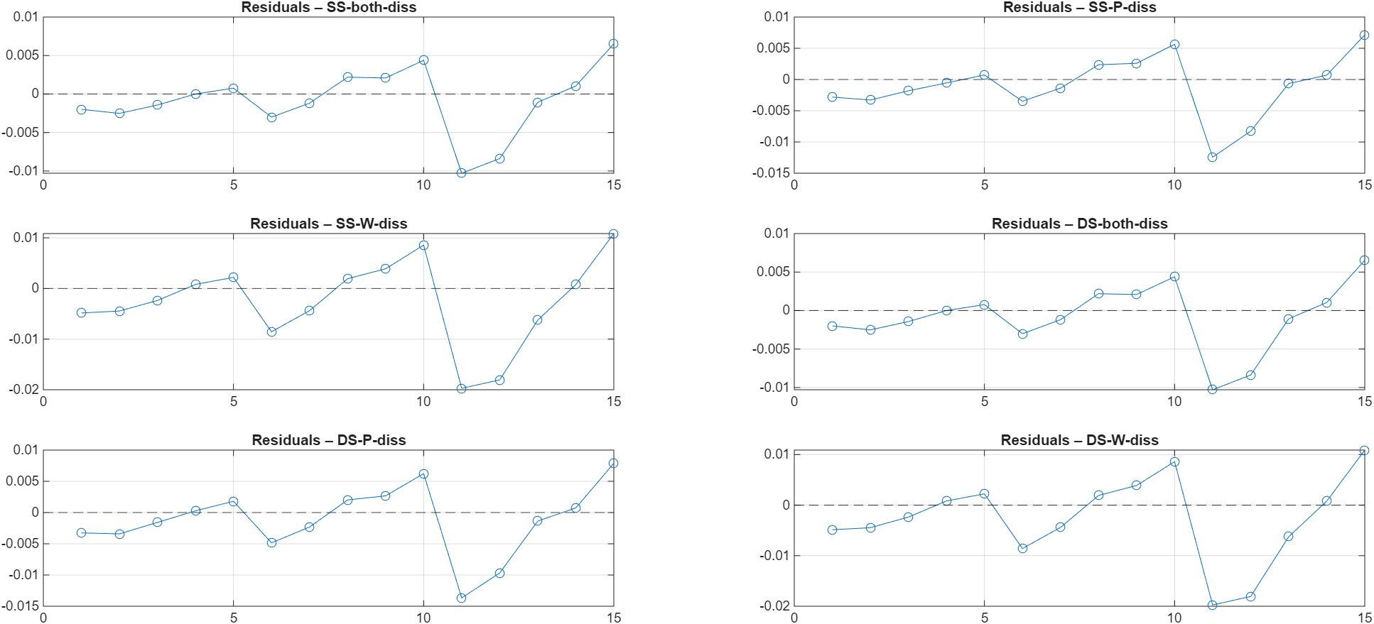
Residual Plots

Slide 33
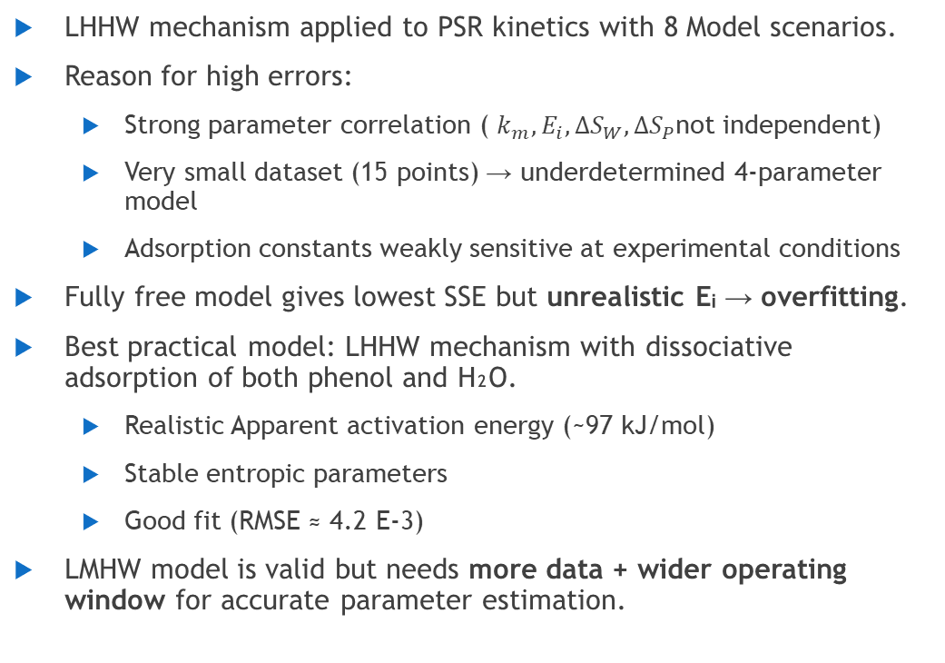
Conclusion
LHHW Kinetic Modelling
LHHW mechanism applied to PSR kinetics with 8 Model scenarios.
Reason for high errors:
  Strong parameter correlation ( $k_{m},E_{i},ΔS_{W},ΔS_{P}$not independent)
  Very small dataset (15 points) → underdetermined 4-parameter model
  Adsorption constants weakly sensitive at experimental conditions
Fully free model gives lowest SSE but unrealistic Eᵢ → overfitting.
Best practical model: LHHW mechanism with dissociative adsorption of both phenol and H₂O.
  Realistic Apparent activation energy (~97 kJ/mol)
  Stable entropic parameters
  Good fit (RMSE ≈ 4.2 E-3)
LMHW model is valid but needs more data + wider operating window for accurate parameter estimation.

Slide 34
References
https://www.sciencedirect.com/science/article/pii/S0016236122035359
https://www.sciencedirect.com/science/article/pii/S0016236124002485
https://www.sciencedirect.com/science/article/pii/S2213343716303736
https://pubs.acs.org/doi/full/10.1021/ acs.iecr.5b03828
H. Scott Fogler. Elements of Chemical Reaction Engineering. 5th Edition.

