Slide 1
Ich weiss, was Du seit letztem Sommer getan hast Adhärenz-Berechnungen mittels elektronischer Patientendaten
Forschungsseminar klinische Pharmazie, Samuel Allemann, 17.08.2017

Slide 2

Patient compliance [sic adherence] has become the best documented, but least understood, health behavior.
Adherence to medications is the process by which patients take their medication as prescribed, further divided into three quantifiable phases:
Initiation, Implementation and Discontinuation
Becker, M. H. and L. A. Maiman (1975). Medical Care 13(1): 10-24.
Vrijens, B., S. De Geest, D. A. Hughes, K. Przemyslaw, J. Demonceau, T. Ruppar, F. Dobbels, E. Fargher, V. Morrison, P. Lewek, M. Matyjaszczyk, C. Mshelia, W. Clyne, J. K. Aronson, J. Urquhart and A. B. C. P. Team (2012). British Journal of Clinical Pharmacology 73(5): 691-705.

Slide 3
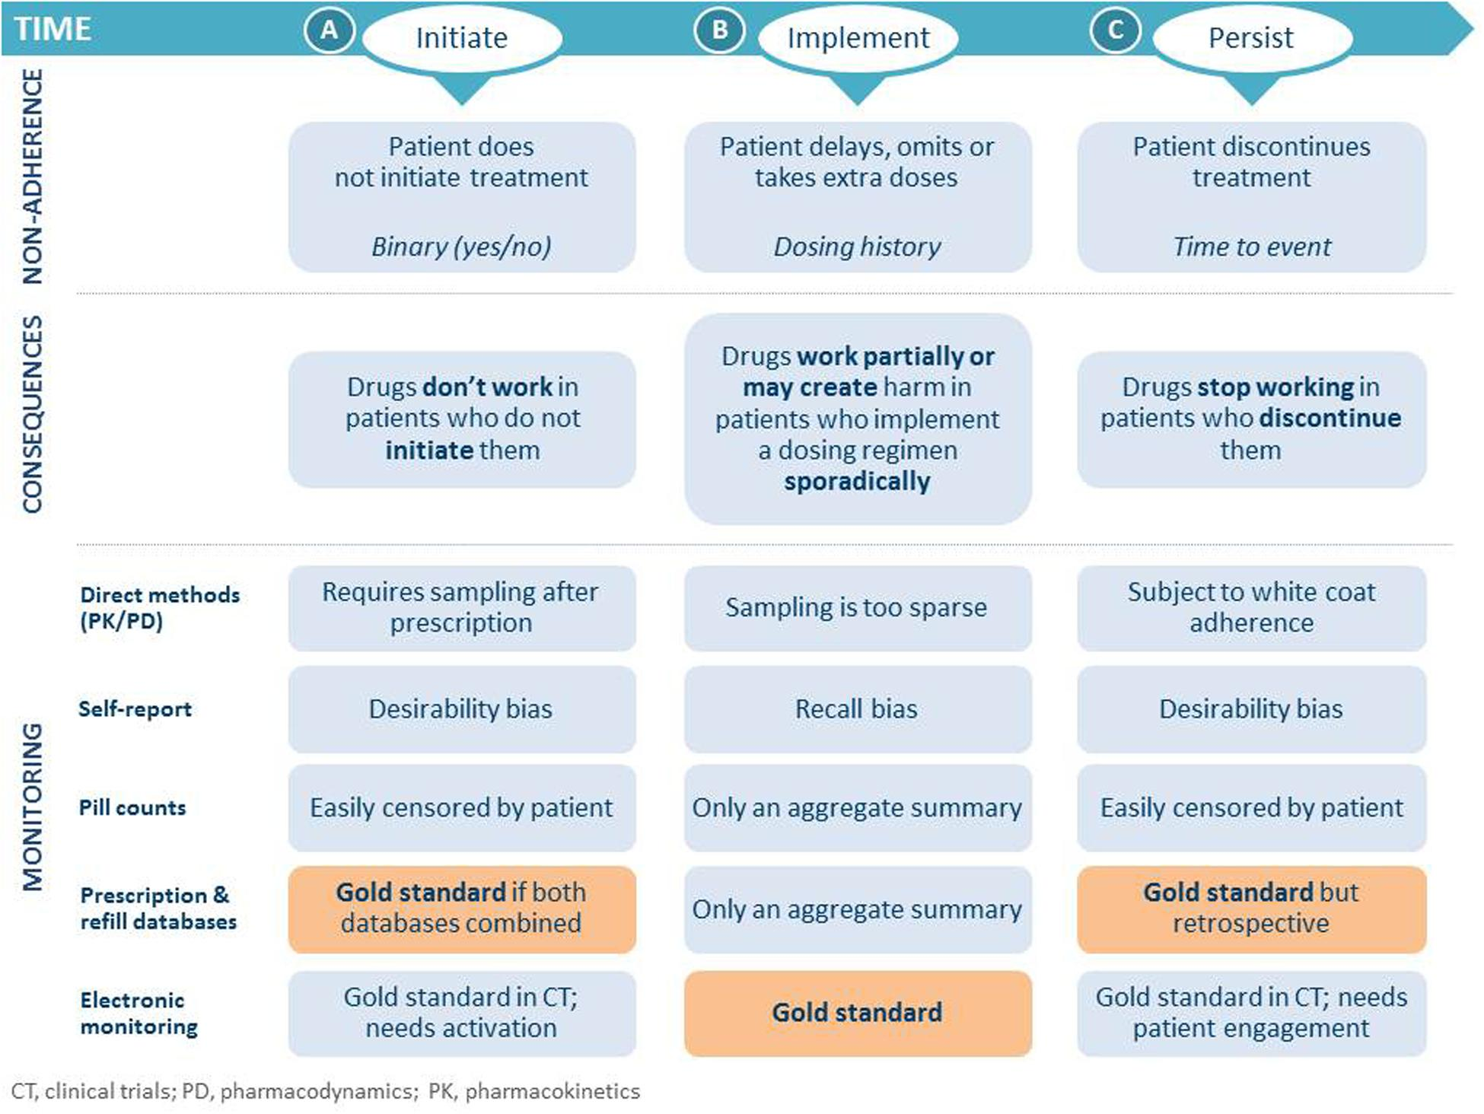
Adherence Measurement
Vrijens, B., S. Antoniou, M. Burnier, A. de la Sierra and M. Volpe (2017). Frontiers in Pharmacology 8: 100.

Slide 4
Adherence estimation from electronic healthcare data (EHD)
Why do we need it?
How do we do it?
What challenges need attention in the future?

Slide 5
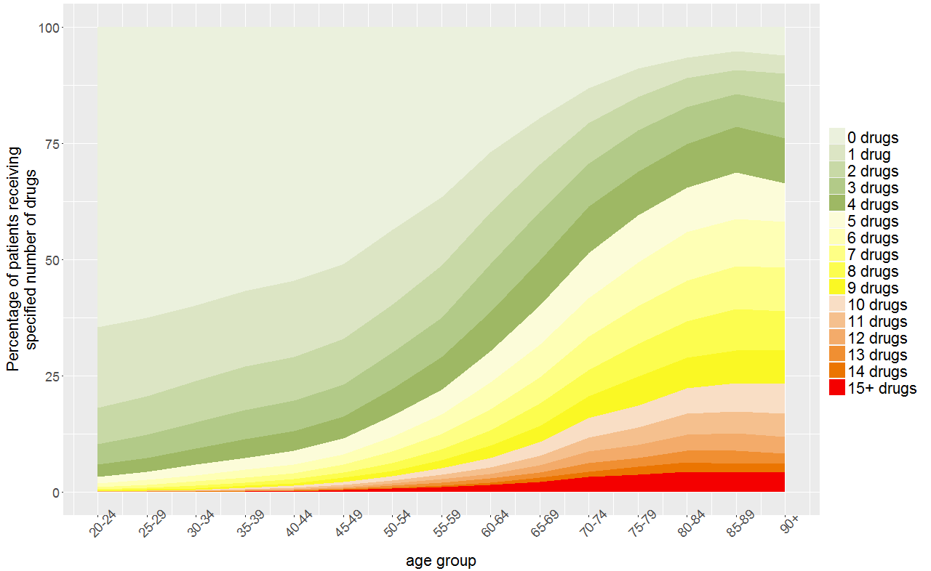
Adherence Taxonomy
> 4% don’t initiate treatment
> 10% don’t implement correctly
~ 40% don’t persist (after 1 year)
Blaschke, T. F., L. Osterberg, B. Vrijens and J. Urquhart (2012). Annual Review of Pharmacology and Toxicology 52: 275-301.
Notes:
Polypharmacy affects most of the elderly population
This study from 2015 showed that over 50% of people over 70 use 5 or more medications

Slide 6
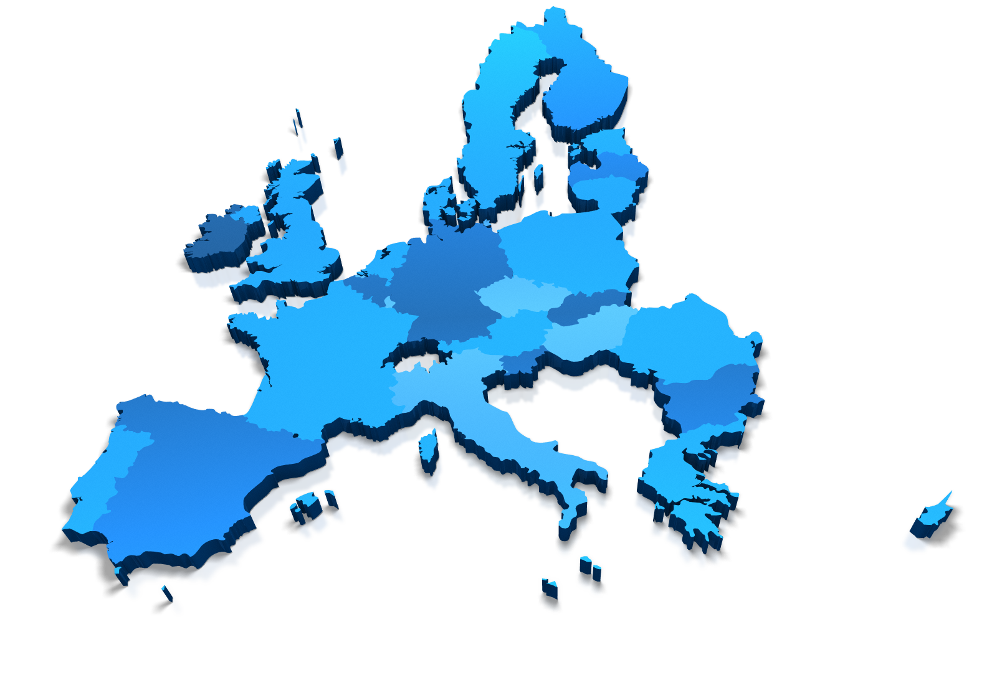

Polypharmacy and adherence
>50% of elderly take >5 medications per day
> 4% don’t initiate treatment
> 10% don’t implement correctly
~ 40% don’t persist (after 1 year)
~20 Mio. tablets per day
not taken
Guthrie, B., B. Makubate, V. Hernandez-Santiago and T. Dreischulte (2015). BMC medicine 13(1): 1.
Blaschke, T. F., L. Osterberg, B. Vrijens and J. Urquhart (2012). Annual Review of Pharmacology and Toxicology 52: 275-301.
Eurostat: Regional Statistics: Reference Guide (2006).

Slide 7
Applications of adherence estimations from Electronic healthcare data (EHD)
1
Predictors
2
(Non-)Adherence
Outcomes
3
Interventions

Slide 8


Adherence in observational studies
Healthy adherer effect
Adherence to
Non-adherence
Beliefs
Knowledge
Motivation
Etc…
Lifestyle
Cognitive impairment
Socioeconomic status
Etc…
Stürmer, T., S. Schneeweiss, J. Avorn and R. J. Glynn (2005). American journal of epidemiology 162(3): 279-289.

Slide 9
Data sources
Source | Pros | Cons
Prescription | Prescriber role Dosage | Patient role? Availability? Interruptions? (Quantity?) Multiple providers?
Pharmacy refills | Patient role Quantity Availability (Dosage) | Prescriber role? Interruptions? Multiple providers?
Insurance claims (reimbursement) | Prescriber & patient role Quantity Availability (Interuptions) | Dosage? Multiple payers?

Slide 10
Adherence estimations: Assumptions
Accurate medication records
First fill = first intake
Fixed daily dosage
Medication administered as indicated
No refill = medication not administered
Medications not purchased or borrowed elsewhere
Medications not diverted
No unknown treatment interruptions or dosing changes
Arnet, I., M. J. Kooij, M. Messerli, K. E. Hersberger, E. R. Heerdink and M. Bouvy (2016). Annals of Pharmacotherapy 50(5): 360-368.

Slide 11
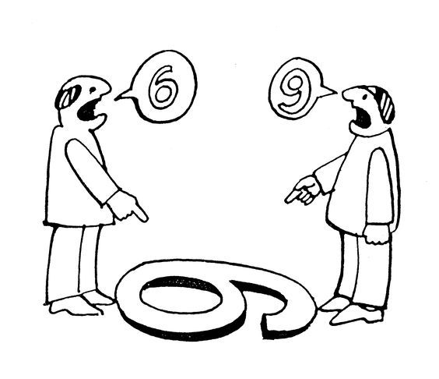
EHD-based adherence measures
Continuous Multiple Interval Measure of Oversupply
Continuous Measure of Medication Acquisition
63.5%
Medication Possession Ratio
Medication Refill Adherence
Proportion of Days Covered
63.0%
Continuous Measure of Medication Gaps
Dates Between Fills Adherence Rate
Compliance Rate
84.4%
109.7%
Refill Compliance Rate
Continuous, Single Interval Measure of Medication Aquisition
104.8%
Hess, L. M., M. A. Raebel, D. A. Conner and D. C. Malone (2006). Annals of Pharmacotherapy 40(7-8): 1280-1288.

Slide 12


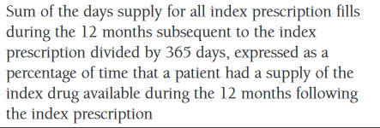

Medication Possession Ratio
«Medication Possession Ratio»
Hess, L. M., M. A. Raebel, D. A. Conner and D. C. Malone (2006). Annals of Pharmacotherapy 40(7-8): 1280-1288.

Slide 13
Adherence estimations: Requirements
PATIENT_ID | MEDI_ID | DATE | QUANTITY | PERDAY
37 | medA | 04/10/2036 | 30 | 4
37 | medA | 07/30/2036 | 30 | 4
37 | medA | 09/15/2036 | 30 | 4
37 | medB | 01/02/2037 | 50 | 4
37 | medB | 01/31/2037 | 50 | 4
76 | medA | 12/13/2035 | 30 | 1
76 | medA | 01/18/2036 | 30 | 1
76 | medA | 01/23/2036 | 60 | 2
76 | medA | 04/25/2036 | 60 | 2
76 | medA | 08/08/2036 | 60 | 2
DURATION

Slide 14
Adherence calculations: the basics
First prescription
Implementation?
First Fill
1st Refill
2nd Refill
3rd Refill
Gap
t_{s}
t₀
t₁
t₂
t₃
t₄
t₅
t_{e}
Initiation
Persistence
Discontinuation
Follow-up window

Slide 15
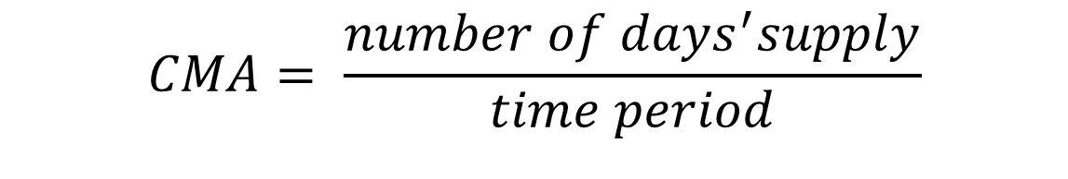
Estimation of Implementation
Implementation?
Refill
Refill
Refill
Refill
t_{s}
t₁
t₂
t₃
t₄
t₅
t_{e}
CMA: Continuous multiple-interval Measure of medication Availability
$$CMA= \frac{number of days^{′}supply}{time period}$$

Slide 16
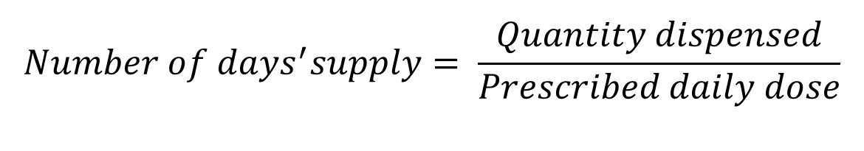
Medication availability: Number of days’ supply
$$Number of days^{′}supply= \frac{Quantity dispensed}{Prescribed daily dose}$$
Prescription
Lisinopril 5 mg 1-0-0
Lisinopril 5 mg 2-0-0
Lisinopril 10 mg 1-0-0
Pharmacy Claims
30 Tbl
100 Tbl
100 Tbl
30 Tbl
Arnet, I., M. J. Kooij, M. Messerli, K. E. Hersberger, E. R. Heerdink and M. Bouvy (2016). Annals of Pharmacotherapy 50(5): 360-368.

Slide 17
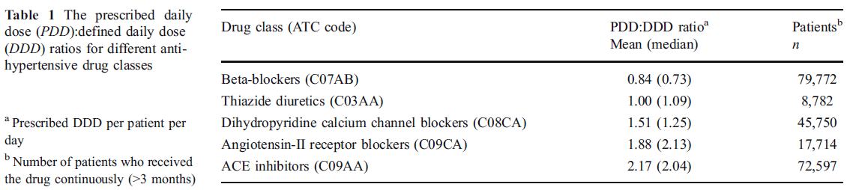
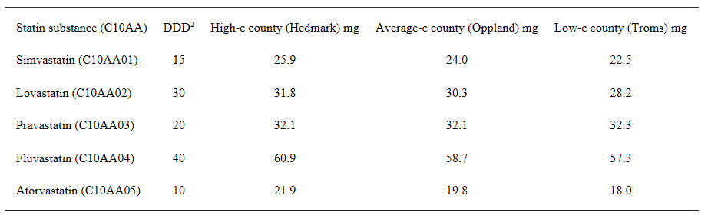
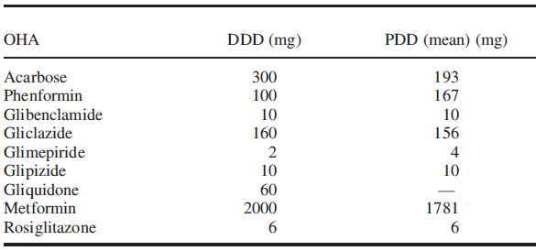
Defined Daily Dose?
Defined Daily Dose (DDD): The assumed average maintenance dose per day for a drug used for its main indication in adults.
Grimmsmann, Thomas, and Wolfgang Himmel (2011). European journal of clinical pharmacology 67(8): 847-854.
Hartz, Ingeborg, et al. (2007) BMC clinical pharmacology 7(1): 14.
Duarte‐Ramos, F., & Cabrita, J. (2006). Pharmacoepidemiology and drug safety 15(4): 269-274.

Slide 18
Estimation of Implementation
Implementation?
Refill
Refill
Refill
Refill
Refill
Refill
t_{s}
t₁
t₂
t₃
t₄
t₅
t_{e}
CMA: Continuous multiple-interval Measures of medication Availability
$$CMA= \frac{number of days^{′}supply}{time period}$$

Slide 19

Mind the gap!
Episode 1
Episode 2
Refill
Refill
Refill
Refill
Refill
Refill
Discontinuation
Re-Initiation

Slide 20
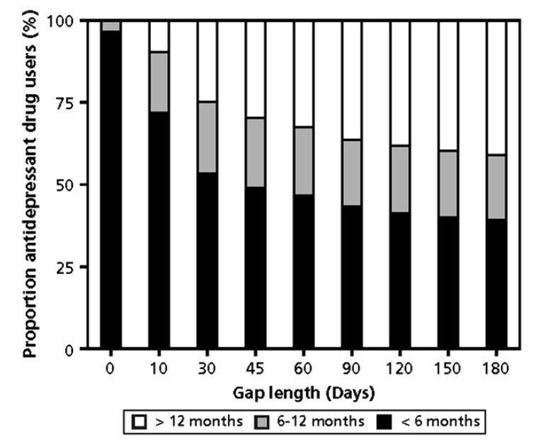
Gap length: influence on drug treatment episode
Greevy, R., M. Huizinga, C. Roumie, C. Grijalva, H. Murff, X. Liu and M. Griffin (2011). Clinical Pharmacology & Therapeutics 90(6): 813-819.
Gardarsdottir, H., Souverein, P. C., Egberts, T. C., & Heerdink, E. R. (2010). Journal of clinical epidemiology 63(4): 422-427.

Slide 21
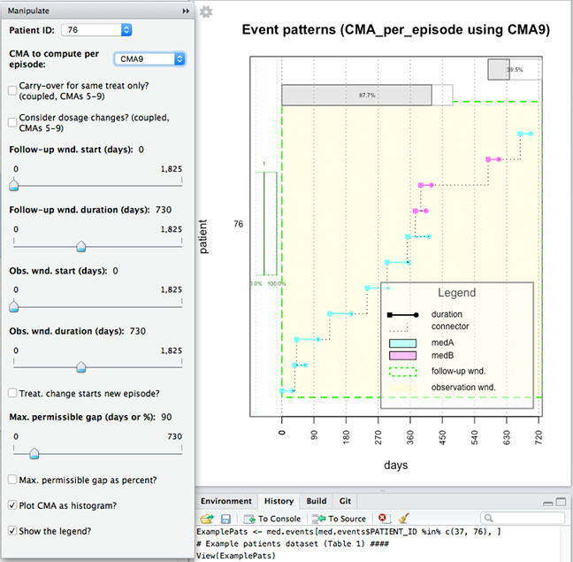
Reproducible Adherence Calculations: AdhereR
Open-source package for R
Compute, summarize, and plot various adherence estimates
Use of single data source
Individual medications

Slide 22



HESPER
Axis 1 : Provision of healthcare performance
Development and measure of actions’ impacts in order to improve safety and performance of care.
Axis 2 : The patient / User
To study the performance from the patient’s point of view, to know the determinants of his adherence to the healthcare system and the interventions enabling to improve it.

Slide 23
Postdoc at HESPER
Develop additions to the AdhereR package to:
link and analyze multiple sources
estimate adherence to polypharmacy
develop algorithms for therapeutic switching
analyze and visualize longitudinal adherence patterns

Slide 24



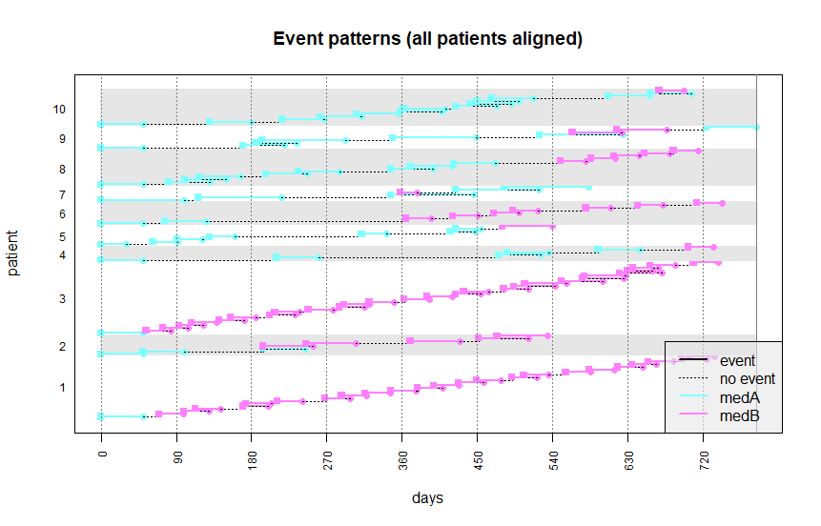

Link multiple sources
Discrepancies?

Slide 25
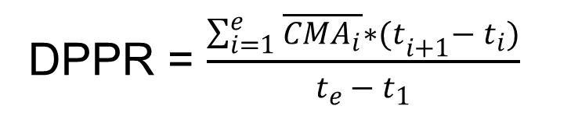






Polypharmacy
$$\overline{{CMA}_{1}}$$
$$\overline{{CMA}_{2}}$$
$$\overline{{CMA}_{3}}$$
$$\overline{{CMA}_{4}}$$
$$\overline{{CMA}_{5}}$$
$$\overline{{CMA}_{6}}$$
t₁
t₂
t₃
t₄
t₅
t₆
t_{e}
DPPR = $\frac{\sum_{i=1}^{e}{\overline{{CMA}_{i}}∗{(t}_{i+1}− t_{i})}}{t_{e }− t_{1}}$
Arnet, I., Abraham, I., Messerli, M., & Hersberger, K. E. (2014). International journal of clinical pharmacy 36(1): 192-201.

Slide 26
Polypharmacy
$$\overline{{CMA}_{1}}$$
$$\overline{{CMA}_{2}}$$
$$\overline{{CMA}_{3}}$$
$$\overline{{CMA}_{4}}$$
$$\overline{{CMA}_{5}}$$
$$\overline{{CMA}_{6}}$$
t₁
t₂
t₃
t₄
t₅
t₆
t_{e}
DPPR = $\frac{\sum_{i=1}^{e}{\overline{{CMA}_{i}}∗{(t}_{i+1}− t_{i})}}{t_{e }− t_{1}}$
Arnet, I., Abraham, I., Messerli, M., & Hersberger, K. E. (2014). International journal of clinical pharmacy 36(1): 192-201.

Slide 27

Therapeutic switching
Generic substitution?
Same drug class?
Same indication?
How should stockpiling be handled?

Slide 28
Longitudinal adherence patterns
CMA = 75%
CMA = 75%
CMA = 75%

Slide 29
Person-centered statistical methods
Predictors?
Outcomes?
Interventions?

Slide 30
Group-based trajectory modeling
CMA₁
CMA₂
CMA₃
CMA₄
CMA₅
CMA₆
CMA₇
CMA₈
CMA₉
CMA₁₀
CMA₁₁
Intercept
Linear Slope
Quadratic Slope
Class
Frankfurt, S., Frazier, P., Syed, M., & Jung, K. R. (2016). The Counseling Psychologist 44(5): 622-660.

Slide 31
GBTM: Class formation
Class 1
Class 2
Class 3

Slide 32
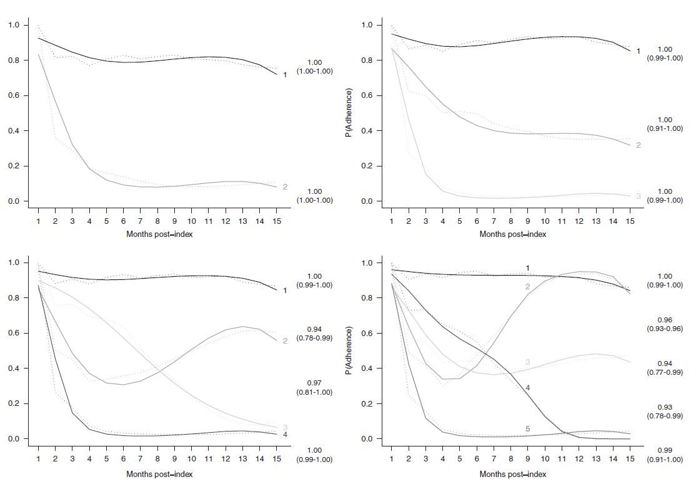
Group-based trajectory modeling
Franklin, J. M., W. H. Shrank, J. Pakes, G. Sanfélix-Gimeno, O. S. Matlin, T. A. Brennan and N. K. Choudhry (2013). Medical care 51(9): 789-796.

Slide 33
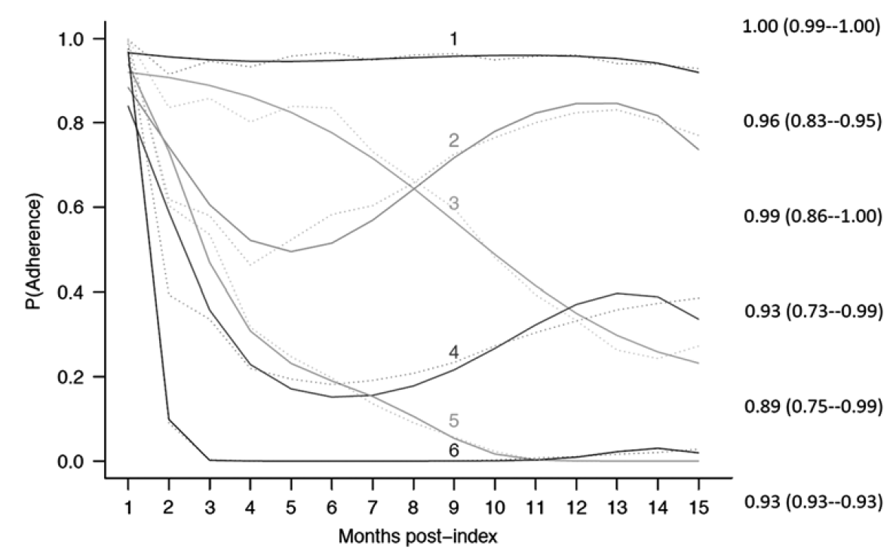
Group-based trajectory modeling
Franklin, J. M., W. H. Shrank, J. Pakes, G. Sanfélix-Gimeno, O. S. Matlin, T. A. Brennan and N. K. Choudhry (2013). Medical care 51(9): 789-796.

Slide 34
Conclusions
Know what you measure
Be transparent
Use reproducible methods
Use person-centered approaches for longitudinal data

Slide 35
Thank you for your attention.

Slide 36

















PD Dr. Isabelle Arnet
Senior Research Scientist
Head Adherence Team
Dr. Markus Lampert
Senior Research Scientist
Head Seamless Care Team
Prof. Dr. Kurt Hersberger
Head of PCRG
Dr. Vera Bernhardt
Senior Teacher and Curriculum Coordinator
Dr. Sandra Unfer Research Scientist
Dr. Fabienne Boeni
Research Scientist
Dr. Markus Messerli Research Scientist
Dr. Samuel Allemann Research Scientist
Esther Spinatsch
Scientific Assistant
Verena Renggli
Scientific Assistant
Fabienne Abt
Administration
PhD Students
Corina Metaxas
Dominik Stämpfli
Lea Brühwiler
Valerie Wentzky
Tamara Imfeld- Isenegger
Helene Studer
Melanie Haag

