Slide 1
Data preparation for computation of adherence from electronic healthcare data
Friday, November 08, 2019

Slide 2
19
Total Responses
Date Created: Wednesday, June 12, 2019
Complete Responses: 14

Slide 3
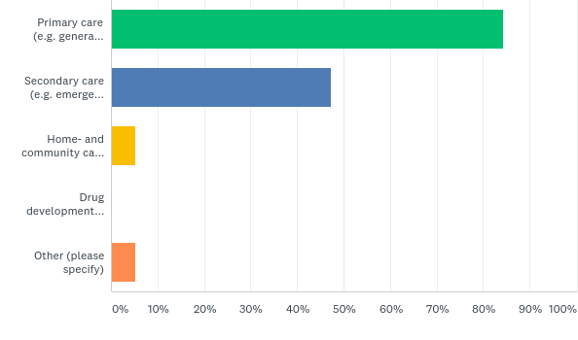
Q1: What setting(s) did your project involve?
Answered: 19 Skipped: 0

Slide 4
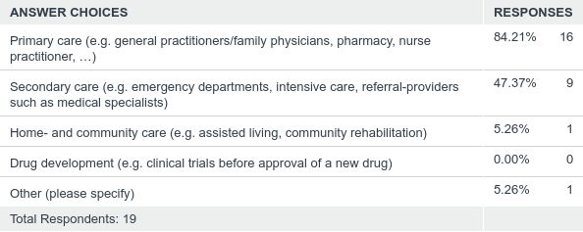
Q1: What setting(s) did your project involve?
Answered: 19 Skipped: 0

Slide 5
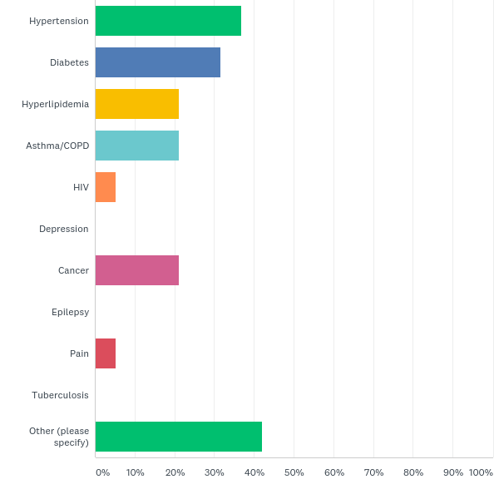
Q2: What treatment area(s) did your project involve?
Answered: 19 Skipped: 0

Slide 6
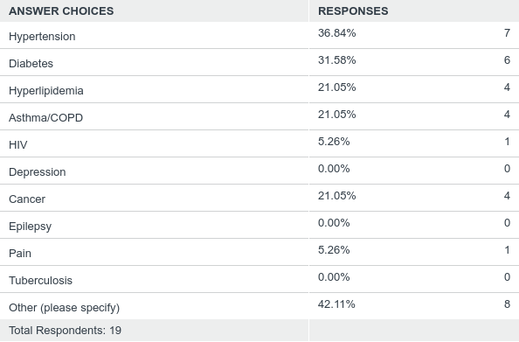
Q2: What treatment area(s) did your project involve?
Answered: 19 Skipped: 0

Slide 7
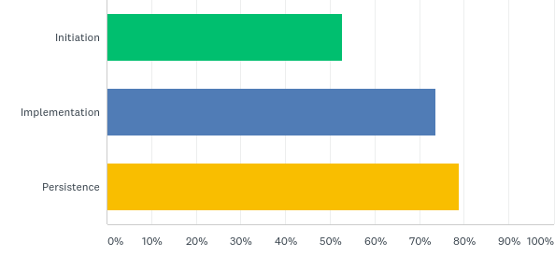
Q3: What adherence phase(s) did you study in your project (according to the ABC-taxonomy)?
Answered: 19 Skipped: 0

Slide 8
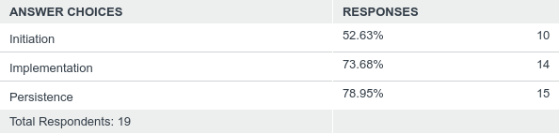
Q3: What adherence phase(s) did you study in your project (according to the ABC-taxonomy)?
Answered: 19 Skipped: 0

Slide 9
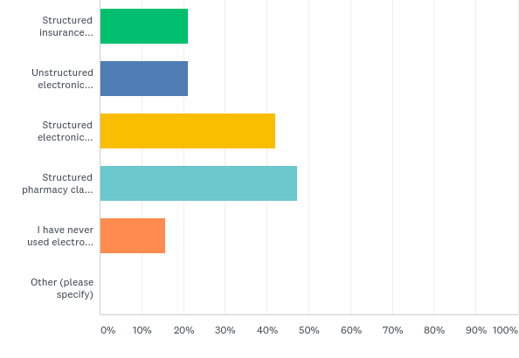
Q4: What electronic healthcare data sources did you use for your project?
Answered: 19 Skipped: 0

Slide 10
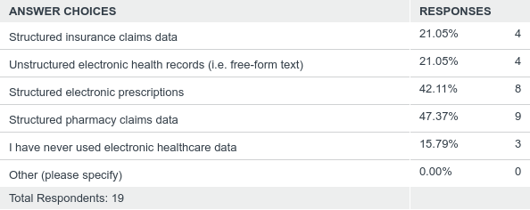
Q4: What electronic healthcare data sources did you use for your project?
Answered: 19 Skipped: 0

Slide 11
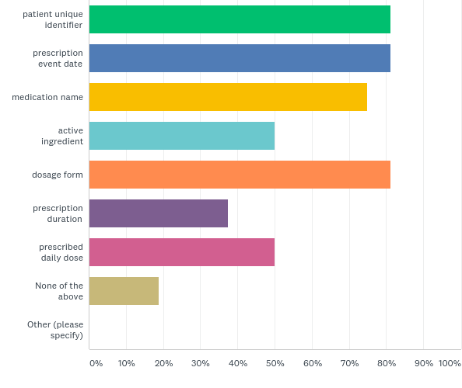
Q5: What information about PRESCRIPTIONS is available from the data sources you have access to?
Answered: 16 Skipped: 3

Slide 12
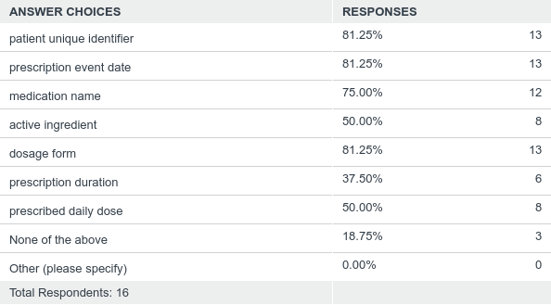
Q5: What information about PRESCRIPTIONS is available from the data sources you have access to?
Answered: 16 Skipped: 3

Slide 13
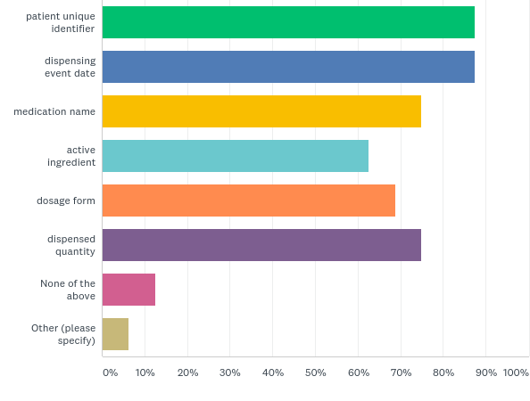
Q6: What information about DISPENSING EVENTS is available from the data sources you have access to?
Answered: 16 Skipped: 3

Slide 14
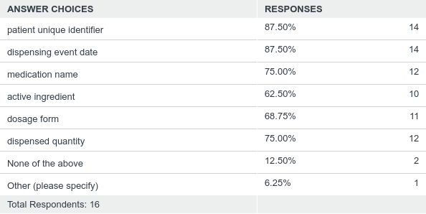
Q6: What information about DISPENSING EVENTS is available from the data sources you have access to?
Answered: 16 Skipped: 3

Slide 15
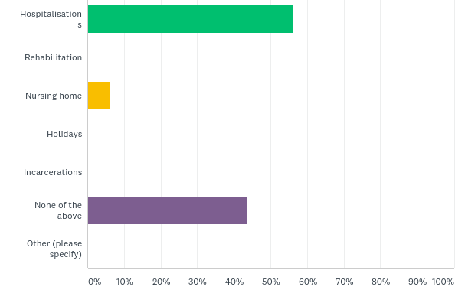
Q7: For what SPECIAL PERIODS do you have start- and end dates available?
Answered: 16 Skipped: 3

Slide 16
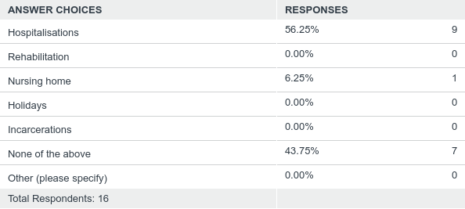
Q7: For what SPECIAL PERIODS do you have start- and end dates available?
Answered: 16 Skipped: 3

Slide 17
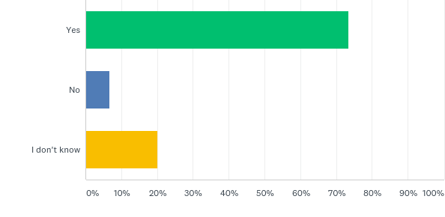
Q8: Do TREATMENT INTERRUPTIONS (periods when prescriptions are interrupted and restarted later) occur in your project?
Answered: 15 Skipped: 4

Slide 18
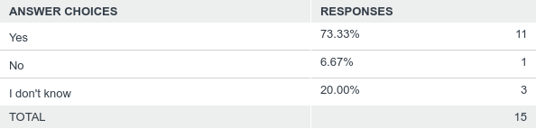
Q8: Do TREATMENT INTERRUPTIONS (periods when prescriptions are interrupted and restarted later) occur in your project?
Answered: 15 Skipped: 4

Slide 19
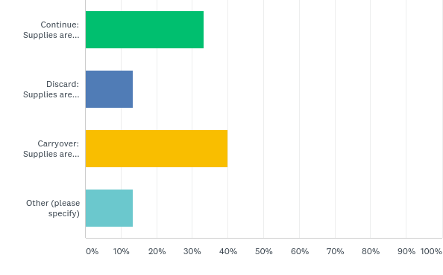
Q9: Which of the following options for handling TREATMENT INTERRUPTIONS would you most likely select?
Answered: 15 Skipped: 4

Slide 20
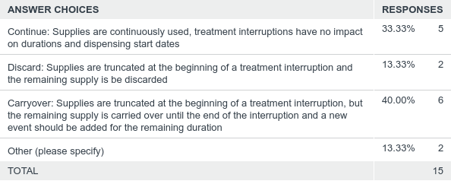
Q9: Which of the following options for handling TREATMENT INTERRUPTIONS would you most likely select?
Answered: 15 Skipped: 4

Slide 21
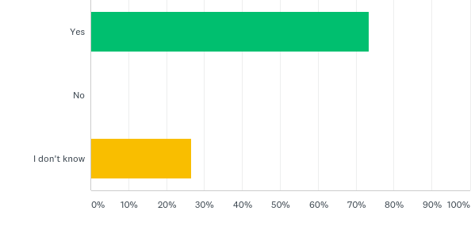
Q10: Do SPECIAL PERIODS (periods where medication use may differ from what is expected based on the available data, e.g. hospitalizations) occur in your project?
Answered: 15 Skipped: 4

Slide 22
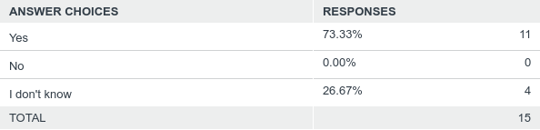
Q10: Do SPECIAL PERIODS (periods where medication use may differ from what is expected based on the available data, e.g. hospitalizations) occur in your project?
Answered: 15 Skipped: 4

Slide 23
Q11: Which of the following options for handling SPECIAL PERIODS would you most likely select for your project?
Answered: 15 Skipped: 4

Slide 24
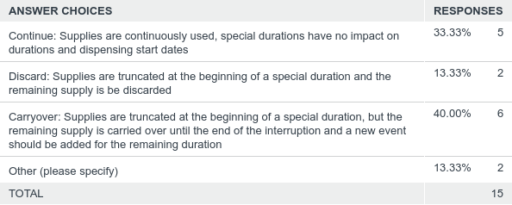
Q11: Which of the following options for handling SPECIAL PERIODS would you most likely select for your project?
Answered: 15 Skipped: 4

Slide 25
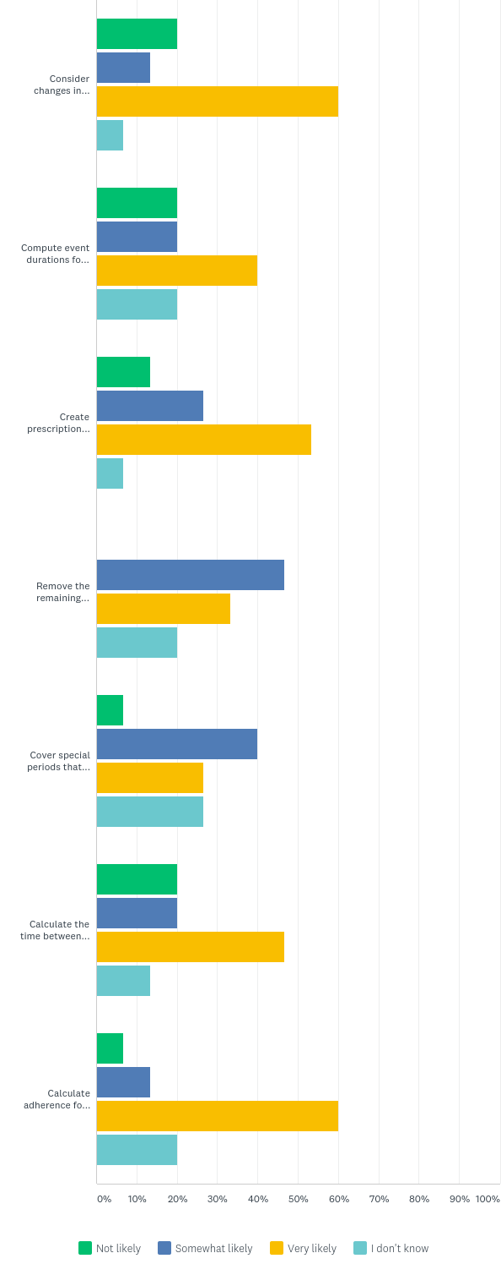
Q12: Would you use the following options to prepare the data for your project? Please rate the likeliness from not likely to very likely:
Answered: 15 Skipped: 4

Slide 26
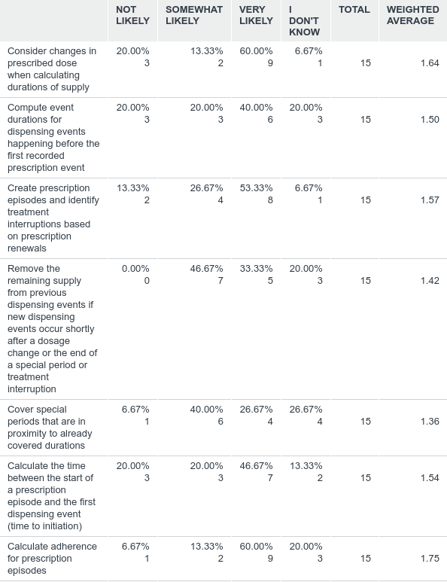
Q12: Would you use the following options to prepare the data for your project? Please rate the likeliness from not likely to very likely:
Answered: 15 Skipped: 4

Slide 27
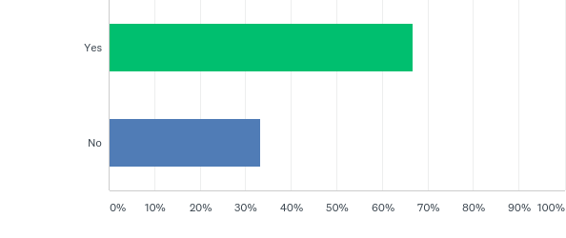
Q14: Did you attend the AdhereR webinar about data preparation on June 13th?
Answered: 15 Skipped: 4

Slide 28
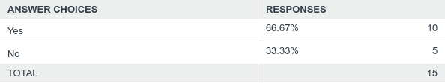
Q14: Did you attend the AdhereR webinar about data preparation on June 13th?
Answered: 15 Skipped: 4

Slide 29
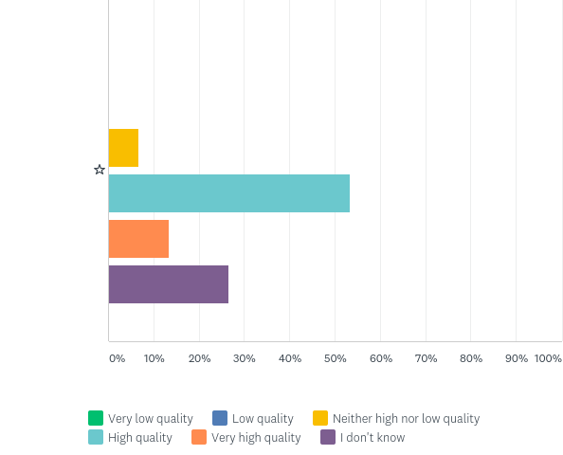
Q15: How would you rate the overall quality of the webinar?
Answered: 15 Skipped: 4

Slide 30
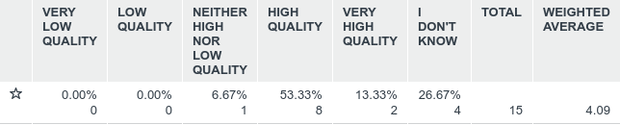
Q15: How would you rate the overall quality of the webinar?
Answered: 15 Skipped: 4

Slide 31
Q17: In what country do you work?
Answered: 14 Skipped: 5

Slide 32
Q17: In what country do you work?
Answered: 14 Skipped: 5

Slide 33
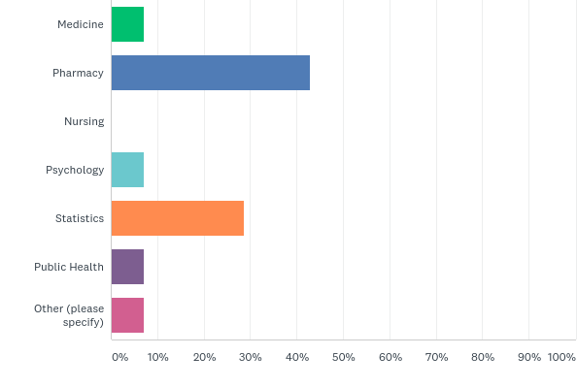
Q18: What is your principal professional background?
Answered: 14 Skipped: 5

Slide 34
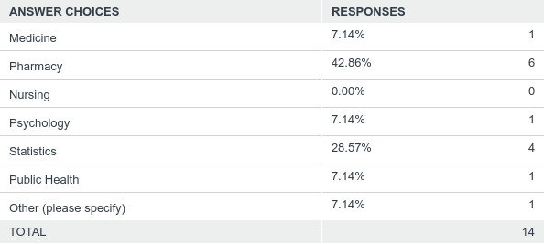
Q18: What is your principal professional background?
Answered: 14 Skipped: 5

Slide 35
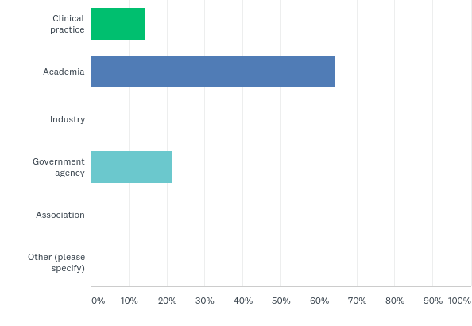
Q19: How would you describe your principal work environment?
Answered: 14 Skipped: 5

Slide 36
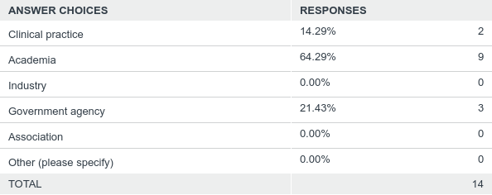
Q19: How would you describe your principal work environment?
Answered: 14 Skipped: 5

Slide 37
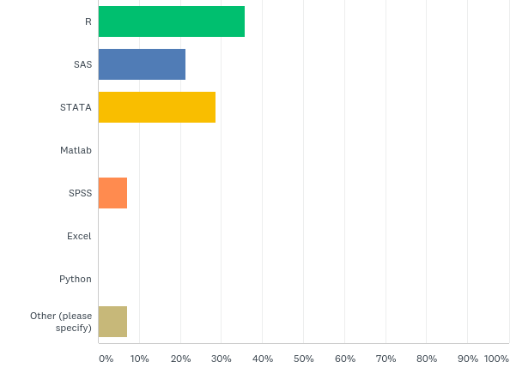
Q20: What software do you mainly use for medication adherence computation?
Answered: 14 Skipped: 5

Slide 38
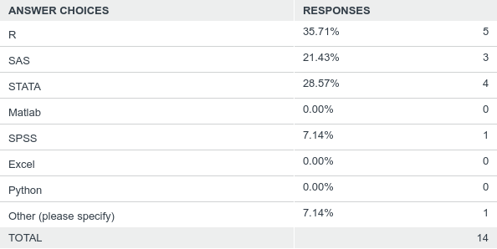
Q20: What software do you mainly use for medication adherence computation?
Answered: 14 Skipped: 5

