Slide 1
Self-report
…
Data analysis workshop, ESPACOMP
20.11.2019
Pr. Marie Schneider, pharmacist, PhD
Chair of medication adherence and interprofessionality,
Institute of Pharmaceutical Sciences of Western Switzerland (ISPSO),
University of Geneva
Notes:
20 minutes

Slide 2
Introduction
Identification of nonadherence is the prerequisite to accurately measuring the impact of nonadherence and in developing interventions and evaluating their effectiveness
If nonadherence is not detected, high risk of patient clinical misclassification (e.g. intensification of treatments, more lab tests)
Misinterpretation of clinical trials outcomes (Type II error)
Self report is the most commonly used clinical and research strategy for assessing patient adherence
However, the reliability and validity of self-reports have been found to be highly variable.
What are the prerequisite for an accurate assessment?
Notes:
Variability accross diseases and treatments

Slide 3
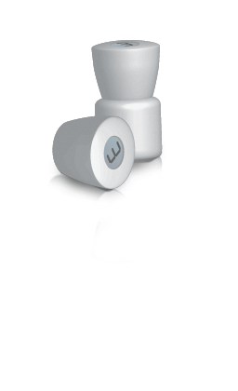


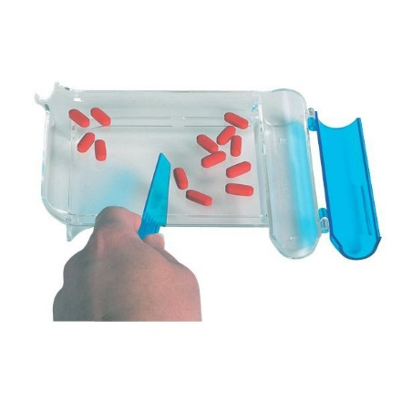



5 top methods to measure medication adherence
Electronic monitor
Medication refill
22%
17%
16%
14%
4%
Nieuwlaat et al. Cochrane Review 2014 DOI: 10.1002/14651858.CD000011.pub4
Notes:
Plus rapide
Introduction: importance de pouvoir mesurer pour intervenir
Total 73%

Slide 4
Definitions
“A self-report study is a type of survey, questionnaire, or poll in which respondents read the question and select a response by themselves without interference. A self-report is any method which involves asking a participant about their feelings, attitudes, beliefs and so on. Examples of self-reports are questionnaires and interviews; self-reports are often used as a way of gaining participants' responses in observational studies and experiments”.
Questionnaires are a type of self-report method which consist of a set of questions usually in a highly structured written form. Questionnaires can contain both open questions and closed questions and participants record their own answers.
Interviews are a type of spoken questionnaire where the interviewer records the responses.
The main strength of self-report methods are that they are allowing participants to describe their own experiences rather than inferring this from observing participants.

Slide 5
Self-report in clinical care vs. research
CLINICAL CARE
Interviews
Appropriateness in clinical interaction
CLINICAL RESEARCH
Questionnaires
?

Slide 6

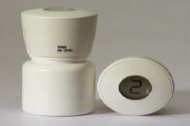
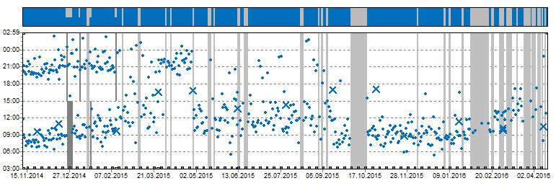
Interprofessonal Medication adherence program IMAP (Switzerland)
Support and reinforce medication adherence and patient’s autonomy
Motivational interviewing patient- pharmacist
Medication Event Monitoring System (MEMS®)
Medication adherence
report
Lelubre M., Schneider M. et al. BioMed Research International 2015, Article ID 103546. DOI.org/10.1155/2015/103546
Schneider, Herzig, Hugentobler, Bugnon, RMS 2013;9:1032-6
Notes:
Experience in Lausanne-Geneva Switzerland:
Objective and dynamic measure of daily medication intake
Data visualisation & feedback to the patient
Secured electronic adherence record
Patient-centered, face-to-face, short but repeated, Long-term follow-up
Self-report of factors affecting medication adherence using motivational interviewing skills whenever necessary
Continuity of care and interprofessionality

Slide 7
PRO’s
Easy to implement
Fast
Accessible
Inexpensive
Flexible
High specificity for nonadherence
Could be validated in different languages/cultures
→ The most commonly used assessment instrument
Notes:
Flexible strategy that can be matched to the characteristics of the regimen being evaluated

Slide 8
CON’s: participants may not respond truthfully - disclosure
Validity → overestimation of adherence
Social desiderability bias
Please HCP
Recall bias
Health literacy
Respondents may be too embarrassed to reveal nonadherence details”
→ sensitive issue
« [The healthcare provider] should keep aware of the fact that patients often lie when they state that they have taken certain medicines » Hippocrates
Notes:
Littérature is congruent that self-report overestimates medication adherence in comparison to pill count, refill data and electronic monitoring.
Understand the questions
Gender and education can affect the way patients report their adherence independently of their actual adherence (Rand 1995)
Reliability (how consistent the measure is under repeated similar conditions)
Validity (Validity refers to whether a study measures or examines what it claims to measure or examine)

Slide 9

Nurses and physicians estimated 464 episodes in 82 HIV patients
Overestimation of medication adherence
Inadequate detection of poor adherence
May miss important opportunities to intervene to improve adherence
Notes:
Nurses and residents

Slide 10
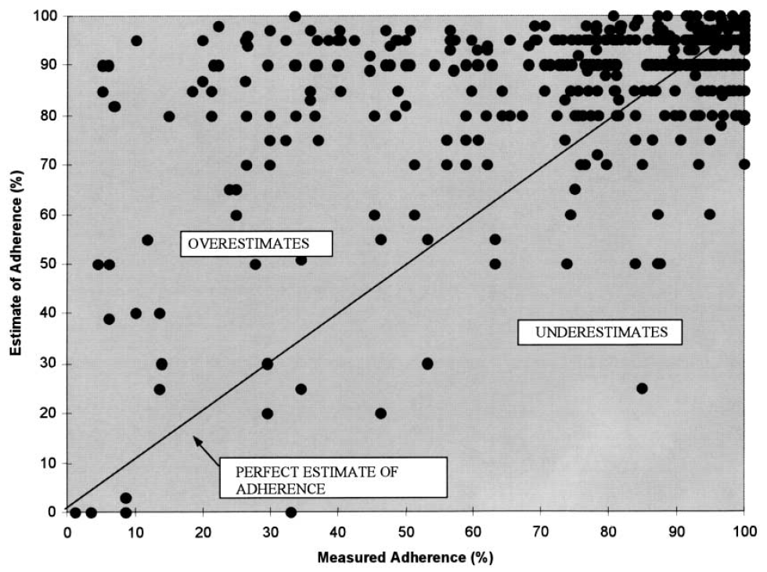

Slide 11
Important features
How to create an appropriate environment?
How to formulate questions?
Which content of questions?
Which period of recall?
When to ask the questions? How often to repeat them?
Who asks the questions?

Slide 12
Environment: TRUST
Non judgmental
Human relationship & caring
HCP sensitivity and skills in eliciting adherence issues
Welcome words, body language
Explanation of today’s agenda, incl. drug self-mangement

Slide 13
How to formulate the questions?
Introduction to the questions on medication adherence:
I am interested in knowing your own way of managing your medications. I gave you medical directions on the use of the medication but transferring this medication into your daily life is another personal step, that needs time to master. Adjustements are sometimes needed. We need to work together on those.
Social norm: patients usually tell me …
Open-ended questions
Avoid questions that are perceived as confrontational by patients
Avoid closed & oriented questions:
« You did not stop taking your medication, did you? »
Notes:
Not proper directions

Slide 14

Content of questions
Estimation of adherence
How would you describe your drug management?
- On a regular/irregular day
- Week days/weekends/vacation
- Morning/evening
Identification of influencing factors (barriers and facilitators)
What helps you to take your medication?
What are the challenges that you have been facing?
Particular attention in each change in patient’s routine
Based on theoretical models
Beliefs & attitudes
Concerns & Expectations
Perspectives
Stepwise identification of solutions
Patient activation
Pre-requisite:
It is IMPORTANT for the patient
The patient is CONFIDENT that he can make the change (self-confidence)
It is the RIGHT MOMENT for the patient to do it (priority)
Notes:
If it is the right timing for the patient: it really matters.
Patient’s routine: private life, professional life, health issues

Slide 15
Content of questions
Estimation of adherence
How would you describe your drug management?
- On a regular/irregular day
- Week days/weekends/vacation
- Morning/evening
Identification of influencing factors
(barriers and facilitators)
What helps you to take your medication?
What are the challenges that you have been facing?
Particular attention in each change in patient’s routine
Based on theoretical models
Beliefs & attitudes
Concerns & Expectations
Perspectives
Other methods may be more accurate: e.g.
Prescription refill
Electronic monitoring
Blood test
Possible by self-report only!!!
Notes:
If it is the right timing for the patient: it really matters.
Patient’s routine: private life, professional life, health issues

Slide 16
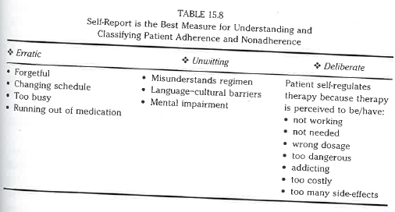

Slide 17
Self-regulation perspectives
Patient = active problem solver
Experiences (symptoms)
Cognitive & emotional interpretation
Taking meds or not
‘common sense’
Information (health care & other)
Leventhal H. Cognitive Therapy and Research 1992; 16:143-163.
Notes:
‘Bon sens’
Explain illness-related behavior, including adherence within the context of chronic illness.
Adherence is one of the procedures that the patient can adopt to cope with their illness
The patient is an active problem solver whose behavior (taking or not taking meds) represents a ‘common sense’ response to their cognitive and emotional interpretation of experiences (symptoms) or received information (from health care and others).
This theory is the main theory in this domain. Developed to conceptualise the adherence process in a way that re-focuses on the patient.
Cognitive and emotional interpretation of health threats. Combine new information with past experiences. These representations guide their strategies for coping with health treats and influence outcomes. The process of chosing coping strategies is assumed to by dynamic and informed by an individual’s personality, social, cultural and religious context. In addition, a complex interplay exists between environmental perceptions, symptoms and beliefs about disease causation.
The self-regulation offers little guidance related to the design of interventions.

Slide 18
Model of reported adherence
Illness consequences
Treatment necessity
Reported adherence
Illness timeline
Treatment concerns
Horn R. Psychology and Health 2002; 17: 17-32.
Notes:
To inhaled preventer medication (asthma)
Timeline: personal ideas about the likely duration of asthma.

Slide 19
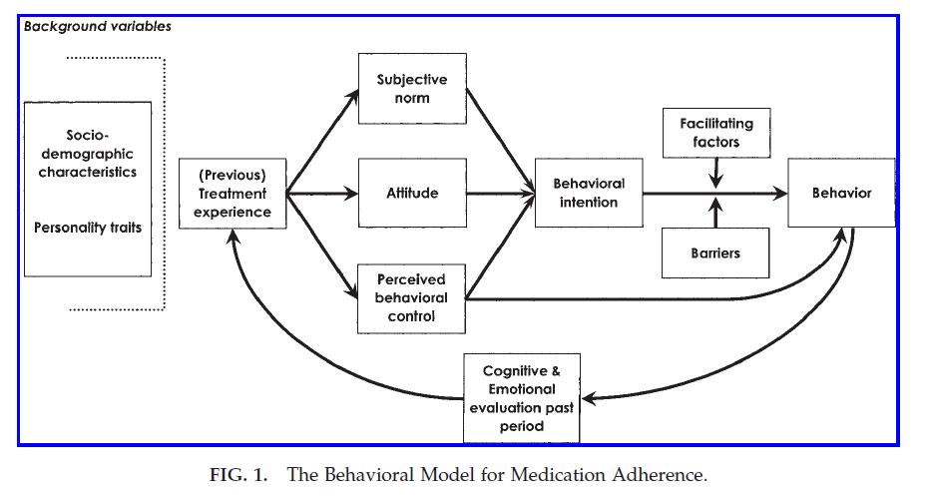
Behavioral model for medication adherence
De Bruin et al. AIDS Pat Care & STDs 2005
Notes:
Attitude: état d’esprit, disposition. Attitude toward a behavior is the degree to which performance of the behavior is positively or negatively valued. Although a person may hold many behavioral beliefs with respect to any behavior, only a relatively small number are readily accessible at a given moment. It is assumed that these accessible beliefs -- in combination with the subjective values of the expected outcomes -- determine the prevailing attitude toward the behavior. Specifically, the evaluation of each outcome contributes to the attitude in direct proportion to the person's subjective probability that the behavior produces the outcome in question (see attitude toward the behavior).
Subjective norm is the perceived social pressure to engage or not to engage in a behavior. It is linked to ‘Normative beliefs’, which refer to the perceived behavioral expectations of such important referent individuals or groups as the person's spouse, family, friends, and -- depending on the population and behavior studied - - teacher, doctor, supervisor, and coworkers. It is assumed that these normative beliefs -- in combination with the person's motivation to comply with the different referents -- determine the prevailing subjective norm. Specifically, the motivation to comply with each referent contributes to the subjective norm in direct proportion to the person's subjective probability that the referent thinks the person should perform the behavior in question (see subjective norm).
Perceived behavioral control refers to people's perceptions of their ability to perform a given behavior. Drawing an analogy to the expectancy- value model of attitude (see attitude toward the behavior), it is assumed that perceived behavioral control is determined by the total set of accessible control beliefs, i.e., beliefs about the presence of factors that may facilitate or impede performance of the behavior.
http://people.umass.edu/aizen/bb.html (consulté le 4.2.15)

Slide 20
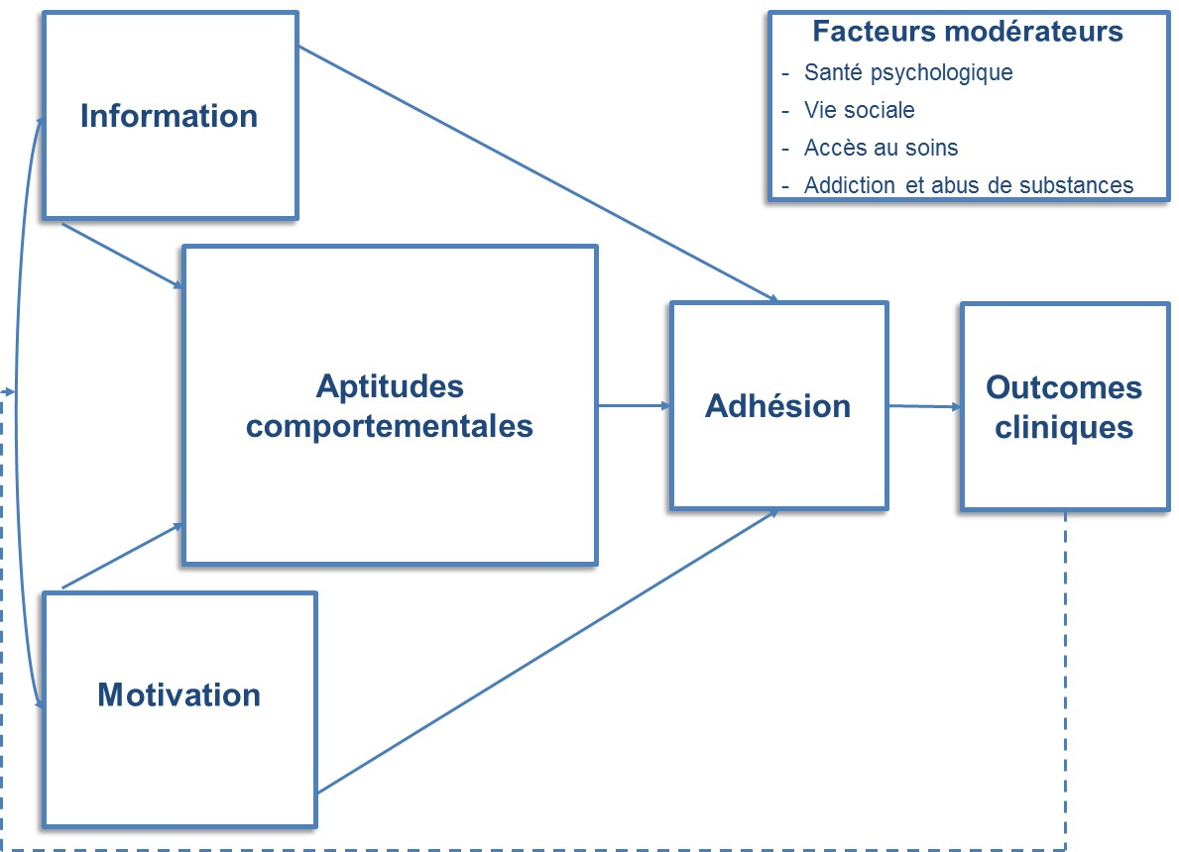
Theoretical model of the IMAP program IMB
Moderators
Psychology health;
Living situation;
Access to care;
Addiction
Information
Motivation
Behaviour
Behavioural & management skills
Adherence
Outcomes
Fisher et al. Health Psychology 2006; 25,4, 462–473
Notes:
Patient motivation and preferences

Slide 21
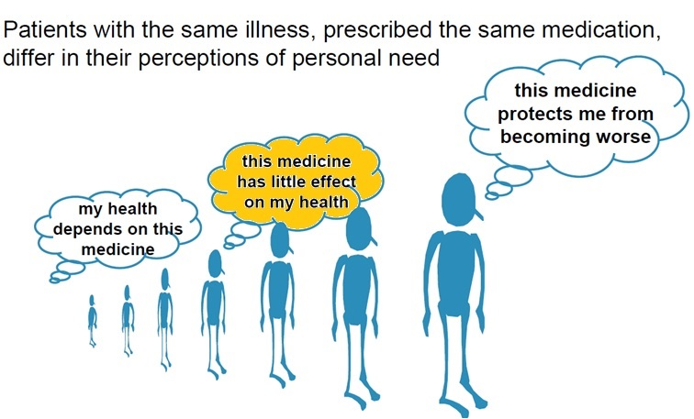

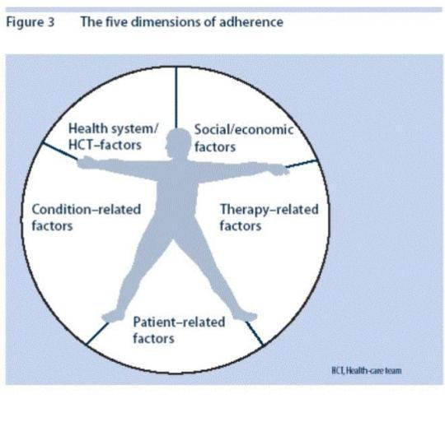
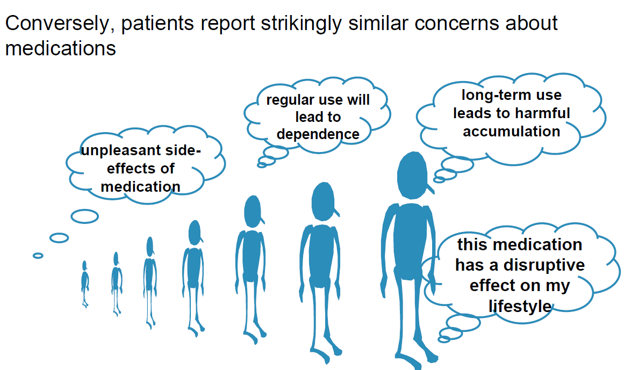
Barriers are multiple → need for a sensitive self-report measurement
Personal: physical, psychological, cognitive & mental helath
Financial
Social
Cultural
Substance abuse
Intentional vs unintentional
Gadkari & McHorney BMC Health Serv Res. 2012;12:98; Wroe A. Journal of Behavioral Medicine; 2002, 25 (4):355-372
Notes:
Important to capture this diversity
Other priorities (e.g. stop smoking)

Slide 22
Table 15.6 p.268

Slide 23
Table 15.8 p.271
Notes:
Unwitting = unawerness of inappropriate medication use

Slide 24
Period of recall
3 last days
7 last days
4 last weeks
Since the last visit
(Recall bias)
Notes:
Most proximal pattern of use
Memory impairment due to age, illness, stress, concomitant medications

Slide 25
When to ask the questions? How often to repeat them?
Chose the right moment: Be predictable
Adjust the questions to medication adherence phase:
initiation – implementation - persistence
Repeat the questions at each visit even before suboptimal implementation happens
(sensitivity to change)

Slide 26
Who asks the questions?
The physician
The nurse
The pharmacist
Face-to-face
Computer, tablet
Secure webportal
Application on personal Smartphone
(social desiderability)

Slide 27
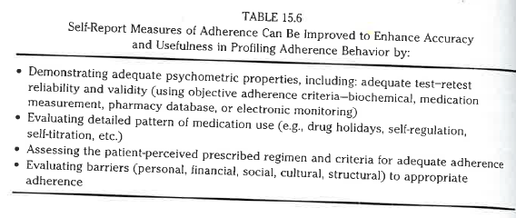
Summary

Slide 28


Challenges
Polypharmacy
« Which medication(s) would you say is/are the most important one(s) according to you? »
Danger of classifying patient as adherent based on personal/social characteristics
Back bone

Slide 29
Take-home messages
Selecting the right self-report instrument according to the dimensions to measure
Self-report is the best suited method to evaluate the richness of factors affecting medication adherence
→ Allows to avoid classifying patients as adherent based on personal/social characteristics
Self-report is less suited for a precise evaluation of the level of medication adherence although it is sometimes the only source of data
→ e.g. repeated, cross-sectional measures in large, prospective cohort studies (Glass, Sterne, Schneider, De Geest et al. AIDS 2015 ; 29:2195–2200)
More attention should be paid on the requirements for ensuring quality of self-reported data, incl. validation of psychometric characteristics.
→ HCP training in communication skills & assessment techniques
Notes:
Gender and education can affect the way patients report their adherence but not their actual adherence (Rand 1995)

Slide 30

References
Garfield et al. BMC Med Res Methodol 2011
Kronish et al. Transl Behav Med 2019
Lam et al. Biomed Res Int 2015
Nguyen et al. Br J Clin Pharmacol 2014
Ose et al. Patient Prefer Adherence 2012
Sawatzky et al. Journal of Clinical Epidemiology 2017
Steiner. Med Care 2012
Stirratt et al. Transl Behav Med 2016
Stirratt et al. J Gen Intern Med 2018
Tourangeau et al. Public Opinion Quarterly 1996
Voils et al. J Clin Epidemiol 2011

Slide 31
Slides not presented

Slide 32
Type of questions
Queries about pattern of use if erratic nonadherence

Slide 33
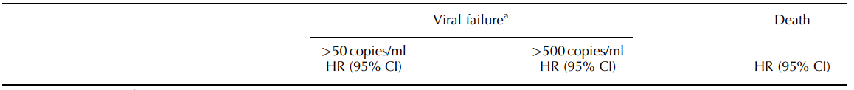
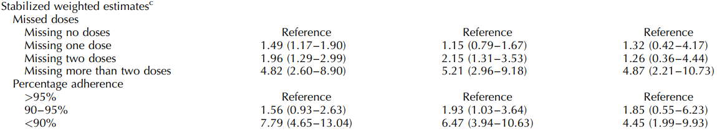
Medication adherence and mortality in HIV
(in past 4 weeks)
Glass, Sterne, Schneider, De Geest et al. AIDS 2015 ; 29:2195–2200
Kamal, Cavassini, Schneider et al. HIV Medicine 2017 DOI: 10.1111/hiv.12542
Notes:
Patients indétectables: qu’est-ce?
Le patient HIV est devenu polymorbide
Patients estiment que leur trithérapie en plus nécessaire que leurs cotraitements.

Slide 34
