Slide 1

Preparing data for adherence calculations with .
Samuel Allemann, Alexandra Dima & Dan Dediu
HESPER – Health Services and Performance Research Lab, UCBL Lyon
Laboratoire Dynamique Du Langage (DDL), Université Lumière Lyon 2
Notes:
Summarise in between: where we are
Less is more

Slide 2
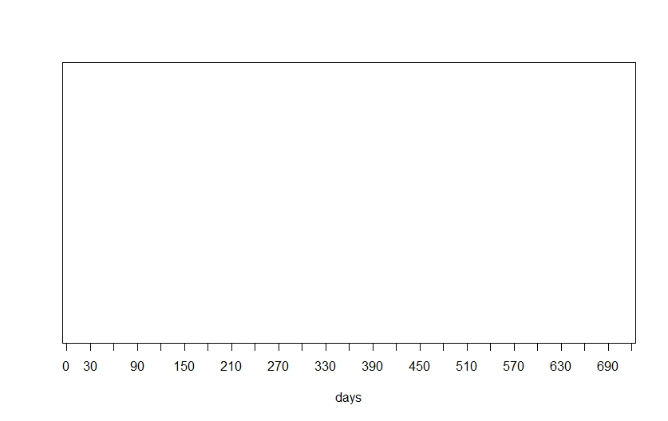
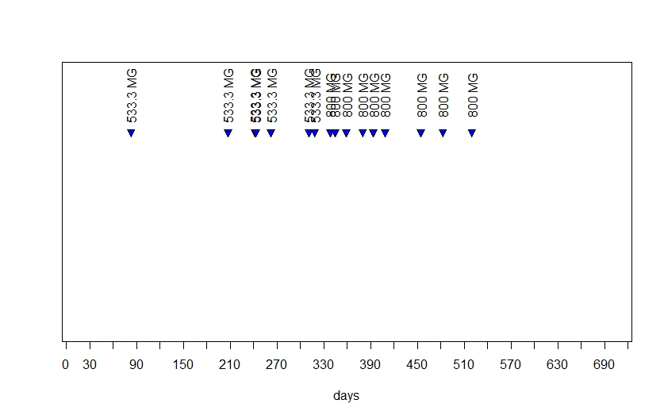
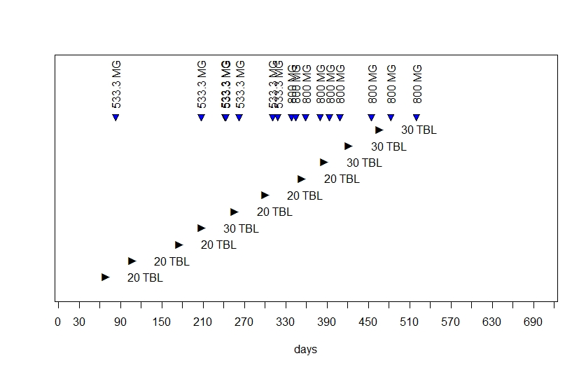
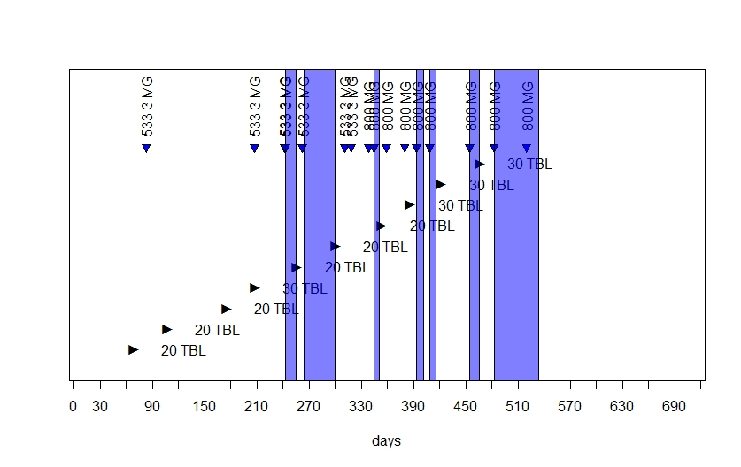
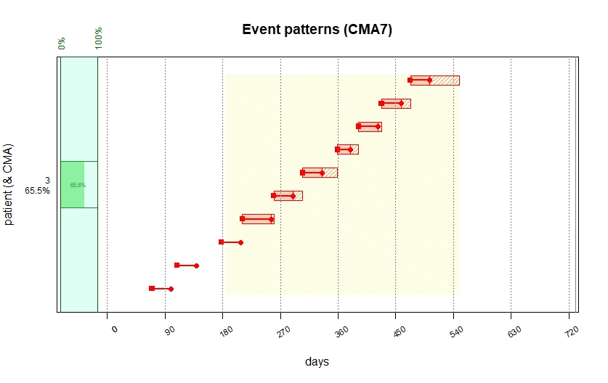
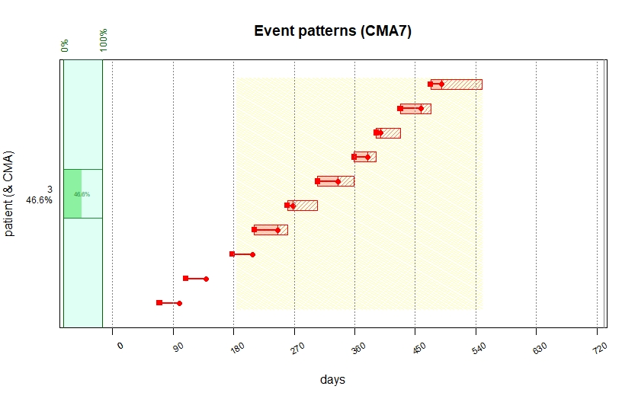
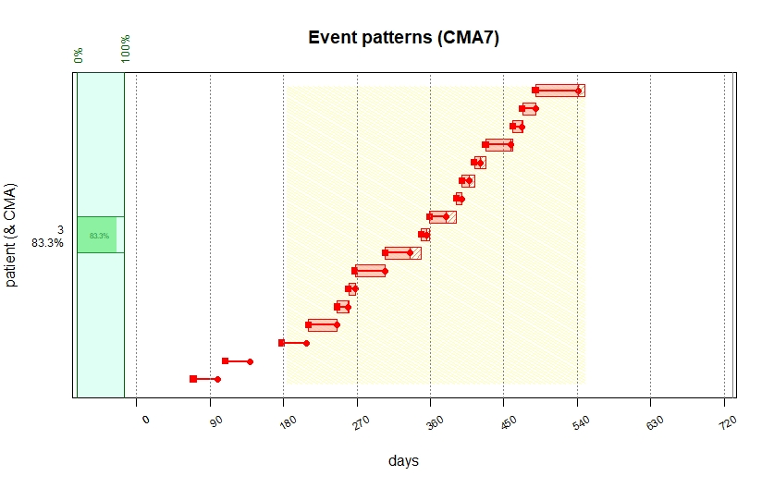
Why data preparation?
Notes:
information about the medication prescribed and dispensed to a patient in a given time period may be found in different data sources
increasingly accessible for linking and thus for a more precise description of adherence patterns.

Slide 3
Overview
compute event durations/prescription episodes
adjust event durations
compute adherence metrics
Notes:
What we will see

Slide 4
Compute Event Durations
Notes:
PDD vs DDD vs RDD
Start of treatment: up-titration
Seasonality:
Asthma controller and reliever medication (Van Dole KB, Swern AS, Newcomb K, Nelsen L. Seasonal patterns in health care use and pharmaceutical claims for asthma prescriptions for preschool- and school-aged children. Ann Allergy Asthma Immunol. 2009 Mar;102(3):198–204.)
Seasonal Allergies
Seasonal affecive disorders
ADHD (Shyu Y-C, Lee S-Y, Yuan S-S, Yang C-J, Yang K-C, Lee T-L, et al. Seasonal Patterns of Medications for Treating Attention-Deficit/Hyperactivity Disorder: Comparison of Methylphenidate and Atomoxetine. Clin Ther. 2016 Mar;38(3):595–602.)

Slide 5
DISPENSING EVENTS
EVENT DURATIONS
CMA
ID
Event date
Duration
Medication class
Daily dose
Quantity
Start date
Episode start
Episode end
Simple CMA
CMA per episode
CMA sliding window
ID
Event date
Medication class
Quantity
TREATMENT EPISODES
PRESCRIBING EVENTS
(INTERACTIVE) PLOTTING
ID
Event date
Medication class
Daily Dose
(Duration)
(Visit)
PRESCRIPTION EPISODES
TIME TO INITIATION
SPECIAL PERIODS
Notes:
Separate datasets for dispensing and dispensing data to create event durations with additional information

Slide 6
compute_event_durations
compute_event_durations(disp.data = durcomp.dispensing,
presc.data = durcomp.prescribing,
special.periods.data = NULL,
ID.colname = "ID",
medication.class.colnames = c("ATC.CODE","UNIT","FORM"),
disp.date.colname = "DATE.DISP",
total.dose.colname = "TOTAL.DOSE",
presc.date.colname = "DATE.PRESC",
presc.daily.dose.colname = "DAILY.DOSE",
presc.duration.colname = "PRESC.DURATION",
visit.colname = "VISIT",
split.on.dosage.change = TRUE,
force.init.presc = TRUE,
force.presc.renew = FALSE,
trt.interruption = “continue",
special.periods.method = “continue",
date.format = "%Y-%m-%d",
suppress.warnings = FALSE,
return.data.table = TRUE,
progress.bar = FALSE)
datasets
labels
settings

Slide 7
Adjust event durations
Notes:
Dong Y-H, Choudhry NK, Krumme A, Lee MP, Wu L-C, Lai M-S, et al. Impact of hospitalization on medication adherence estimation in claims data. Journal of Clinical Pharmacy and Therapeutics. 2017;42(3):318–28.
Ihle P, Krueger K, Schubert I, Griese‐Mammen N, Parrau N, Laufs U, et al. Comparison of Different Strategies to Measure Medication Adherence via Claims Data in Patients With Chronic Heart Failure. Clinical Pharmacology & Therapeutics [Internet]. 2019 Jan 8 [cited 2019 Apr 1];0(0). Available from: https://ascpt.onlinelibrary.wiley.com/doi/abs/10.1002/cpt.1378

Slide 8
DISPENSING EVENTS
EVENT DURATIONS
CMA
ID
Event date
Duration
Medication class
Daily dose
Quantity
Start date
Episode start
Episode end
Simple CMA
CMA per episode
CMA sliding window
PRESCRIBING EVENTS
SPECIAL PERIODS
TREATMENT EPISODES
ID
Start date
End date
(Type)
(Method)
(Medication)
(INTERACTIVE) PLOTTING
PRESCRIPTION EPISODES
TIME TO INITIATION

Slide 9
Special periods / Treatment interruptions
Continue
Discard
Carryover

Slide 10
Compute adherence metrics

Slide 11
DISPENSING EVENTS
EVENT DURATIONS
CMA
ID
Event date
Duration
Medication class
Daily dose
Quantity
Start date
Episode start
Episode end
Simple CMA
CMA per episode
CMA sliding window
PRESCRIBING EVENTS
SPECIAL PERIODS
TREATMENT EPISODES
ID
Start date
End date
(Type)
(Method)
(Medication)
(INTERACTIVE) PLOTTING
PRESCRIPTION EPISODES
TIME TO INITIATION

Slide 12
Summary
Correct data preparation is crucial for meaningful adherence estimation
Data from different sources can be used to compute and adjust event durations
Options in AdhereR allow for transparent and reproducible workflow

Slide 13

Thank you!
www.adherer.eu
Notes:
Thank you ESPACOMP, PCNE, EuroDURG, ESCP

