Slide 1


Disclamer
DevOps Course

Slide 2
Who we are?
Devops.Course

Slide 3


Slide 4

Namecheap
Domain name registration
WHOIS guard
Hosting (Dedicated, VPS, Shared)
Private Email service
WordPress managed hosting
VPN
Reseller services

Slide 5

Our contribution in DevOps community
The course is

Slide 6

DevOps Culture Propaganda
The course is

Slide 7

DevOps Culture

Slide 8
The main idea:
DevOps is not a role!
This is philosophy!

Slide 9
Testing

Slide 10
Continuous Integration/Continuous Delivery

Slide 11
Deployment

Slide 12
Monitoring

Slide 13
Communication

Slide 14
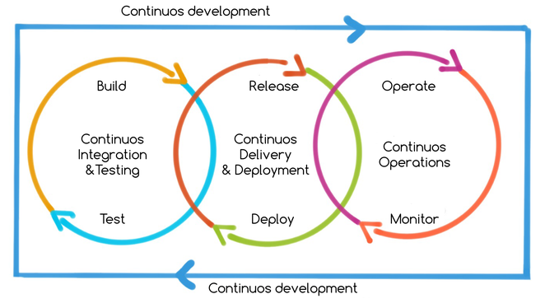

Slide 15
Hiring to company
The course is not

Slide 16
Learning Programming
The course is not

Slide 17
Learning System Administration
The course is not

Slide 18
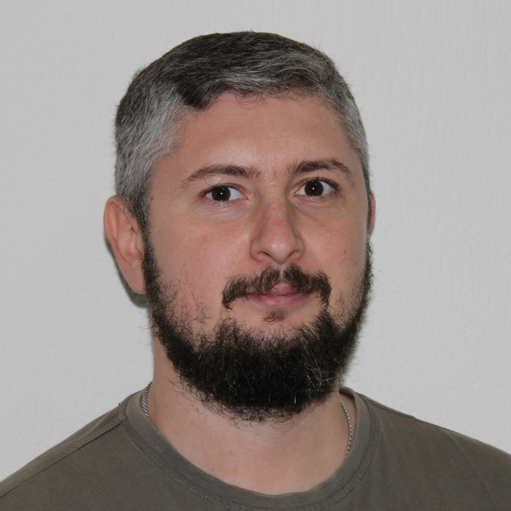
Nick Lototskiy
DevOps Evangelist at Namecheap
More than 5 years of work as trainer
More than 18+ years in IT
About Trainer:

Slide 19
Hiring to company
Course

Slide 20

Questions ?

Slide 21
Let’s start!!!!

