Slide 1
Artificial Neural Networks and Deep Learning - (AI253IA)
Facial Recognition in Airport Management Systems
Presented By:
Keerti Patil | 1RV22AI022
Ashwin Ajoy Dharmavaram | 1RV22AI011
Faculty Mentors
Dr. Somesh Nandi
Dr. S Anupama Kumar

Slide 2
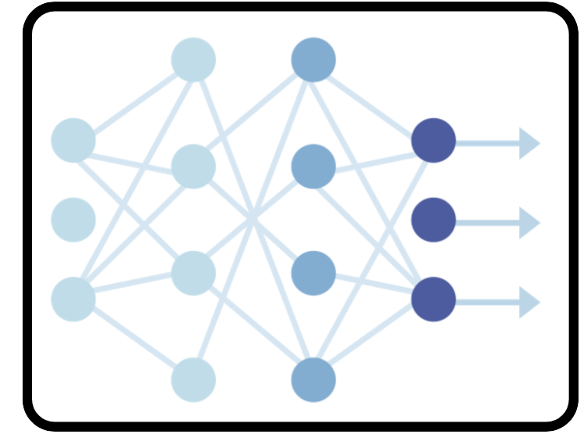
Agenda
Introduction
Literature Survey
Requirement Analysis
System Architecture
Methodology
Module Specifications

Slide 3
Introduction
Current airport systems face inefficiencies, delays, and poor coordination, causing confusion and disrupting passenger schedules.
The proposed Face Recognition in Airport Management Systems focuses on the security and surveillance at the airports.
Existing modular systems with features like self-service check-ins and baggage tracking are underutilized due to ineffective implementation and management.

Slide 4
Literature Survey
No. | Author and Title | Details of Publication | Summary of the Paper
1 | D. Han, Y. Li, and J. Denzler, “KAN See Your Face.” | https://arxiv.org/abs/2411.18165, 2024 | Attempts to generate facial images given the embeddings. The constant improvements to both generative AI, and computer hacking techniques is seen and that we must improve data security on our system.
2 | W. Yu and W. Wei, “Local and Global Feature Attention Fusion Network for Face Recognition.” | https://arxiv.org/abs/2411.16169, 2024 | Aims to improve low resolution image face recognition. The authors created a Local and Global Feature Attention Fusion network that performs facial recognition by adaptively allocating attention between local and global information complementarity. Common issues such as poor lighting, facial occlusion, etc, are addressed.

Slide 5
Literature Survey
No. | Author and Title | Details of Publication | Summary of the Paper
3 | H. O. Shahreza and S. Marcel, “HyperFace: Generating Synthetic Face Recognition Datasets by Exploring Face Embedding Hyper4sphere.” | https://arxiv.org/abs/2411.08470, 2024 | Explores the problem of synthetic dataset generation by converting the problem to an optimization problem solved through gradient descent. Proposes a new model called “HyperFace”.
4 | C. A. Antipona, R. R. Magsino, R. M. Dioses, and K. E. Mata, “An Enhancement of Haar Cascade Algorithm Applied to Face Recognition for Gate Pass Security.” | https://arxiv.org/abs/2411.03831, 2024 | Used the Haar_Cascade Algorithm’s 128 dimension vector that it uses for facial encoding. Instead of converting it to grayscale, it uses a subprocess that converts the grayscale image to RGB. Greatly improved the accuracy to 98.39% (20% increase) along with 63.59% precision and 98.3% recall.

Slide 6
Literature Survey
No. | Author and Title | Details of Publication | Summary of the Paper
5 | T. Chettaoui, N. Damer, and F. Boutros, “FRoundation: Are Foundation Models Ready for Face Recognition?.” | https://arxiv.org/abs/2410.23831, 2024 | Analyses impact of Foundation models, models that are trained on highly diverse, and large scale datasets. Foundation Models are highly versatile and broadly applicable to different tasks. Results found are comparable to the models that are created from scratch using small datasets.
6 | M. Alansari, O. A. Hay, S. Javed, A. Shoufan, Y. Zweiri, and N. Werghi, “GhostFaceNets: Lightweight Face Recognition Model From Cheap Operations,” | IEEE Access, vol. 11, no. , pp. 35429–35446, 2023 | Ghost modules use a series of inexpensive linear transformations to extract additional feature maps from a set of intrinsic features Allows for a more comprehensive representation of the underlying information.

Slide 7
Literature Survey
No. | Author and Title | Details of Publication | Summary of the Paper
7 | S. Gao, R. Wu, X. Wang, J. Liu, Q. Li, and X. Tang, “EFR4CSTP: Encryption for face recognition based on the chaos and semi 4 tensor product theory,” | Information Sciences, vol. 621, pp. 766–781, 2023 | This proposes a system for encryption of facial images.
8 | G. Jeevan, G. C. Zacharias, M. S. Nair, and J. Rajan, “An empirical study of the impact of masks on face recognition,” | Pattern Recognition, vol. 122, p. 108308, 2022 | Analysis on literature on facial recognition on people wearing masks in light of the COVID-19 pandemic. Considers the models that their cited papers have used for solving the problem and optimizes their parameters.

Slide 8
Literature Survey
No. | Author and Title | Details of Publication | Summary of the Paper
9 | H. Qiu, D. Gong, Z. Li, W. Liu, and D. Tao, “End2End Occluded Face Recognition by Masking Corrupted Features,” | IEEE Transactions on Pattern Analysis and Machine Intelligence, vol. 44, no. 10, pp. 6939–6952, 2022 | States that most facial recognition models only work with clean data, while real world is always occluded, which is a main cause of low validation accuracy. To solve this, intentional masking of areas of images to train the model to predict the occluded parts was done. This helped in better generalization.
10 | D. Semedo, D. Carmo, R. Padnevych, and J. Magalhaes, “Contact-free Airport Borders with Biometrics-on-the-Move” | 2021 IEEE International Workshop on Biometrics and Forensics (IWBF), 2021, pp. 1–2 | Focuses on contactless passengers’ boarding without physical barriers ensuring hygiene during COVID 19 pandemic. The security at the airport was ensured based on contactless scans, fraud detection using the technology.

Slide 9
Literature Survey
No. | Author and Title | Details of Publication | Summary of the Paper
11 | Y. Li, K. Guo, Y. Lu, and L. Liu, “Cropping and attention based approach for masked face recognition,” | Applied Intelligence, vol. 51, no. 5, pp. 3012–3025, 2021 | A cropping based approach is used while combining it with a Convolutional Block Attention Module. The optimal cropping is explored for each case, while the CBAM module is adopted to focus on the regions around the eyes.
12 | Q. Meng, S. Zhao, Z. Huang, and F. Zhou, “MagFace: A Universal Representation for Face Recognition and Quality Assessment” | Proceedings of the IEEE/CVF Conference on Computer Vision and Pattern Recognition (CVPR), Jun. 2021, pp. 14225–14234. | Proposes MagFace, a category of losses that learn a universal feature embedding whose magnitude can measure the quality of the given face. Under the new loss, it can be proven that the magnitude of the feature embedding monotonically increases if the subject is more likely to be recognized.

Slide 10
Literature Survey
No. | Author and Title | Details of Publication | Summary of the Paper
13 | E. M. Onyema, P. K. Shukla, S. Dalal, M. N. Mathur, M. Zakariah, and B. Tiwari, “Enhancement of Patient Facial Recognition through Deep Learning Algorithm: ConvNet,” | Journal of Healthcare Engineering, vol. 2021, no. 1, p. 5196000, 2021 | Demonstrates use of neural networks for patient facial expression recognition. Reaches an accuracy of 70%, which is close to the state of the art with a lesser number of layers.
14 | S. Li, J. Xu, X. Xu, P. Shen, S. Li, and B. Hooi, “Spherical Confidence Learning for Face Recognition” | Proceedings of the IEEE/CVF Conference on Computer Vision and Pattern Recognition (CVPR), Jun. 2021, pp. 15629–15637 | Emerging research has found that spherical spaces better match the underlying geometry of facial images. States that due to their dependence on deterministic embeddings, noisy images are mapped into poorly learned regions of space which leads to inaccuracies.

Slide 11
Literature Survey
No. | Author and Title | Details of Publication | Summary of the Paper
15 | S. Bouyakoub, A. Belkhir, F. M. Bouyakoub, and W. Guebli, “Smart airport: an IoT-based Airport Management System,” | Proceedings of the International Conference on Future Networks and Distributed Systems, in ICFNDS '17. Cambridge, United Kingdom: Association for Computing Machinery, 2021 | Describes the scope of smart airports with IoT paradigm and hence, proposes to implement an IoT. Integrated with smart airport management system focusing on automating the passengers’ baggage checking, improved flight services, etc.
16 | L. Li, X. Mu, S. Li, and H. Peng, “A review of face recognition technology,” | IEEE Access, vol. 8, pp. 139110–139120, 2020. | Survey on historical methods of facial recognition, before deep learning such as using facial geometry for facial recognition purposes,. Examines the accuracies of various current models such as FaceNet, Deepface, etc, and it shows that among the 26 selected models. FaceNet has the highest accuracy of 99.63%.

Slide 12
Literature Survey
No. | Author and Title | Details of Publication | Summary of the Paper
17 | S. I. Serengil and A. Ozpinar, “LightFace: A Hybrid Deep Face Recognition Framework” | 2020 Innovations in Intelligent Systems and Applications Conference (ASYU), 2020, pp. 1–5 | Creates a lightweight facial recognition model using facial feature alignment, and creates a framework wrapping the most popular facial recognition models such as DeepFace. DL based biometric models that can be deployed on devices with constrained memory and computational resources has proven to be a significant challenge.
18 | D. Almeida, K. Shmarko, and E. Lomas, “The ethics of facial recognition technologies, surveillance, and accountability in an age of artificial intelligence: a comparative analysis of US, EU, and UK regulatory frameworks,” | AI and Ethics, vol. 2, no. 3, pp. 377–387, 2020 | Highlights the importance of facial recognition for the safety of the passengers at airports. Reduces crime and increases surveillance keeping GDPR (General Data Protection Regulations) and data acquisition into consideration.

Slide 13
Literature Survey
No. | Author and Title | Details of Publication | Summary of the Paper
19 | L. Li, X. Mu, S. Li and H. Peng, "A Review of Face Recognition Technology" | IEEE Access, vol. 8, pp. 139110-139120, 2020, doi: 10.1109/ACCESS.2020.3011028. | The paper reviews face recognition techniques, focusing on challenges like illumination and pose variation, categorizing methods Addresses system evaluation and psychophysical studies.

Slide 14
Literature Survey
No. | Author and Title | Details of Publication | Summary of the Paper
20 | Z. Zhang, “Technologies Raise the Effectiveness of Airport Security Control,” | 2019 IEEE 1st International Conference on Civil Aviation Safety and Information Technology (ICCASIT), 2019, pp. 431–434 | Describes how to optimize the checking of the customer baggages using the CT technology, the conventional technology that is used in order to carry on document verification, etc. The behavioral biometric technology is the research domain in which key concepts like facial recognition and retinal scans of the passengers at the airport are focused on, research has been undertaken for the implementation of the respective technologies.

Slide 15
Literature Survey
Inference from the Literature survey:
FaceNet (99.63%), MagFace, and Ghost modules enhance recognition with robust embeddings and attention mechanisms.
Synthetic datasets (e.g., HyperFace) and CBAM modules improve data efficiency and masked face recognition.
Lightweight models and encryption methods ensure security and efficient deployment.
IoT-based systems use facial recognition for contactless boarding and fraud detection, adhering to GDPR.

Slide 16
Objectives
Enhanced surveillance at the airports.
Choose an optimal model to use for the facial recognition system.
Design a facial recognition system to uniquely identify passengers by comparing with existing terrorist database.

Slide 17
Requirement Analysis
Hardware Specifications:
Raspberry Pi 4 B
Raspberry PI 5MP Camera
Server (for DBMS, Application, and Web Interface)
● CPU: Dual-core processor
● RAM: 8 GB
● Storage: 50 GB
● Network: Standard Ethernet or Wi-Fi connection
● Operating System: Linux(Ubuntu 18.04LTS+) or Windows 10+

Slide 18

Requirement Analysis
Software Specifications:
Programming Language:
Python: Version 3.12.4
Libraries/Frameworks:
Flask: 3.0.3
OpenCV: 4.9.0.80
Tensorflow: 2.17.0
Tensorflow Lite: 2.17.0
Psycopg2: 2.9.10
Database Management System:
PostgreSQL: Version 16+

Slide 19
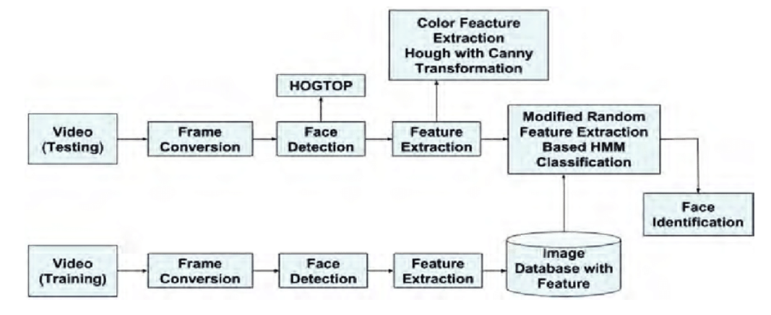
System Architecture
Dlib Architecture

Slide 20
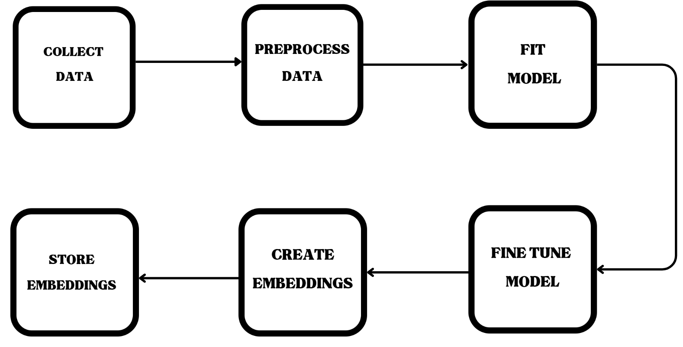
Methodology

Slide 21
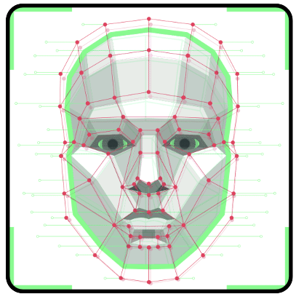
Module Specifications
Data collection and Preprocessing :
Input: Raw Images of People
Process: Reshaping, Cleaning
Output: Processed Images
Implementation of ANN / DL algorithm:
Input: Processed Images
Process: Model Training
Output: Images with vector embeddings
Testing and Validation:
Input: Test Images
Process: Prediction
Output: Model Accuracy

Slide 22
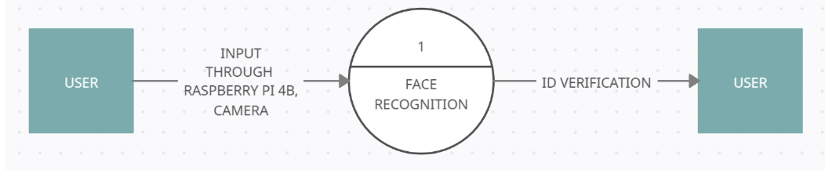
Data Flow Diagrams
Level 0 of Data Flow Diagram

Slide 23
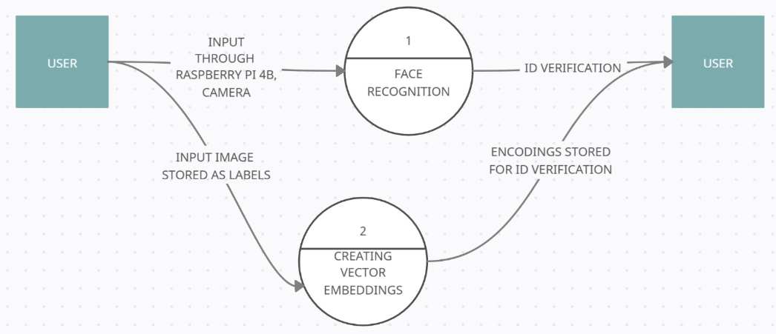
Data Flow Diagrams
Level 1 of Data Flow Diagram

Slide 24
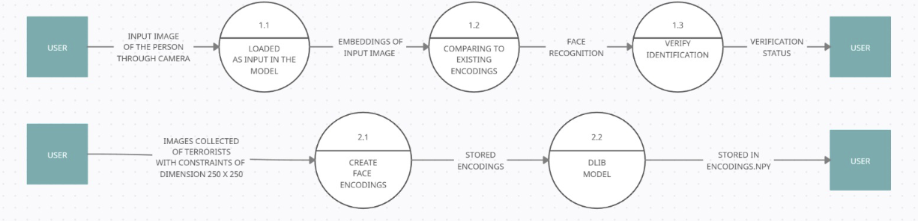
Data Flow Diagrams
Level 2 of Data Flow Diagram

Slide 25
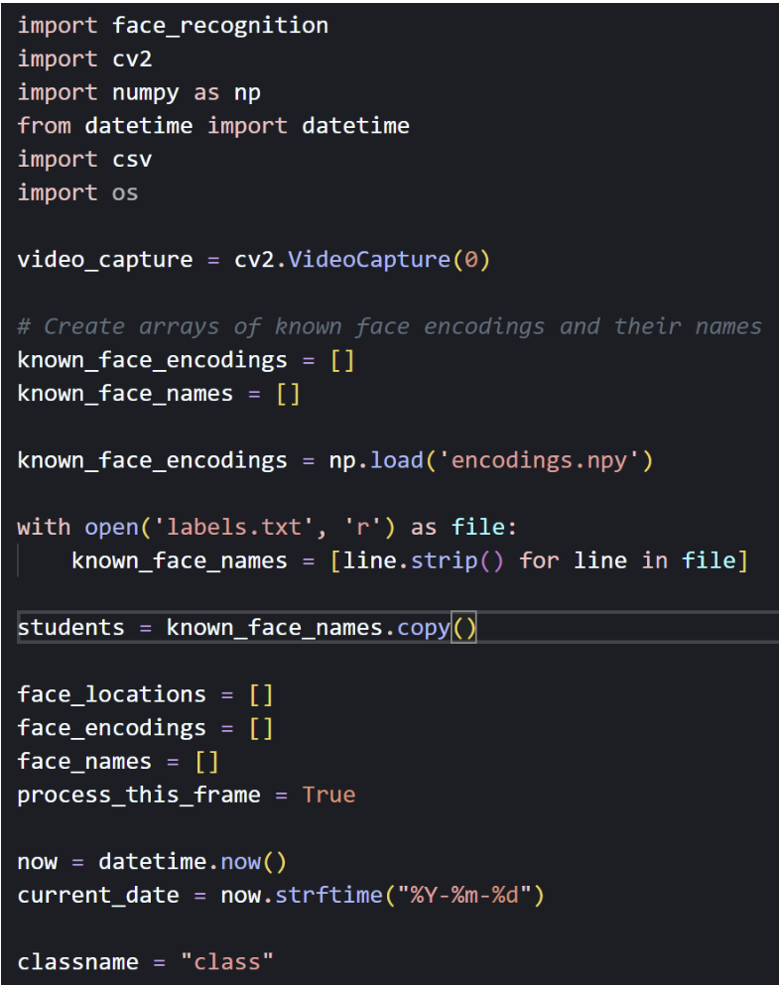
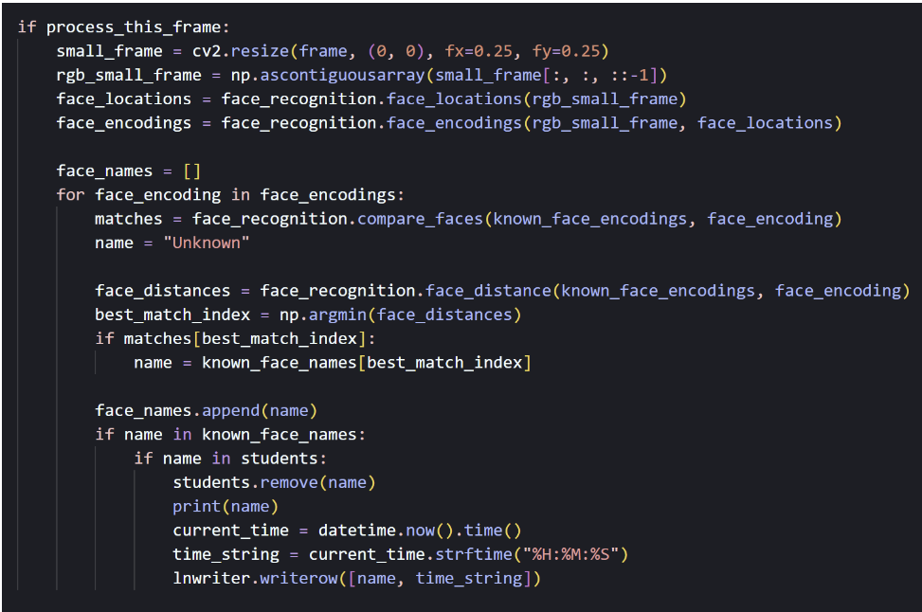
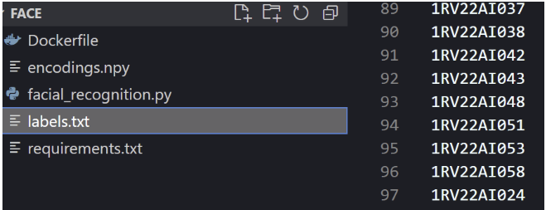
Implementation
Code Snippets

Slide 26
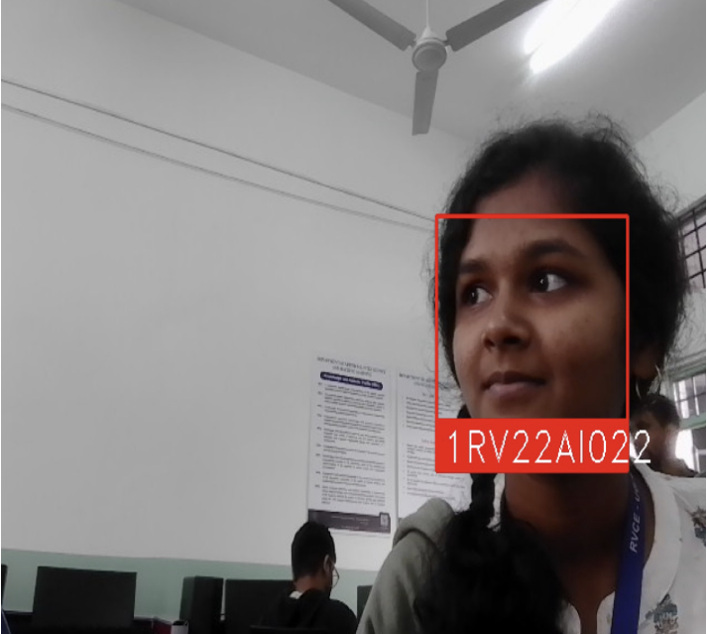
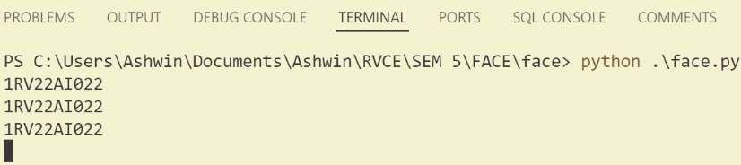
Implementation and Result
Based on the above results, we can see that choice of 0.45 as an embedding threshold is a good estimate, as we achieve an accuracy of 90.47% in a constrained system.
Face Recognition

Slide 27
THANK YOU

