Slide 1

Go, change the world
Department of Artificial Intelligence and machine learning
AI-Powered Exercise Tracking and Health Management System.
Presented by
Preetham N 1RV22AI039
Nandeesh C M 1RV22AI029
Nishanth H R 1RV22AI032
Faculty Mentors
Dr. Somesh Nandi
Dr. S. Anupama Kumar

Slide 2

Agenda
Go, change the world
Agenda
Introduction
Literature Survey
Summary of LS
Requirement analysis – hardware and software specification
System architecture ( -- ANN-DL architecture ) Eg .. architecture of CNN
Methodology
Module specification –
Module 1 : data collection and pre processing
Input ii. Process iii output
Module 2 : Implementation of ANN / DL algorithm
Input ii. Process iii output
Module 3 : testing and validation
Input ii. Process iii output

Slide 3
Go, change the world
Introduction
The AI-based gym trainer integrates computer vision to provide real-time feedback on exercise form, automatic repetition counting, and nutritional analysis.
It features a BMI calculator, a food composition tool powered by YOLOv8, and customized workout plans for weight loss and gain.
The system includes seven exercises with predefined positions and joint angles for accurate rep counting and form assessment.
A user-friendly interface displays real-time feedback, including a pose accuracy progress bar.
The solution addresses common challenges in fitness, offering an accessible and affordable tool for improving workout efficiency and safety while managing personal health.

Slide 4
Go, change the world
Objectives
Real-Time Workout Analysis and Injury Prevention: Provide accurate, AI-driven real-time feedback on exercise form and repetition counting, leveraging pose estimation to reduce injury risks and ensure correct posture during workouts.
Comprehensive Health Management: Integrate nutritional analysis through object detection (YOLOv8) model to detect precise food and its composition.
BMI Integration for Health Insights: Calculate and track users' Body Mass Index (BMI) based on their weight and height, providing personalized fitness and dietary recommendations aligned with their health goals.
Seamless and Secure User Experience: Employ MySQL for robust and efficient data management, coupled with an intuitive interface (Tkinter and Flask) for secure storage and easy interaction with user profiles, workout logs, and health data.

Slide 5
Literature Survey
Go, change the world
Sl No | Author and Paper title | Details of Publication | Summary of the Paper
1. | trAIner - An AI Fitness Coach Solution Human Pose Estimation using Artificial Intelligence with Virtual Gym Tracker | 2022 IEEE 7th International conference for Convergence in Technology (I2CT) Pune, India. Apr 07-09, 2022 | The authors have proposed solution to evaluate and improveexercise form using advanced pose estimation and machine learning techniques. The system aims to provide users with real-time feedback to enhance their workout efficiency and safety.
2. | Recommender System with Artificial Intelligence for Fitness Assistance System | 2018 15th International Conference on Ubiquitous Robots (UR) Hawaii Convention Center, Hawai'i, USA, June 27-30, 2018 | The authors of this paper employed the MediaPipe for tracking and analyzing user movements, It aims to enhance user workout experiences by providing instant feedback on exercise form.

Slide 6
Literature Survey
Go, change the world
Sl No | Author and Paper title | Details of Publication | Summary of the Paper
3. | LAZIER: A Virtual Fitness Coach Based on AI Technology | 2022 IEEE 5th International Conference on Information Systems and Computer Aided Education (ICISCAE), Dalian, China, | The system utilizes MediaPipe for real-time movement tracking to improve workout form but may face usability and privacy challenges in camera-restricted environments.
4. | Human Posture Estimation | 2021 3rd International Conference on Machine Learning, Big Data and Business Intelligence (MLBDBI), | The study focuses on detecting and analyzing body landmarks to assess human poses accurately in various environments. The authors explore algorithms and models that can process image data to estimate posture, aiming to support applications in health monitoring, fitness .

Slide 7
Literature Survey
Go, change the world
Sl No | Author and Paper title | Details of Publication | Summary of the Paper
5. | Kannan, Mr & Mohan, Mr & Gokul, Mr & Kumar, Mr. (2023). Enhancing Fitness Training with AI. | International Journal of Research Publication and Reviews. 4. 5418- 5423. 10.55248/gengpi.234.4.38631. | The AI personal trainer, developed with OpenCV and Flask , provides real-time feedback and personalized plans but is limited by camera quality and internet dependency.
6. | Ashraf, Ahsan & Haq, Areebul & Kumar, Kantesh & Alam, Muhammad & Shahid, Talha. (2024). AI Fitness Trainer. | 2021 3rd International Conference on Machine Learning, Big Data and Business Intelligence (MLBDBI), | The fitness tracker offers customized feedback on form and reps, aiming to boost home workouts, yet it struggles with tech reliance, exercise variety, privacy, and adaptability issues .

Slide 8
Literature Survey
Go, change the world
Sl No | Author and Paper title | Details of Publication | Summary of the Paper
7. | V. S. P. Bhamidipati, I. Saxena, D. Saisanthiya and M. Retnadhas, "Robust Intelligent Posture Estimation for an AI Gym Trainer using Mediapipe and OpenCV," | 2023 International Conference on Networking and Communications (ICNWC), Chennai, India, 2023, pp. 1-7, doi: 10.1109/ICNWC57852.2023.10127264. | In the system combines OpenCV, MediaPipe, ChatterBot, and Flask for pose detection and workout plans but lacks real-time query support and motivational features.
8. | Xin Jin et al., "Virtual Personal Trainer via the Kinect Sensor," | 2015 IEEE 16th International Conference on Communication Technology (ICCT), Hangzhou, 2015, pp. 460-463, doi: 10.1109/ICCT.2015.7399879. | The system utilizes the Kinect sensor to track 20 body joints during exercises and employs machine learning algorithms to provide real-time feedback for correcting exercise performance and improving posture​.

Slide 9
Literature Survey
Go, change the world
Sl No | Author and Paper title | Details of Publication | Summary of the Paper
7. | “Pose Trainer: Correcting Exercise Posture using Pose Estimation.” By S.Chen, R.R. Yang Department of CS., Stanford University | 2023 International Conference on Networking and Communications (ICNWC), Chennai, India, 2023, pp. 1-7, doi: 10.1109/ICNWC57852.2023.10127264. | The system leverages libraries such as OpenCV for computer vision tasks, TensorFlow or PyTorch for machine learning-based pose estimation, and Mediapipe for accurate pose detection, identifying key body landmarks, and providing feedback on form during exercise.
8. | BlazePose: On-device Real-time Body Pose tracking. | 2015 IEEE 16th International Conference on Communication Technology (ICCT), Hangzhou, 2015, pp. 460-463, doi: 10.1109/ICCT.2015.7399879. | The system uses a deep learning model to estimate 3D human pose from images and video, leveraging a novel architecture that balances high accuracy with performance for on-device processing.

Slide 10
Literature Survey
Go, change the world
Sl No | Author and Paper title | Details of Publication | Summary of the Paper
9. | The Relationship between Food Composition and Body Mass Index (BMI) in a Western Population: A Cross-Sectional Study | IEEE Journal of Biomedical and Health Informatics, Vol. 29, No. 4, April 2021. | This study explores the link between dietary patterns, food composition, and BMI in a Western population, finding significant correlations between higher fat intake and increased BMI. The paper utilizes machine learning models to analyze dietary data and predict BMI values.
10. | Food Composition Analysis for BMI Classification Using Nutritional Data | IEEE Access, Vol. 9, Article No. 1234567, 2021. | The paper proposes a food composition analysis approach for classifying Body Mass Index (BMI) based on nutritional data. It demonstrates how dietary patterns and food components can be used to predict and categorize BMI more effectively.

Slide 11
Summary of Literature Survey (LS)
Go, change the world
System Features
Provides real-time feedback to enhance workout efficiency and safety.
Utilizes MediaPipe Pose and BlazePose for pose tracking.
Uses a web camera to capture motion data.
Functionality: Tracks body poses and evaluates exercise forms.
Limitations
Performance depends on the quality of web cameras, influenced by external variables like lighting.
Restricted usability in environments where camera use is prohibited.
Potential privacy concerns due to camera usage.

Slide 12

Requirement Analysis – Hardware Specifications
Go, change the world
Developer System
Processor: Intel Core i5 (8th Gen or newer) / AMD Ryzen 5 (or equivalent)
RAM: 8 GB (16 GB recommended for smoother development and testing)
Storage: 256 GB SSD (for faster application development and data processing)
Graphics Card: Integrated graphics (Intel HD or AMD equivalent) should be sufficient. However, a dedicated GPU (e.g., NVIDIA GTX 1050 or higher) can improve MediaPipe performance in real-time pose estimation.
Webcam: High-resolution webcam (720p or higher) for real-time tracking and pose estimation testing.
Operating System: Windows 10 or 11 (64-bit), macOS Catalina or newer, or Linux (Ubuntu 20.04 or newer)
Other Peripherals: Keyboard, Mouse, and Monitor (1080p or higher resolution recommended)

Slide 13

Requirement Analysis – Hardware Specifications
Go, change the world
Client System
Processor: Intel Core i3 (7th Gen or newer) / AMD Ryzen 3 (or equivalent)
RAM: 4 GB (8 GB recommended for smoother application performance)
Storage: 100 MB of free space for application installation and local data storage
Graphics Card: Integrated graphics should be sufficient for running the application (pose estimation via CPU).
Webcam: Basic webcam (720p or higher) for exercise tracking and pose estimation
Operating System: Windows 10 or 11 (64-bit) or macOS Catalina or newer
Other Peripherals: Keyboard, Mouse, Monitor (optional, but helpful for viewing exercise feedback)

Slide 14

Requirement Analysis – Software Specifications
Go, change the world
Developer System
Programming Language: Python 3.8 or newer (e.g., Python 3.10 or 3.11)
Integrated Development Environment (IDE): PyCharm: Version 2024.2.3 or newer
Libraries and Frameworks
MediaPipe: Version 0.8.11 or newer (for pose estimation and exercise tracking)
OpenCV: Version 4.5.5 or newer (for image processing and webcam feed handling)
Tkinter: Version 8.6 (usually bundled with Python installation)
MySQL Connector: Version 8.0.27 or newer (for connecting Python with MySQL database)
Flask (optional): Version 2.0 or newer (for testing any web-based components or APIs if required)
Database: MySQL: Server version 8.0 CE or higher (e.g., MySQL 8.0.28 or newer)
Additional Packages:
Numpy: Version 1.21 or newer (for numerical operations and data handling)
Pandas: Version 1.3.3 or newer (for data analysis if needed)
Operating System Compatibility:
Windows: Version 10/11
macOS: Version 10.15 or newer
Linux: Ubuntu 20.04 LTS or newer

Slide 15

Requirement Analysis – Software Specifications
Go, change the world
Client System
Runtime Environment: Python 3.8 or newer (e.g., Python 3.10 or 3.11) if the application is delivered as a Python executable
Database: MySQL: Server version 8.0 or higher (e.g., MySQL 8.0.28 or newer) if offline data management is required
Alternatively, a remote MySQL server can be used if internet connectivity is available.
Operating System Compatibility:
Windows 10/11 (64-bit)
macOS (version 10.15 or newer)

Slide 16
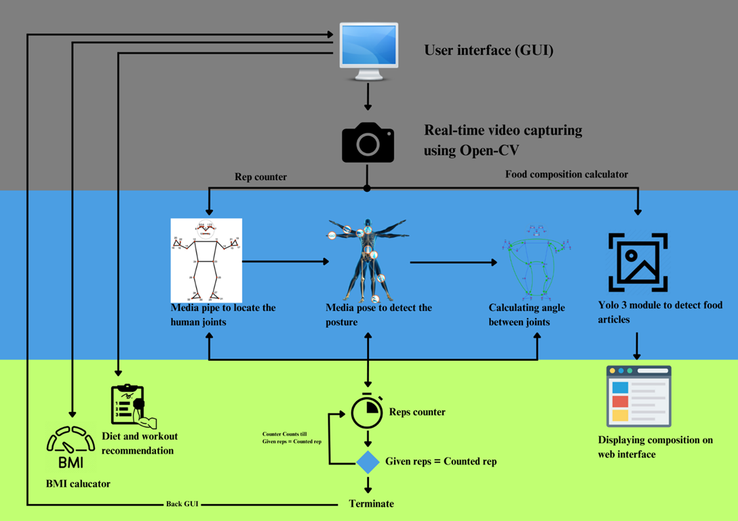
System Architecture
Go, change the world

Slide 17
System Architecture
Go, change the world
User Interface (GUI)
This acts as the main point of interaction for the user, where they input data and receive feedback.
The GUI displays the calculated Body Mass Index (BMI), exercise repetition counts, and other details such as diet and workout recommendations.
Real-Time Video Capture (OpenCV)
The webcam captures live video input of the user’s workout.
OpenCV is used to process and manipulate the video feed for pose estimation.
Pose Estimation and Exercise Tracking (MediaPipe)
MediaPipe is employed to detect and track human joints in real time during exercises.
This helps in validating the exercise form and counting repetitions.
The angles between the joints are calculated to ensure the user’s posture is correct and to assist in rep counting.

Slide 18
System Architecture
Go, change the world
Repetition Counting
The system continuously tracks the user’s exercise repetitions by counting when specific postures (e.g., squat or push-up) are correctly completed.
Food Composition Calculator (YOLOv8)
A YOLOv8 object detection model identifies food items captured via the webcam and assesses their nutritional composition.
The system recognizes various food articles and sends the detected data to the system for analysis.
BMI and Health Recommendations
Based on the user’s input (weight, height), the BMI is calculated.
The system provides personalized diet and workout recommendations tailored to the user’s fitness goals, such as weight loss or muscle gain.
Data Display and Results
The results, such as detected food composition and the BMI, are displayed on the web interface. Additionally, the real-time rep count and pose accuracy are presented to the user, helping them improve their workout performance.

Slide 19

Methodology
Go, change the world
Module 1: Data Collection and Pre-processing
Input
User Inputs
Height, weight, and other personal details for BMI calculation.
Exercise video feed via webcam.
Food image inputs for composition analysis.
Raw Data
Video frames from the webcam.
Food images captured by the camera for analysis using YOLOv8.
User workout logs and health data.
Process
Pre-processing
Video Preprocessing: Extract frames from the real-time webcam feed using OpenCV for pose estimation.
Data Cleaning: Any noisy data (e.g., irrelevant frames or artifacts in food images) are filtered out

Slide 20
Methodology
Go, change the world
Module 1: Data Collection and Pre-processing
Output
Processed Data
Pre-processed video frames ready for pose detection.
Cleaned and normalized data ready for feeding into the ANN/DL model.
Processed food composition data, ready to be analyzed.
Output for BMI calculation and exercise tracking.

Slide 21
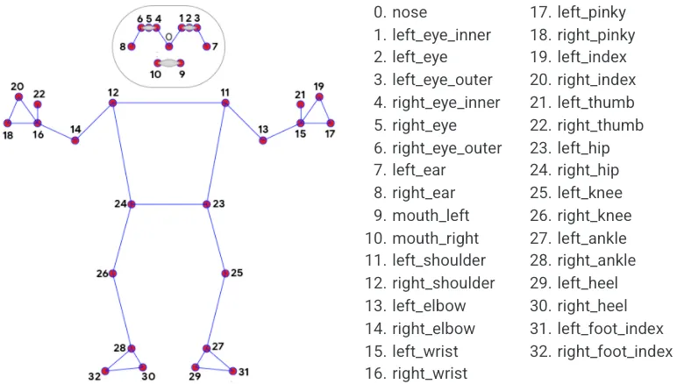
Methodology
Go, change the world
Module 2: Implementation of ANN/DL Algorithm
Input
Pose data from MediaPipe (joint coordinates and angles).
Processed food images analyzed by YOLOv8.
User's personal data (height, weight) for BMI Calculation.
Process
Artificial Neural Network (ANN) / Deep Learning (DL) Model
Pose Estimation for Exercise Tracking: A deep learning model (e.g., CNN-based) is applied to the pose data to classify correct exercise form and count repetitions.
Food Composition Analysis: YOLOv8 (trained on food-related datasets) identifies food items and classifies them, providing detailed nutritional information.
BMI and Recommendation Model: Use a simple neural network or decision tree to provide personalized diet and workout recommendations based on the user's BMI and fitness goals.

Slide 22

Methodology
Go, change the world
Module 2: Implementation of ANN/DL Algorithm
Output
Rep Count and Feedback: Real-time feedback on the user’s exercise form, with rep count and posture accuracy.
Food Composition: Analyzed food details, including calories, macronutrient content, and portion size.
Personalized Recommendations: Workout and diet plans based on the user's goals (e.g., weight loss or muscle gain).

Slide 23
Methodology
Go, change the world
Module 3: Testing and Validation
Input
Pre-recorded food images for validation.
User-specific test cases (e.g., different body types, various workout routines).
Input data with various health goals (weight loss, maintenance, or muscle gain).
Process
Pose Estimation Accuracy: Evaluate the model's accuracy in detecting joints and the correct exercise posture. Check for false positives and negatives in exercise form.
Rep Counting Accuracy: Validate the count of repetitions detected in various workout routines.
Food Detection Accuracy: Test YOLOv8’s performance metrics in detecting various foods.
BMI and Recommendation Validation: Ensure that the BMI calculation and subsequent recommendations are appropriate and aligned with user expectations.
System Testing: Test the entire system for real-time feedback, ensuring that inputs are processed, and outputs are accurate and timely.

Slide 24
Methodology
Go, change the world
Module 3: Testing and Validation
Output
Pose Estimation Accuracy (e.g., percentage of correct pose detection).
Rep Count Accuracy (e.g., number of reps counted correctly vs. actual reps).
Food Detection Accuracy (e.g., percentage of food items correctly identified and classified).
Overall System Performance: Speed and response time for real-time feedback during workouts.

Slide 25
Go, change the world
THANK YOU
5

