Slide 1

Go, change the world
Department of AIML
Image segmentation with size detection of rice grains
Presented by
Kushagra Aatre 1RV22AI025
Kriti Kannan 1RV22AI064
Faculty Mentors:
Dr S Anupama Kumar,
Associate Professor,
Dept of AIML, RVCE
Somesh Nandi,
Assistant Professor,
Dept of AIML, RVCE

Slide 2

Go, change the world
Problem Definition
Current methods for grain classification are manual or rely on basic image processing techniques, which face significant challenges. These include the inability to handle variations in grain shape and size, lack of robust and automated systems for high accuracy, and sensitivity to environmental factors like lighting and background noise. To address these issues, the project aims to design a deep learning-based algorithm for a grain sorter machine that can accurately detect individual rice grains in an image, classify them as "good" or "bad" based on their shape and size, and operate efficiently under varied conditions for real-time applications.
‹#›

Slide 3
Go, change the world
Object Detection
GMM
Image Preprocessing:
The algorithm first converts the input image to grayscale and applies Gaussian blur to smooth it. Then, it uses adaptive thresholding to create a binary image that separates the foreground (grains) from the background.
Gaussian Mixture Model (GMM):
The preprocessed image is flattened, and a GMM clusters the pixels into two groups: grains and background. This results in a segmented image where grains are highlighted.
Grain Mask Creation:
The GMM output is used to create a binary mask, where grains are marked in white (255) and the background in black (0). This mask represents the regions of interest for the grains.

Slide 4
Go, change the world
Object Detection
GMM
Bounding Box Detection: Using connected component analysis, the algorithm identifies groups of connected pixels in the binary mask. For each group (representing a grain), it calculates a bounding box to mark its location in the original image.
Original
Masked
Final
Output

Slide 5
Go, change the world
Object Detection
GMM
Why was this model not suitable ?
Issue: Close Rice Particles Merging into the Same Bounding Box
Merged Bounding Boxes: The algorithm interprets closely placed grains as a single cluster, producing a bounding box that encloses multiple grains instead of separating them.
Underlying Cause
Assumption of Gaussian Shape: GMM assumes that clusters are elliptical (Gaussian in shape). Real-world rice grains, especially when overlapping or touching, do not conform to this assumption. As a result, GMM cannot effectively model the true boundaries of individual grains.
Overlapping Distributions: Close grains lead to overlapping Gaussian components, making it difficult for GMM to separate them based on probabilities.

Slide 6
Go, change the world
Object Detection
Autoencoding and DBSCAN
Autoencoder Design and Training -Two convolutional layers with ReLU activation and a kernel size of 3×3, followed by max-pooling to downsample the input dimensions are used for encoder and decoder. The final layer uses a sigmoid activation to output reconstructed images with pixel values normalized between 0 and 1. The autoencoder is compiled using the adam optimizer and binary_crossentropy as the loss function.
Reconstruction Error Calculation -The absolute difference between the original and reconstructed images is computed for each pixel, forming an error map.
Error Analysis and Thresholding -A threshold is determined based on the 95th percentile of the error values. Pixels with errors above this threshold are considered significant. A binary mask is generated to isolate high-error regions.

Slide 7
Go, change the world
Object Detection
Autoencoding and DBSCAN
Clustering High-Error Regions -The coordinates of high-error pixels are extracted from the binary mask and Density-Based Spatial Clustering of Applications with Noise (DBSCAN) is applied on that.
Hyperparameters tuned:
eps: Defines the maximum distance for two points to be considered neighbors.
min_samples: Minimum number of points required to form a cluster.
Bounding Box Generation
Each cluster (ignoring noise) is analyzed to compute bounding boxes.
Bounding box coordinates are determined using the minimum and maximum x and y values of the points in the cluster.

Slide 8

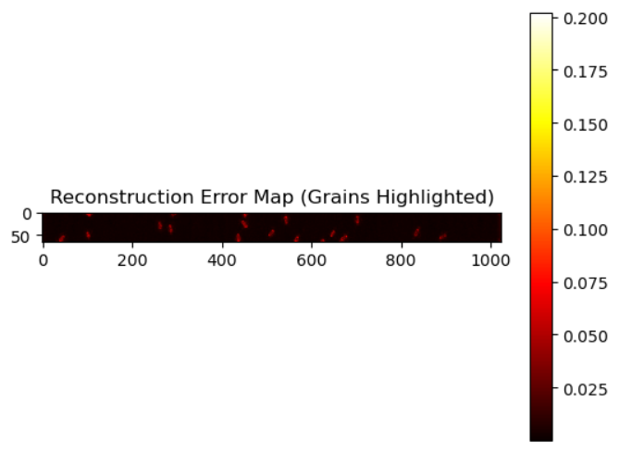
Go, change the world
Object Detection
Grains isolated
After autoencoding
Bounding boxes

Slide 9
Go, change the world
Object Detection
Autoencoding and DBSCAN
Why this model suitable ?
Localized Error Detection: Reconstruction error maps highlight specific regions with significant differences, enabling precise anomaly identification.
Robust Clustering: DBSCAN effectively identifies clusters of anomalies while filtering noise, making it suitable for irregular or scattered patterns.
Scalability: Autoencoder generalizes better to unseen datasets after training, as it captures a broad distribution of the data's characteristics.
Challenge
Latency may arise during clustering and error map generation in FPGA as autoencoders are computationally intensive
The algorithm can be optimized using quantization for FPGA deployment on low-power edge devices, enabling real-time detection in industrial settings. This can be done reducing numerical precision (e.g., to INT8 or fixed-point) to minimize computational complexity, memory usage, and power consumption while maintaining acceptable accuracy.

Slide 10
Go, change the world
Colour Detection
HSV
Why Use HSV?
Better color segmentation: HSV separates color (hue) from intensity (value), making it more effective for distinguishing grains.
Robust to lighting changes: Variations in illumination affect the value (V) component, but hue (H) remains stable.
Easier thresholding: You can set a range of HSV values to segment good and bad grains effectively.
Algorithm
Convert Image to HSV
Since OpenCV uses BGR by default, you convert the image from BGR to HSV using:
python
CopyEdit
hsv = cv2.cvtColor(image, cv2.COLOR_BGR2HSV)
This helps in isolating color-based features for rice grain classification.
Thresholding Based on Color
You define HSV ranges to segment the grains based on their color properties. For example:
lower_bound = np.array([H_min, S_min, V_min])
upper_bound = np.array([H_max, S_max, V_max])
‹#›

Slide 11
Go, change the world
Methodology
HSV
This creates a binary mask where pixels within the HSV range are white (255), and others are black (0).
This helps in separating good grains from bad ones based on color variations.
Morphological Operations (Optional)
We apply operations like cv2.morphologyEx() to remove noise and refine the segmented grains.
Feature Extraction
After segmentation, you may analyze properties like shape, texture, or size of the grains for classification.
You can use cv2.findContours() to extract individual grains.

Slide 12
Go, change the world
Methodology
Multiscale kernels
Multiscale kernels are convolutional filters that operate at different scales (or sizes) to analyze an image. The idea is to apply multiple kernels of varying sizes to the same image to capture features at different resolutions.
This size filter is applied to the rice images with bounding boxes to classify them based on their bounding box areas and threshold kernels
We have stored these values in json format so that rice can be filtered as select and reject quality

Slide 13

Go, change the world
Methodology
Integration
We are detecting white rice particles using autoencoders and DBSCAN clustering to create bounding boxes
We are detecting black rice particles using a black masking algorithm
These algorithms are integrated to obtain the final bounding of each rice particles with either red or green depending on the color.
Further Size filter is applied to reduce noise and remove reject quality rice.

Slide 14
Go, change the world
THANK YOU
‹#›

