Slide 1




Go, change the world
Department of Artificial Intelligence and
Machine Learning
Title - Offline Text Summarisation using AI Model
Presented by,
Rachith S 1RV22AI040
Gagan Gowda V S 1RV23AI400
Shivukumar M. H 1RV22AI053
Faculty Mentors: Dr. Somesh Nandi
Dr. S. Anupama Kumar

Slide 2

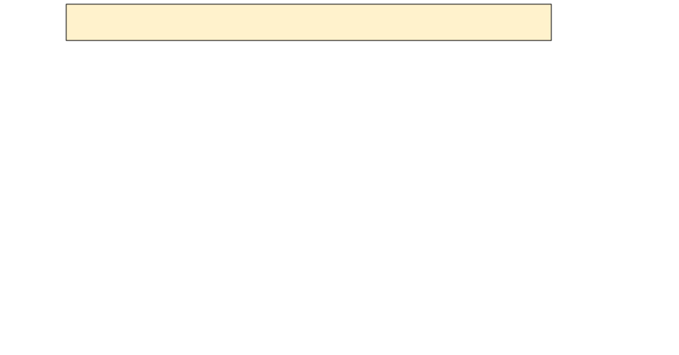


Introduction
Go, change the world
1. 2. 3. 4. 5. 6. 7. 8.
Agenda Introduction Literature Survey Summary of LS Requirement analysis – hardware and software specification System architecture ( -- ANN-DL architecture ) Eg .. architecture of CNN Methodology Module specification –
a.Module 1 : data collection and pre processing
i.Input ii. Process iii output
b.Module 2 : Implementation of ANN / DL algorithm
i.Input ii. Process iii output
c.Module 3 : testing and validation
i.Input ii. Process iii output

Slide 3
Agenda
Go, change the world
The agenda of this project is to:
Develop an offline text summarization system using Deep Learning (DL) techniques.
Leverage the FLAN-T5 Transformer model for generating concise summaries from large text documents.
Automate the summarization process for documents in PDF, DOCX, and TXT formats.
Provide a robust pre-processing pipeline and multi-format output capabilities.

Slide 4
Introduction
Go, change the world
Text summarization is a critical task in Natural Language Processing (NLP), aimed at reducing the length of text documents while retaining essential information. With the increasing volume of data, summarization helps extract meaningful insights efficiently. This project utilizes the FLAN-T5 Transformer model to:
Process lengthy text documents.
Generate extractive or abstractive summaries.
Work offline without requiring constant server connections.
This approach ensures high accuracy, efficient processing, and versatility in handling multiple document formats.

Slide 5

Objectives
Go, change the world
Creating an offline text summarization tool for various document formats (PDF, DOCX, TXT).
Generating high-quality abstractive summaries using pretrained FLAN-T5 model.
Enable saving summaries in TXT, DOCX, and PDF formats.
Provide a simple interface for users to upload documents and download summaries.
Optimization of memory and the computation resources to process large texts effectively.

Slide 6
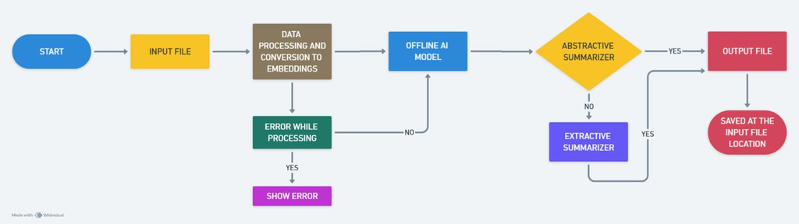
Methodolody And Architecture
Go, change the world
Start: The process begins.
Input File: The user provides an input file to the system.
Data Processing and Conversion to Embeddings: The input file undergoes processing, where it is converted into embeddings,
which are numerical representations of the data.
Error While Processing: If an error occurs during processing, an error message is displayed.
If no errors occur, the process proceeds to the next step.
Offline AI Model: The processed data is fed into an offline AI model.
Decision Point - Abstractive Summariser:

Slide 7

Hardware Requirements
Go, change the world
Hardware Requirements:
Component Specification:
Processor:
Intel Core i7 or higher / AMD Ryzen 7 or higher.
RAM:
Minimum 16 GB (32 GB recommended for large datasets)
Storage:
Minimum 512 GB SSD (1 TB recommended)
GPU:
NVIDIA GTX 1060 (6GB) or higher (e.g., NVIDIA RTX 3060 for better performance)
Monitor:
Full HD resolution (1920x1080) or higher
Peripherals:
Keyboard, Mouse, and optional external storage device

Slide 8
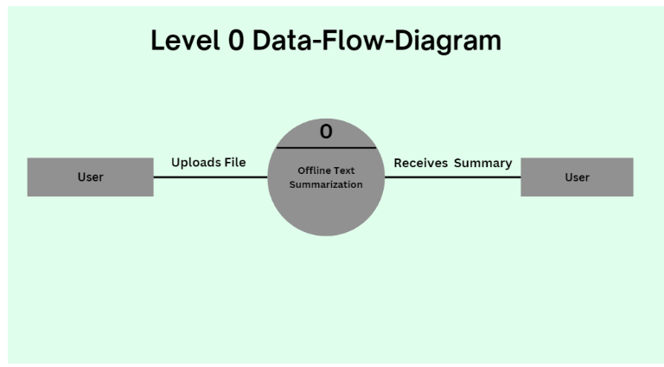
Data Flow Diagram
Go, change the world
‬
‭ Level 0 DFD‬
‬‭ Input‬‭ : User provides file path.‬
‬Process‬‭ :‬‭
The‬‭ system‬‭ extracts,‬‭ preprocesses,‬‭ segments,‬‭ summarizes,‬‭ and‬‭ outputs‬
‭ the summarized content.‬
‬‭ Output‬‭ : Summarized text.‬

Slide 9
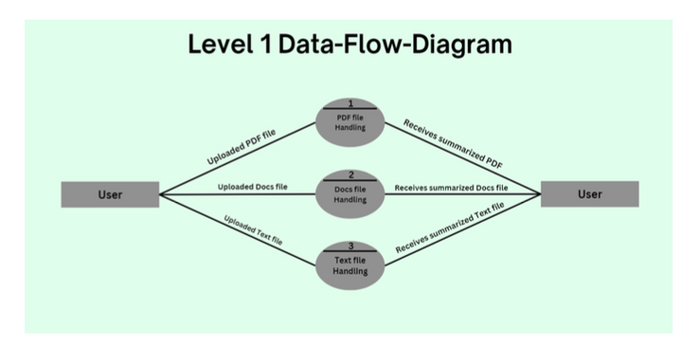
Data Flow Diagram
Go, change the world
‭ Level 1 DFD‬
‭ 1.‬‭ Input Handling‬‭ :‬
Accepts user file input.‬
‬‭ Reads file based on extension.‬
‭ 2.‬‭ Text Extraction‬‭ :‬
○Extracts raw text from file.‬
‭ 3.‬‭ Text Preprocessing‬‭ :‬
‬‭ Cleans text and removes extra whitespaces.‬
○‬‭ Converts text to lowercase.‬
‭ 4.‬‭ Segmentation‬‭ :‬
‬‭ Segments text with overlap for context preservation.‬
‭ 5.‬‭ Summarization‬‭ :‬
‬‭ Feeds segmented text into FLAN-T5 model for summary generation.‬
‭ 6.‬‭ Output Generation‬‭ :‬
‬‭ Combines segment summaries into a final output.‬

Slide 10

Software Requirements
Go, change the world
Software Requirements:
Operating System: Windows 10/11 (64-bit) or Ubuntu 20.04 LTS (or higher)
Programming Language: Python 3.9 or higher
IDE/Code Editor: PyCharm, VS Code, or Jupyter Notebook
Deep Learning Framework: PyTorch 1.10 or TensorFlow 2.x
NLP Library: Hugging Face Transformers (e.g., FLAN-T5 Model)
Text Processing Tools: NLTK, spaCy
Document Libraries: PyPDF2, python-docx, fpdf
Parallel Processing: ThreadPoolExecutor (Python built-in)
GPU Drivers: CUDA Toolkit 11.x (for GPU acceleration) and cuDNN
Dependencies: NumPy, pandas, re, and tqdm

Slide 11
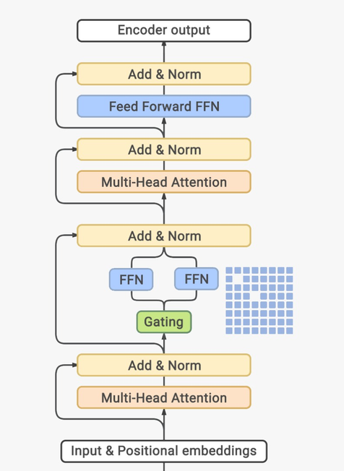
System architecture
Go, change the world
1. Input Layer
User Input: Raw text document or paragraph.
Tokenization: Splitting text into subwords using SentencePiece.
2. Encoder-Decoder Transformer Model
Embedding Layer: Converts tokenized input into dense vectors.
Positional Encoding: Adds sequential information to token embeddings.
Decoder Block:
Multi-Head Self-Attention (Masked)
Cross-Attention with Encoder Output
Feed Forward Network (FFN)
Gating Mechanism (Optional in Variants)
Skip Connections & Layer Normalization
3. Output Processing
Softmax Layer: Converts logits to probability distribution.
Greedy/Beam Search Decoding: Generates text output.
4. Post-Processing
Detokenization: Converts generated tokens back into text.
Refinement (Optional): Removal of redundant information.
5. Deployment Pipeline
Model Hosting: Hugging Face/TF-Serving/Triton Inference Server.
API Layer: Flask/FastAPI serving interface.
Frontend UI: Web-based or CLI for user interaction.

Slide 12
Deep Learning Architecture (FLAN-T5)
Go, change the world
Tokenization
Text input is tokenized using the FLAN-T5 tokenizer.
Special tokens and truncation handle sequence length constraints.
Encoder
Encodes tokenized input into high-dimensional representations.
Uses Transformer architecture for contextual understanding.
Decoder
Generates a concise summary based on encoded representations.
Implements beam search to optimize generated summaries.
Output Processing
Decodes generated tokens into human-readable text.
Removes special tokens for clean output.

Slide 13
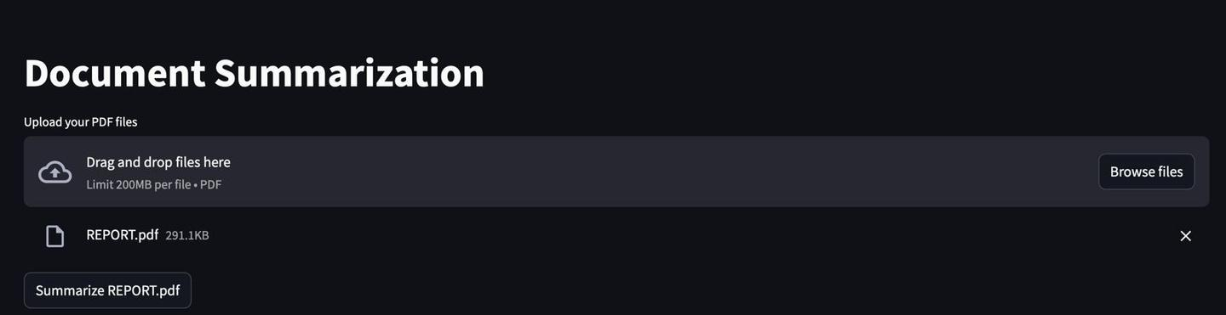
Result and discussion
Go, change the world
Input

Slide 14
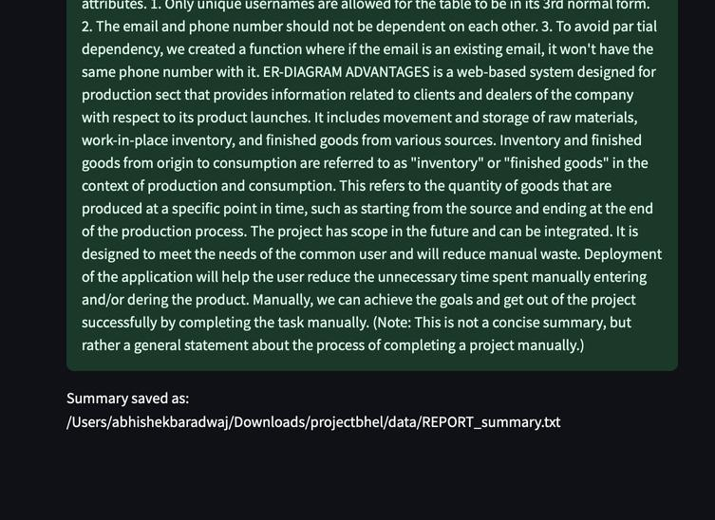
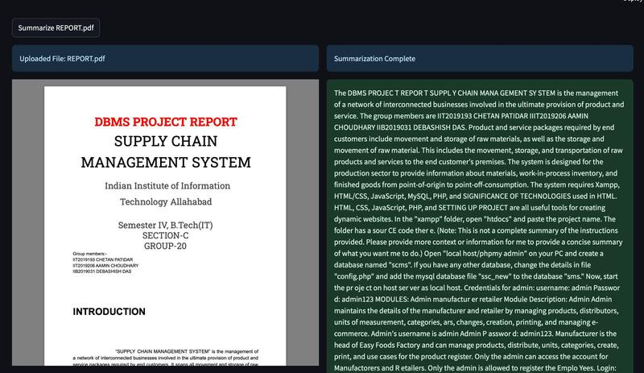
Result and discussion
Go, change the world
Output

Slide 15
Literature Survey
Go, change the world
SI NO. | Author and Paper title | Details of Publication | Summary of the Paper
1 | Meetkumar Patel , Adwaita Chokshi , Satyadev Vyas , Khushbu Maurya Machine Learning Approach for Automatic Text Summarization Using Neural Networks | Published in Journal of Machine Learning, 2020 | The paper discusses the use of neural networks, particularly deep learning models like RNN and LSTM, for abstractive text summarization. It presents a method for automatically summarizing long articles into shorter versions while retaining key information.
2 | Mahmood Yousefiazar Query-oriented Single-document Summarization Using Unsupervised Deep Learning | International Journal of Computational Linguistics, 2019 | This paper reviews both extractive and abstractive text summarization techniques, focusing on deep learning approaches such as Transformers and their applications in various domains like news articles and scientific papers.

Slide 16
Literature Survey
Go, change the world
SI NO. | Author and Paper title | Details of Publication | Summary of the Paper
3 | Meetkumar Patel et al., "Machine Learning Approach for Automatic Text Summarization Using Neural Networks." | Journal of Machine Learning, 2020 | Discusses the application of RNN and LSTM for abstractive text summarization, focusing on retaining critical information from lengthy articles.
4 | Mahmood Yousefiazar, "Query-oriented Single-document Summarization Using Unsupervised Deep Learning." | International Journal of Computational Linguistics, 2019 | Explores deep learning techniques such as Transformers for extractive and abstractive summarization of news articles and scientific papers.

Slide 17
Literature Survey
Go, change the world
SI NO. | Author and Paper title | Details of Publication | Summary of the Paper
5 | Kryštof Göring et al., "Evaluation of Pretrained Transformers for Abstractive Summarization." | Official Documentation | Evaluates the performance of BERT, GPT, and FLAN-T5 models, emphasizing FLAN-T5 for its superior abstractive summarization capabilities.
6 | Hugging Face Team, "Documentation on FLAN-T5 Model." | International Journal of Computational Linguistics, 2019 | Provides insights into FLAN-T5’s architecture and its tokenization methods tailored for summarization tasks.

Slide 18
Literature Survey
Go, change the world
SI NO. | Author and Paper title | Details of Publication | Summary of the Paper
7 | Chin-Yew Lin, "ROUGE: A Package for Automatic Evaluation of Summaries." | Proceedings of the ACL Workshop, 2004 | Introduces the ROUGE metric, essential for evaluating summarization models based on n-gram overlaps.
8 | Raffel et al., "Exploring the Limits of Transfer Learning with a Unified Text-to-Text Transformer." | Journal of Machine Learning Research, 2020 | Discusses how FLAN-T5 leverages the T5 framework for summarization tasks.

Slide 19
Go, change the world
THANK YOU

