Slide 1


Image Caption Generator using Deep Learning
ANN & DL
Lab EL Presentation
Name of the Mentor :
Dr Somesh Nandi
Presented by :
SANDEEP S PAWAR 1RV22AI049
SANJANA KUMARI SINGH 1RV22AI072
TANISHQ REDDY 1RV22AI061

Slide 2

INTRODUCTION
Image captioning is a challenging yet important task that combines computer vision and natural language processing (NLP) to generate meaningful textual descriptions of images. It plays a crucial role in automated content generation, assistive technology, and human-AI interaction.
This project aims to develop an AI-powered image captioning model that can analyze an image and generate a coherent and contextually accurate sentence describing its contents. The system leverages deep learning techniques, including Convolutional Neural Networks (CNNs) for image feature extraction and Recurrent Neural Networks (RNNs)/Long Short-Term Memory (LSTMs) for sentence generation.

Slide 3
MOTIVATION
The motivation for this project stems from the growing need for automated image understanding and content generation in various domains. One of the primary applications is assistive technology, where image captioning can aid visually impaired individuals by providing verbal descriptions of images, making digital content more accessible.
Beyond accessibility and automation, image captioning has significant implications for surveillance and security, where AI-powered models can analyze and describe scenes from security footage, aiding in monitoring and anomaly detection.

Slide 4
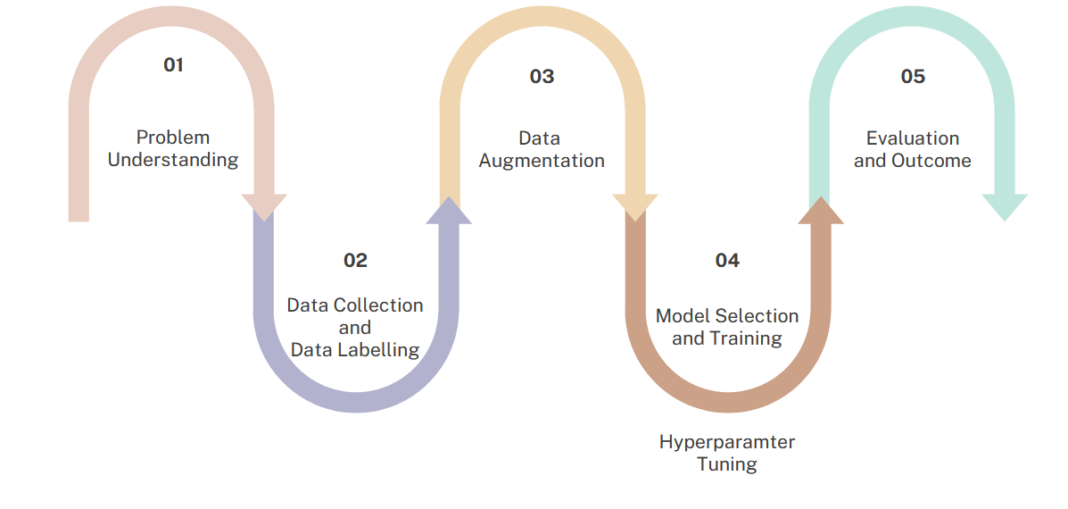
METHODOLOGY

Slide 5
LITERATURE SURVEY
Sl No | Author and Paper title | Details of Publication | Summary of the Paper
1 | Show and tell: A neural image caption generator | Oriol Vinyals; Alexander Toshev; Samy Bengio; Dumitru Erhan 2015 IEEE Conference on Computer Vision and Pattern Recognition (CVPR) | This foundational paper introduces a generative model that combines convolutional neural networks (CNNs) for image feature extraction with recurrent neural networks (RNNs) for text generation. The proposed architecture demonstrates significant advances in generating accurate and human-like captions for images.
2 | Image Caption Generation using ResNET-50 and LSTM | Satish Kumar Satti; Goluguri N V Rajareddy; Prasad Maddula; N V Vishnumurthy 2023 IEEE Silchar Subsection Conference (SILCON) | This paper explores combining ResNet-50 and LSTM for generating image captions. ResNet-50, a convolutional neural network (CNN), is employed for feature extraction from images, while LSTM, a recurrent neural network, generates corresponding textual descriptions. The approach bridges computer vision and natural language processing, enabling detailed and coherent descriptions of image content.

Slide 6
LITERATURE SURVEY
Sl No | Author and Paper title | Details of Publication | Summary of the Paper
3 | Image Caption Generator Using Deep Learning | Prof.S. Sankareswari, Miss.Bibi Zainab Dongarkar, Miss.Heena Dongarkar, Miss.Simran Sarang, Miss.Madhura Valke | The paper titled "Image Caption Generator Using Deep Learning" discusses a system that generates textual descriptions of images using deep learning. The authors employ Convolutional Neural Networks (CNNs) for feature extraction and Long Short-Term Memory (LSTM) networks for generating sequential text descriptions. This interdisciplinary approach combines computer vision and natural language processing to create meaningful captions for images, potentially useful in accessibility tools and automated systems.
4 | Deep Fusion: A CNN-LSTM Image Caption Generator for Enhanced Visual Understanding | Chandradeep Bhatt; Sumit Rai; Rahul Chauhan; Deepika Dua; Mukesh Kumar; Sanjay Sharma | The research focuses on the development of a CNN-LSTM-based image caption generator, combining natural language processing (NLP) and computer vision to create descriptive captions for images. Using a large dataset of image-caption pairs, the system preprocesses images to extract visual features via a pre-trained CNN. These features, along with tokenized captions, are fed into an LSTM decoder trained with beam search and maximum likelihood estimation to enhance caption generation.

Slide 7
Summary of Literature Survey
Combines CNNs for feature extraction and RNNs for text generation.
Significant advancements in generating human-like image captions.
Uses ResNet-50 (CNN) for feature extraction and LSTM for textual descriptions.
Bridges computer vision and natural language processing for coherent captions.
Employs CNNs and LSTMs to generate sequential text descriptions from images.
Highlights interdisciplinary applications like accessibility tools and automation.
Develops a CNN-LSTM model for image captioning using a large dataset.
Preprocesses images via a pre-trained CNN, with features fed into an LSTM decoder.
Uses beam search and maximum likelihood estimation for enhanced captions.

Slide 8
SYSTEM ARCHITECTURE
Input Processing (Image & Text Preprocessing)
The system takes an input image that needs to be described.
The image is resized and normalized before being fed into a deep learning model.
The corresponding captions from the dataset are preprocessed by:
Converting text to lowercase.
Removing special characters and punctuation.
Tokenizing words and creating a vocabulary.
Adding startseq and endseq tokens to mark the beginning and end of sentences.
Feature Extraction (CNN-Based Encoder)
A pretrained Convolutional Neural Network (CNN) VGG16, is used to extract high-level features from the image.
The CNN removes the final classification layer and outputs a feature vector representing the image’s key attributes.
These extracted features serve as inputs to the language model for caption generation.

Slide 9
SYSTEM ARCHITECTURE
Caption Generation (RNN-Based Decoder)
A Recurrent Neural Network (RNN) with Long Short-Term Memory (LSTM) units is used to generate captions.
The LSTM takes the processed caption sequences and the extracted image features as inputs.
It predicts the next word in the sequence based on the previous words and the visual features.
The process continues iteratively until the model generates the endseq token, marking the end of the caption.
Training and Caption Generation
The model is trained using paired image-caption data, where Categorical Crossentropy is used as the loss function to measure the difference between predicted and actual captions. The Adam optimizer is employed to enhance training efficiency. A technique called Teacher Forcing is applied, where actual words from captions are fed into the model to help it learn patterns effectively.

Slide 10
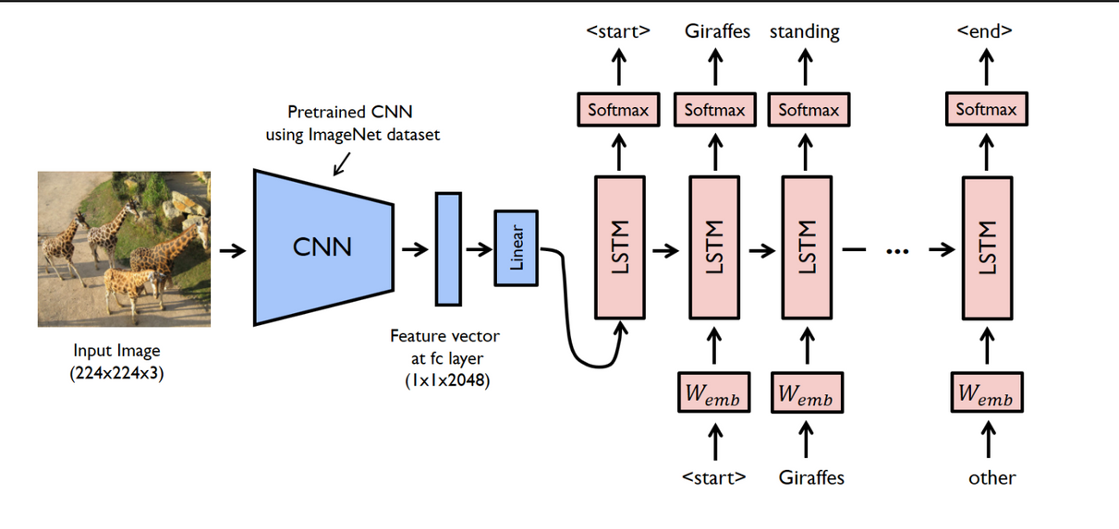
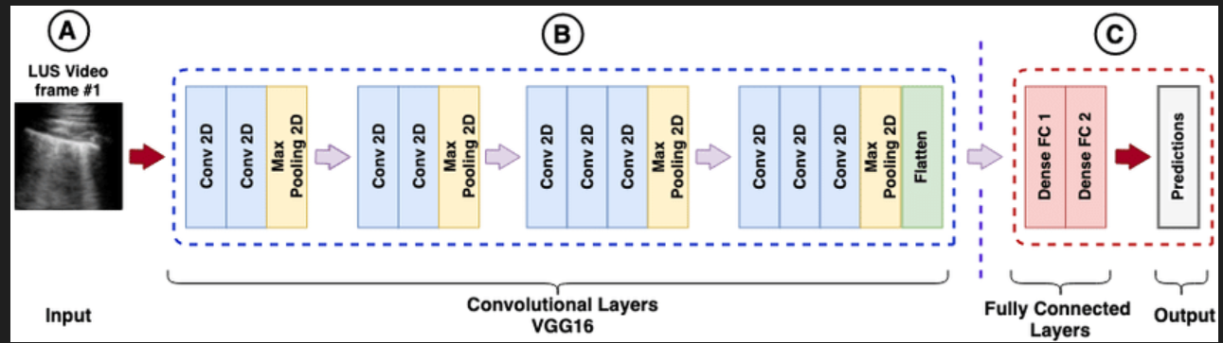
SYSTEM ARCHITECTURE

Slide 11
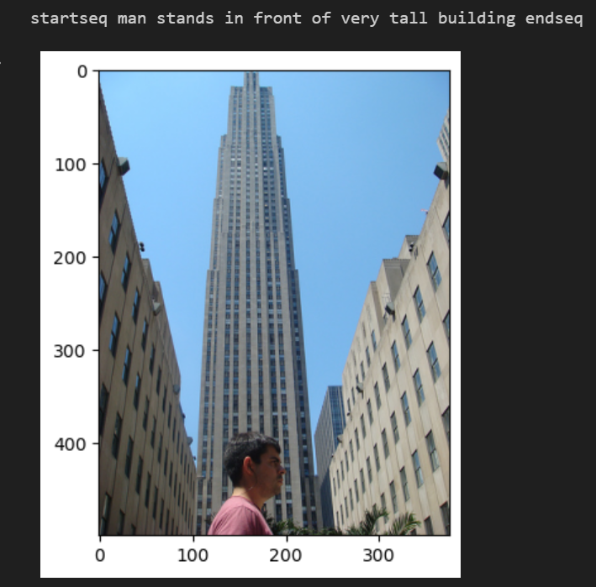
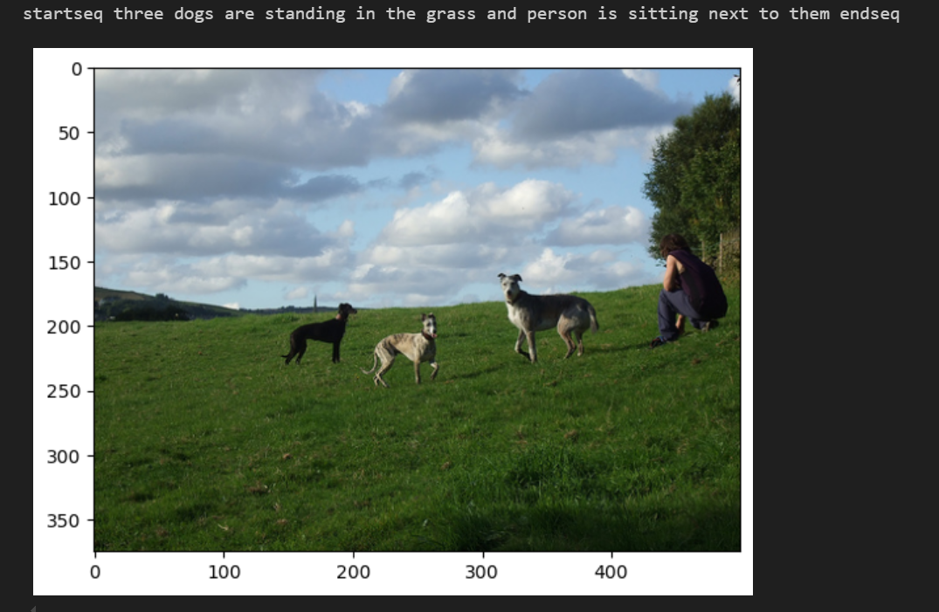
RESULTS

