Slide 1

Data visualization
Rajasekaran & shaik Mastan
Information Technology Department
Ibri College of Technology
Sultanate of Oman.

Slide 2
Agenda
Python IDE
Essential Libraries
.CSV File
Loading data into pandas
Examples using pandas
Data Visualization using matplotlib
Drawing graphs / charts
Saving your chart to a .pdf file
Clarifications
Vote of Thanks

Slide 3
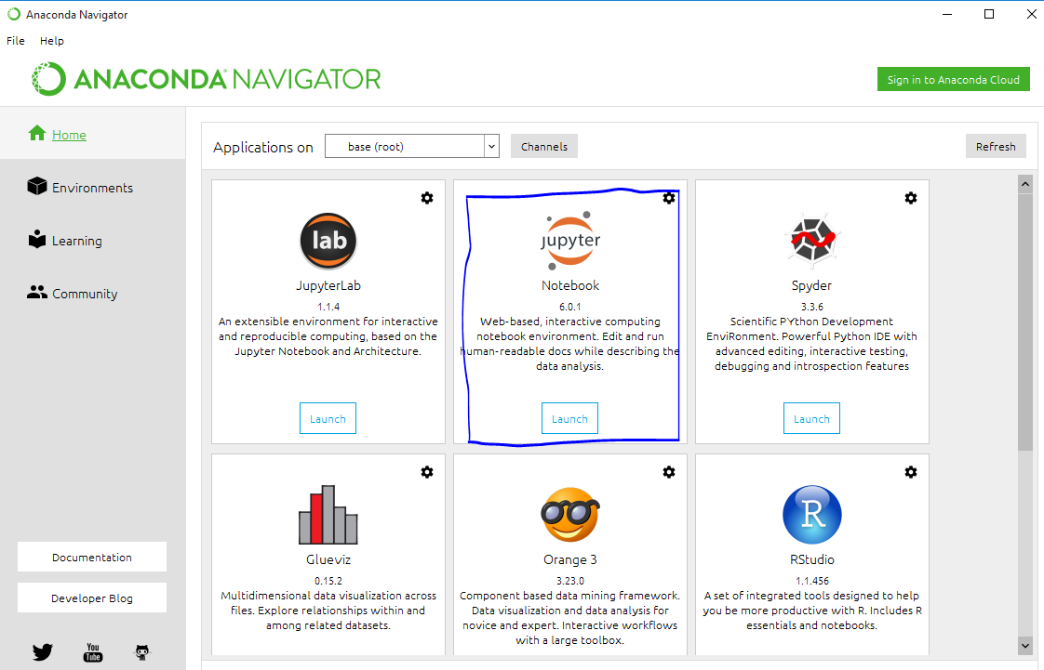

Slide 4
Essential Libraries
NumPy: For scientific computing. general-purpose array-processing package. It provides high-performance multidimensional array objects and tools to work with the arrays.
Pandas: Pandas take data in a CSV file or a SQL database and create a Python object with rows and columns called a data frame. It's based on two main data structures: "Series" (one-dimensional, like a list of items) and "Data Frames" (two-dimensional, like a table with multiple columns). Pandas allows converting data structures to DataFrame objects, handling missing data, and adding/deleting columns from DataFrame, imputing missing files, and plotting data with histogram or plot box. It’s a must-have for data wrangling, manipulation, and visualization.

Slide 5
Matplotlib: helps to generate data visualizations such as two-dimensional diagrams and graphs.
Scikitlearn: It features ML algorithms like SVMs, random forests, k-means clustering, spectral clustering, mean shift, cross-validation and more...
TensorFlow: TensorFlow is an AI library that helps developers to create large-scale neural networks with many layers using data flow graphs. TensorFlow also facilitates the building of Deep Learning models, push the state-of-the-art in ML/AI and allow easy deploy of ML-powered applications.
Django: High-level Python Web framework that encourages rapid development.

Slide 6
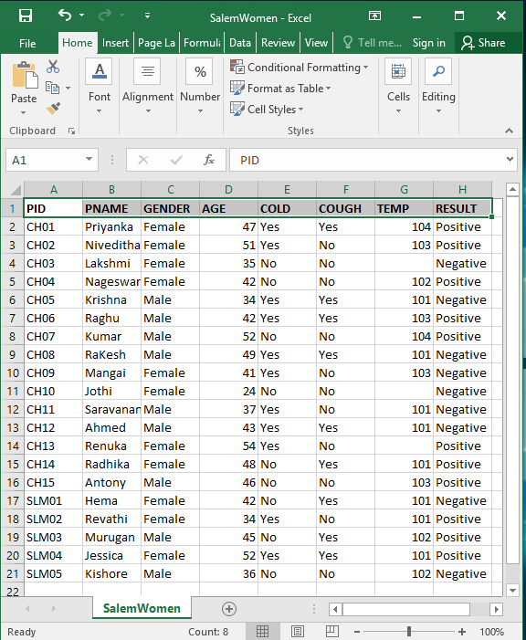
SalemWomen.csv

Slide 7
Key Features of Pandas
Pandas is an open-source Python Library providing high-performance data manipulation and analysis tool using its powerful data structures.
The name Pandas is derived from the word Panel Data – an Econometrics from Multidimensional data.
Fast and efficient DataFrame object with default and customized indexing.
Tools for loading data into in-memory data objects from different file formats.
Data alignment and integrated handling of missing data.
Label-based slicing, indexing and subsetting of large data sets.
Columns from a data structure can be deleted or inserted.
Group by data for aggregation and transformations.
High performance merging and joining of data.

Slide 8
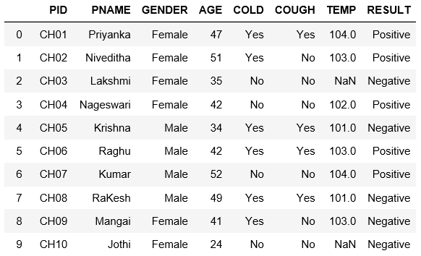
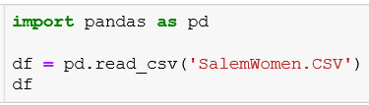
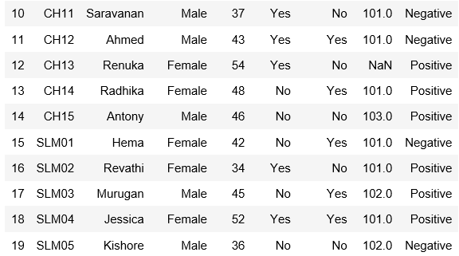

Loading Data into pandas
Read from .CSV file
Read from EXCEL File

Slide 9

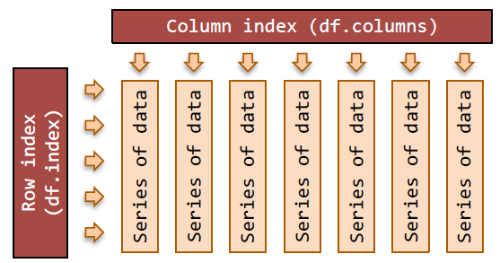
DataFrame
df = pd.read_csv('SalemWomen.CSV')
df is now what Pandas call a DataFrame object.
This object keeps track of both data (numerical as well as text), and column and row headers.
DataFrame is a container of Series.
DataFrame is 2D and Series is 1D.
The pandas DataFrame is a 2D table of data with column and row indexes.
The columns are made up of pandas Series objects.

Slide 10
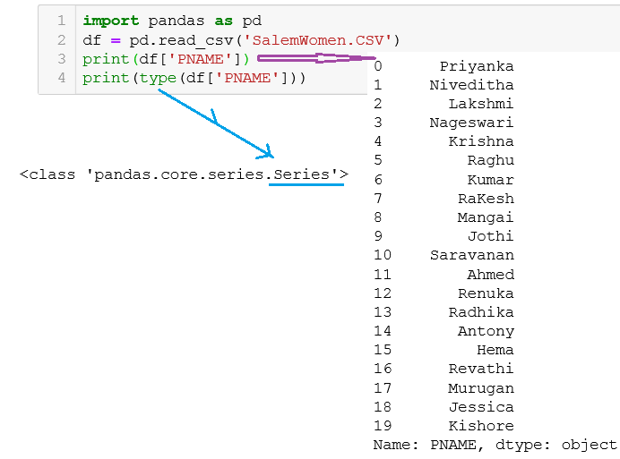
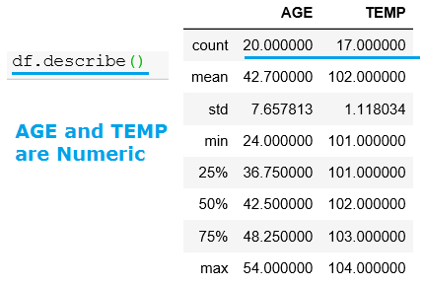

Slide 11
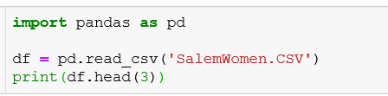

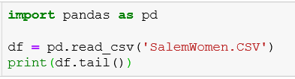
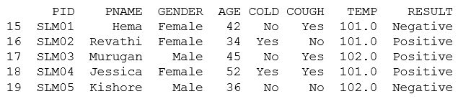
Using head() and tail()

Slide 12
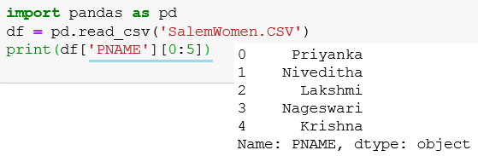
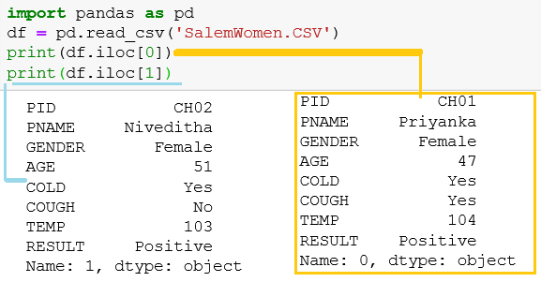


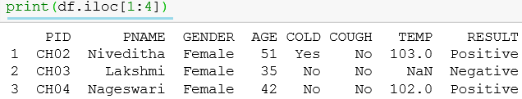
iloc

Slide 13
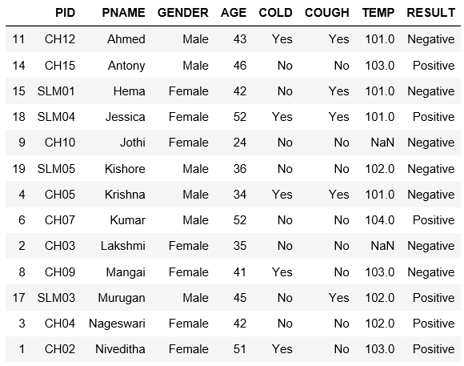
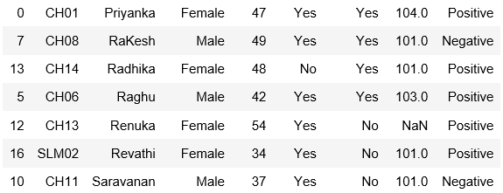

Slide 14
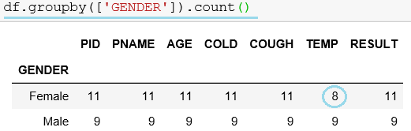
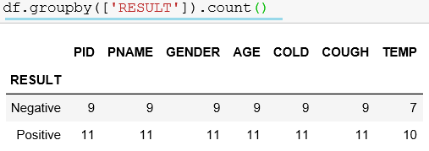
groupby

Slide 15
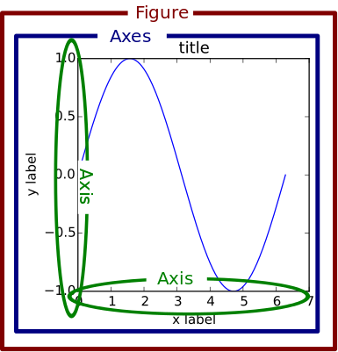
data visualization: Matplotlib in Python
I believe that visualization is one of the most powerful means of achieving personal goals.
Harvey Mackay

Slide 16
Visualizations are the easiest way to analyze and absorb information.
Visuals help to easily understand the complex problem.
Matplotlib is one of the most popular Python packages used for data visualization
Naturally, data scientists want a way to visualize their data.
We just import pyplot from matplotlib
matplotlib.pyplot is a python package used for 2D graphics.
Types of plots Bar Graph Histogram Scatter Plot Area Plot Pie Chart

Slide 17
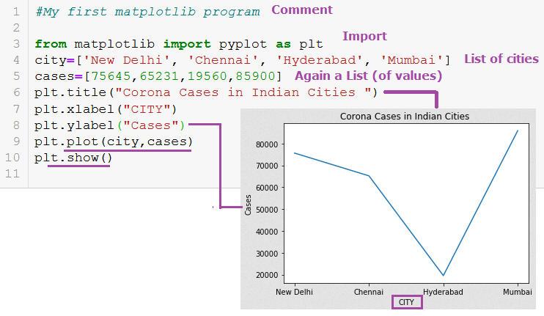

Slide 18
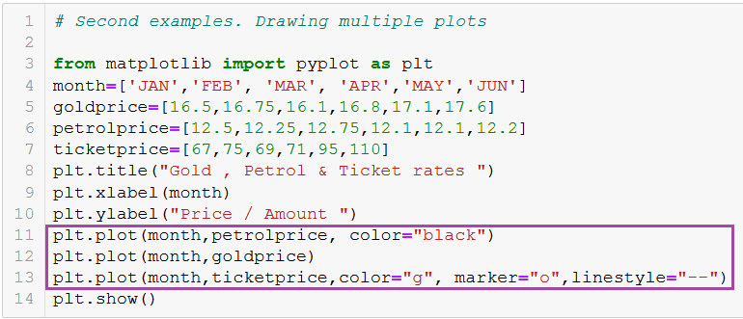
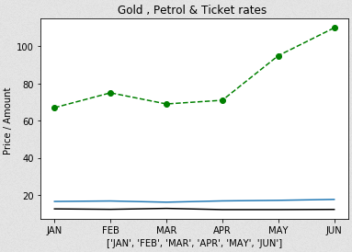
Marker & linestyle

Slide 19
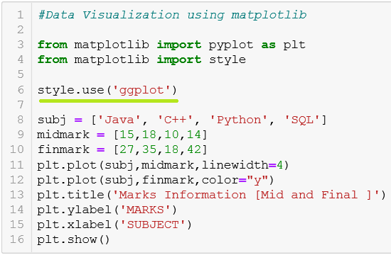
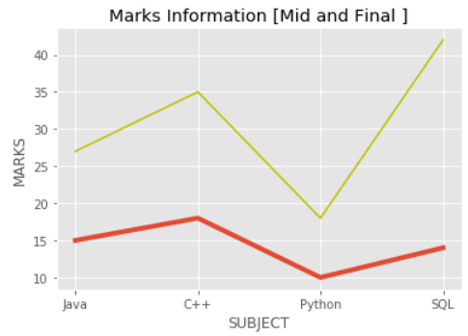

Slide 20
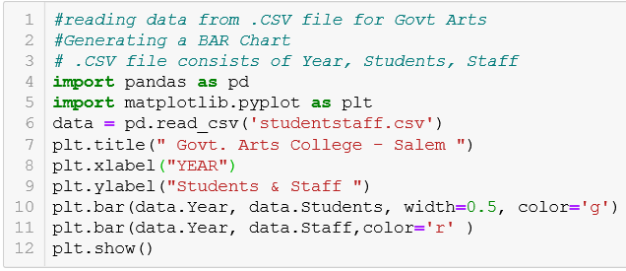
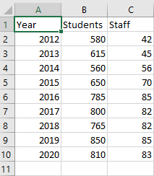
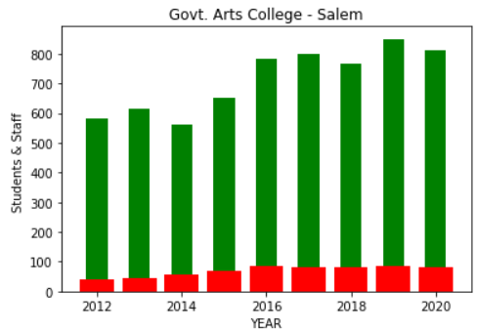

Slide 21
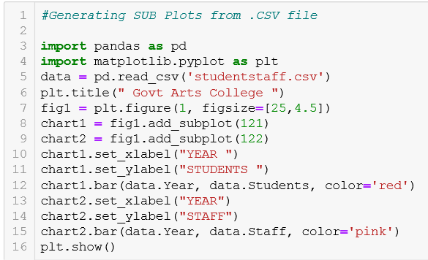
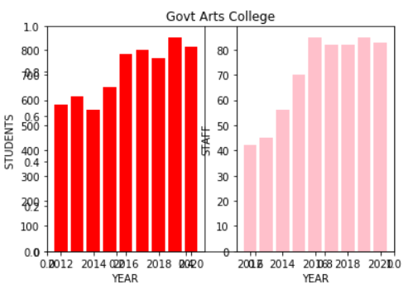
Sub plots

Slide 22
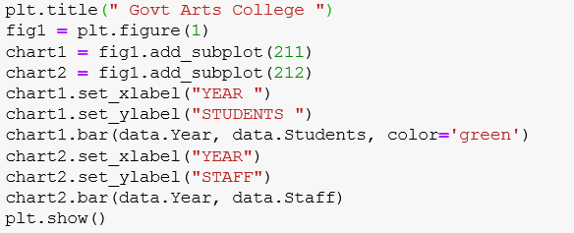
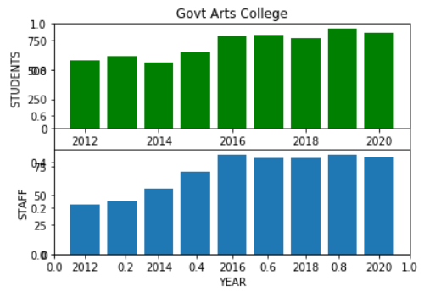
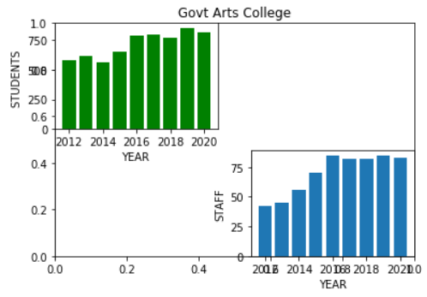


Slide 23
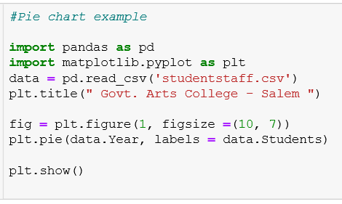
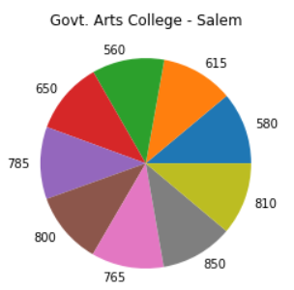

Slide 24
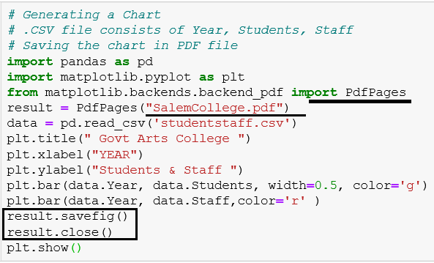
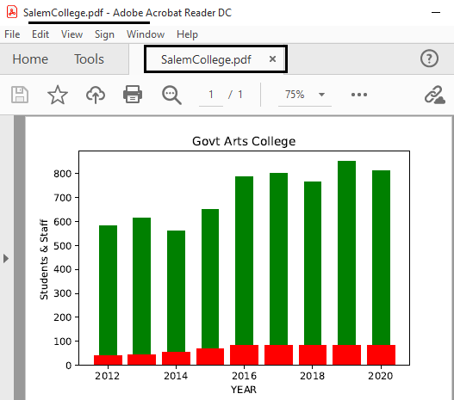
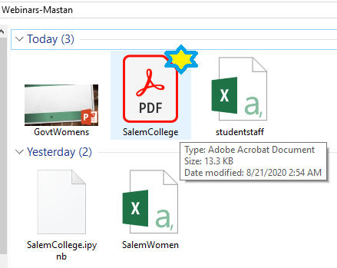
Saving your chart in .pdf

Slide 25


