Slide 1

SpaGCN: Identifying Spatial Domains and Variable Genes through Graph Convolutional Networks with Gene Expression, Spatial Location, and Histology Integration
Computational Genomics – May 2023
Ksenija Mladenovic (3336/2022)
Emilija Nikic (3077/2022)
Aleksa Bogdanovic (3333/2022)

Slide 2
Introduction
Spatial transcriptomics technologies have made it possible to analyze gene expression with spatial information in tissues
Traditional clustering methods cannot account for spatial information and histology, leading to non-contiguous clusters
To address this issue, new methods have been developed, such as stLearn, BayesSpace, and Zhu et al
To link spatial domains with biological functions at the gene expression level, it is crucial to identify genes that show enriched expression in the identified domains
Current methods such as Trendsceek, SpatialDE, and SPARK do not consider tissue taxonomy, making it difficult to utilize these genes for further biological investigations

Slide 3
SpaGCN
SpaGCN is a graph convolutional network-based approach that considers the joint identification of spatial domains and spatially variable genes
SpaGCN first identifies spatial domains using a graph convolutional network with an added iterative clustering layer, which integrates gene expression, spatial location, and histology through the construction of an undirected weighted graph that represents the spatial dependency of the data
For each spatial domain, SpaGCN then detects spatially variable genes (SVGs) that are enriched in the domain against its surrounding regions by differential expression analysis guided by domain information
SpaGCN also has the option to detect meta genes that are uniquely expressed in a given domain

Slide 4
SpaGCN
SpaGCN works with both sequencing-based and smFISH-based data, and uses a graph convolutional layer to aggregate gene expression information from neighboring samples
It then clusters the samples into spatial domains, and detects Spatially Variable Genes (SVGs) that are enriched in each domain
If a single gene cannot represent the expression pattern of a domain, SpaGCN constructs a meta gene by combining multiple SVGs
The method also offers subcluster detection within each spatial domain
Compared to other methods, SpaGCN was found to detect SVGs with more coherent expression patterns and better biological interpretability

Slide 5
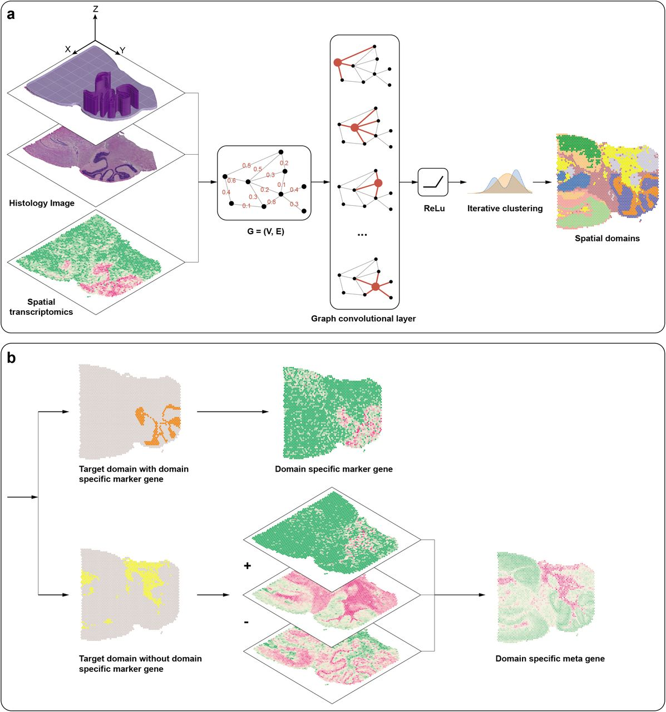
Workflow of spaGCN
First picture: SpaGCN starts from integrating gene expression, spatial location and histology information using a graph convolutional network (GCN), then separates spots into different spatial domains using unsupervised iterative clustering
Second picture: For each detected spatial domain, SpaGCN identifies SVGs or meta genes by domain guided differential expression analysis

Slide 6
Application to mouse olfactory bulb data
To assess the effectiveness of SpaGCN, the authors analyzed a dataset of mouse olfactory bulb (MOB), which consists of genes measured in 262 spots across five layers of MOB
The authors compared the clustering results of SpaGCN to K-means and Louvain methods, with SpaGCN producing more accurate results in line with the known 5-layer structure of MOB
The authors then used SpaGCN to detect 60 SVGs specific to each spatial domain, with genes showing strong specificity for the corresponding domain
The study demonstrates the effectiveness of SpaGCN in identifying domain-specific SVGs in single-cell RNA sequencing data.

Slide 7
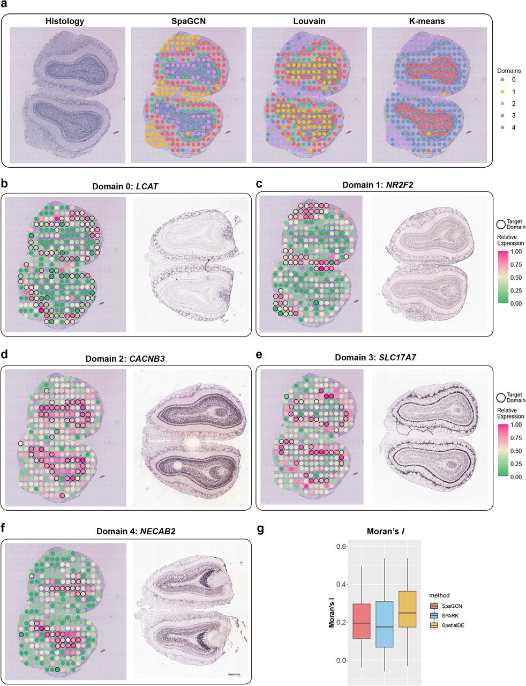
Spatial domains and SVGs detected in the mouse olfactory bulb dataset
a) Histology image of the tissue section and spatial domains detected by SpaGCN, Louvain’s method, and K-means clustering
b-f) Spatial expression patterns of SVGs detected by SpaGCN for domains 0 (LCAT), 1 (NR2F2), 2 (CACNB3),3 (SLC17A7), and 4 (NECAB2), and the corresponding in situ hybridization of these SVGs obtained from the Allen Brain Atlas
g) Boxplot of Moran’s I values for SVGs detected by SpaGCN, SPARK, and SpatialDE.

Slide 8
Application to mouse posterior brain data
The results show that SpaGCN's spatial domains are more spatially contiguous than Louvain's results. The analysis further explores the number of spatially variable genes (SVGs) detected by SpaGCN, SpatialDE, and SPARK
It shows that SpaGCN detected fewer SVGs, but they have clear spatial expression patterns compared to the other methods
SpaGCN's filtering criteria eliminates false positives and ensures clear spatial expression patterns of all detected SVGs
SpaGCN identifies a meta gene by combining multiple genes to accurately mark a spatial domain, where a single gene is not enough

Slide 9
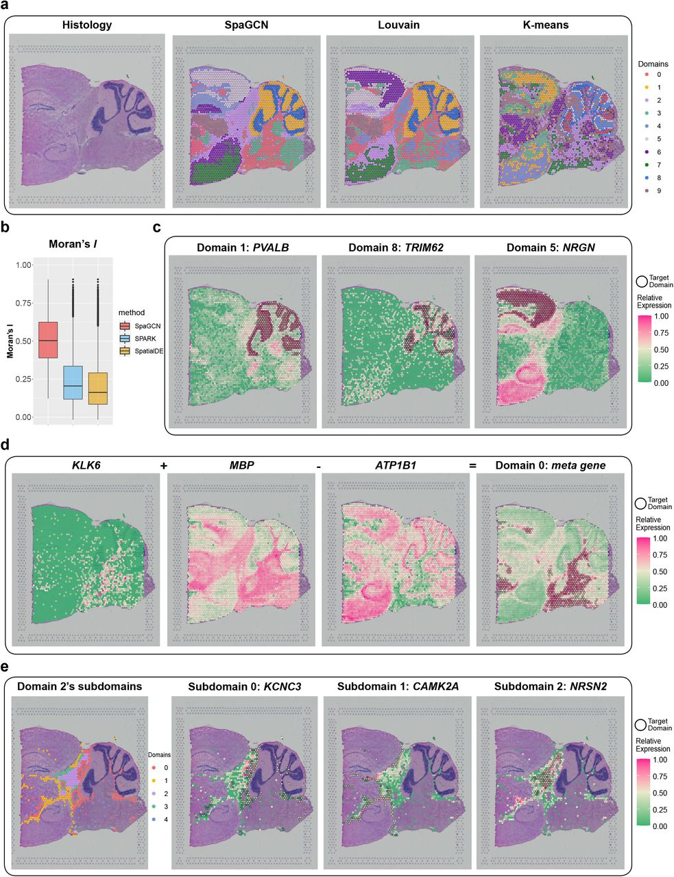
Spatial domains and SVGs detected in the mouse brain posterior brain dataset
a) Histology image of the tissue section and spatial domains detected by SpaGCN
b) Boxplot of Moran’s I values for SVGs detected by SpaGCN, SPARK, and SpatialDE
c) Spatial expression patterns of SVGs detected by SpaGCN for domain 1 (PVALB), 8 (TRIM62), and 5 (NRGN)
d) Spatial expression patterns of genes KLK6, MBP, ATP1B1
e) Clustering results for 5 sub-domains detected by SpaGCN for domain 2, and the spatial expression patterns of SVGs for sub-domains 0 (KCNC3), 1 (CAMK2A), and 2 (NRSN2)

Slide 10
Application to LIBD human dorsolateral prefrontal cortex data
The SpaGCN method has been shown to be advantageous over other methods when applied to the LIBD human dorsolateral prefrontal cortex (DLPFC) data
The DLPFC data was obtained by sequencing 12 slices from DLPFC that span six neuronal layers plus white matter
SpaGCN successfully identified layer structures with clear boundaries, unlike K-means and Louvain, which failed to do so
SpaGCN was also able to detect spatially variable genes (SVGs), which showed that gene expression profiles of spots from white matter are distinct from spots in the neuronal layers
SpaGCN also found layer-specific meta genes, which were useful for downstream analysis

Slide 11
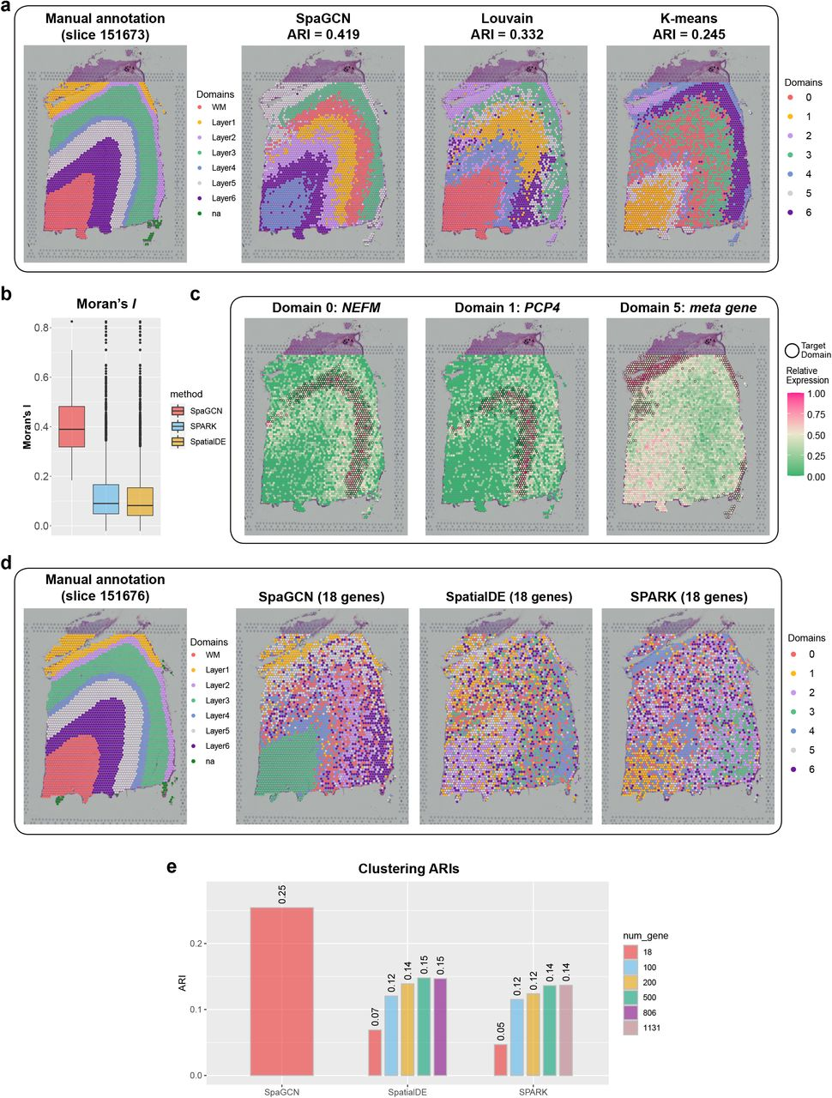
Spatial domains and SVGs detected in the LIBD human dorsolateral prefrontal cortex dataset
a) Manually annotated layer structure for slice 151673 from the original study20, and spatial domains detected by SpaGCN, Louvain’s method, and K-means clustering
b) Boxplot of Moran’s I values for SVGs detected by SpaGCN, SPARK, and SpatialDE for slice 151673
c) Spatial expression patterns of SVGs for domain 0 (NEFM) and domains 1 (PCP4), and a meta genes
d) Manually annotated layer structure for slice 151676 from the original study20, and K-means clustering results for slice 151676 using 18 genes selected by SpaGCN, SPARK, and SpatialDE
e) ARIs between manually annotated layers and K-means’ clustering using SVGs selected by different methods

Slide 12
Application to human primary pancreatic cancer tissue
The authors analyzed a human primary pancreatic cancer tissue dataset consisting of 224 spots and 16,448 genes across 3 manually annotated sections to demonstrate SpaGCN's ability to detect tumorous regions
SpaGCN detected 12 SVGs, with 3, 8, and 1 SVGs for domains 0, 1, and 2, respectively
They also identified a meta gene using KRT17, MMP11, and SERPINA1 that marked the cancer region better than the originally identified SVG KRT17
KRT17 functions as a tumor promoter and regulates proliferation in pancreatic cancer, and MMP11 has been found to be a prognostic biomarker for pancreatic cancer

Slide 13
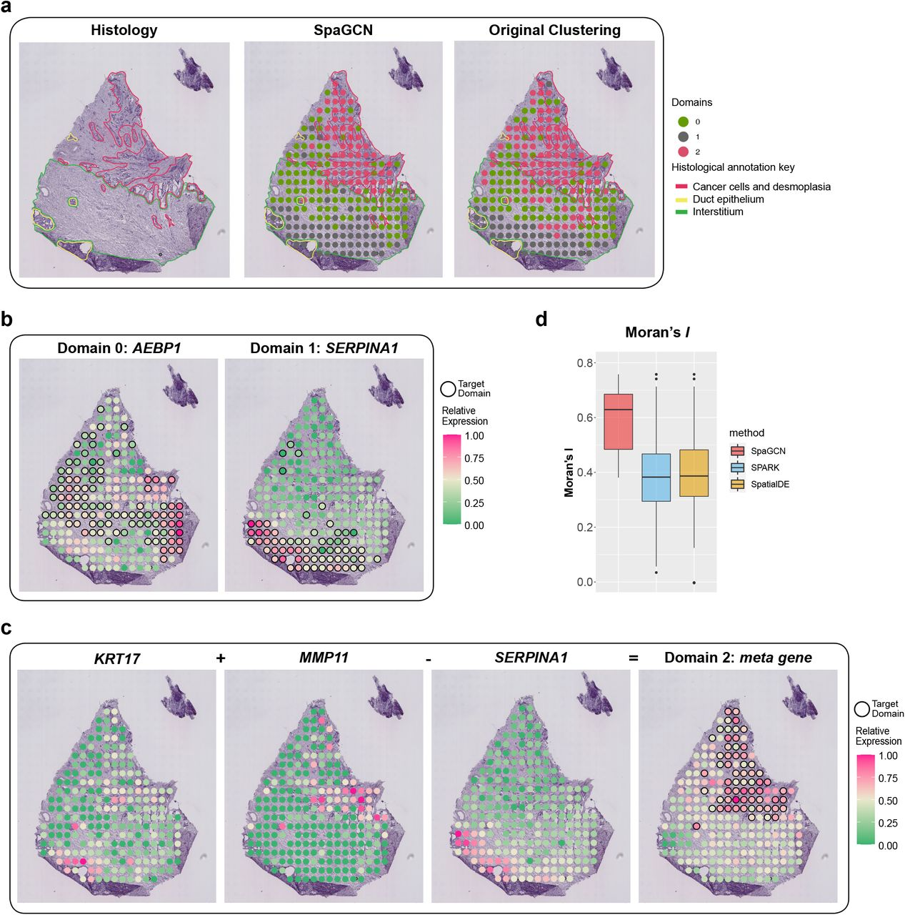
Spatial domains and SVGs detected in the human primary pancreatic cancer tissue dataset
a) Histology image of the tissue section with manually annotated regions from the original study5, spatial domains detected by SpaGCN, and clustering results from the original study.
b) Spatial expression pattern of SVGs detected by SpaGCN for domain 0 (AEBP1) and domain 1 (SERPINA1)
c) Spatial expression patterns of genes KRT17, MMP11, SERPINA1, which form the specific marker meta gene for domain 2 (KRT17 + MMP11 - SERPINA1)
d) Boxplot of Moran’s I values for SVGs detected by SpaGCN, SPARK, and SpatialDE

Slide 14
Application to MERFISH mouse hypothalamus data
Unlike sequencing-based spatial transcriptomics data, the captured tissue area is smaller, and fewer genes are measured, making it challenging to detect spatial domains
However, SpaGCN detected spatial domains that corresponded well with the annotated hypothalamic nuclei, with domain 2 corresponding to ACA, domain 3 corresponding to PS, and domain 7 corresponding to MnPo.
In contrast, the domains identified by the Hidden Markov Random Field (HMRF) approach showed little overlap with the hypothalamic region annotation
SpaGCN also detected 19 SVGs, including DGKK, ERMN, and SLN, which showed enriched expression patterns for domains 2, 3, and 7.

Slide 15
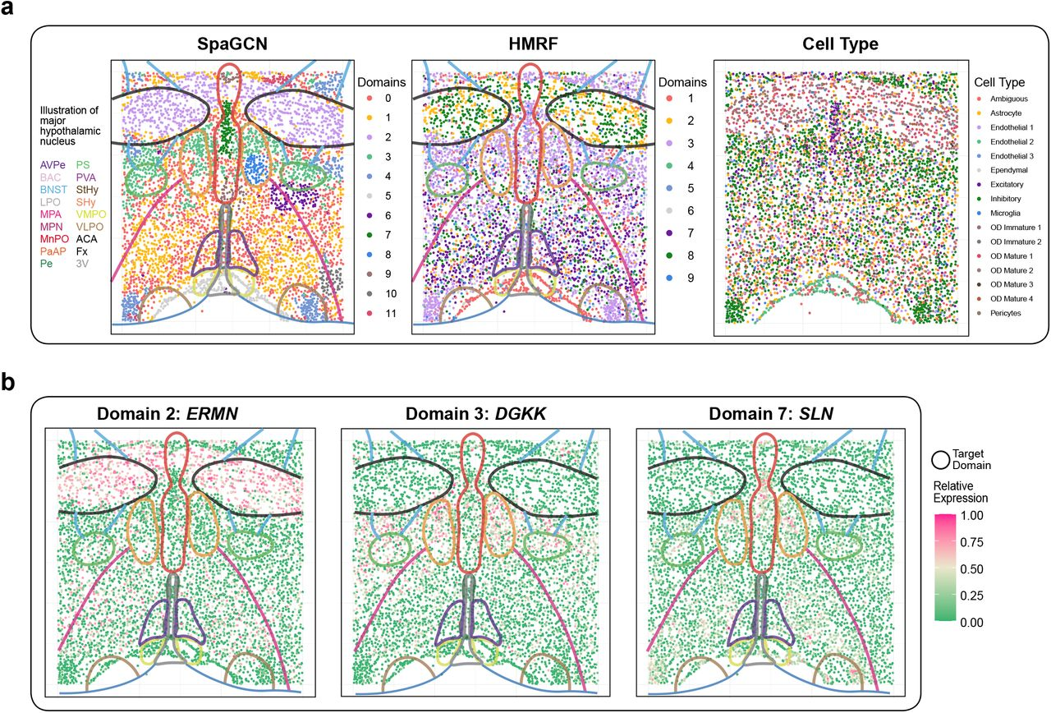
Spatial domains and SVGs detected in the MERFISH mouse brain hypothalamus dataset
a) Spatial domains detected by SpaGCN and the HMRF method overlayed with annotated hypothalamic nuclei from the original study2, and cell type distribution from the original study
b) Spatial expression patterns of SVGs detected by SpaGCN for domain 2 (ERMN), domain 3 (DGKK), and domain 7 (SLN)

Slide 16
Results discussion
SpaGCN also allows users to customize SVG filtering criteria based on p-value and three additional metrics
The authors recorded the run time and memory usage for the mouse posterior brain data, SpaGCN completed spatial domain and SVG detection in less than one minute
The authors demonstrated that SpaGCN is a flexible, fast, and memory-efficient approach for analyzing spatial transcriptomics data
It enables accurate identification of spatial domains and SVGs in large-scale spatial transcriptomics studies, which can have significant implications in understanding the spatial organization of gene expression and its role in disease pathogenesis

