Slide 1
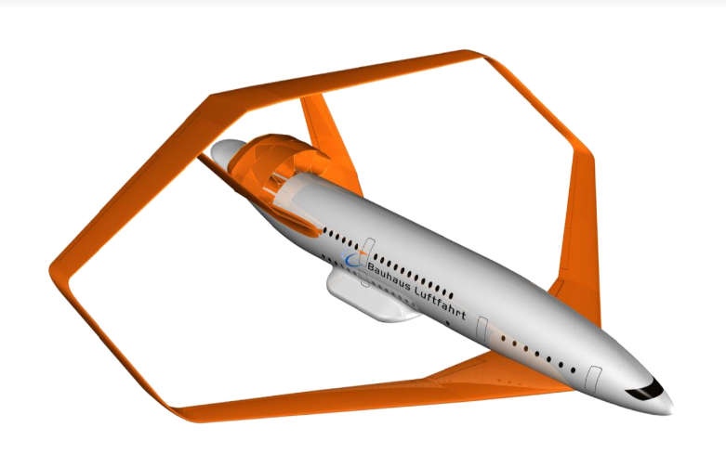
Aircraft Design Advanced Meric Taneri
Radical Aircraft Concepts
Aircraft Design Frameworks
UNICADO
Full and Hybrid Electric Aircraft
Hydrogen Aircraft
Unconventional Configurations
Design Evaluation and Life Cycle Assessment
Fleet and Network, Operations

Slide 2
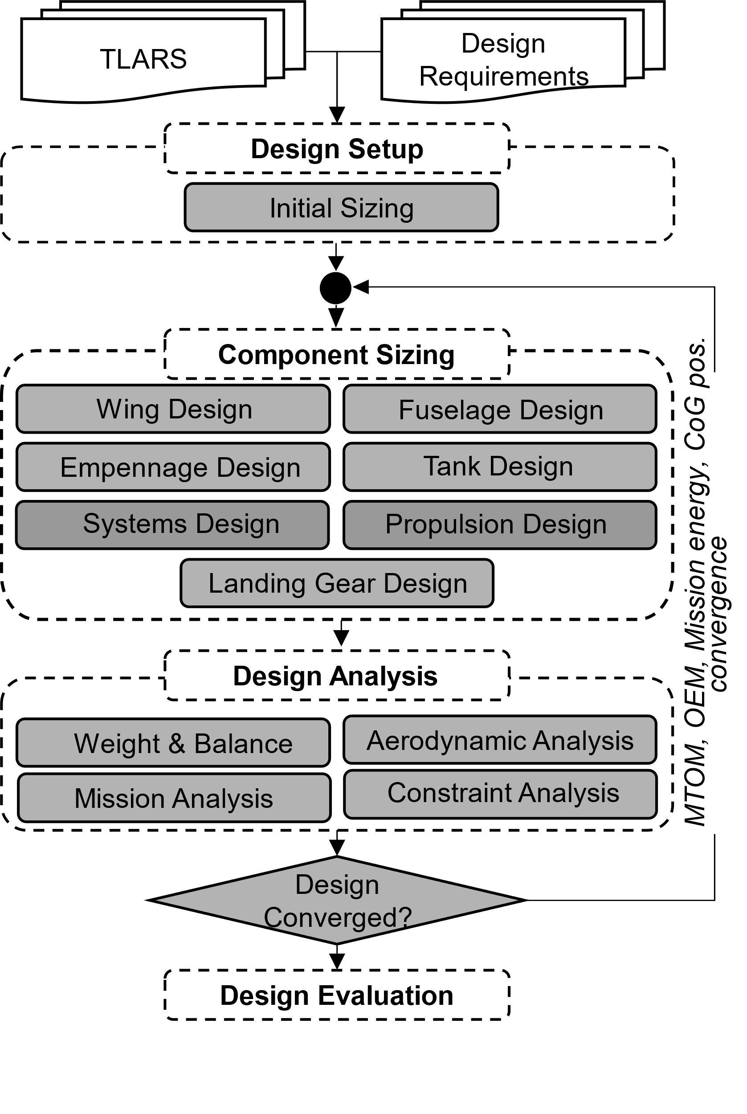
Previously on UNICADO
A “quick” rundown of component design cluster
Some information about the Aircraft XML file and configurations
Challenges of Component Design
Component Design
Today is going to be all about design analysis and the convergence loop
Design evaluation will be covered at later lectures throughout the semester.

Slide 3
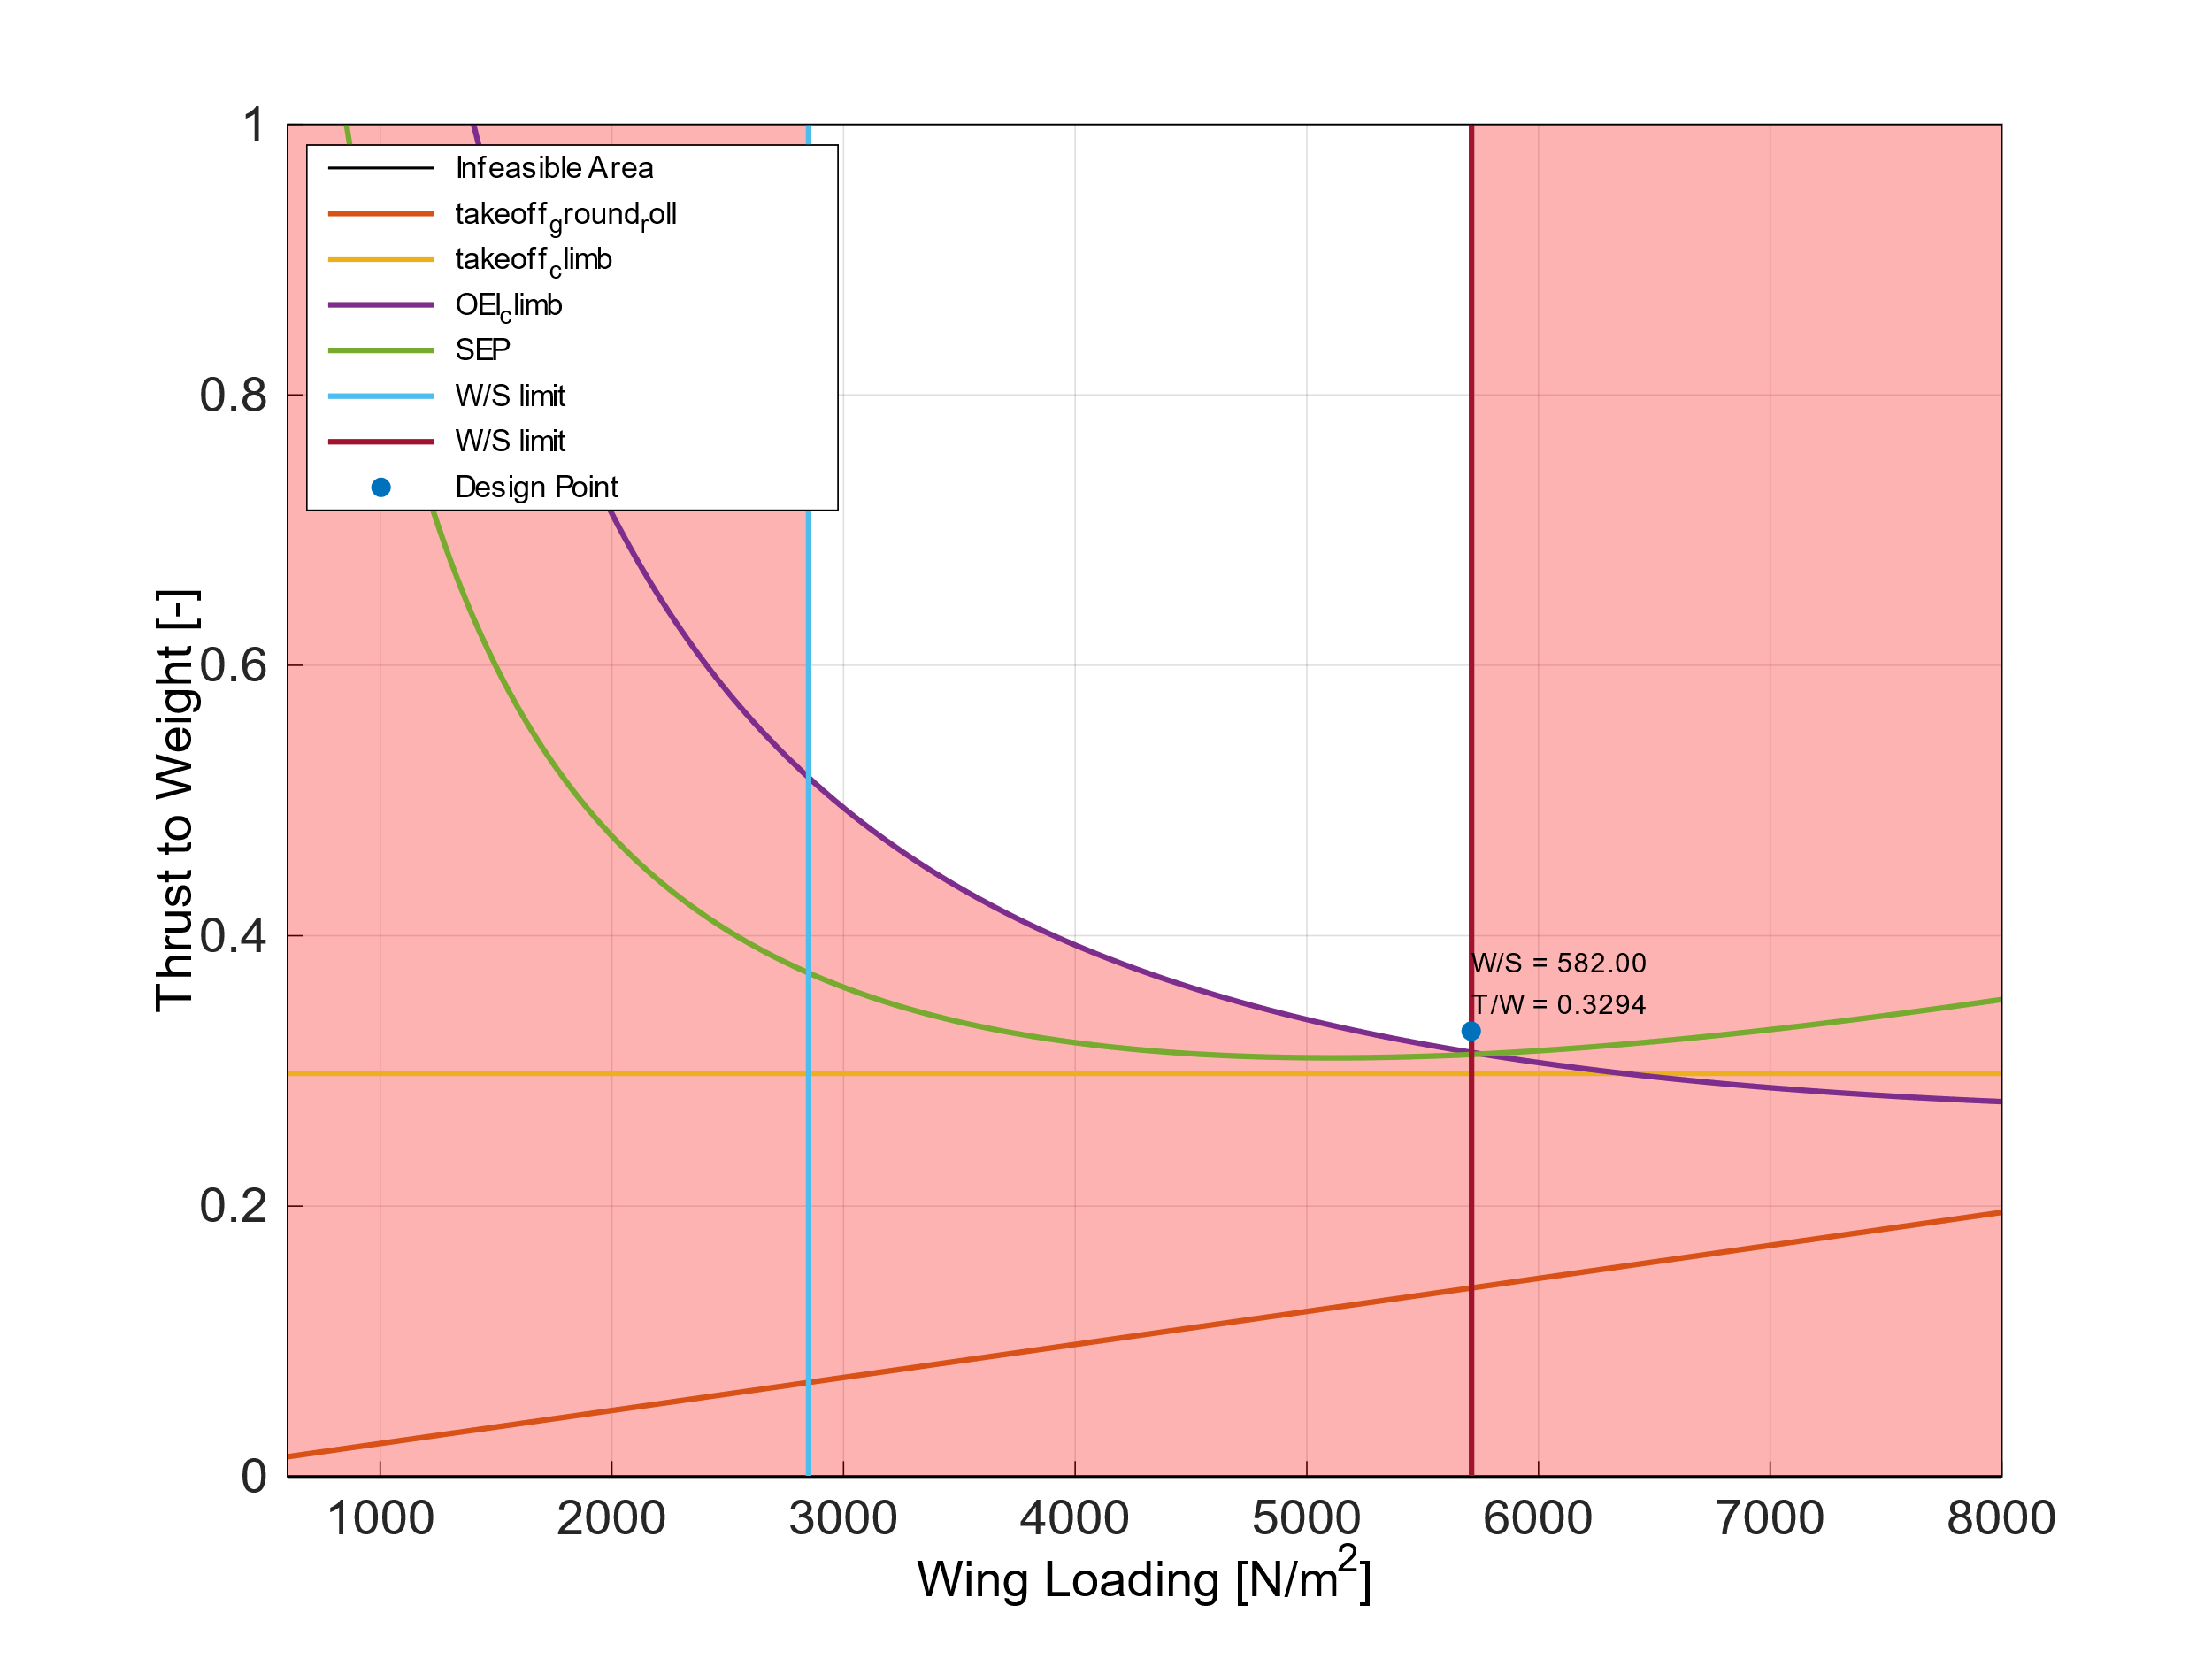
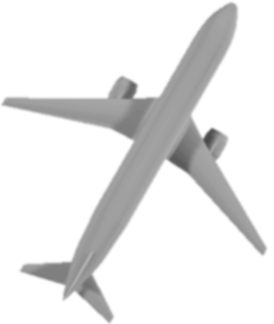
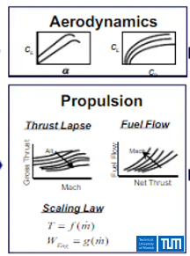

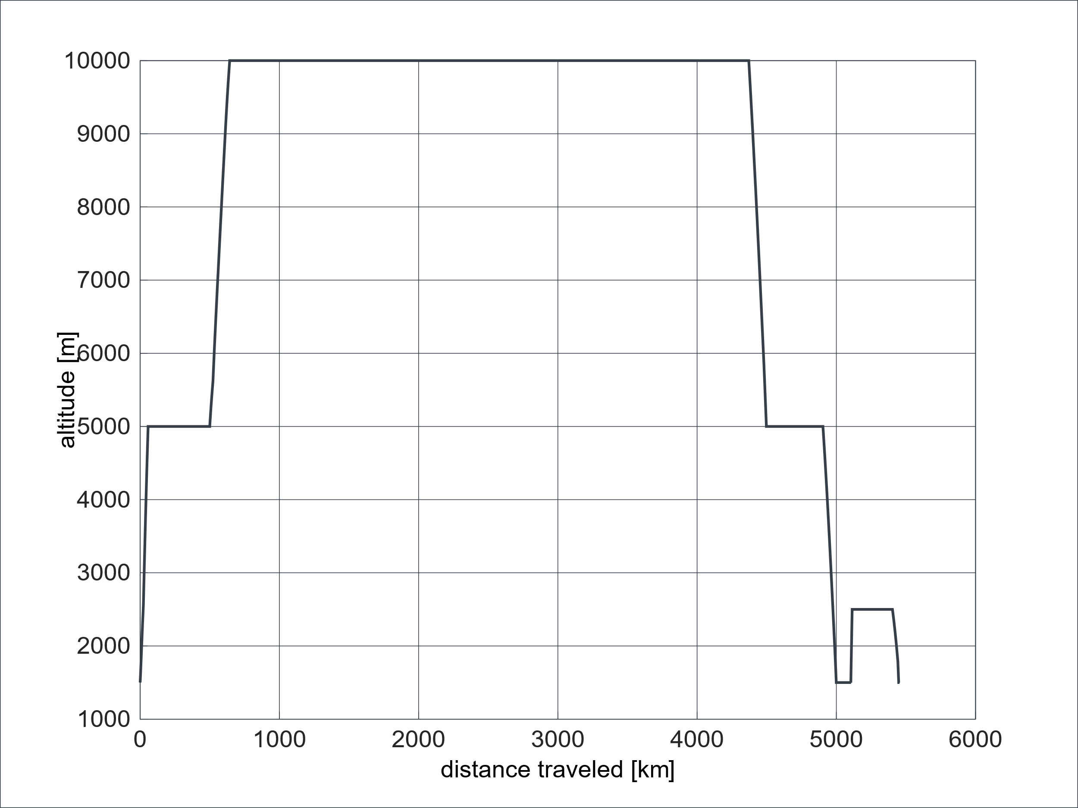



Design Analysis and Convergence Loop
Point Performance Requirements
Component Design
Constraint Analysis
$$T_{SL}/W_{TO}$$
$$W_{TO}/S_{Ref}$$
Design Choices
Component Design
Weight fractions
TLARs
Mission Analysis
$$W_{TO}$$
$$W_{E}$$
$$W_{F}$$
$W_{P}$
Aircraft Concept
Weight and Balance Analysis
Mission Performance Requirements

Slide 4
Design Analysis
Analyzes the current state of the design
Where snowball effects and trends are realized
Where assumptions and documentations become crucial
Where robustness becomes an issue
Component Design
Design Analysis
Three objectives:
Capture fundamental phenomena
Allow integration of higher fidelity analysis tools to capture additional effects
Documentation

Slide 5








Aerodynamic Analysis
Let’s do an example functional breakdown
What do I need from an “aerodynamic analysis” tool?
Component Design
Calculate $C_{D}$
Calculate $C_{Di}$
Calculate $C_{L}$
Calculate $C_{D0}$
Calculate $C_{f}$
Calculate $C_{M}$
Calculate $C_{D_{fi}}$
Design Analysis
Read A/C geometry
Calculate $C_{D_{wave}}$
Do trim
Create polar
Store polar

Slide 6
Aerodynamic Analysis
Here is a list of tools and methods that are available for doing Aerodynamic Analysis – some are in UNICADO
UNICADO uses the Lifting Line Version 3.1 developed by Karl Heinz Horstmann
Integration of AVL is in progress
Polhamus (from Aircraft Design Basics) can be integrated
Drag component build-up method (Raymer)
Component Design
Equivalent skin friction method (Raymer)
Transsonic wave drag increase estimation (Malone & Mason)
Lift curve slope calculation (Polhamus, slender body, lifting line, Ackeret)
Aerodynamics
Oswald factor estimation (Nita & Scholz)
XFoil (Drela)
Design Analysis
Xrotor (Drela)
AVL (Drela)
PAWAT – propeller and wing aerodynamics tool (in-house: Steiner)

Slide 7

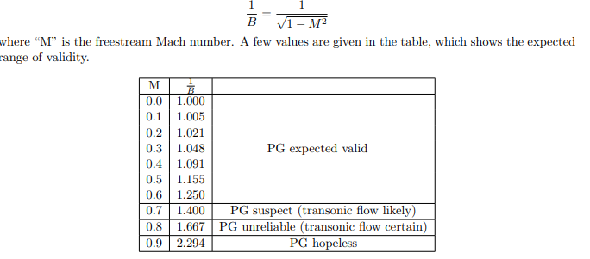
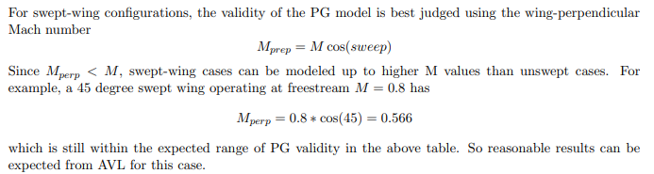
Aerodynamic Analysis
Lifting_Line – Assumptions
Potential-theoretical procedure for the case of a
smooth,
incompressible flows,
assuming that the airfoil profiles are thin and able to be modelled by flat plates
An inviscid, irrotational and steady flow around a wing is modeled by the distribution of a system of singularities over the wing and the superposition of this system with the undisturbed incoming flow
If necessary, a compressibility correction (Göthert) with the appropriate geometric modifications can be switched on
Vortex Lattice (AVL) – Assumptions
Best suited for aerodynamic configurations which consist mainly of:
thin lifting surfaces
at small angles of attack
at small angles of sideslip
Assumes quasi-steady flow, meaning that unsteady vorticity shedding is neglected.
Compressibility is treated in AVL using the classical Prandtl-Glauert (PG) transformation

Slide 8
Aerodynamic Analysis
Questions:
Are the assumptions checked?
They should be checked
What if the configuration does not comply with the assumptions
Throw a warning message to inform the user or,
Create an internal procedure to make the correction
Do not make the correction to get to a number, make the correction to get the phenomena
Can all the functions be fulfilled with just AVL or Lifting_Line?

Slide 9
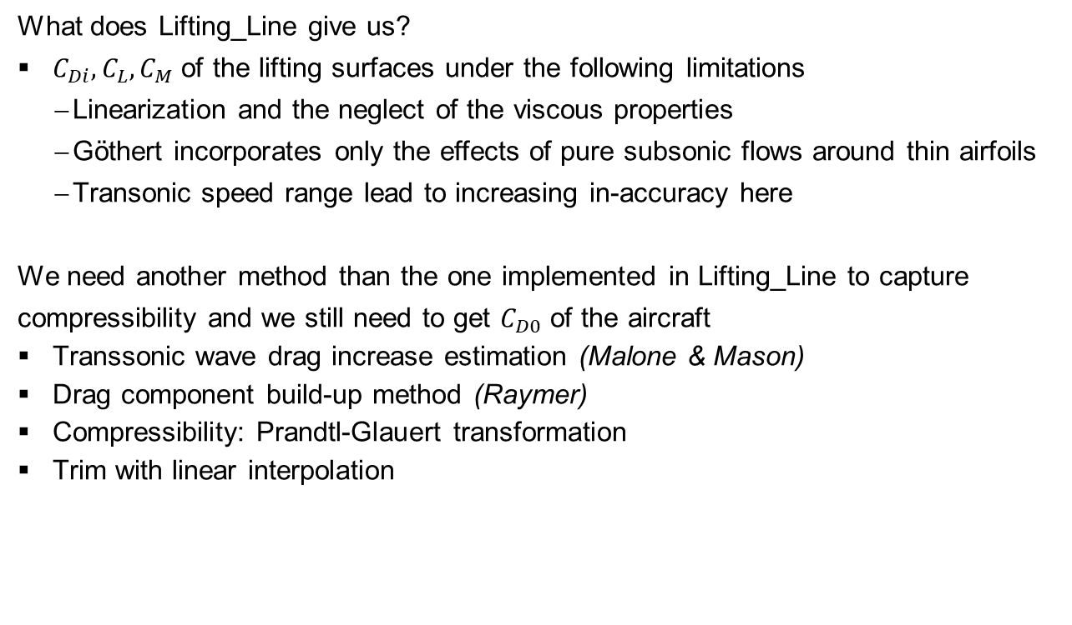
Aerodynamic Analysis
What does Lifting_Line give us?
$C_{Di}, C_{L},C_{M}$ of the lifting surfaces under the following limitations
Linearization and the neglect of the viscous properties
Göthert incorporates only the effects of pure subsonic flows around thin airfoils
Transonic speed range lead to increasing in-accuracy here
We need another method than the one implemented in Lifting_Line to capture compressibility and we still need to get $C_{D0}$ of the aircraft
Transsonic wave drag increase estimation (Malone & Mason)
Drag component build-up method (Raymer)
Compressibility: Prandtl-Glauert transformation
Trim with linear interpolation
Component Design
Design Analysis
Notes:
Mention that the documentation can be given if wanted

Slide 10
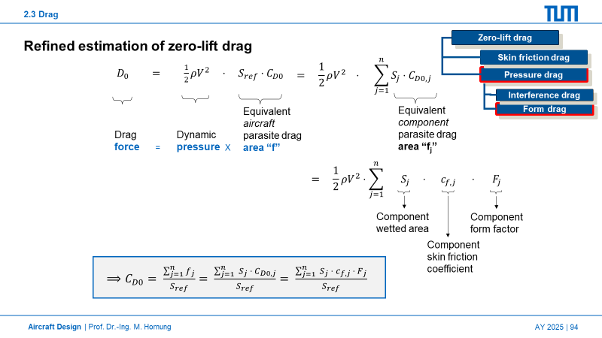
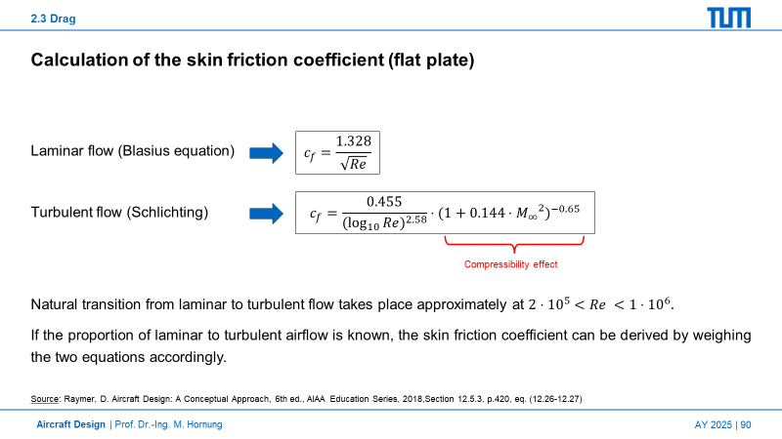
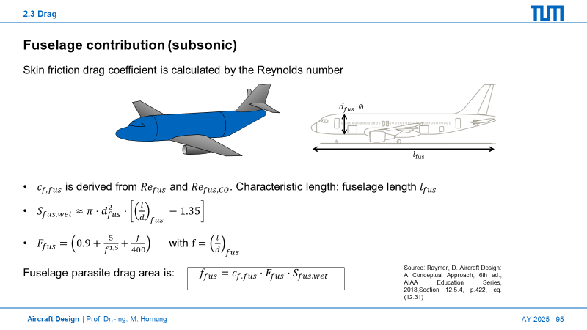
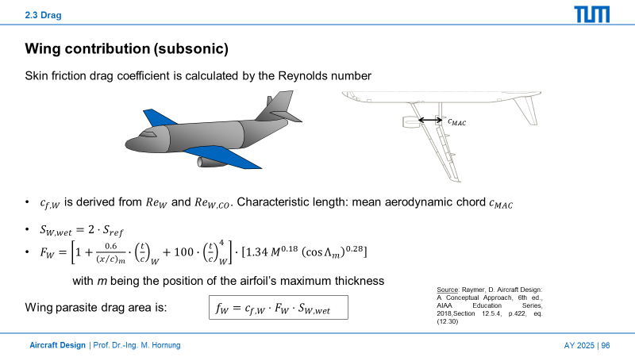
Aerodynamic Analysis
Component Build-up Method from Aircraft Design Basics: Is applied within the design environment
Why? Because you can get the trends and snowball effects even with these “very simple” equations
+ You can use these methods on “segments” rather than the whole surface to make them more “complex”

Slide 11
Aerodynamic Analysis
Main challenge
Capturing assumptions and conditions under which the equations and methods are applied
In UNICADO aerodynamic analysis, there is a “one method to rule them all” approach meaning that a single method is implemented and applied to all conditions and configurations without any documentation
A good documentation example would be USAF STABILITY AND CONTROL, DATCOM ADB072483
3134 pages of pure documentation
Always make sure to check the assumptions and limitations of tools that you implement
Make sure to document these for the users
Add references to the material that you are using

Slide 12
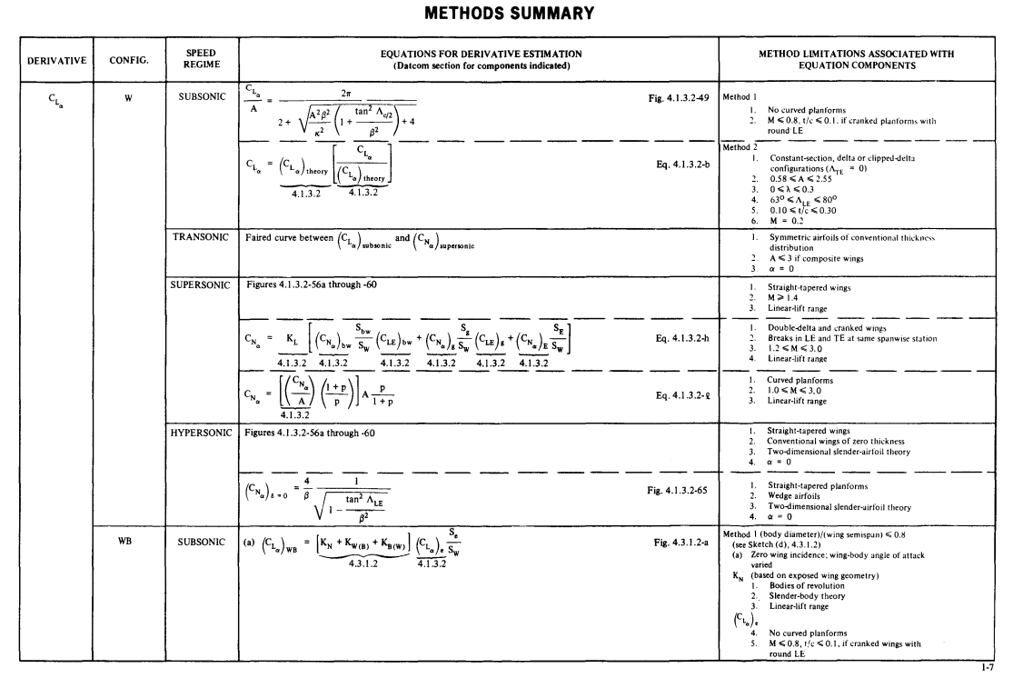
Source: R. D. Finck, USAF STABILITY AND CONTROL DATCOM, McDonnell Douglas Corporation Douglas Aircraft Division, 1978, Section 1, 1-7
Notes:
There is a lot of room to grow in UNICADO
This report is a collection, correlation, codification, and recording of best knowledge, opinion, and judgment in the area of aerodynamic stability and control prediction methods. It presents substantiated techniques for use 1 early in the design or concept study phase, 2 to evaluate changes resulting from proposed engineering fixes, and 3 as a training on cross-training aid. It bridges the gap between theory and practice by including a combination of pertinent discussion and proven practical methods. For any given configuration and flight condition, a complete set of stability and control derivatives can be determined without resort to outside information. A spectrum of methods is presented, ranging from very simple and easily applied techniques to quite accurate and thorough procedures. Comparatively simple methods are presented in complete form, while the more complex methods are often handled by reference to separate treatments. Tables which compare calculated results with test data provide indications of method accuracy. Extensive references to related material are also included.
Final rept. Sep 1975-Sep 1977

Slide 13
Mission Analysis
Component Design
Weight fractions
Mission Analysis
$$W_{TO}$$
$$W_{E}$$
$$W_{F}$$
$W_{P}$
Design Analysis
Mission Performance Requirements

Slide 14

Mission Analysis
Challenges of Mission Analysis
The mission analysis shall create a mission from Top Level Aircraft Requirements and Mission Requirements
The mission profile might not be given in some cases
A design mission that fits the requirements must be automatically generated to get the mass properties of the aircraft
Putting mission analysis in a convergence loop comes with additional challenges
The convergence loop requires the mass properties in each iteration
This means that the tool must be able to handle “infeasible” configurations
The tool must also provide enough complexity to capture the snowball effects
Increased granularity and doing optimization comes with increased runtime
Mission Analysis
$$W_{TO}$$
$$W_{E}$$
$$W_{F}$$
$W_{P}$

Slide 15
Mission Analysis
There are two Mission Analysis tools in UNICADO which take two approaches
DEFAULT Approach
Mission is created in detail based on the TLARs and Mission Requirements
Operating conditions and flight conditions are calculated at each step of the segment
Changes the conditions iteratively until the required end conditions of the steps are reached
Possible segments:
takeoff
climb
climb_to_cruise
climb_to_ceiling
change_flight_level_constant_ROC
accelerate
change_speed
change_speed_to_CAS
change_speed_to_Mach
cruise
descend_to_approach
descend
level_glide_slope_interception
landing

Slide 16
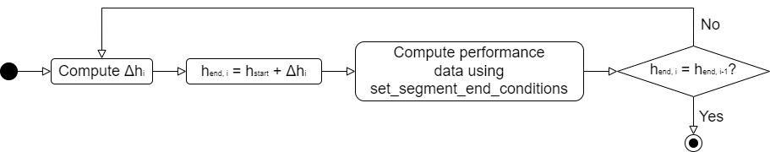


Mission Analysis
Δh
What happens if the aircraft does not have enough Specific Excess Power at the current iteration?
It gets stuck in the loop
This mode assumes that the aircraft CAN FULFILL all requirements

Slide 17
Mission Analysis
The default approach has some neat functionality like flight path optimization
BUT
If the aircraft is in the loop, and if the current state of the aircraft is not meeting the requirements, this tool aborts execution
Without a mass estimation, the convergence loop fails
This tool does not work while the aircraft is moving in the design space
Weight fractions
Mission Analysis
$$W_{TO}$$
$$W_{E}$$
$$W_{F}$$
$W_{P}$
Mission Performance Requirements

Slide 18
Simple Mission Analysis
We need a second approach that is robust enough for the convergence loop to continue execution
Garbage in – garbage out, but you still get something out
Fast execution – no iterations unless necessary
Very simple, decision tree based approach for going from one state to another
Input Format
Check-Point to Check-Point
Altitude
Mach
Distance or time
Altitude
Mach
Distance or time
1
2
Use Case: Setting up pre-defined climb or descend profiles
Flight profile dictates the analysis
Segment Definition
1
Altitude
Mach
2
Altitude
Mach
Distance
Use Case: Simple segment definitions from top level requirements
Aircraft characteristics dictate the analysis

Slide 19

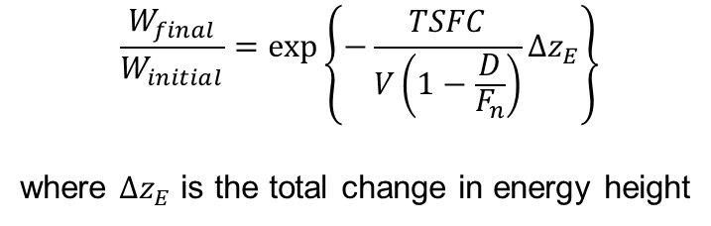




Simple Mission Analysis
Basics
The decision tree is based on the Energy Height concept
Any combination of acceleration and altitude change can be evaluated with a simple logic
$$E=PE+KE=Wh+\frac{1}{2}mV^{2}$$
$$E_{s}=\frac{E}{W}=h+\frac{V^{2}}{2g}$$
$$\frac{dE_{s}}{dt}=\frac{dh}{dt}+\frac{V}{g}\frac{dV}{dt}$$
$$P_{s}=\frac{dE_{s}}{dt}=\frac{F_{n}−D}{W}V$$
Start
State i
Target
$$\frac{dh}{dt}+\frac{V}{g}\frac{dV}{dt}=\frac{F_{n}−D}{W}V$$
i-1
i-2
h_1
M_1
R_1
…
h_i
M_i
R_i
h_2
M_2
R_2
1
…
i
2
…
$$\frac{W_{final}}{W_{initial}}=\exp\left\{−\frac{TSFC}{V\left(1−\frac{D}{F_{n}}\right)}Δz_{E}\right\}$$
where $Δz_{E}$ is the total change in energy height
2
1
0
State vector

Slide 20











Simple Mission Analysis
$$\frac{dh}{dt}+\frac{V}{g}\frac{dV}{dt}=\frac{F_{n}−D}{W}V$$
$${E_{s}}_{target}−{E_{s}}_{i}$$
Decision Tree – State Transition
$$<0$$
$$>0$$
$$=0$$
$$V_{target}>V_{i} \&\& h_{target}>h_{i}$$
Cruise
$$false$$
$$true$$
$$V_{target}>V_{i}$$
Accelerated Climb
50% SEP → Climb
50% SEP → Acceleration
$$false$$
$$true$$
Accelerated Climb
Accelerated Climb
100% SEP → Climb
100% SEP → Acceleration

Slide 21










Simple Mission Analysis
$$\frac{dh}{dt}+\frac{V}{g}\frac{dV}{dt}=\frac{F_{n}−D}{W}V$$
$${E_{s}}_{target}−{E_{s}}_{i}$$
Decision Tree – State Transition
$$<0$$
$$>0$$
$$=0$$
$$V_{target}<V_{i} \&\& h_{target}<h_{i}$$
$$V_{target}>V_{i} \&\& h_{target}>h_{i}$$
Cruise
$$true$$
$$false$$
$$V_{target}<V_{i}$$
Set linear flight path
2
Calculate $\frac{dh}{dt}$
$$true$$
$$false$$
Calculate $\frac{dV}{dt}$with remaining SEP
Calculate $\frac{dV}{dt}$with SEP
Calculate $\frac{dh}{dt}$with SEP
Decelerated descent
Decelerate
Descend

Slide 22
Simple Mission Analysis
Fail Cases
What if the aircraft does not have enough thrust to increase its energy state?
Means that the aircraft is not meeting the point performance requirements – not my tool not my business
The loop still needs the mass properties to continue
Put thrust to more than 100%?
Stop climbing and continue from that altitude?
What if the fuel tanks are empty?
We work with mass fractions – fuel tanks are only used for shifting the cg
Use the final location of the cg for trimming
What if the aircraft does not have enough drag to decrease its energy state?
This is rather a problem of setting up the descent profile
Move the “transition point” backwards
1
2

Slide 23
Constraint Analysis
Point Performance Requirements
Constraint Analysis
$$T_{SL}/W_{TO}$$
$$W_{TO}/S_{Ref}$$
Component Design
Weight fractions
Design Analysis

Slide 24
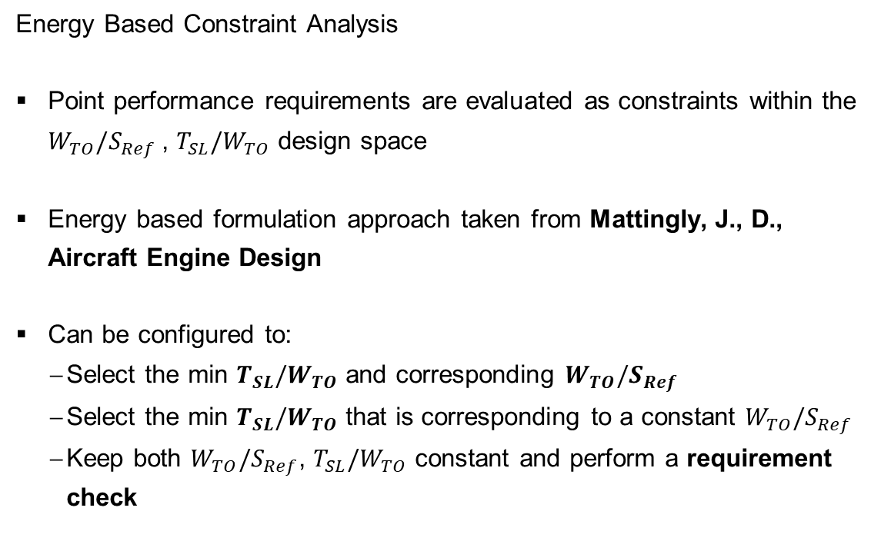
Constraint Analysis
Energy Based Constraint Analysis
Point performance requirements are evaluated as constraints within the $W_{TO}/S_{Ref}$, $T_{SL}/W_{TO}$ design space
Energy based formulation approach taken from Mattingly, J., D., Aircraft Engine Design
Can be configured to:
Select the min $T_{SL}/W_{TO}$ and corresponding $W_{TO}/S_{Ref}$
Select the min $T_{SL}/W_{TO}$ that is corresponding to a constant $W_{TO}/S_{Ref}$
Keep both $W_{TO}/S_{Ref}$, $T_{SL}/W_{TO}$ constant and perform a requirement check

Slide 25
Constraint Analysis
Energy Based Constraint Analysis
Multiple cases can be evaluated using the functions provided in the constraint analysis module
The Constraint Analysis config file can be used to add additional point performance limitations to the ones coming from the TLARs
Possible Constraints
Cruise Mach number
Constant speed climb
Constant altitude/speed turn
Horizontal acceleration – dash
Takeoff ground roll
Braking roll
Service ceiling – SEP
Takeoff climb angle
Gust

Slide 26

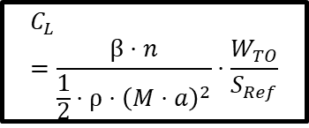

Constraint Analysis
Initialize
For each case:
$$C_{L}=\frac{β⋅n}{\frac{1}{2}⋅ρ⋅{\left(M⋅a\right)}^{2}}⋅\frac{W_{TO}}{S_{Ref}}$$
Read polar
Get CD
Evaluate constraint
Find Dominant Curve
Find minimum $\frac{T_{SL}}{W_{TO}}$
Find corresponding $\frac{W_{TO}}{S_{Ref}}$
Update design point

Slide 27
Constraint Analysis
Challenge of Constraint Analysis and Convergence Loop
The constraint analysis module (or constraint sizing module) selects a new design point based on the point performance requirements
If the selection method is not constructed carefully, it might result in oscillations in the design point
These oscillations can prevent convergence
If the design tools cannot handle movement within the design space, selecting a new design point can halt execution
But is this the fault of constraint analysis, or the design tools?

Slide 28
Convergence Loop
Point Performance Requirements
Component Design
Constraint Analysis
$$T_{SL}/W_{TO}$$
$$W_{TO}/S_{Ref}$$
Design Choices
Component Design
Weight fractions
TLARs
Mission Analysis
$$W_{TO}$$
$$W_{E}$$
$$W_{F}$$
$W_{P}$
Aircraft Concept
Weight and Balance Analysis
Mission Performance Requirements

Slide 29
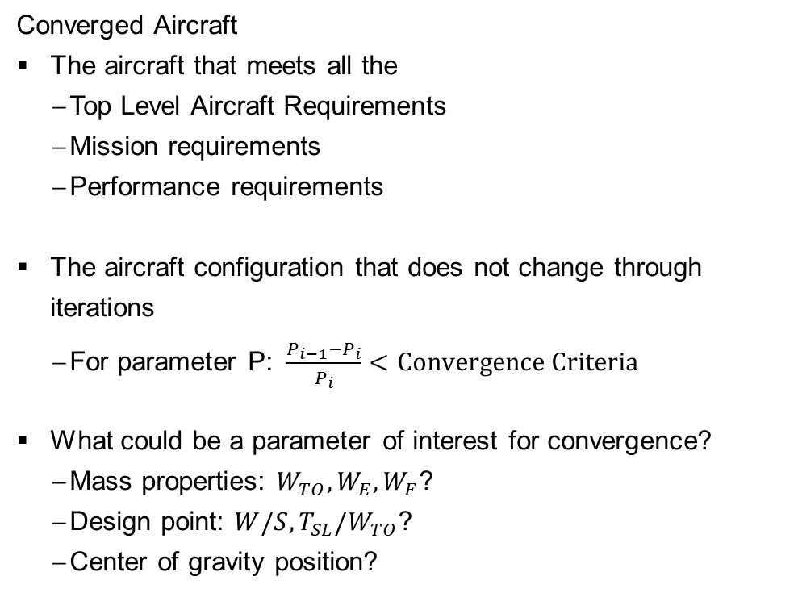
Convergence Loop
Converged Aircraft
The aircraft that meets all the
Top Level Aircraft Requirements
Mission requirements
Performance requirements
The aircraft configuration that does not change through iterations
For parameter P: $\frac{P_{i−1}−P_{i}}{P_{i}}<Convergence Criteria$
What could be a parameter of interest for convergence?
Mass properties: $W_{TO}, W_{E}, W_{F}$?
Design point: $W/S, T_{SL}/W_{TO}$?
Center of gravity position?
Choose the convergence criteria wisely, you might get stuck in iterations

Slide 30
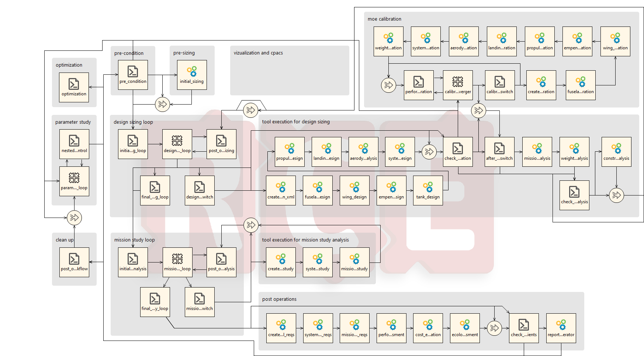
UNICADO in RCE
Component Design

