Slide 1
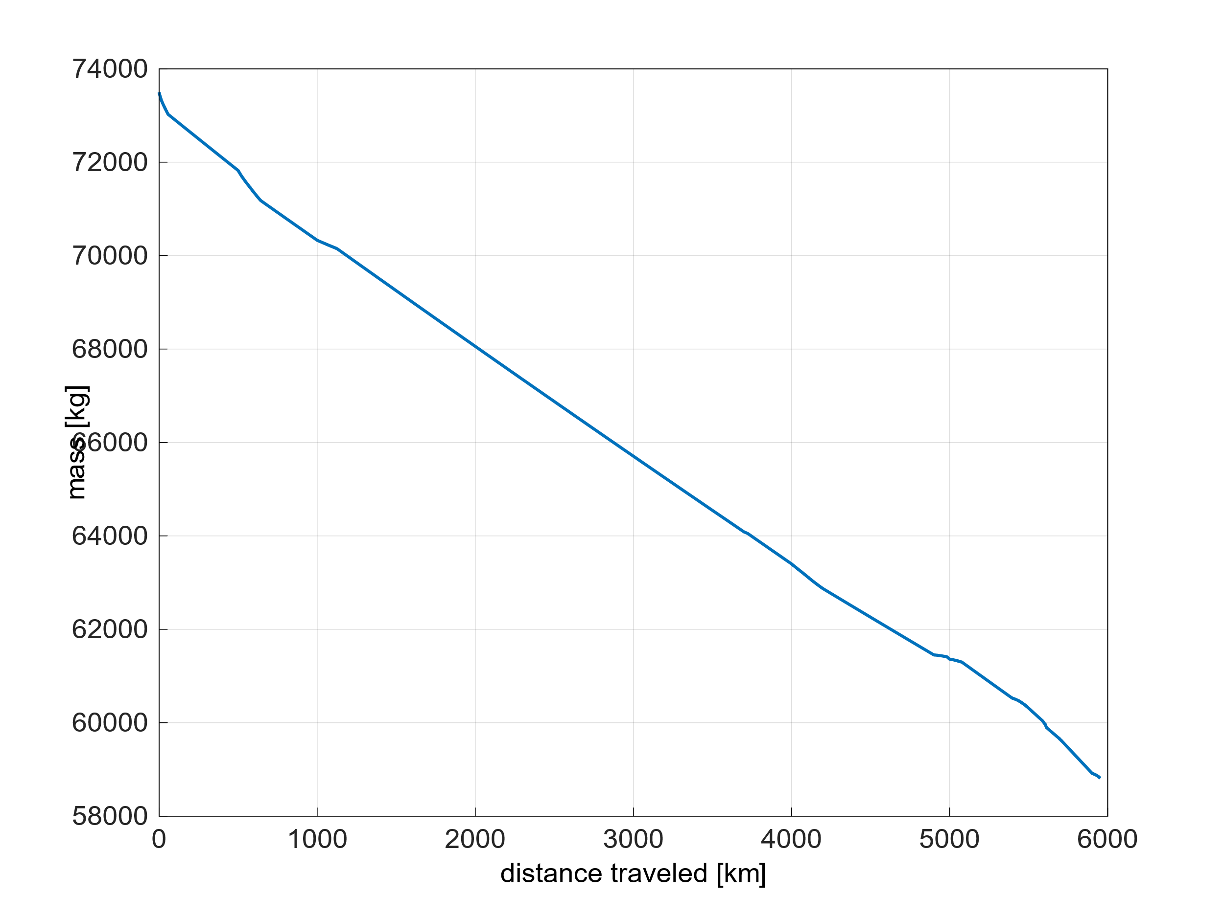
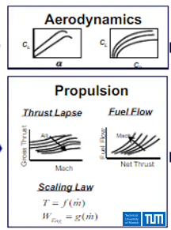
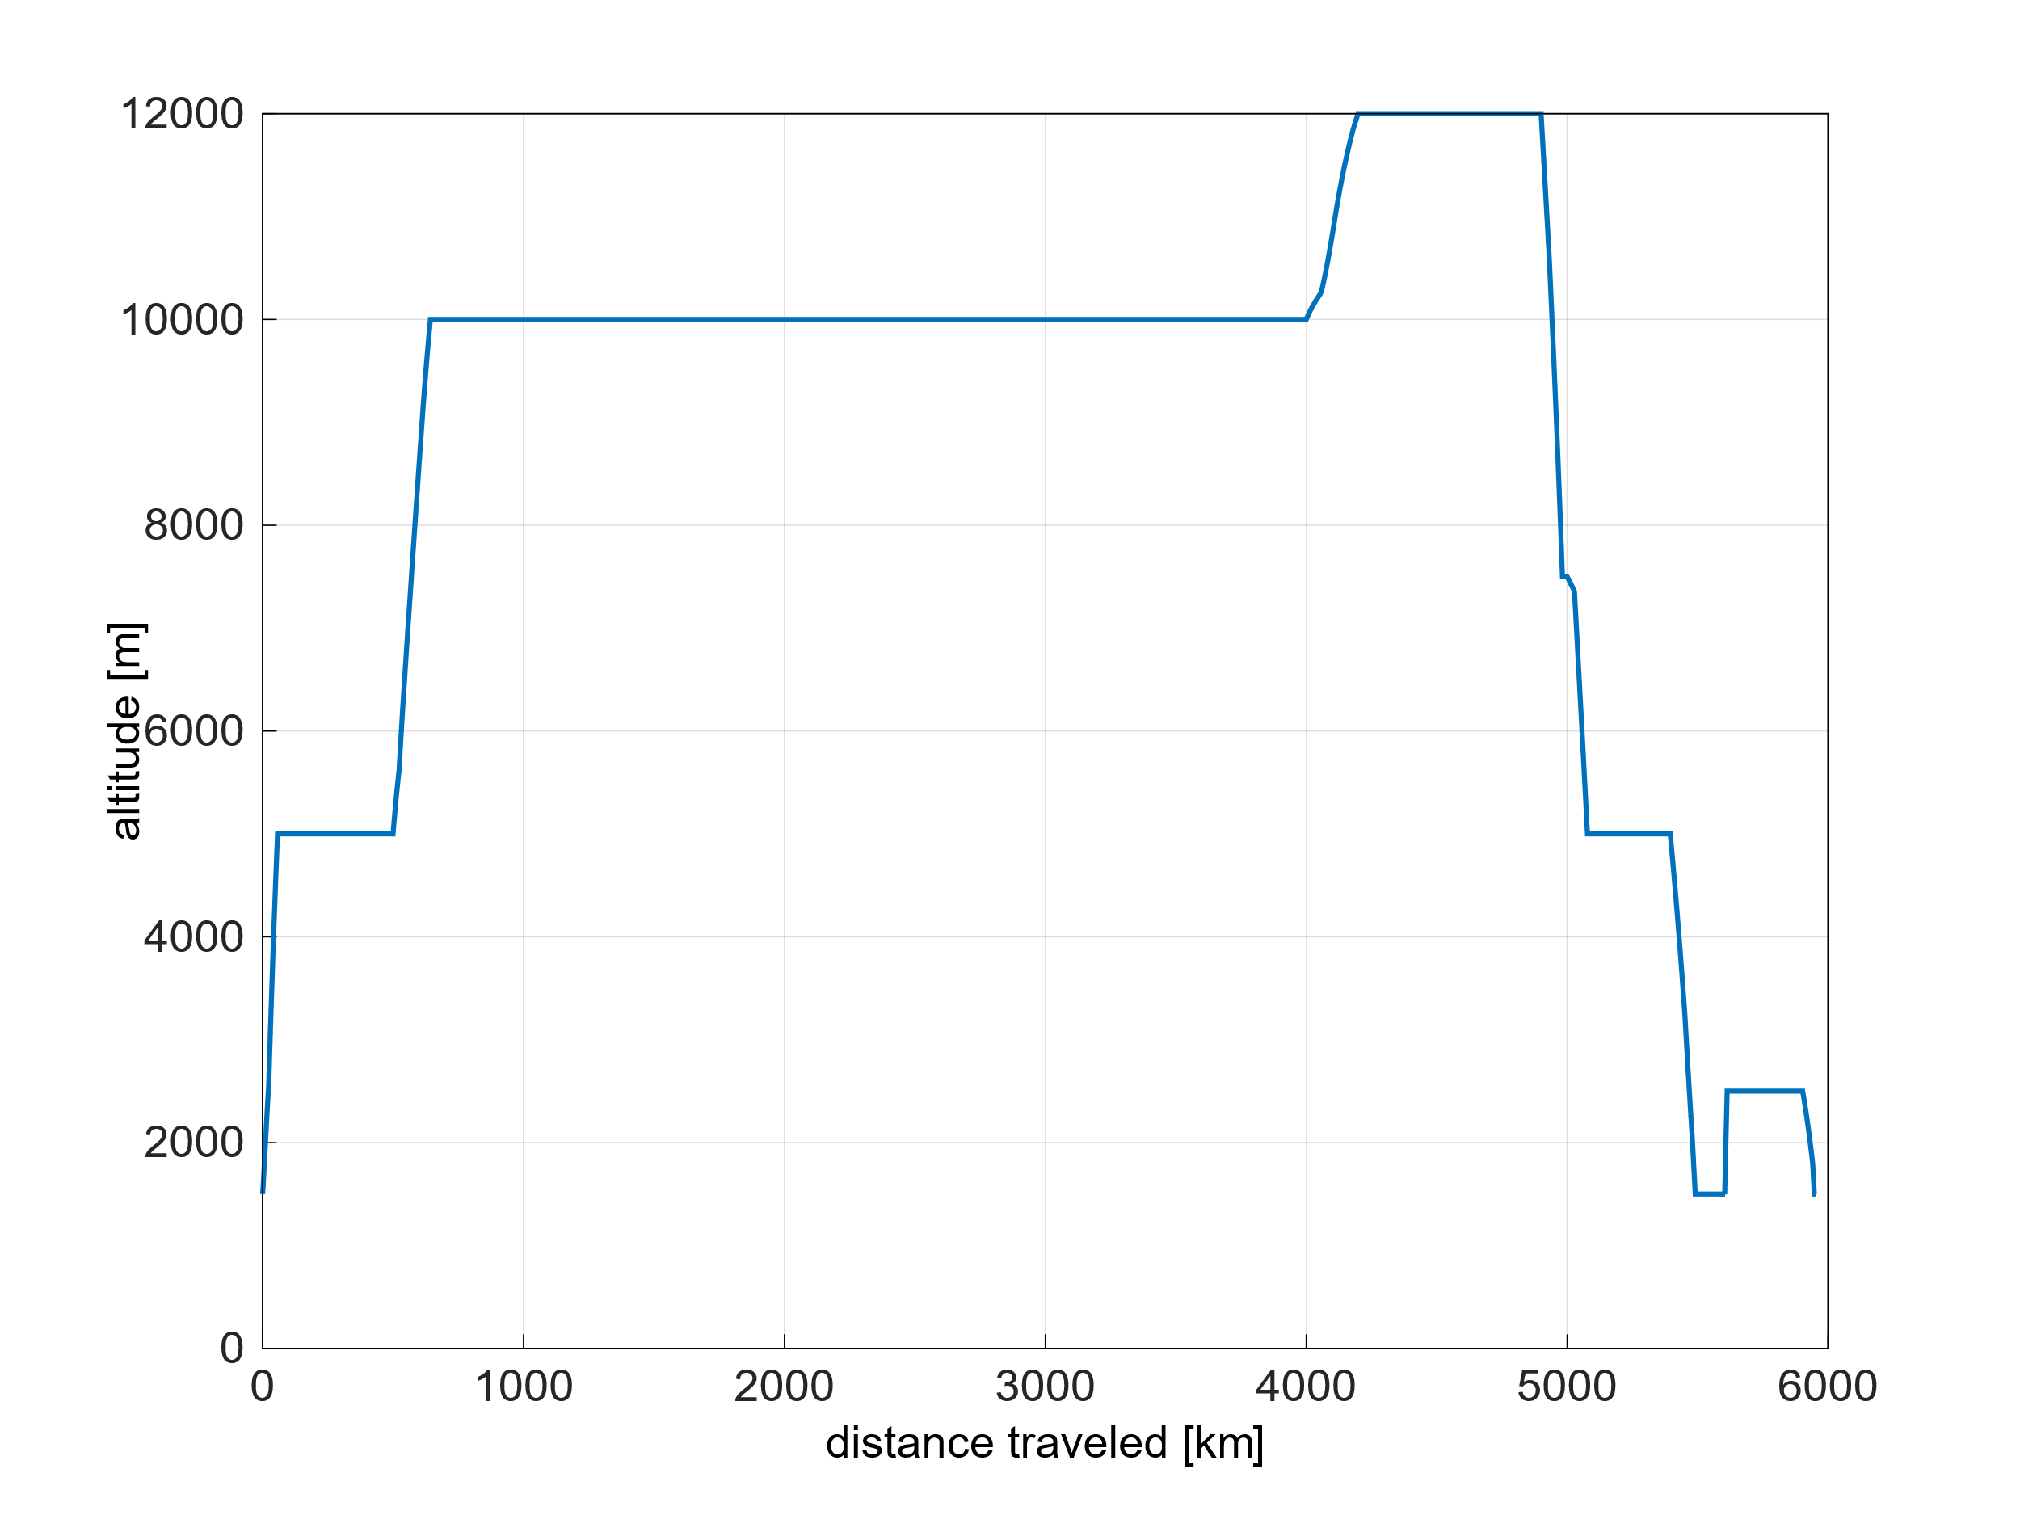
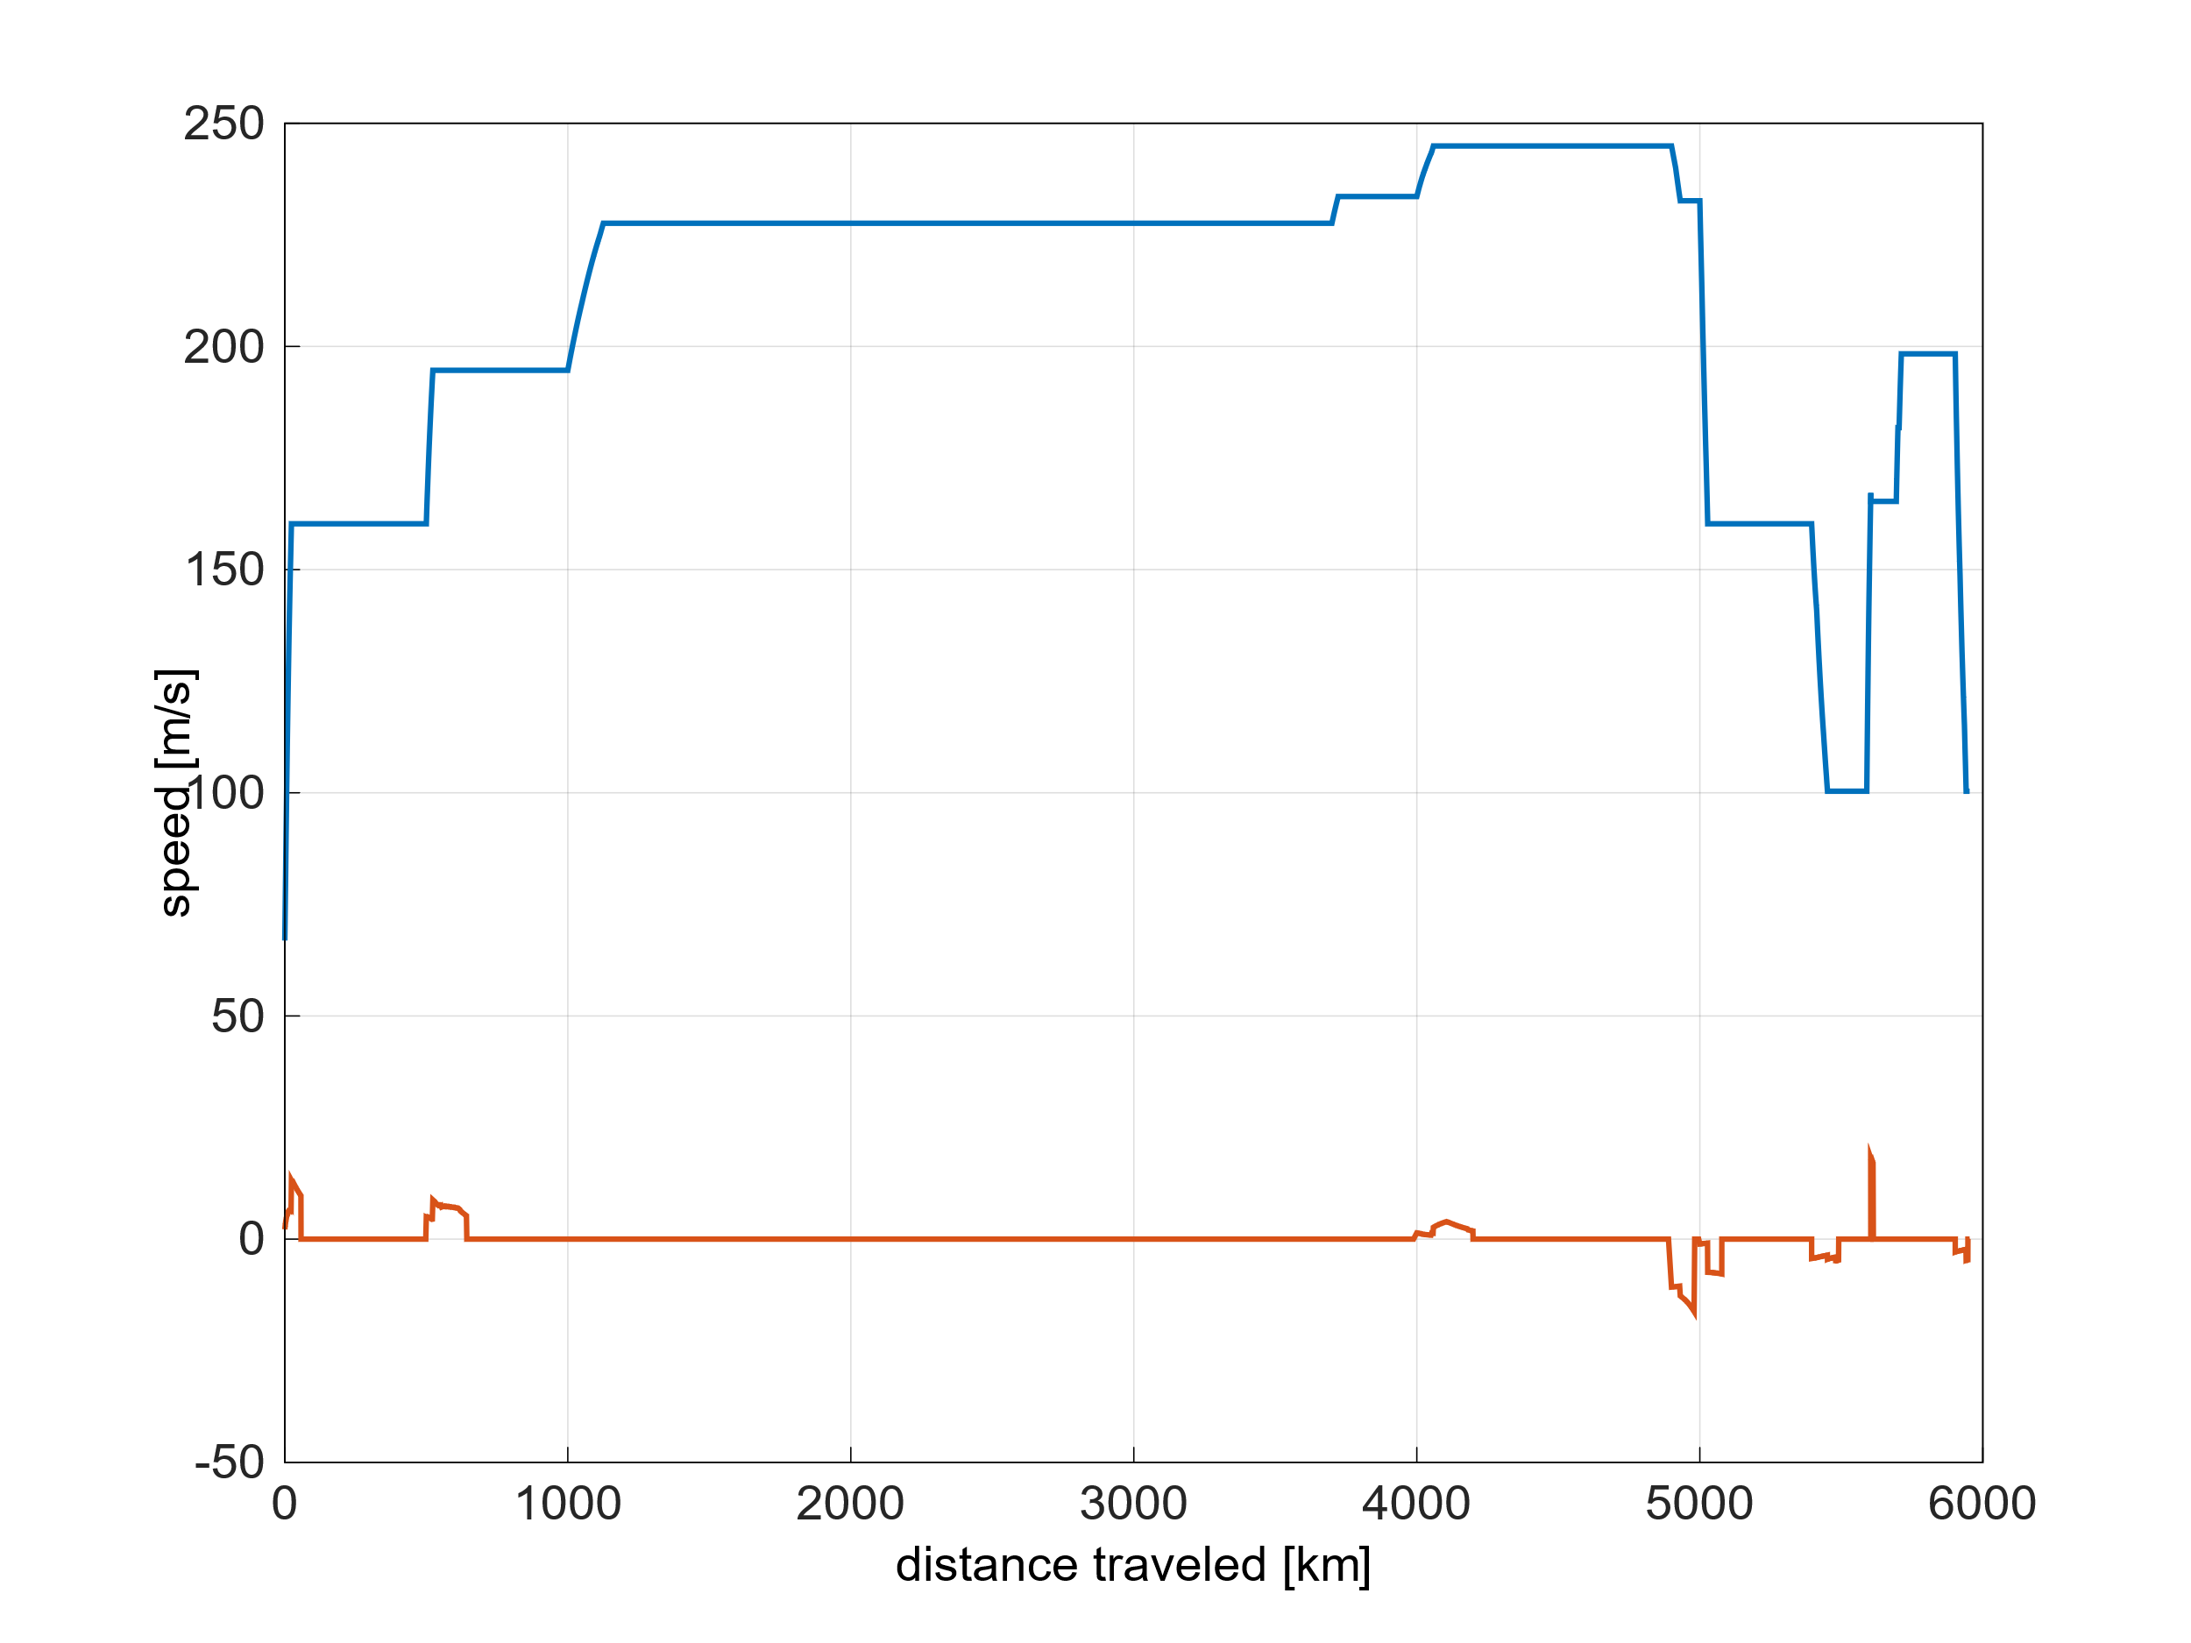
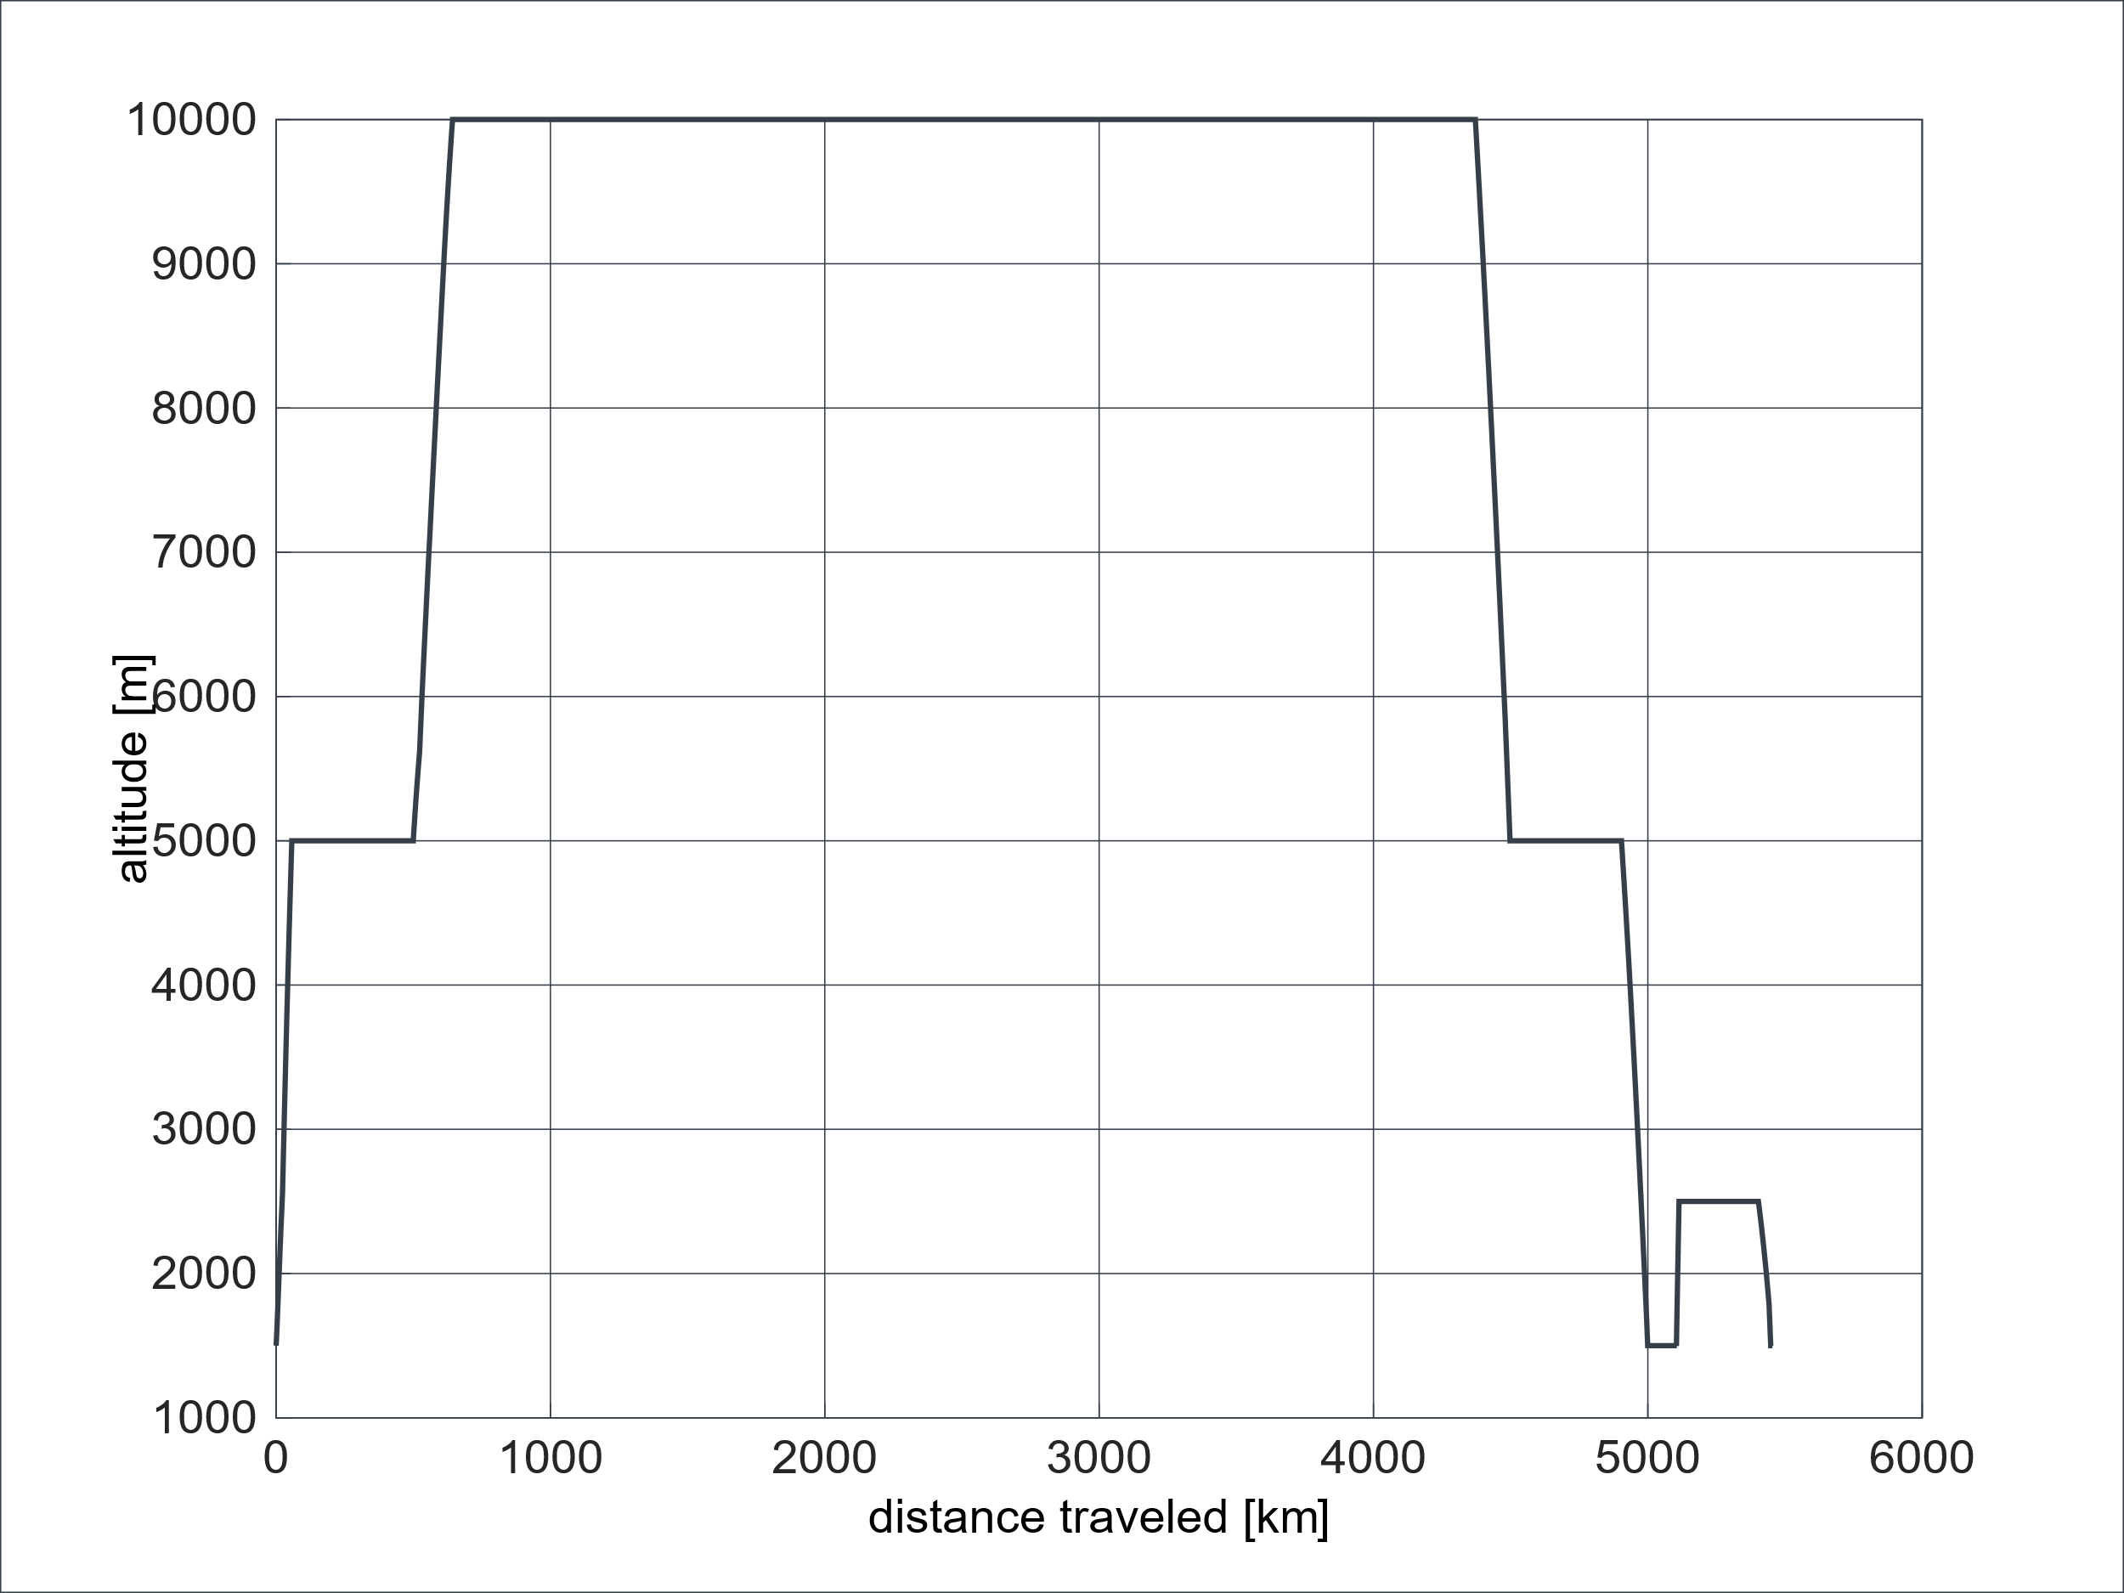


UNICADO Review
Mission Analysis
Weight fractions
Mission Analysis
$$W_{TO}$$
$$W_{E}$$
$$W_{F}$$
$W_{P}$
Mission Performance Requirements

Slide 2
UNICADO Review
Mission Analysis
Input Format – Mission Performance Requirements
Examples
Check-Point to Check-Point
5
6
4
7
Altitude
Mach
Radius or time
Altitude
Mach
Radius or time
3
1
2
8
2
9
Use Case: Setting up pre-defined climb or descend profiles
Flight profile dictates the analysis
1
10
11
12
Segment Definition
1
Altitude
Mach
2
Altitude
Mach
2
3
Radius
Use Case: Simple segment definitions from top level requirements
Aircraft characteristics dictate the analysis
1
4

Slide 3
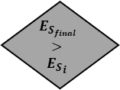
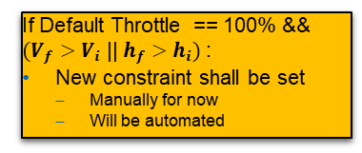
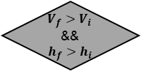

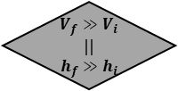


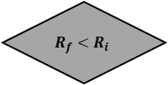

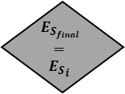
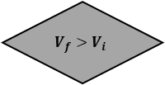

UNICADO Review
Specific Energy: $E_{S}=h+\frac{V^{2}}{2g_{0}}$
Mission Analysis
2
Logic – For Each Segment
1
$$R_{f}<R_{i}$$
$$E_{S_{final}}$$
$$>$$
$${E_{S}}_{i}$$
$V_{f}>V_{i}$ &&
$$h_{f}>h_{i}$$
50% SEP → Climb
50% SEP → Acceleration
Set Throttle
Increase Default Throttle
Delete state variables
$V_{f}≫V_{i}$ ||
$$h_{f}≫h_{i}$$
Default: 85% Throttle
Increase Throttle if:
${ΔE}_{S}≪$
$$V_{f}>V_{i}$$
100% SEP → Acceleration
Accelerated Climb $\left(\frac{dh}{dt},\frac{dv}{dt}\right)$
If Default Throttle == 100% && $(V_{f}>V_{i}$ || $h_{f}>h_{i})$:
New constraint shall be set
Manually for now
Will be automated
Default: 10s step
Adjust timestep if:
$V_{f}$ or $h_{f}$ or $R_{f}$can be reached
Move to step i+1
Calculate state variables
100% SEP → Climb
$$E_{S_{final}}$$
$$=$$
$${E_{S}}_{i}$$
Cruise
Store state variables
Default: 60s step
Adjust timestep if:
$R_{f}$can be reached

Slide 4
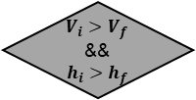
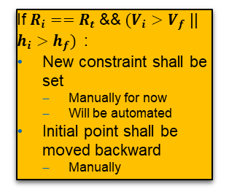

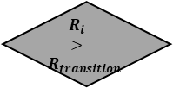

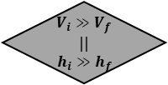

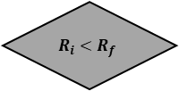


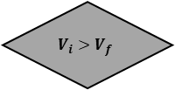
UNICADO Review
Specific Energy: $E_{S}=h+\frac{V^{2}}{2g_{0}}$
Mission Analysis
1
Logic
2
$$R_{i}<R_{f}$$
$$R_{i}$$
$$>$$
$$R_{transition}$$
$V_{i}>V_{f}$ &&
$$h_{i}>h_{f}$$
2
Set linear flight path
Calculate $\frac{dh}{dt},\frac{dv}{dt}$
Move transition point back
Delete state variables
$V_{i}≫V_{f}$ ||
$$h_{i}≫h_{f}$$
If $R_{i}==R_{t}$&& $(V_{i}>V_{f}$ || $h_{i}>h_{f})$:
New constraint shall be set
Manually for now
Will be automated
Initial point shall be moved backward
Manually
$$V_{i}>V_{f}$$
Calculate $\frac{dv}{dt}$
Decelerated descent $\left(\frac{dh}{dt},\frac{dv}{dt}\right)$
Engine on Idle
Default: 10s step
Adjust timestep if:
$V_{f}$ or $h_{f}$ or $R_{f}$can be reached
Move to step i+1
Calculate state variables
Calculate $\frac{dh}{dt}$
Store state variables
Cruise

Slide 5
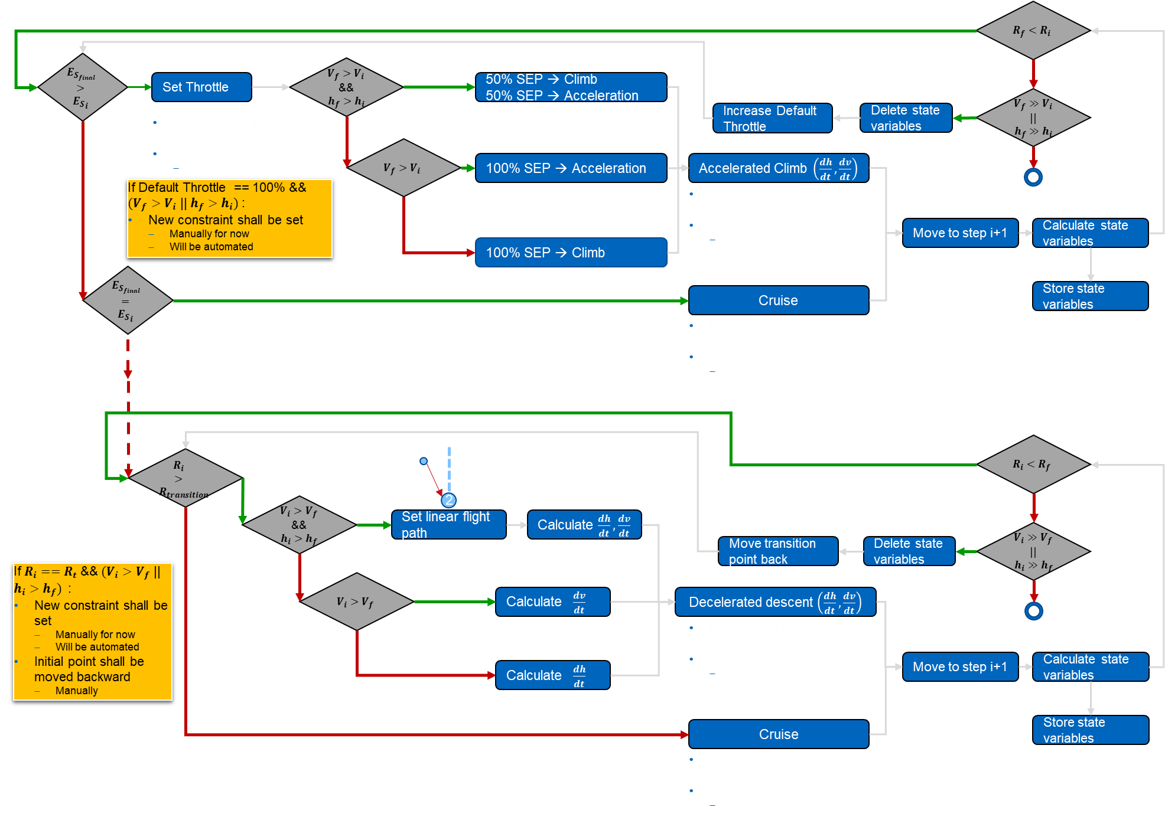
UNICADO Review
Mission Analysis
If mission fails at any point it is because either
the point performance requirements are not fulfilled or,
the point performance requirement does not exist for a limiting case
Instead of breaking the loop
mission shall ask for or create new constraints
the aircraft shall be resized

