Slide 1
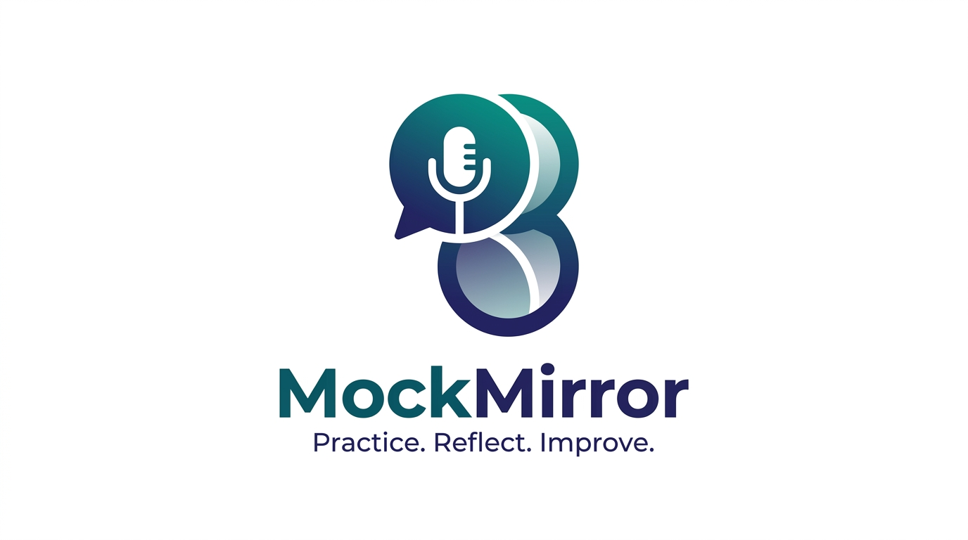
TEAM MEMBERS
1
Member 1 Name
Enrollment: XXXXXXXXXX
MockMirror
2
Member 2 Name
Enrollment: XXXXXXXXXX
Practice. Reflect. Improve.
3
Member 3 Name
Enrollment: XXXXXXXXXX
AI-Powered Multimodal Interview Simulator
4
Member 4 Name
Enrollment: XXXXXXXXXX

Slide 2
The Problem
Why Traditional Interview Preparation Fails Students & Job Seekers
▸ Placement & Job Interview Anxiety: Students and freshers face extreme nervousness during campus placements and job interviews due to lack of real practice with a live interviewer.
▸ Hesitation While Speaking: Many candidates know the answers but freeze, stutter, or hesitate when speaking out loud, leading to poor first impressions and missed opportunities.
▸ Unknown Question Patterns: Candidates have no idea what type of questions will be asked — technical, behavioral, situational, or resume-based — and cannot prepare effectively.
▸ No Feedback on Body Language: Traditional preparation completely ignores facial expressions, eye contact, posture, and head movement — all critical factors interviewers silently evaluate.
▸ Static & Scripted Mock Tools: Existing tools provide pre-written Q&As that don't adapt to a candidate's actual resume, spoken answers, or real-time performance.
▸ No Safe Practice Environment: There is no affordable, private, judgment-free space where candidates can repeatedly practice and improve before the real interview.

Slide 3
Our Solution — MockMirror
Practice. Reflect. Improve.
▸ AI-Powered Conversational Practice: Candidates visit our website and practice for their interviews by having a real-time voice conversation with our AI interviewer — just like a real interview.
▸ Resume-Based Personalized Questions: Upload your PDF resume, and the AI reads your skills, projects, and experience to ask highly targeted and relevant questions.
▸ Real-Time Answer Evaluation: The AI doesn't just ask questions — it analyzes every answer for correctness, depth, and relevance. If an answer is fake or vague, it immediately corrects the candidate.
▸ Face Expression & Posture Detection: Using the browser camera, MockMirror tracks facial expressions, face centering, eye contact, and head posture — providing feedback on physical presentation.
▸ Comprehensive Performance Report: A detailed report is generated with scores across technical accuracy, communication, confidence, and behavioral metrics — downloadable as PDF.

Slide 4
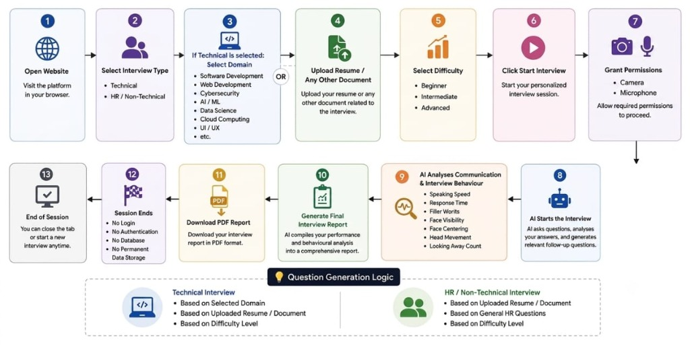
User Workflow
How a Candidate Uses MockMirror — Complete Step-by-Step Flow

Slide 5
Future Scope
Scaling MockMirror Beyond Candidate Self-Practice
✅ CURRENT VERSION (Candidate Mode)
🚀 FUTURE VERSION (Interviewer Mode)
▸ Self-Practice: Candidate uploads resume, selects domain & difficulty, practices independently.
▸ AI-Generated Questions: Questions auto-generated based on resume, domain, and difficulty.
▸ Behavioral Tracking: Face detection and posture tracking provide visual behavior feedback.
▸ Interviewer Dashboard: Interviewer selects topics and uploads syllabus for AI to prepare questions.
▸ AI Conducts on Behalf: AI interviews candidates on behalf of the interviewer using provided material.
▸ Automated Reports: Interviewer receives detailed candidate performance reports automatically.
Additional Future Enhancements
▸ Sentiment & Stress Analysis: Detect micro-expressions to assess confidence and stress in real-time.
▸ Live Coding Whiteboard: Integrate browser-based coding environments for technical screening.
▸ Multi-Language Support: Support regional languages and accent improvement coaching modules.
▸ LMS & Placement Cell Integration: License MockMirror to universities and corporate HR portals.

Slide 6
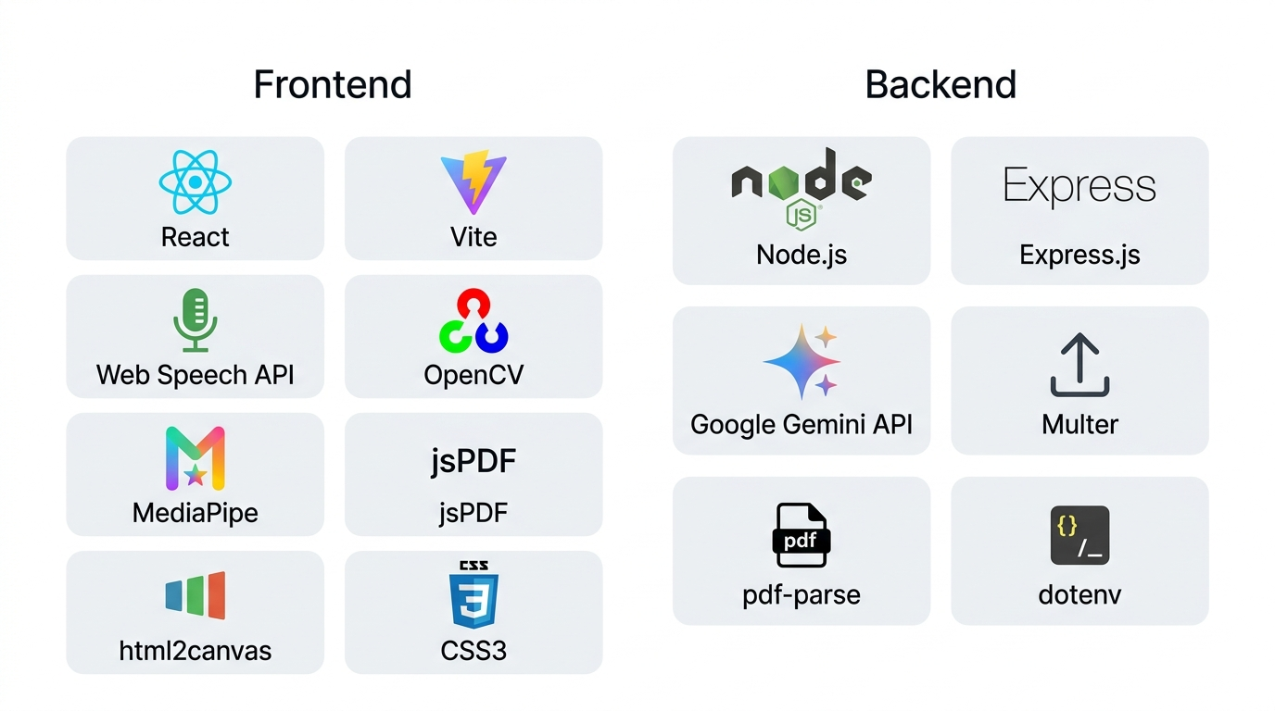
Technology Stack
Built with Modern, Privacy-First Technologies
🔒 100% Privacy — No Database
📷 Client-Side Vision Processing
⚡ Zero Friction Setup
No login. Resume parsed in-memory.
Video never leaves user's device.
Ready in under 60 seconds.

Slide 7
Thank You!
MockMirror
Practice. Reflect. Improve.
We are ready for your Questions & Answers

