Slide 1

TEAM TERMINAL4
TEAM MEMBERS
1
Yash Prajapati
Enrollment: 250413116015
2
Tisha Kotak
Enrollment: 240410116132
MockMirror
Yesha Patel
Enrollment: 250413116015
3
Practice. Reflect. Improve.
4
Hetvi Shah
Enrollment: 250413107019
AI-Powered Multimodal Interview Simulator

Slide 2
THE PROBLEM
Why Interview Preparation is Broken
• Placement & Job Interview Anxiety: Students and freshers face extreme nervousness during campus placements and job interviews due to lack of real practice with a live interviewer.
• Hesitation While Speaking: Many candidates know the answers but freeze, stutter, or hesitate when speaking out loud, leading to poor first impressions.
• Unknown Question Patterns: Candidates have no idea what type of questions will be asked — technical, behavioral, situational, or resume-based — and cannot prepare effectively.
• No Feedback on Body Language: Traditional preparation ignores facial expressions, eye contact, posture, and head movement — all critical factors interviewers silently evaluate.
• Static Mock Interviews: Existing tools provide scripted, pre-written Q&As that don't adapt to a candidate's actual resume, spoken answers, or real-time performance.
• No Safe Practice Environment: There is no affordable, private, judgment-free space where candidates can repeatedly practice and improve before the real interview day.

Slide 3
OUR SOLUTION — MOCKMIRROR
Practice Smart. Interview Confident.
• AI-Powered Conversational Practice: Candidates visit our website and practice for their interviews by having a real-time voice conversation with our AI interviewer — just like a real interview.
• Resume-Based Personalized Questions: Upload your PDF resume, and the AI reads your skills, projects, and experience to ask highly targeted and relevant questions.
• Real-Time Answer Evaluation: The AI doesn't just ask questions — it analyzes every answer for correctness, depth, and relevance. If an answer is fake or vague, it immediately calls it out and corrects the candidate.
• Face Expression & Posture Detection: Using the browser camera, MockMirror tracks facial expressions, face centering, eye contact, and head posture — providing feedback on how the candidate physically presents themselves.
• Comprehensive Performance Report: A detailed report is generated with scores across technical accuracy, communication, confidence, and behavioral metrics — downloadable as a PDF.

Slide 4
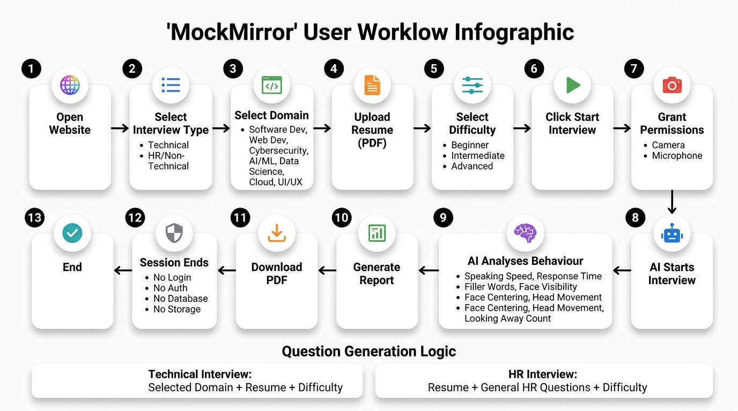
USER WORKFLOW
How a Candidate Uses MockMirror — Step by Step

Slide 5
FUTURE SCOPE
Scaling MockMirror Beyond Candidate Self-Practice
CURRENT VERSION (Candidate Mode)
FUTURE VERSION (Interviewer Mode)
• Self-Practice: Candidate uploads resume, selects domain & difficulty, and practices independently with AI.
• AI-Generated Questions: Questions are auto-generated based on resume, domain, and difficulty level.
• Behavioral Tracking: Face detection and posture tracking provide visual behavior feedback.
• Interviewer Dashboard: The interviewer selects topics and uploads custom data/syllabus for the AI to prepare questions from.
• AI Conducts on Behalf: The AI interviews the candidate on behalf of the interviewer using the provided material.
• Automated Candidate Reports: The interviewer receives a detailed performance report of each candidate without being present.
ADDITIONAL FUTURE ENHANCEMENTS
• Sentiment & Stress Analysis: Detect micro-expressions to assess confidence and stress in real-time.
• Live Coding Whiteboard: Integrate browser-based coding environments for technical screening.
• Multi-Language & Accent Coaching: Support regional languages and accent improvement modules.
• LMS & Placement Cell Integration: License MockMirror to universities and corporate HR portals.

Slide 6
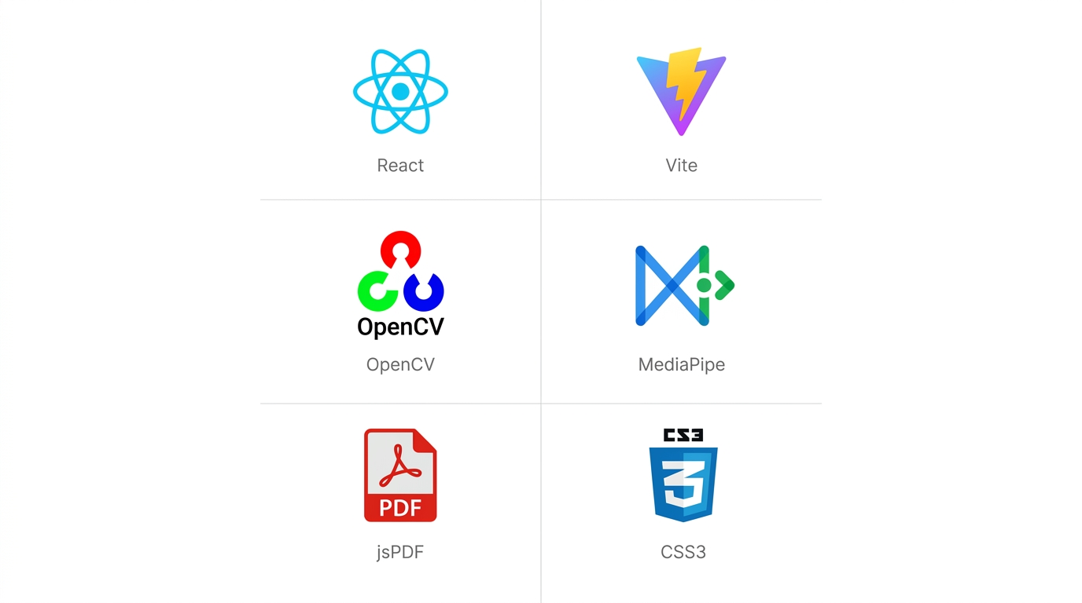
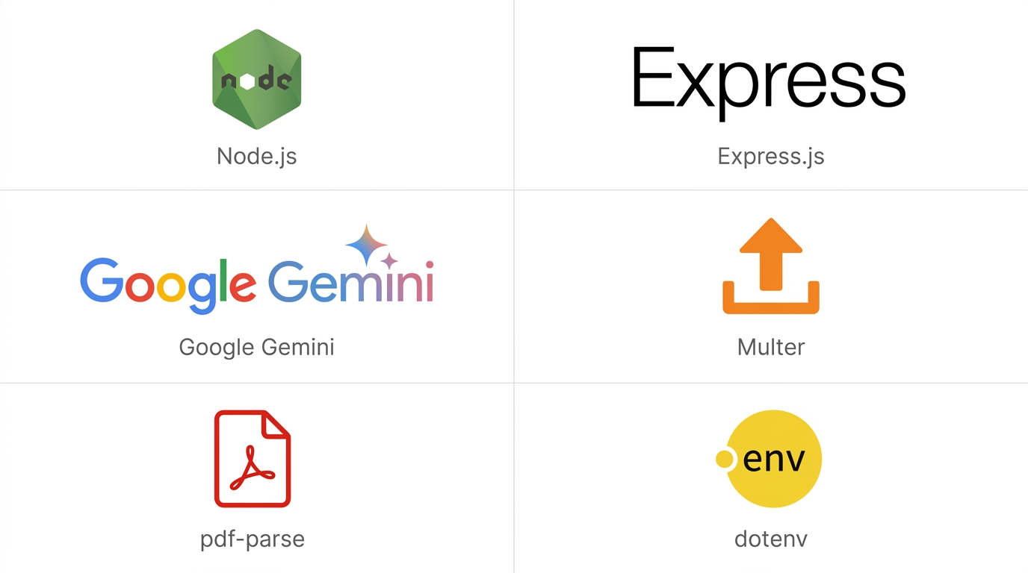
TECHNOLOGY STACK
Built with Modern, Privacy-First Technologies
FRONTEND
BACKEND
KEY ARCHITECTURE PRINCIPLES
🔒 100% Privacy No database. No login. Resume parsed in-memory.
📷 Client-Side Vision All camera processing runs locally in the browser.
⚡ Zero Friction Open website → Upload resume → Start. Under 60s.

Slide 7
Thank You!
MockMirror
Practice. Reflect. Improve.
We are ready for your Questions & Answers

