Slide 1



Team - Nightowls
Team Members :
Bhuvnesh Verma
Ashish Kamble
Abhay Mishra

Slide 2
Problem Statement :
Create a medicine shopping portal for the patients of your hospital in order to address the home deliver system of your hospital .
Key points:
Secure Login
Special Key Encryption
Exclusive Access
User-Friendly Navigation
Price Filter
Shopping Cart
Add to Cart Button
Safe and Enjoyable

Slide 3
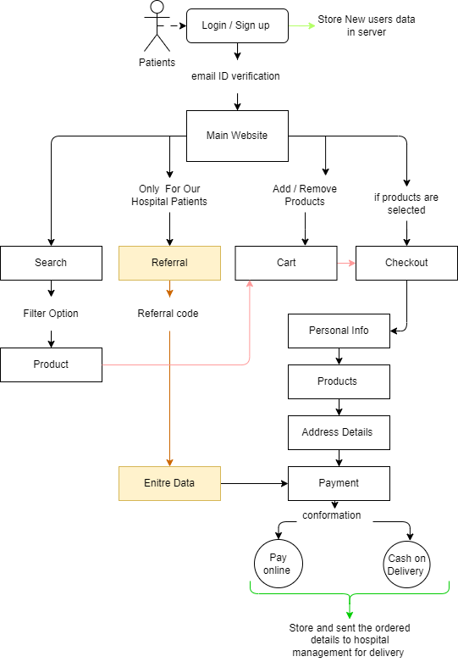
Solution Description:
Our proposal introduces a robust web-based application, serving as an integrated healthcare platform for patients. This comprehensive solution aims to enhance communication, accessibility, and the overall healthcare experience by bridging the gap between providers and patients.
Setting us apart is the innovative Referral Code Section, streamlining the prescription ordering process. This feature seamlessly integrates with the hospital system, automatically retrieving patient details for a swift and accurate ordering experience aligned with doctor recommendations.
Discover the efficiency of personalized healthcare management through our cutting-edge referral code functionality, elevating service standards in the healthcare industry.

Slide 4
Advantages :
Personalized Dashboards:
Patients access tailored dashboards for health info, test results, and prescribed meds.
Electronic Prescription Submission:
Healthcare pros submit e-prescriptions, reducing errors and streamlining the process.
Medication Information and Ordering:
Detailed med info provided; patients can easily order prescribed medications.
Real-time Prescription Updates:
Patients get real-time updates on prescription status for transparency and assurance.
Secure Data Handling:
Robust security measures ensure compliance and protect sensitive health data.
Notification System:
Notifications for appointments, refills, and health updates enhance patient engagement.
Mobile Accessibility:
Mobile-friendly design enables convenient access and medication orders from smartphones.
Integration with Hospital Systems:
Seamless integration with EHR and diagnostic systems for accurate and complete patient records.

Slide 5
Drawbacks :
Technical Glitches:
Potential for application downtime, glitches, or compatibility issues affecting user experience.
Security Risks:
Concerns about storing and transmitting sensitive health data online, with potential risks of data breaches.
Integration Challenges:
Difficulty in seamlessly integrating the application with existing hospital systems, requiring time and resources.
Referral Code Misuse:
Security risks if the Referral Code Section is not adequately protected, leading to unauthorized access.
Internet Dependency:
Reliance on stable internet connectivity, posing challenges for patients in areas with poor network coverage.
Regulatory Compliance:
Ensuring compliance with healthcare regulations and data protection laws is crucial for legal adherence.
Cost Implications:
Initial development and ongoing maintenance costs may impact the hospital's budget.
Patient Dependency:
Overreliance on the digital platform may create dependency issues for patients during disruptions.

