Slide 1

Natural Language Processing
P7: Analyzing Thematic Alignment in Scientific Journals AY 2025/2026
Roberto Antoniello · 47891A
Università degli Studi di Milano
Roberto Antoniello · 47891A · Natural Language Processing

Slide 2
Project goal
Research Question
Goal
Scientific journals define their thematic boundaries through Aim & Scope section.
Is it possible to assess quantitatively the coherence between published articles and the declared scope?
This leads to the need of having a systematic and reproducible method to assess this evaluation.
Introduction of a quantitative framework which measures the semantic alignment between published articles and the declared scope.
Detection of thematic drift over time and potential outliers.
Roberto Antoniello · 47891A · Natural Language Processing

Slide 3
Dataset
1.530
Jan 2021– Dec 2025
Crossref API
Articles
Range of time
Data source
Dataset attributes
Articles distribution per year
title
Year | Articles
2021 | 192
2022 | 276
2023 | 216
2024 | 292
2025 | 554
abstract
doi
year
Roberto Antoniello · 47891A · Natural Language Processing

Slide 4

Workflow
Preprocessing
Embedding generation
Cosine
Similarity
Temporal
Analysis
Removal of HTML tags during data collection
whitespace normalization
Removal of non-printable characters
Every abstract and the declared scope are encoded
using a pretrained model
Computation of alignment score
Score distribution analysis
Temporal drift analysis
Roberto Antoniello · 47891A · Natural Language Processing

Slide 5
Embedding generation & similarity computation
Model used
Cosine similarity
Allenai-specter, a transformer-based model specialized in scientific texts. It was fine-tuned using citation links between papers as a supervision signal.
Output: 768-dimensional embedding vectors.
Cosine similarity is computed between each article’s abstract embedding and the journal’s scope embedding.
Input:
1530 abstracts embeddings
1 scope embedding
Roberto Antoniello · 47891A · Natural Language Processing

Slide 6
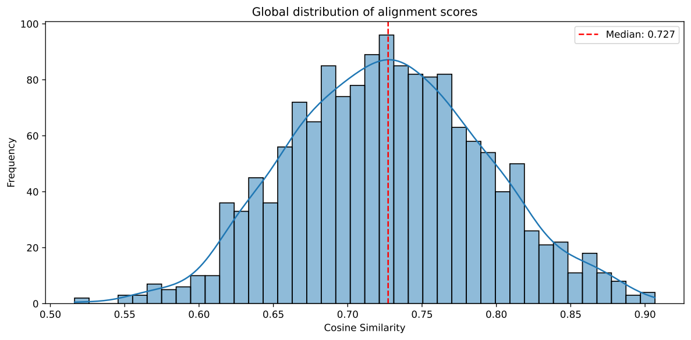
Results – alignment score distribution
0.727
0.065
0.516
0.907
Mean
Std. Deviation
Min value
Max value
[ Fig. 1 — Global Distribution of Alignment Scores ]
Interpretation
The distribution is strongly concentrated around the mean with limited dispersion,
The majority of published articles is semantically aligned to the declared scope.
Aligned score < 0.6 potentially identifies articles deviating of scope(outliers),
Aligned score > 0.85 indicates a strong alignment to the declared scope.
Roberto Antoniello · 47891A · Natural Language Processing

Slide 7
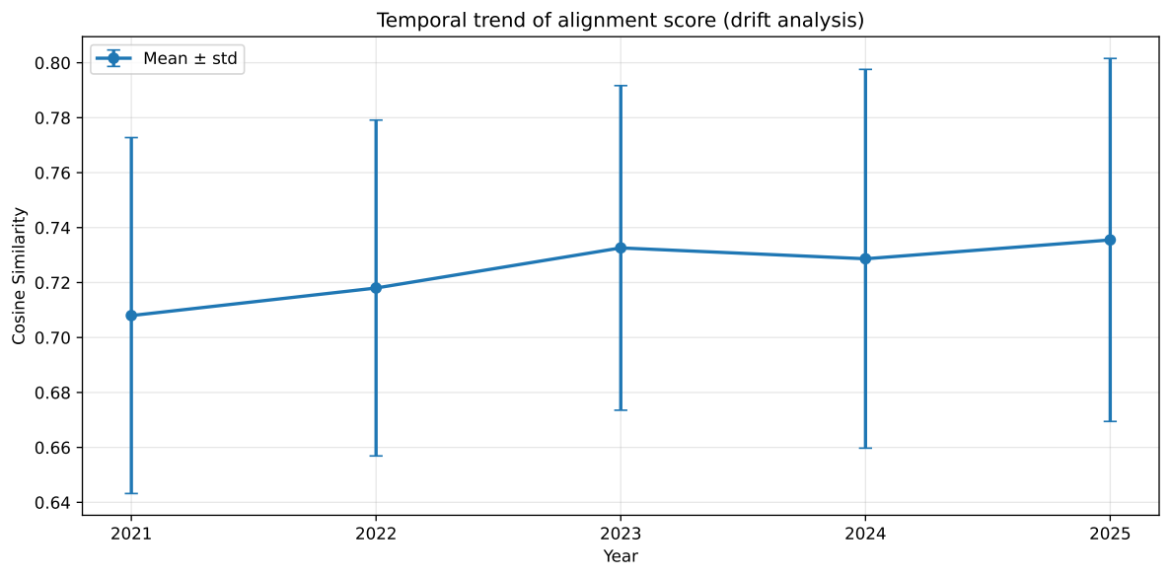
Results – Temporal analysis
[ Fig. 2 — Temporal Trend of Alignment Score ]
Year | Mean | Std
2021 | 0.708 | 0.065
2022 | 0.718 | 0.061
2023 | 0.733 | 0.059
2024 | 0.729 | 0.069
2025 | 0.736 | 0.066
Mean trend
Dispersion
Gradual increase from 0.708 (2021) to 0.736 (2025). No negative drifts, editorial coherence doesn’t decrease over time.
Dispersion remains relatively stable over time, indicating limited thematic heterogeneity across publication years.
Roberto Antoniello · 47891A · Natural Language Processing

Slide 8
Conclusions
Quantitative framework
Possible improvements
A reproducible method to evaluate semantic alignment between published articles and the declared scope of a selected scientific journal, based on quantitative semantic measures.
A comparison of alignment score between multiple journals of the same sector.
Frontiers in Artificial Intelligence
Limitations
A global mean of 0.727 indicates that the journal maintains editorial coherence during the selected period of time 2021-2025.
The analysis is limited to 5 years and a single journal.
Roberto Antoniello · 47891A · Natural Language Processing

