Slide 1
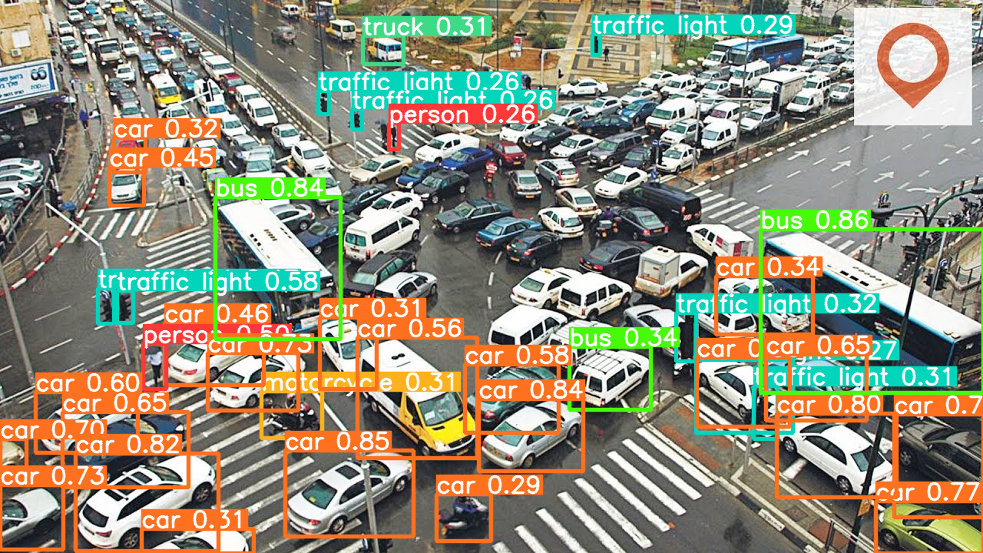
Improving the reliability of yolo using DIP techniques
Muhammad Hamza i202244
Masters Data Science, NUCES ISB
CS5035 - Applied Image Processing

Slide 2
Introduction
DIP Techniques and Traditional Computer Vision
Rapid Object Detection using boosted Cascade
Traditional CV limitations and GPU utilization for Deep Learning Model Training
Series of Deep Learning Based Image Classifier brewed out

Slide 3
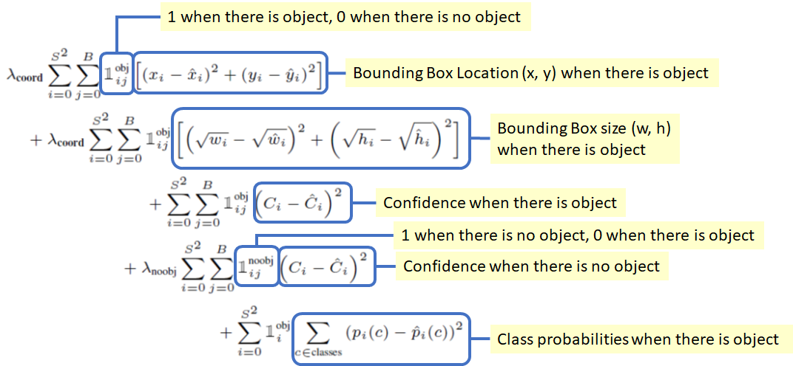
Yolo
Object Detection Framework
You look only once – Fast
A very Comprehensive Loss Function
https://towardsdatascience.com/yolov1-you-only-look-once-object-detection-e1f3ffec8a89

Slide 4
Dataset
MS COCO 2017 Validation dataset
Fifty-One
Target Study for 7 classes – Use Case Images
Person
Car, Bus, Truck
Motorcycle, Bicycle
Traffic Light

Slide 5
Experiment
Techniques Applied
Gaussian Blur
Increase Sharpness
Blur n Sharp
Gamma Correction
Histogram Equalization

Slide 6
Experiments
Major Achieving Targets
Avoid Miss-Classification of Objects (Reduce False Positives; increase Precision of model)
Detect Objects that was missed by model in flash input image (Reduce False Negatives; Increase Recall)

Slide 7
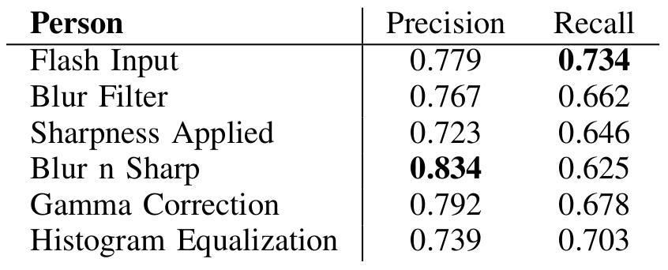
Investigating Person Class
Use Case Images

Slide 8
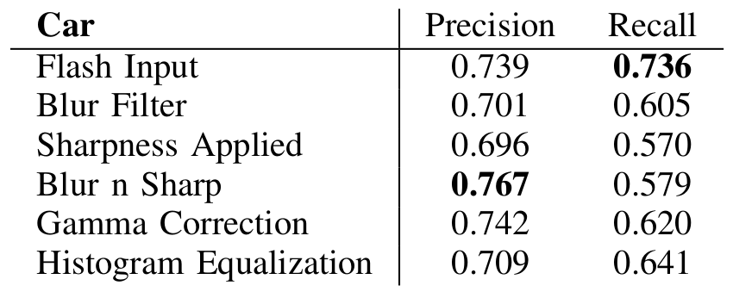
Investigating Car Class
Use Case Images

Slide 9
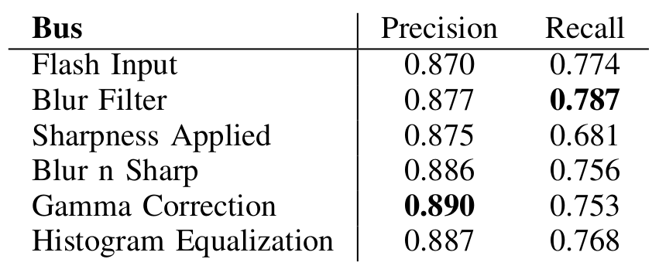
Investigating Bus Class
Use Case Images

Slide 10
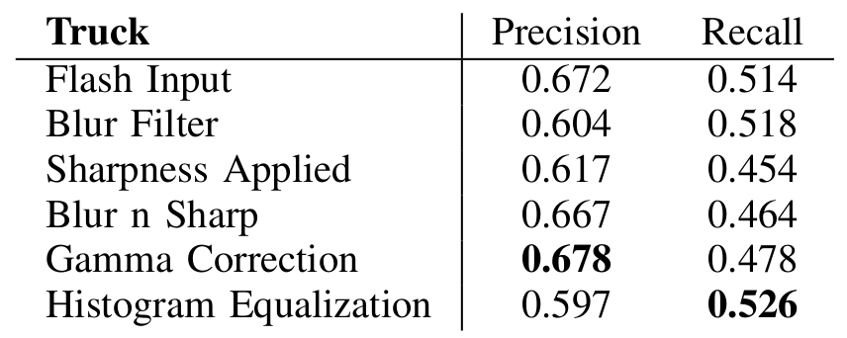
Investigating Truck Class
Use Case Images

Slide 11
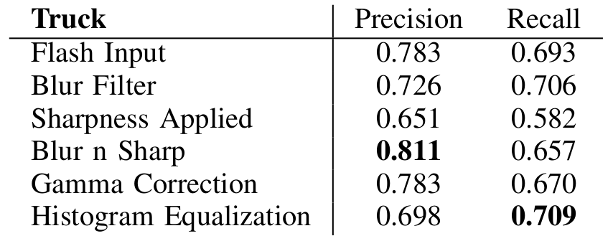
Investigating Motorcycle Class
Motorcycle
Use Case Images

Slide 12
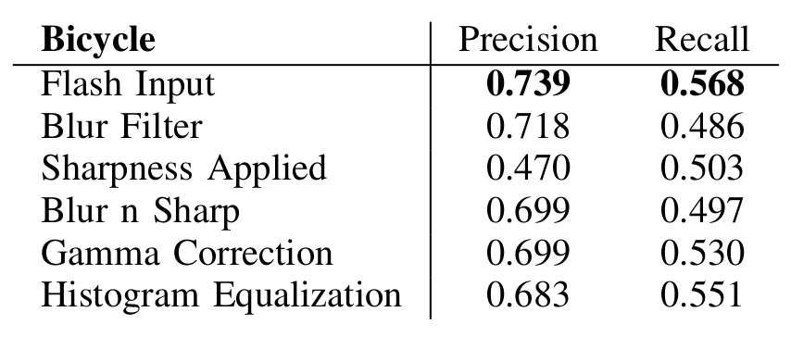
Investigating Bicycle Class
Use Case Images

Slide 13
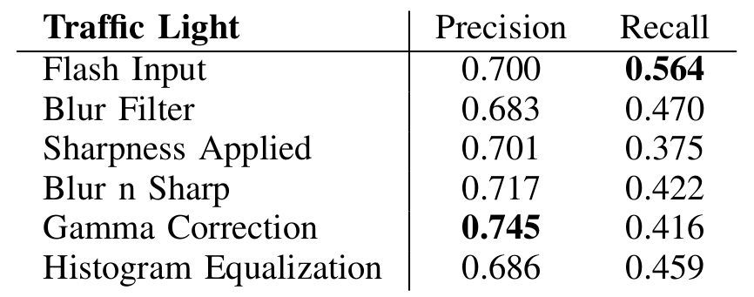
Investigating Traffic-light Class
Use Case Images

Slide 14
Discussion
Significant Improvements in:
Person
Traffic Light
No effect on Localization of Objects
Bus localization improved slightly
Applications
Specialized Scenarios
Controlled Environments

Slide 15
Thank You! For queries: i202244@nu.edu.pk

