Slide 1
What are the secrets to the success of coffee and tea stores in US?
Group16
Zongliang Han, Ziyi Yang, Chuyi Lin

Slide 2
Goal
We focus on Coffee&Tea stores in Pennsylvania, we want to explore the factors of making Coffee&Tea business successful.
Our goal is to help business owner of Coffee&Tea industry in Pennsylvania analyzing what attributes affect rating. What can we learn from reviews data, such as customer satisfaction of service.

Slide 3
Questions
What business attributes make Coffee&Tea stores success?
Location?
WiFi?
Price?
Type?
Which aspects can business owner take action to improve their ratings?

Slide 4
Data Preprocessing
Filtered Yelp business category to coffee&tea stores in Pennsylvania.
Extracted businesses that are open, remove rows that business attributes are all empty, and empty rating.
Choose attributes with high frequency.
Merged Yelp business with Yelp review dataset.

Slide 5
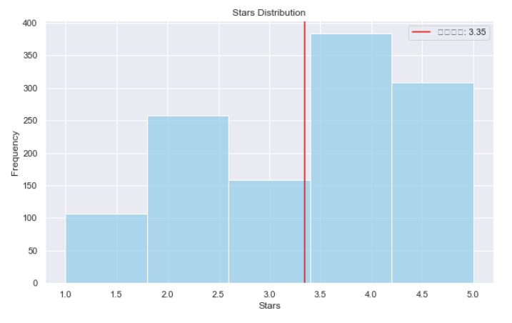
EDA
We notice that 4- and 5-star are the most popular, and also that 2-star are more common than 1- or 3-star reviews. We can assume that customers will go through the trouble of leaving a review only if they were highly impressed or highly disappointed.

Slide 6
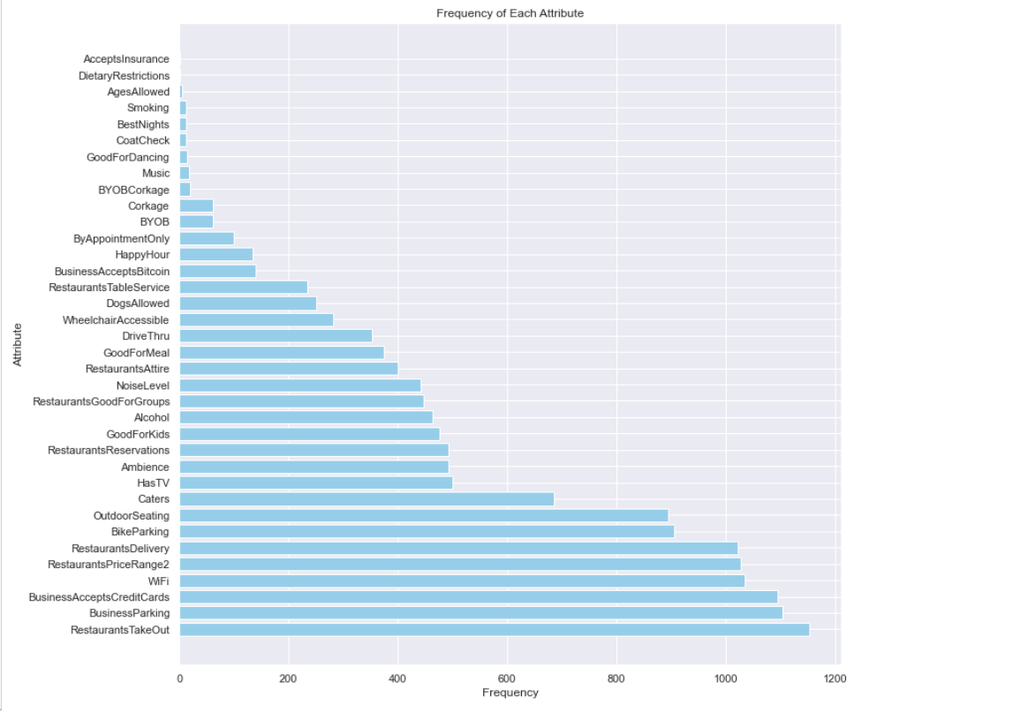

Slide 7
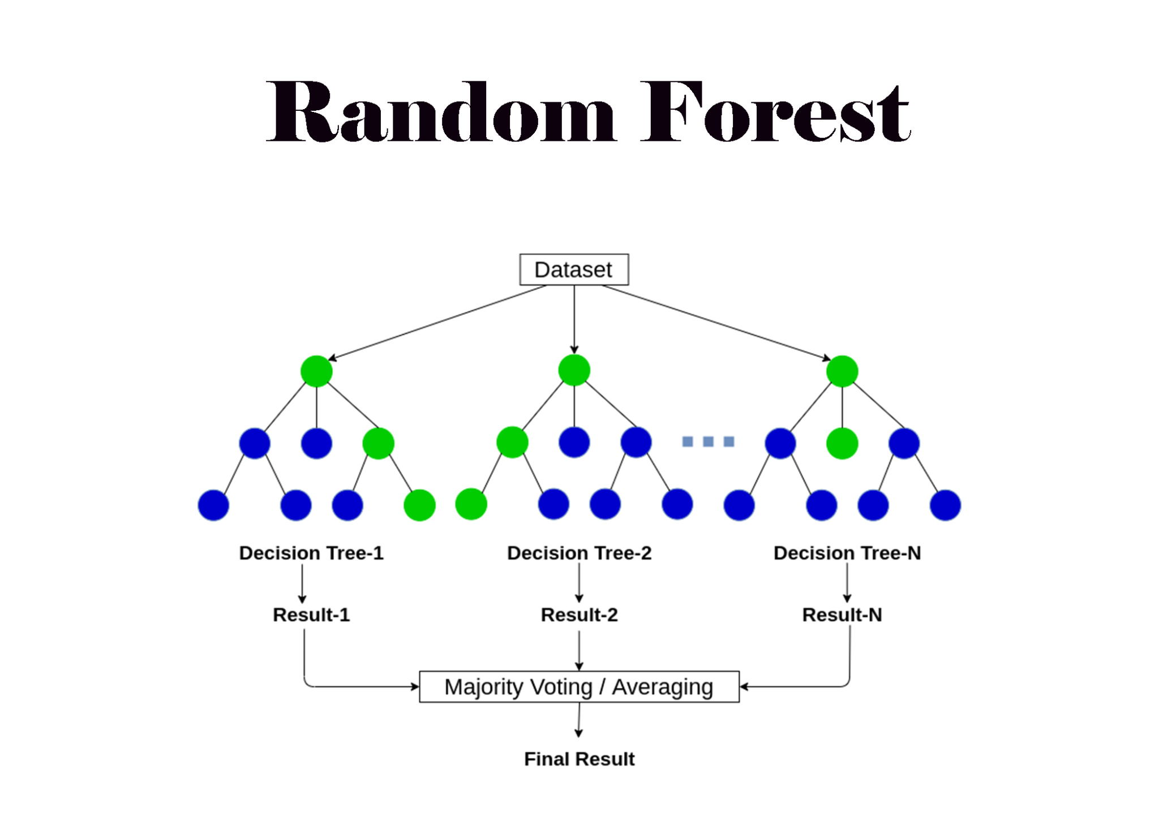
Business Attribute Analysis
Trained Random Forest regressor on attributes with frequency larger than 200.
Before modeling, we transform attributes into dataframe, and convert categorical columns to dummy variables, filling missing value with 0.
Target variable is rating, split data into training set and test set.

Slide 8
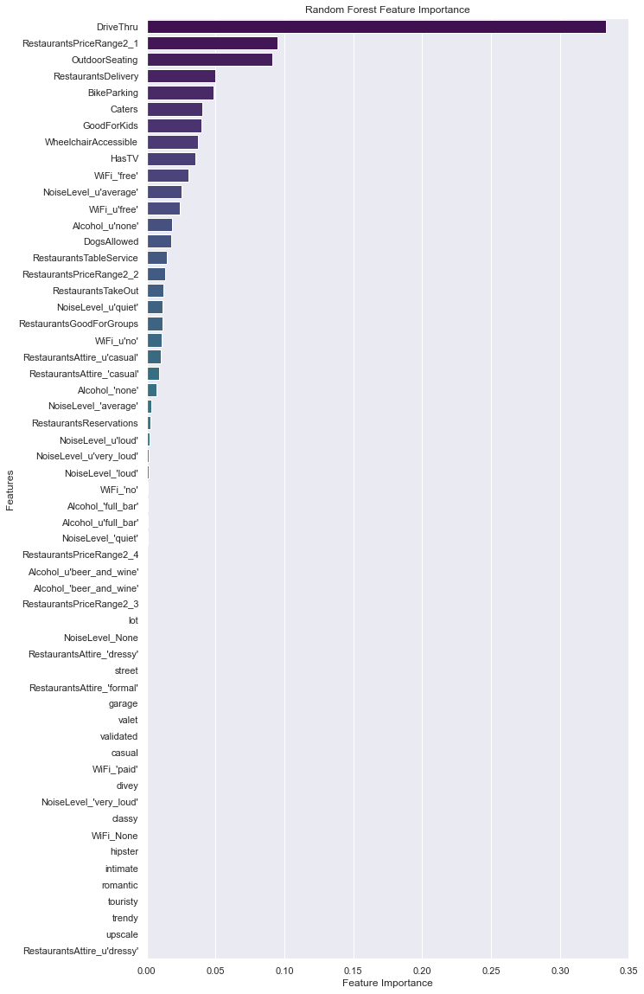
Feature Importance
R squared on train set and test set: 0.63, 0.42.
Drive through, price range, outdoor seating and delivery service are the most important features

Slide 9
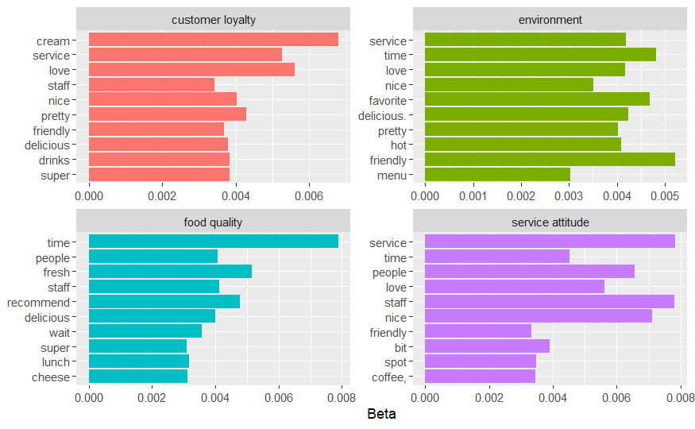
Topic Model
The LDA topic model categorized review data into 4 groups
Topics | Words with high frequency
customer loyalty | service, friendly, drinks, delicious, cream
environment | friendly, hot, time, nice
food quality | fresh, lunch, recommend, cheese, wait, delicious
service attitude | friendly, staff, nice, time

Slide 10
Suggetion
Unbuilt:
place restaurant to somewhere convenient traffic for Delivery and some driver passed.
For the size of restaurant should be bigger not only for inner space but also or outsider part.
Try to offer some place for stopping bicycle especially location closer to University.
Built:
Do some products response to do some adjust to products especially for some low-selling rate.
Set one to two guy to supervise staff’s service attitude.
Assess the consumption level of whole city or one to two surrendered city to change the price.

Slide 11
shiny app
https://exiarose.shinyapps.io/shiny_coffee/
Location
Three high and low-star reviews

Slide 12
Thank you

