Slide 1
LEVEL 5 • MISSION 1
Turners Car Insurance
AI Vehicle Recognition Prototype
A proof of concept for a simpler vehicle-insurance customer journey.
PLAN
BUILD
CONNECT
Stakeholders + context
React prototype
Azure image recognition
SHOW & TELL • ~3 MINUTES

Slide 2
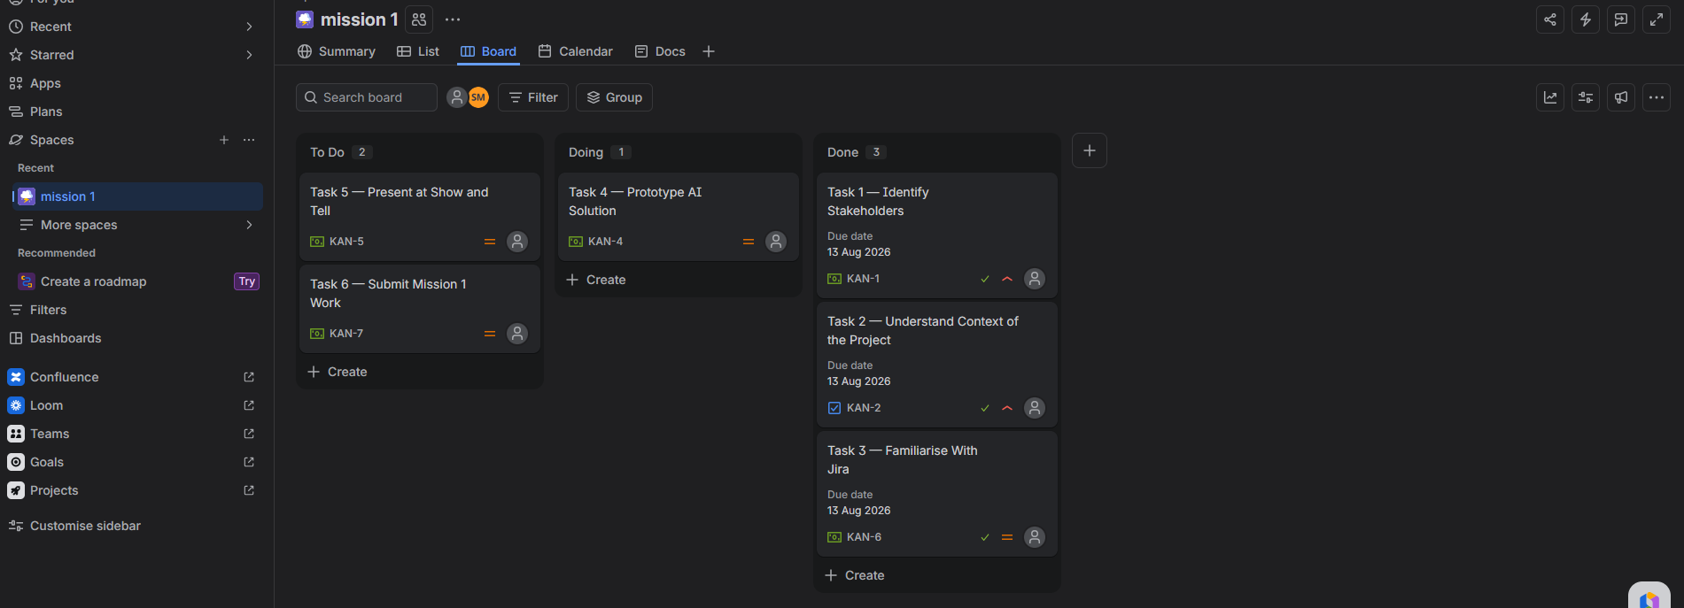
PLANNING
Understand the project before building
Tasks 1–3 established who matters, what matters, and how the work is tracked.
Stakeholders
Turners Car Auctions, Insurance, Finance, customers and the development team.
Customer focus
A simpler journey, accurate information and less confusion across purchase, finance and insurance.
Project management
Six Mission tasks tracked in Jira using To Do, Doing and Done.
Evidence: Jira board actively tracking all six Mission tasks
MISSION 1 • TURNERS CAR INSURANCE
2

Slide 3
SOLUTION
How the AI prototype is designed to work
The prototype separates the customer-facing React interface from the cloud image-recognition step.
1
2
3
4
Upload
→
Preview
→
Analyse
→
Return result
Customer selects a clear vehicle photo.
React loads the image and confirms the selected file.
Azure image recognition analyses the vehicle image.
The prediction is displayed back in the interface.
Prototype scope
Vehicle recognition only — insurance premium calculation is outside this proof of concept.
MISSION 1 • TURNERS CAR INSURANCE
3

Slide 4
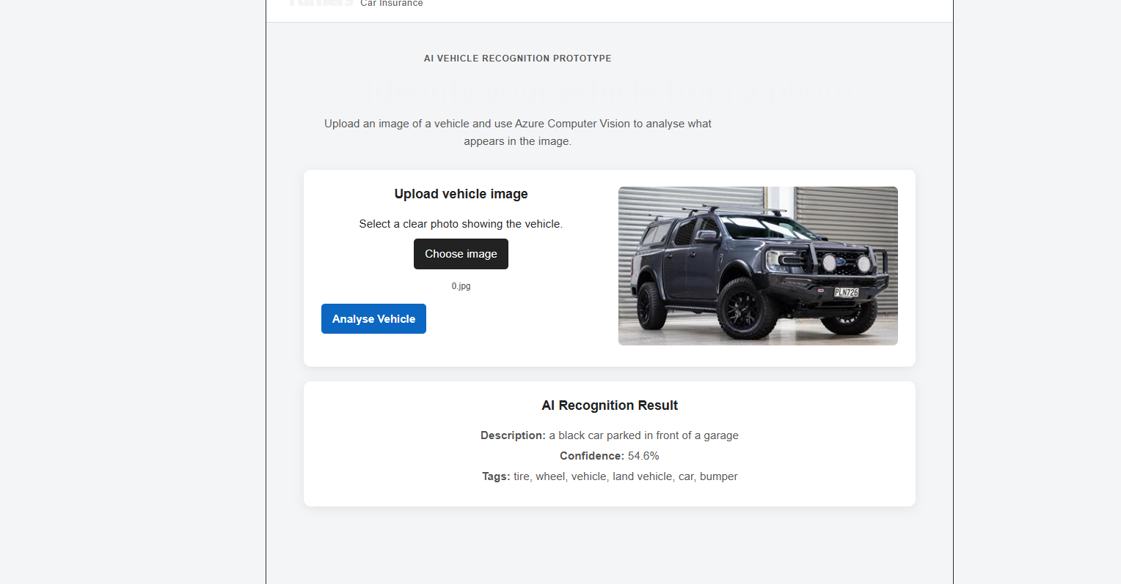
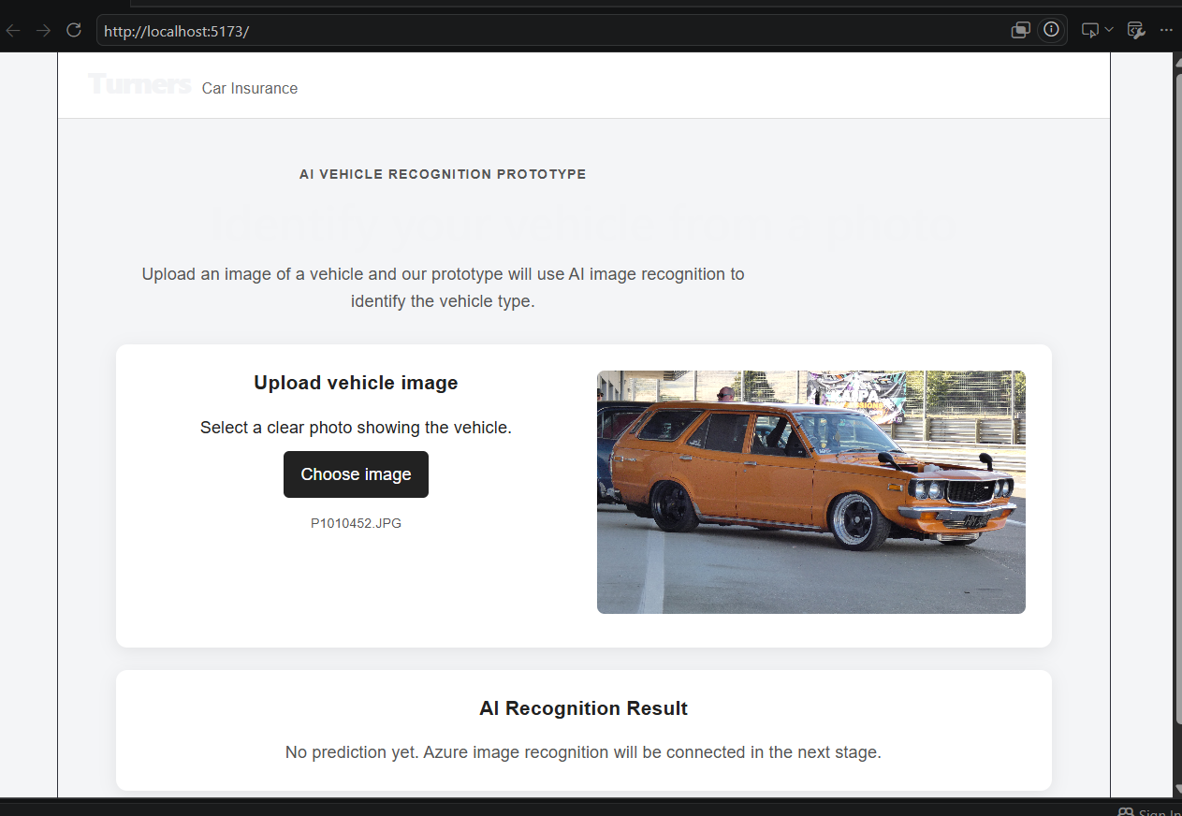
PROTOTYPE
Azure Computer Vision working end-to-end
A vehicle image is uploaded in React, analysed through the Node backend, and the Azure result is returned to the interface.
TEST RESULT
✓ Azure connected
✓ Vehicle recognised
54.6%
description confidence
Returned tags
tire • wheel • vehicle
land vehicle • car • bumper
Finding: general Computer Vision detects vehicle content reliably, but exact make/model or body type would require a specialised/custom-trained model.
MISSION 1 • TURNERS CAR INSURANCE
4

