Slide 1
MULTIPLE
FILE CONVERSIONS
PRESENTATION OF PROJECT WORK
By:
Ansh Sachdeva(41325502716)
Nitin Kumar(41725502716)
Kunal Wadhawan(0122502716)
Under The Guidance of :
PANKAJ SINGH YADAV
Assistant Professor
Dept. of CSE, JEMTEC, Gr. Noida, GGSIP University

Slide 2
Outline.
2
Abstract
Introduction
Objective
Scope
Theoretical Background
Existing System
Proposed System
Literature Survey
Synopsis : Challenges in Data Conversion Process
Research : Analysis of an Audio File Structure Format
Problem Definition
Project Mission
Target Users
April 22, 2020| Multiple File Conversions | Group 6

Slide 3
Outline.
3
Feasibility Study
Economic, Technical and Operational Feasibility
Problem Definition
Problem Statement
Target Users
Designing and Implementation
System Design
Data Flow Diagram
Use Case Diagram
Miscallanous
Source Code and Screenshots
Task Log
Conclusion and Future Work
References
April 22, 2020| Multiple File Conversions | Group 6

Slide 4
Abstract.
4
File conversion is the conversion of computer data from one format to another.
A conversion can be as simple as converting a text file from one character encoding system to another (e.g. converting a markdown file to html or converting a colored image to grayscale ). It can also be as complex as conversion between different image formats, which requires deeper understanding of compression and encoding algorithms.
In this project, we have proposed and implemented a platform (aio.io) for converting files from one format to another without the use of any server.
Files are converted into different formats using various conversion algorithms.
April 22, 2020| Multiple File Conversions | Group 6

Slide 5
Introduction.
5
A Computer File is a blob of information stored on a memory device. These files are used for recording data discretely and are managed and organized by a File system.
Data conversion is the process of conversion of computer data from one format to another. We often need to convert a file to a different format based on our needs
There are many challenges and principles involved in the conversion of file from one format to another. We have attached a seperate research on that.
In this project , we researched on various concepts involved and approaches used in converting a file from one format to another, their advantages and drawbacks, feasibility,etc. We use this knowledge to build a better solution for converting files.
April 22, 2020| Multiple File Conversions | Group 6

Slide 6
Existing Solutions.
7
Internet dependency: Websites like smallpdf.com, webresize.com, etc provide online solution to converting a file from one format to another. These solutions would not work with poor connectivity
Privacy Concern : Giving your personal data to untrusted websites is a high risk to security as these websites can analyse and misuse your data
Memory issue :Offline softwares like libreoffice, CoUtils ,etc provide an offline approach to this problem but they take a very large memory space
Cost :Softwares like Acrobat and Photoshop are very expensive.
April 22, 2020| Multiple File Conversions | Group 6

Slide 7
Proposed Solution.
8
In this project, we have proposed and implemented a platform (aio.io) for converting files from one format to another without the use of any server. Various image(png,jpeg,svg,gif), video(mp4,flv) , audio(mp3,ogg) and file formats (docx,pdf,odf,txt,html,etc) would be converted interoperability between the same file type
Features:
Completely offline: Files are converted and stored on the user device only
Free to use
Better Security: No logs are created on the Website Server
April 22, 2020| Multiple File Conversions | Group 6

Slide 8
Proposed Solution.
9
Features:
Faster file conversions : Since user’s device is being used to perform conversions, we get incredible speeds without compromising on efficiency
Small Application Size
April 22, 2020| Multiple File Conversions | Group 6

Slide 9
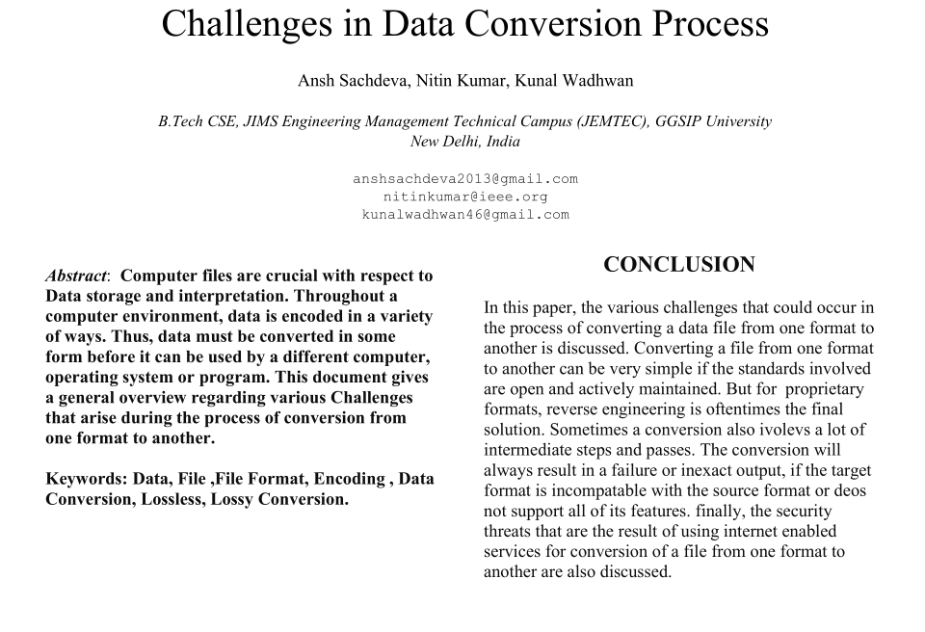
Literature Survey
6
April 22, 2020| Multiple File Conversions | Group 6

Slide 10
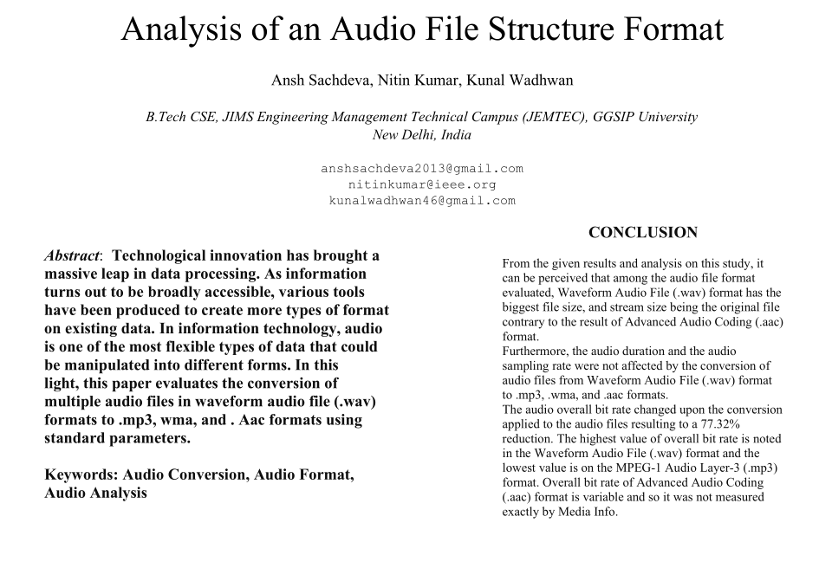
Literature Survey
6
April 22, 2020| Multiple File Conversions | Group 6

Slide 11
Principles of Data Conversion
13
Before any data conversion is carried out, the user or application programmer should keep a few basics of computing and information theory in mind. These includes:
Information Discard Rule: Information can easily be discarded by the computer, but adding new information takes effort.
Information Addition Rule: The computer can add information only in a rule-based fashion.
Upsampling Rule : Up-sampling the data or converting to a more feature-rich format does not add information; it merely makes room for that addition, which usually a human must do (Automatic restoration of information that was lost through a lossy compression process would probably require important advances in artificial intelligence).
Data Rule: Data stored in an electronic format can be quickly modified and analysed.
Because of these realities of computing and information theory, data conversion is often a complex and error-prone process that requires the help of experts.
April 22, 2020| Multiple File Conversions | Group 6

Slide 12
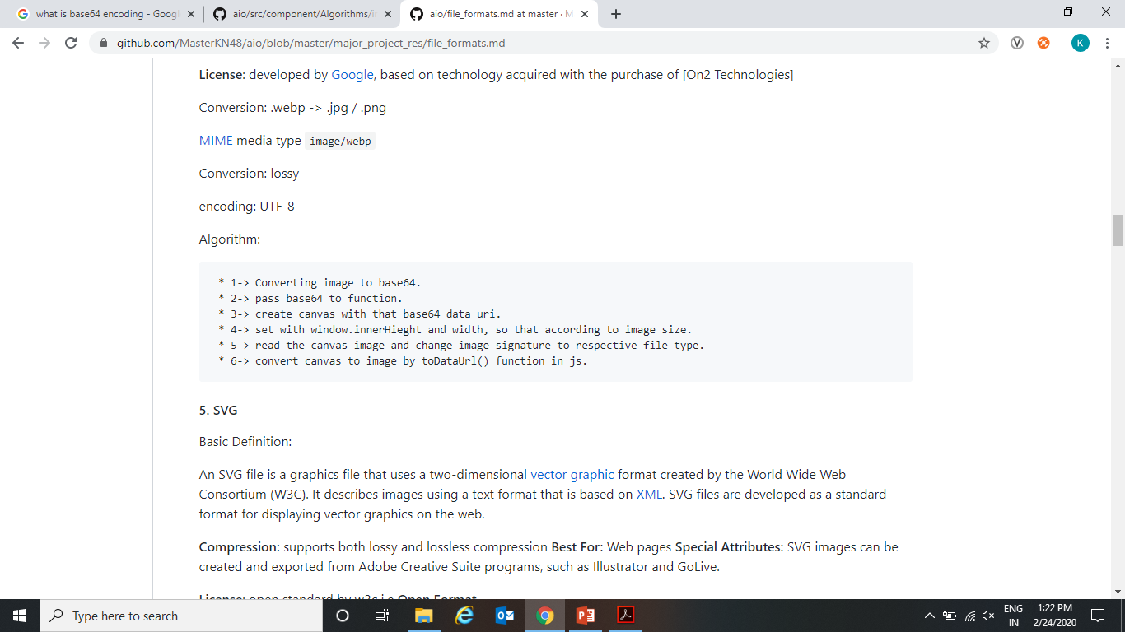
Image Conversion Algorithm.
14
.PNG -> .JPG/.WEBP
.JPG -> .PNG/.WEBP
.GIF -> .PNG/.JPG/.WEBP
.WEBP -> .JPG/.PNG
.SVG -> .JPG/.PNG/.WEBP
April 22, 2020| Multiple File Conversions | Group 6

Slide 13
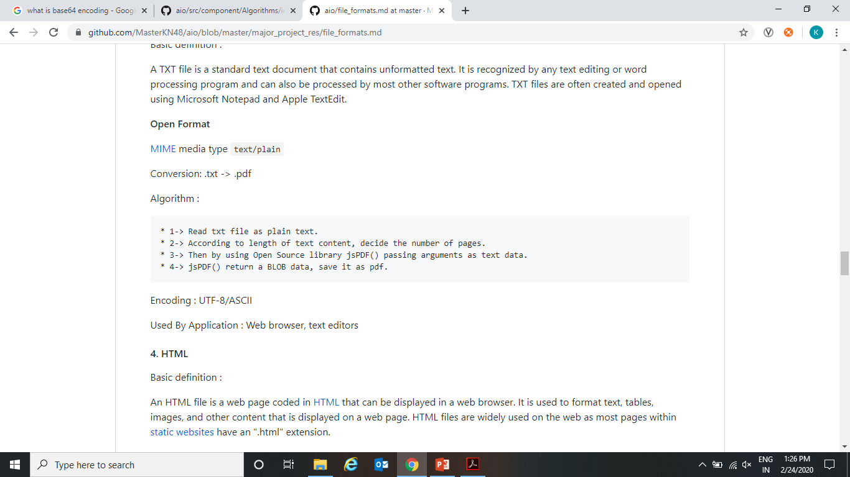
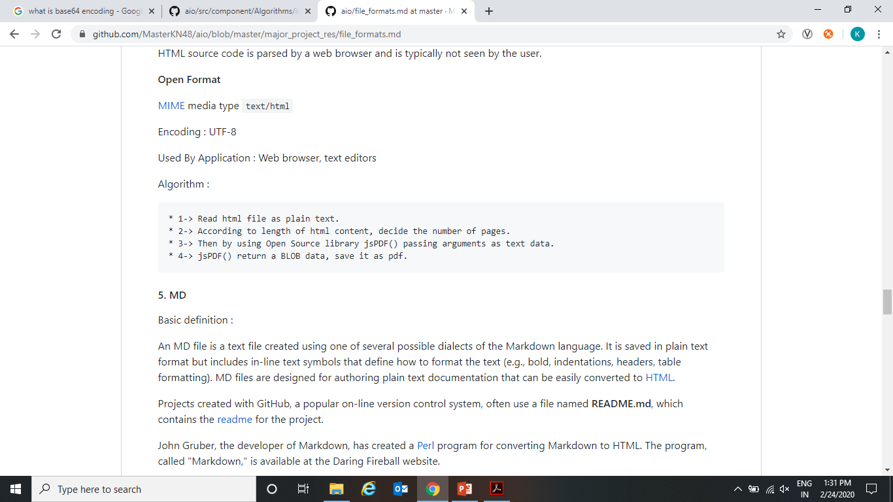
Document Conversion Algorithm
15
.TXT -> .PDF
.HTML -> .PDF
April 22, 2020| Multiple File Conversions | Group 6

Slide 14
Problem Definition
16
Project Mission
The aim of our project is provide a platform for the file format conversion and compression without the use of server side which allows it to work offline . And keeping the size of application small making it to use anytime, anywhere.
Target Users
We are targeting every users who want to change there file formats for various purposes like online form filing, software application images need in particular format ,etc. Any user who want to particular file format without concerning about its privacy of data and want to save time and efforts.
April 22, 2020| Multiple File Conversions | Group 6

Slide 15
System Design
17
Software and hardware used :
Software Used: VS Code, Git Version Control Software, NPM , Google Chrome, Jest for software testing
Languages/Frameworks Used : HTML5, BulmaCSS , React.js, JSON, NodeJS (in dev mode)
Hardware Used : HP Pavillion laptop with 1Tb hard disk, 8gb ram and i5 7th Gen Processor running on Linux(Ubuntu)
April 22, 2020| Multiple File Conversions | Group 6

Slide 16
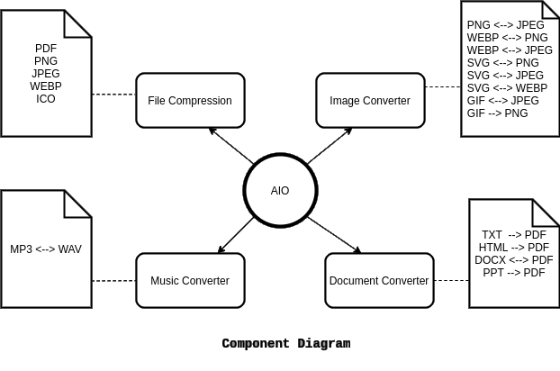
System Design
18

Slide 17
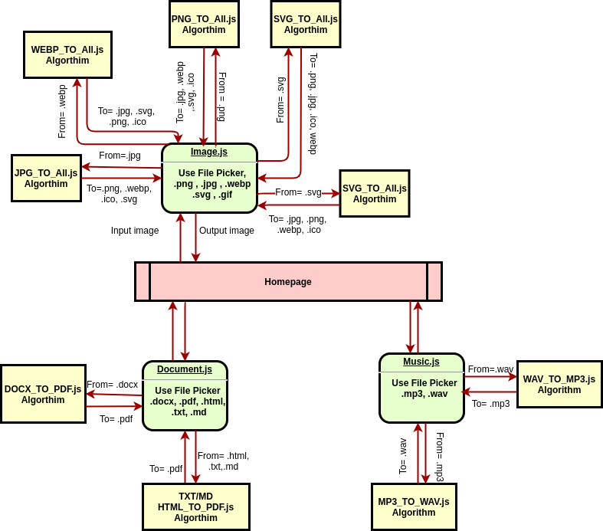
Data Flow Diagram
19

Slide 18
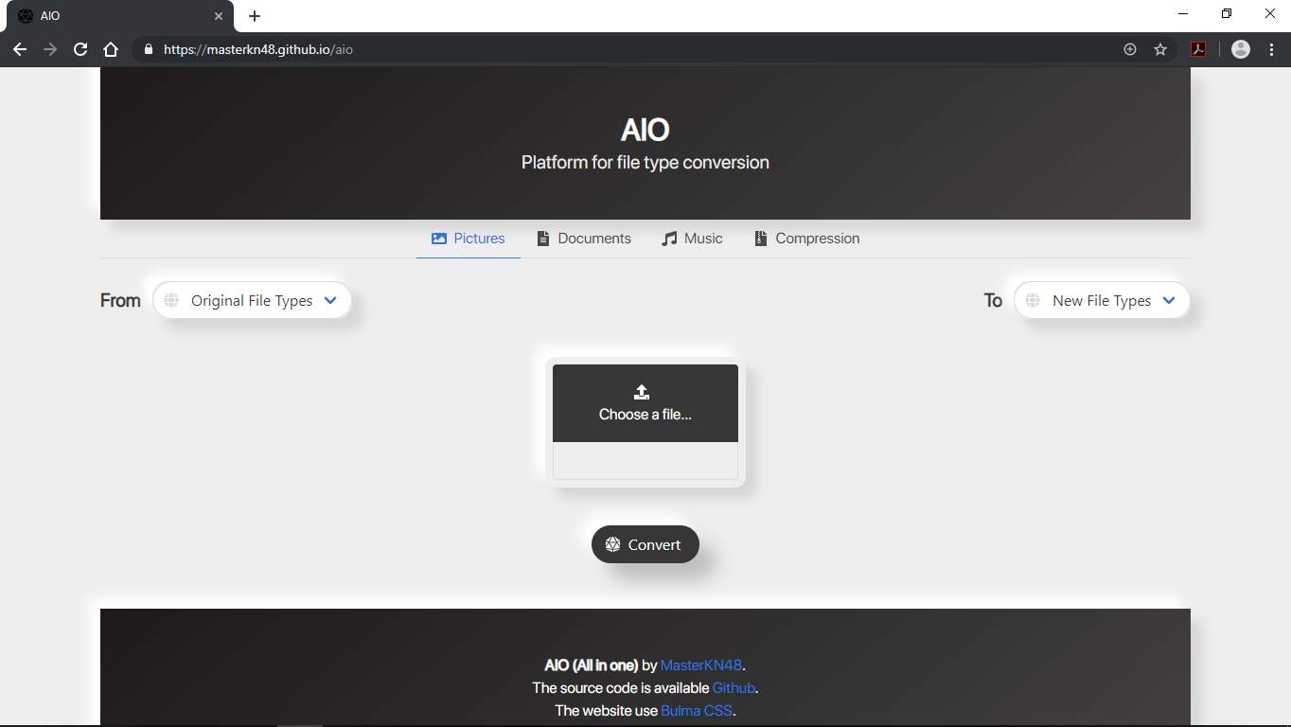
System Design: Preview
20
April 22, 2020| Multiple File Conversions | Group 6

Slide 19
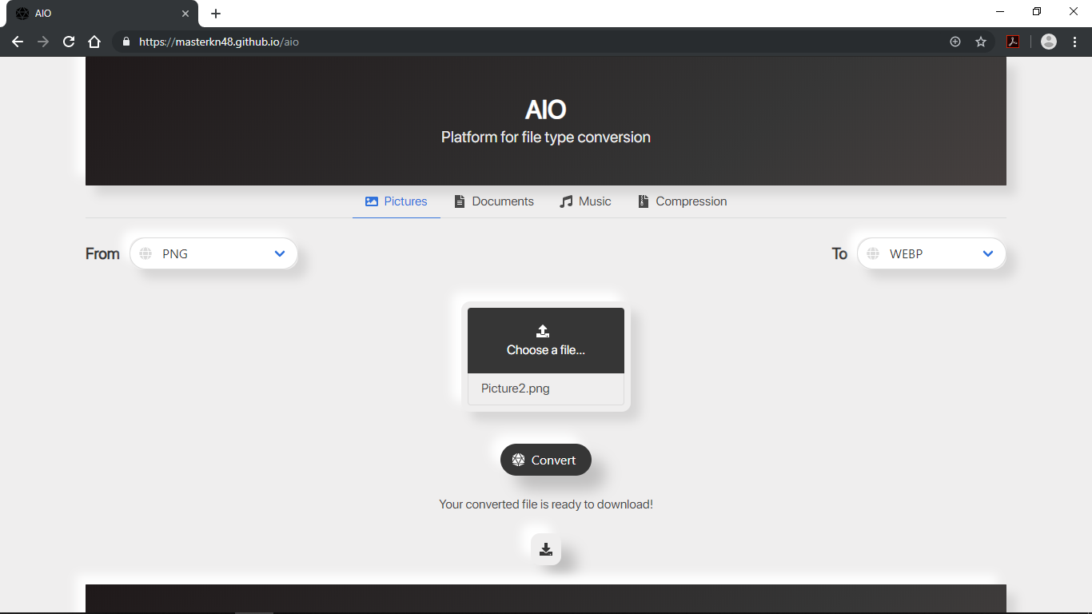
System Design: Preview
21
April 22, 2020| Multiple File Conversions | Group 6

Slide 20
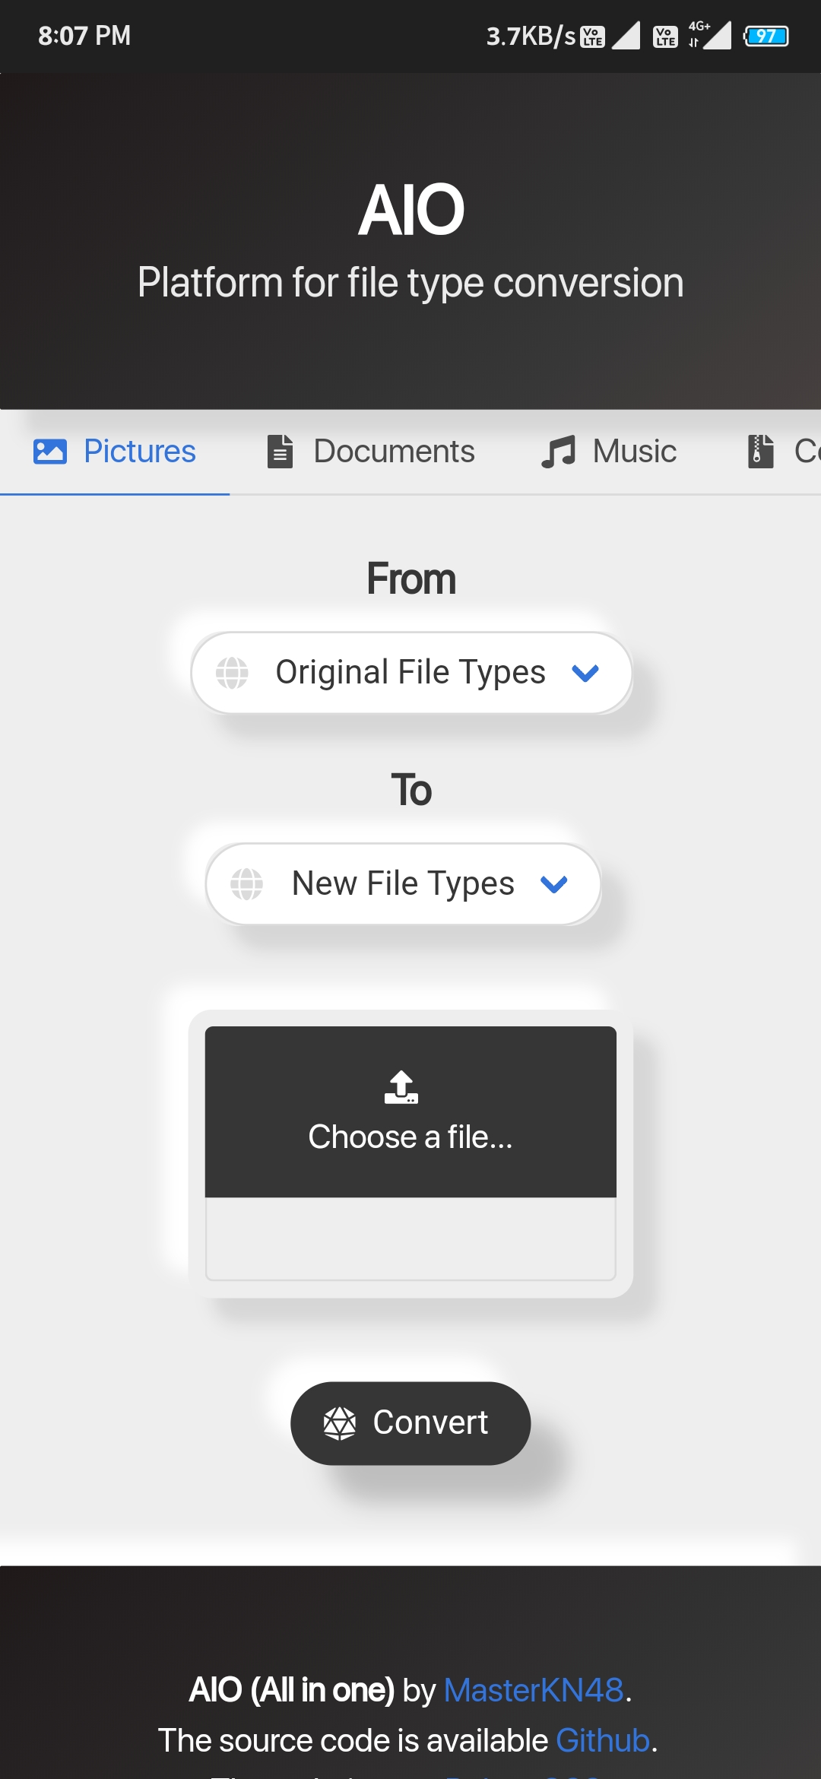
System Design: Preview
22
Source Code : https://github.com/MasterKN48/aio/
Live Demo : https://masterkn48.github.io/aio/
April 22, 2020| Multiple File Conversions | Group 6

Slide 21
System Design: Task Log :
23
Milestones | Date Assigned | Date Completed | Task
1. Study over file conversion | 5/01/2020 | Till the project end | Study about various aspects of File formats and conversion.
2. Designing the application | 10/01/2020 | 15/01/2020 | Task is to create design of application like wireframe, mockups, understanding design challenges.
3. Modules Generation | 16/01/2020 | 20/01/2020 | Deciding number of modules 1-> Image Convertor, 2-> Document Convertor, 3-> Compressed File Convertor, 4-> Audio Convertor
4. Creating Image Convertor | 21/01/2020 | 02/02/2020 | Searching about images conversion algorithms, and created all image convertor
April 22, 2020| Multiple File Conversions | Group 6

Slide 22
System Design: Task Log :
24
Milestones | Date Assigned | Date Completed | Task
5. Create Document Convertor | 03/02/2020 | 10/02/2020 | Creating document handling modules.
6. Document Modules | 11/02/2020 | 15/02/2020 | Study about documents file format. Creating algorithm design for txt to pdf.
7. Document Modules | 16/02/2020 | 20/02/2020 | Study about open formats, proprietary formats, worked on html to pdf and pdf to html.
8. Creating File Compression Modules and documents modules | 21/02/2020 | 30/02/2020 | Searching about compression, conversion algorithms, and creating algorithms for file compression
April 22, 2020| Multiple File Conversions | Group 6

Slide 23
Conclusion
25
The Purpose and objective of our project is to provide security to user who doesn’t want to share crucial data to anyone else but need a platform to convert there file without any fear of data privacy.
This project will provide a platform which can available anywhere and be use at any time.
This project will provide small size very fast file convertor.
April 22, 2020| Multiple File Conversions | Group 6

Slide 24
References
26
www.wikipedia.com : file formats details
www.fileFormat.com : file formats details and its associated softwares.
www.reactjs.org : for learning reactjs
evaluating file formats nationalarchives.gov.uk/documents/information-management/evaluating-file-formats.pdf This guidance will help you to evaluate files.
A Highly Accurate PDF-To-Text Conversion System for Academic Papers Using Natural Language Processing Approach https://www.researchgate.net/publication/327992611_A_Highly_Accurate_PDF-To-Text_Conversion_System_for_Academic_Papers_Using_Natural_Language_Processing_Approach
Conversion of DICOM Image in to JPEG, BMP and PNG Image Format https://www.researchgate.net/publication/258789781_Conversion_of_DICOM_Image_in_to_JPEG_BMP_and_PNG_Image_Format
April 22, 2020| Multiple File Conversions | Group 6

Slide 25
Acknowledgement
27
We are willing to express our profound gratitude and heartiest thanks to all the researchers in the field of File Handling and System Programming , specially to the developers of File Sytems, who have made their research work easy to accomplish.
- Ansh , Nitin and Kunal
April 22, 2020| Multiple File Conversions | Group 6

Slide 26
Multiple File
Conversion.
THANK YOU!

