Slide 1
Securing Storage in
Cloud Computing.
PRESENTATION OF PROJECT WORK
By:
Ansh Sachdeva(41325502716)
Nitin Kumar (41725502716)
Under The Guidance of :
PANKAJ SINGH YADAV
Assistant Professor
,Dept. of CSE,JEMTEC,Gr. Noida, GGSIP University

Slide 2
Outline.
2
Abstract.
Introduction
Objective
Scope
Theoritical Background
Existing System
Proposed System
Features
AES
DES
Feasibility Study
Economic Feasibility
Technical Feasibility
September 09,2019 | Secure Storage in Cloud Computing| Group 3

Slide 3
Outline.
3
Operational Feasibility
Problem Definition
Problem Statement
Target Users
Designing and Implementation
System Design
Data Flow Diagram
Use Case Diagram
Miscallanous
Source Code and Screenshots
Task Log
Conclusion and Future Work
References
September 09,2019 | Secure Storage in Cloud Computing| Group 3

Slide 4
Abstract.
4
The cloud computing platform gives people the opportunity for sharing resources, services and information among the people of the whole world
In private cloud system, information is shared among the persons who are in that cloud.
In this project , we have proposed new security architecture for a cloud based platform called “PICSABIZ” . It is an online platform for designers and ui/ux developers where they could publish and sell their art to subscribers in a secure manner
Files on the server are encrypted via AES and triple DES algorithm
This ensures secure communication system and hiding information from others
September 09,2019 | Secure Storage in Cloud Computing| Group 3

Slide 5
Introduction.
5
Cloud computing is one the most important and developing concept for both the developers and the users
Resources are shared among all of the servers, users and individuals.
In the area of cloud computing different security models and algorithms are applied.
we have proposed new security architecture for cloud computing platform
In this model high ranked security algorithms are used for giving secured communication process
September 09,2019 | Secure Storage in Cloud Computing| Group 3

Slide 6
Introduction(Contd.)
6
Our proposed model distributive server concept is used, thus ensuring higher security.
It also helps to solve main security issues like malicious intruders, hacking
The AES algorithm is used for secured downloading from servers
September 09,2019 | Secure Storage in Cloud Computing| Group 3

Slide 7
Previous Work.
7
The Existing System
Identification based cloud computing security model have been worked out by different researchers.
Yao’s Garbled Circuit is used for secure data saving in cloud servers.
AES based file encryption system is used in some of these models. But these models keep both the encryption key and encrypted file in one database server.
Only one successful malicious attack in the server may open the whole information files to the hacker.
September 09,2019 | Secure Storage in Cloud Computing| Group 3

Slide 8
Proposed Solution
9
In our proposed model we have worked with the following security algorithms:
AES for Secured file encryption
Pass code and 3rd party based login options for user Authentication
The system works in the following manner:
When user visits the website or opens the app, they are presented with a beautiful previews of various art posted by authenticated users.
These arts are non downloadable unless user takes a subscription of the author. We ensure that these art reain non downloadable by preventing screenshot access and by removing download options at the client site. The files are also non downloadable via server since all the files are encrypted on the server.
September 09,2019 | Secure Storage in Cloud Computing| Group 3

Slide 9
Proposed Solution(Contd.)
10
Once the user is successfully logged in and has paid the required amount, the user receives a secret key in their email
They can now simple enter the key and downloading process will begin
Features
System is highly user friendly.
The system provides privacy and security as the art can only be downloaded after entering the private key of author.
The sysem prvides data Integrity.
The system provides clarity in its functionality event to its naiive users.
September 09,2019 | Secure Storage in Cloud Computing| Group 3

Slide 10
AES Algorithm.
11
AES is a symmetric block cipher
It uses the same key for both encryption and decryption
The algorithm can only accept a block size of 128 bits and a choice of three keys - 128, 192, 256 bits
Encryption consists of 10 rounds of processing for 128-bit keys, 12 rounds for 192-bit keys, and 14 rounds for 256-bit keys.
Except for the last round in each case, all other rounds are identical.
September 09,2019 | Secure Storage in Cloud Computing| Group 3

Slide 11
DES Algorithm
12
The Data Encryption Standard (DES) is a symmetric-key block cipher published by the National Institute of Standards and Technology (NIST).
The block size is 64-bit. Though, key length is 64-bit, DES has an effective key length of 56 bits, since 8 of the 64 bits of the key are not used by the encryption algorithm (function as check bits only).
DES is a previously dominant algorithm for encryption, and was published as an official Federal Information Processing Standard (FIPS). DES is now considered to be insecure due to the small key size.
Triple DES applies DES three times to each block to increase the key size. The algorithm is believed to be secure in this form.
September 09,2019 | Secure Storage in Cloud Computing| Group 3

Slide 12
Feasibility Study
13
A Feasibility study is an assessment of the practicality of a proposed project or system. A feasibility study aims to objectively and rationally uncover the strengths and weaknesses of an existing or proposed System.
In feasibility study of Our Project Securing Storage in Cloud important aspects
were considered for feasibility study like the problem definition and the process
for solution. The cost and benefit analysis was also done.
Economic Feasibility
The project was within the budget and produced the desired results. The human resources consisted of 2 members of our project. The output consisted of getting the desired results. Thus with the consideration of the inputs, the outputs were achieved successfully. The project was within limit. The inputs didn’t overdo the outputs.
September 09,2019 | Secure Storage in Cloud Computing| Group 3

Slide 13
Feasibility Study
14
Technical Feasibility
Technical feasibility revolves around the technical aspects of the project. The project is aimed to target at the lowest spec computer devices available. The test systems consisted of Pentium 4 laptops with 1 gb RAM, and they were easily able to absorb the new s/w being installed.The project thus was technically feasible. The project could be made to work correctly, fulfilling its task, with the existing s/w and personnel
Operational Feasibility
Operational Feasibility aims to determine the impact of the system on the users. Pur Website PicsaBiz was tested by 10 random people and designers. It was new for them but it was simple enough for them to understand. The system developed was found to be user friendly and interactive
September 09,2019 | Secure Storage in Cloud Computing| Group 3

Slide 14
Problem Defination
15
Project Mission
The aim of our project is to develop a secure image distribution platform named PicsaBiz .The website server would store files in an encrypted manner and the security and integrity of data and information will be maintained at the time of downloading and distribution
Target Users
Our Project is targeted at budding artists and designers who want to make money through their art in a secure and safe manner.
September 09,2019 | Secure Storage in Cloud Computing| Group 3

Slide 15
System Design
16
Platform Designing:
Software Used : VS Code, MySQL IDE, Git Version Control Software, Inkscape(For designing icons and vectors), chrome( for testing)
Languages/Frameworks Used : HTML/CSS/JS , BootStrap, MongoDB , Express.js, React.js, Node.js, JSON
Hardware Used : HpPavillion laptop with 1Tb hard disk, 8gb ram and i5 7th Gen Processor running on Linux(Ubuntu)
September 09,2019 | Secure Storage in Cloud Computing| Group 3

Slide 16
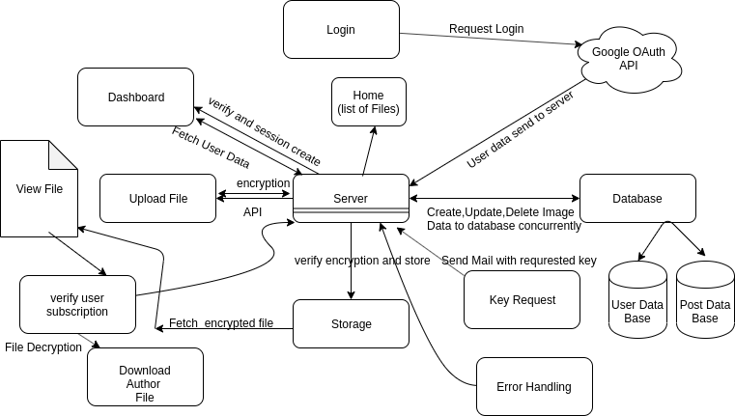
System Design
17
Data Flow Diagram
September 09,2019 | Secure Storage in Cloud Computing| Group 3

Slide 17
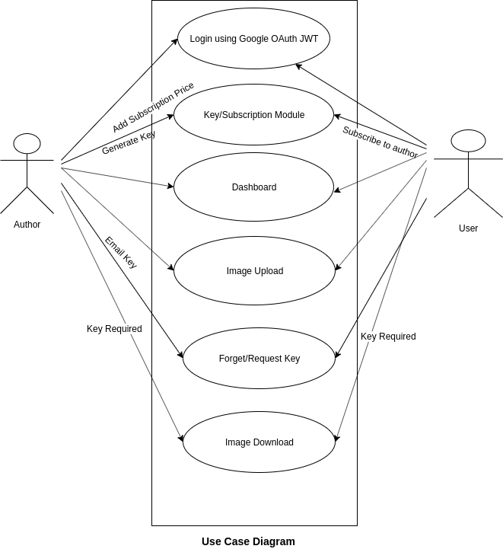
System Design
18
September 09,2019 | Secure Storage in Cloud Computing| Group 3

Slide 18
System Design
19
Source Code:
Available at: https://github.com/MasterKN48/college_mini_project
Working SnapShots:
September 09,2019 | Secure Storage in Cloud Computing| Group 3

Slide 19
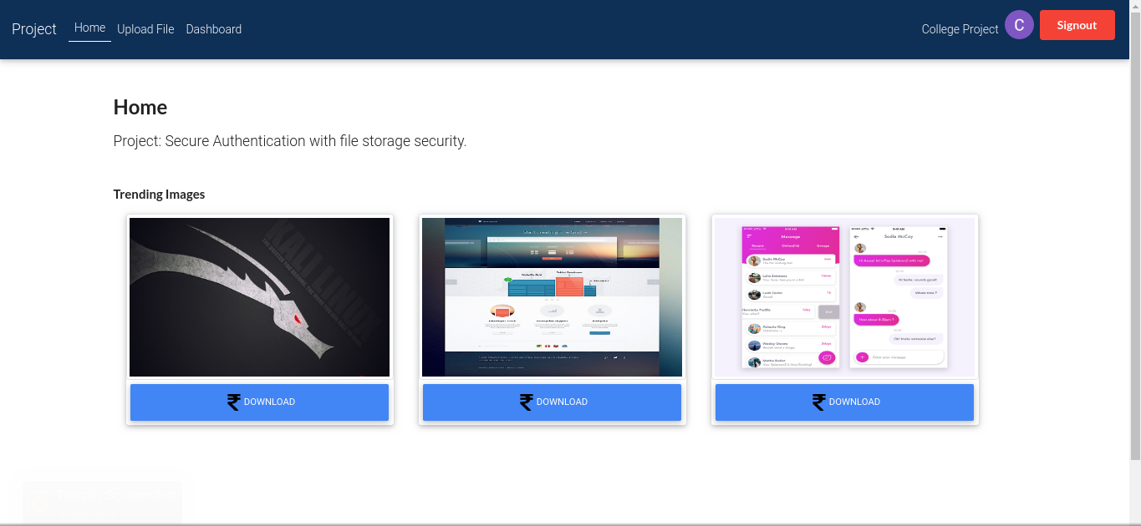
System Design: Working SnapShots:
20
September 09,2019 | Secure Storage in Cloud Computing| Group 3

Slide 20
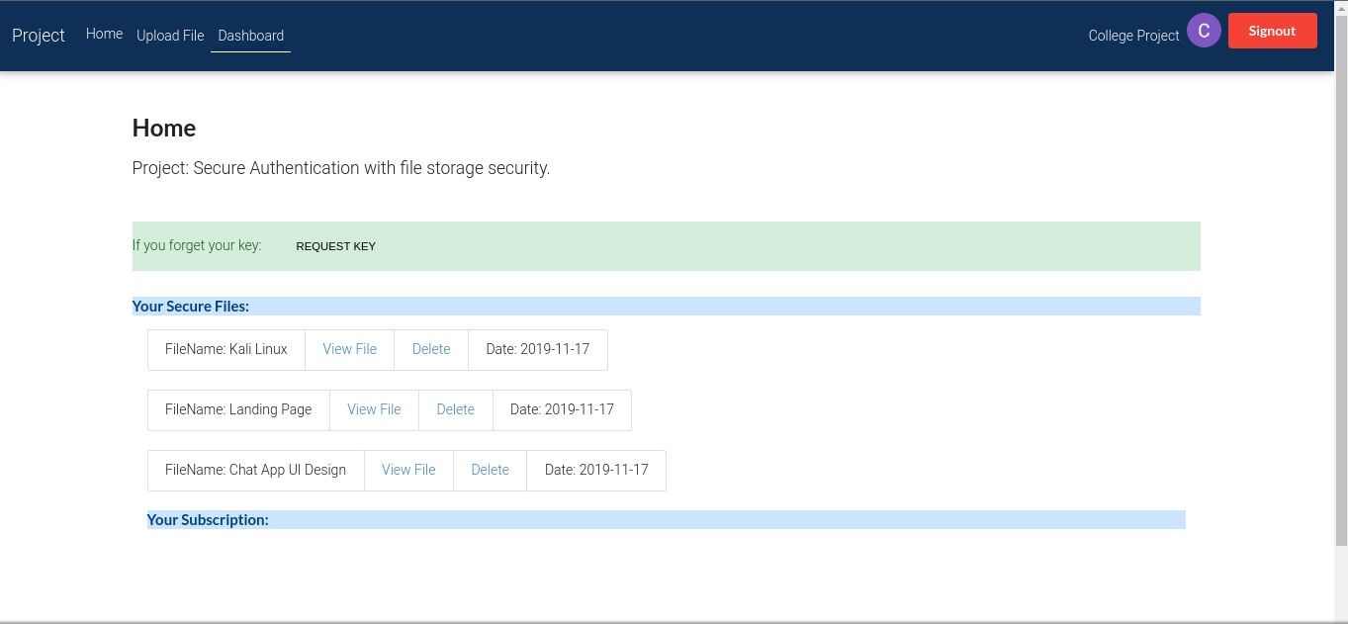
System Design: Working SnapShots:
21
September 09,2019 | Secure Storage in Cloud Computing| Group 3

Slide 21
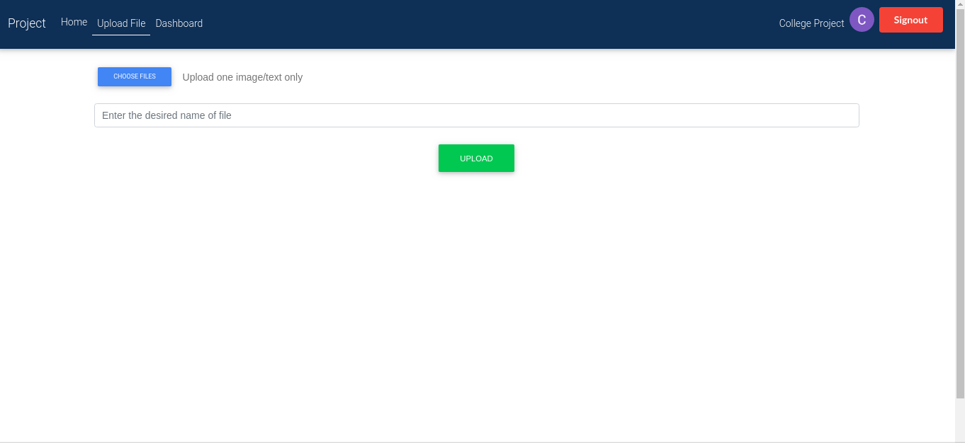
System Design: Working SnapShots:
22
September 09,2019 | Secure Storage in Cloud Computing| Group 3

Slide 22
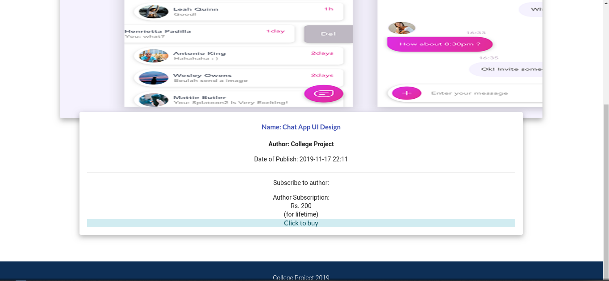
System Design: Working SnapShots:
22
September 09,2019 | Secure Storage in Cloud Computing| Group 3

Slide 23
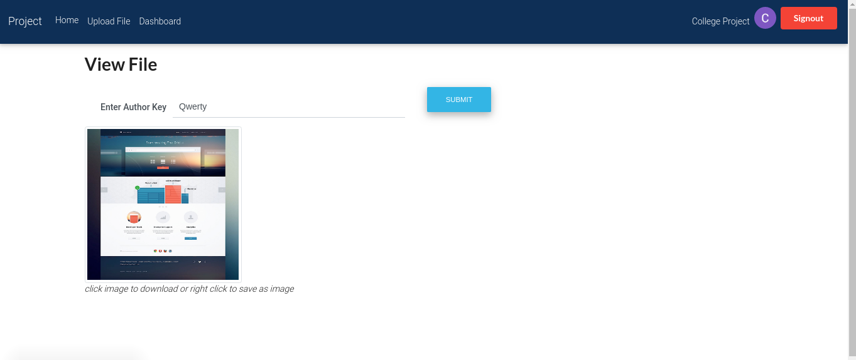
System Design: Working SnapShots:
22
September 09,2019 | Secure Storage in Cloud Computing| Group 3

Slide 24
System Design: Task Log :
23
Team Member Name | Date Assigned | Date Completed | Task
Nitin Kumar and Ansh Sachdeva | August 3rd 2019 | August 5th, 2019 | Project Planning: Idea evaluation , Requirement Gathering
Ansh Sachdeva | August 6th2019 | August 25th 2019 | Theoritical research: CryptoGraphy Algorithms
September 09,2019 | Secure Storage in Cloud Computing| Group 3

Slide 25
System Design: Task Log :
24
Team Member Name | Date Assigned | Date Completed | Task
Nitin Kumar | August 26th 2019 | September 30th | Theoritical research: Web development : backend planning , Framework analysis, DFD creation
Ansh | Ocotober 1st,2019 | October 2^{nd,} ,2019 | Project planning: Designs and wireframes
September 09,2019 | Secure Storage in Cloud Computing| Group 3

Slide 26
System Design: Task Log :
25
Team Member Name | Date Assigned | Date Completed | Task
Nitin Kumar and Ansh | Ocotber 3rd, 2019 | October 31st,2019 | Product development: website frontend, website backend, mobile frontend, mobile backend
Ansh | November 1st | November 8th , 2019 | Manual Testing : Unit testing, Monkey Testing
September 09,2019 | Secure Storage in Cloud Computing| Group 3

Slide 27
System Design: Task Log :
26
Team Member Name | Date Assigned | Date Completed | Task
Nitin | November 8th ,2019 | November 14th ,2019 | User Acceptance Testing : Feasibility testing, alpha-beta testing survey analysis
Ansh and Nitin | November 15th ,2019 | November 17th ,2019 | Final Changes and Documentation
September 09,2019 | Secure Storage in Cloud Computing| Group 3

Slide 28
Conclusion.
27
Through this project, we have proposed a newer security structure for cloud computing environment which includes AES and Triple DES file encryption system
This model ensures security for whole cloud computing structure
In our proposed system, an intruder cannot easily get information and upload the files because he needs to take control over all the servers, which is quite difficult.
September 09,2019 | Secure Storage in Cloud Computing| Group 3

Slide 29
Conclusion (Contd.).
28
The model, though it is developed in a cloud environment, individual servers’ operation has got priority here.
So, decision taking is easy for each server, like authenticate user, give access to a file etc.
September 09,2019 | Secure Storage in Cloud Computing| Group 3

Slide 30
Future work .
29
In our proposed model we have used AES encryption system which is deterministic. For this reason, it becomes fragile in long run process. But the other algorithms make the model highly secured.
In future we want to work more on ensuring secure uploading/downloading system between users and system, user to user.
We also want to add a payment gateway which would make this model business ready
September 09,2019 | Secure Storage in Cloud Computing| Group 3

Slide 31
Acknowledgement.
30
We are willing to express their profound gratitude and heartiest thanks to all the researchers in the field of cloud computing architecture’s security, specially to the developers of security algorithms, who have made their research work easy to accomplish.
- Ansh and Nitin
September 09,2019 | Secure Storage in Cloud Computing| Group 3

Slide 32
References.
31
Network security and cryptograpy by Himanshu sharma
Yashpal Kadam, “Security Issues in Cloud Computing A Transparent View”, International Journal of Computer Science Emerging Technology, Vol-2 No 5 October, 2011 , 316-322
“Cloud Computing: Silver Lining or Storm Ahead?”, Volume 13 Number 2, Spring 2010
Hongwei Li, Yuanshun Dai, Ling Tian and Haomiao Yang, “Identity-Based Authentication for Cloud Computing”, CloudCom 2009, LNCS 5931, pp. 157–166, 2009
Sven Bugiel, Stefan Nurnberger, Ahmad-Reza Sadeghi, Thomas Schneider, “Twin Clouds: Secure Cloud Computing with Low Latency”, CASED, Germany, 2011
September 09,2019 | Secure Storage in Cloud Computing| Group 3

Slide 33
References(Contd.).
32
Sven Bugiel, Stefan Nurnberger, Ahmad-Reza Sadeghi, Thomas Schneider, “Twin Clouds: Secure Cloud Computing with Low Latency”- Extended Abstract, CASED, Germany, 2011
Luis M. Vaquero, Luis Rodero-Merino, Daniel Morán, “Locking the sky: a survey on IaaS cloud security”, Computing (2011) 91:93–118
Yang Tang, Patrick P. C. Lee, John C. S. Lui, and Radia Perlman, “FADE”
Burt Kaliski, The Mathematics of the RSA Public-Key Cryptosystem, RSA Laboratories
Joan Daemen, Vincent Rijmen, “AES Proposal: Rijndael”, 1999
Joan Daemen, Vincent Rijmen, “Announcing the ADVANCED ENCRYPTION STANDARD (AES)”, Federal Information Processing Standards Publication 197, November 26, 2001
Joshua Holden, Mohammad Musa, Edward Schaefer, and Stephen Wedig, “A Simplified AES Algorithm”, January 2010
September 09,2019 | Secure Storage in Cloud Computing| Group 3

Slide 34
Secure Storage in
Cloud Computing.
THANK YOU!

