Slide 1
Deep reinforcement learning
Faustine Gusto – Thursday 29th November 2018

Slide 2
Introduction
Artificial intelligence (agent) able to learn by herself to do some tasks
Main difference from Deep Learning :
No supervisor, only a reward signal
Goal : maximize the number of rewards instead of minimize an error
Idea :
An agent will learn how to behave in an environment

Slide 3
Definitions
Reward
Feedback signal
Indicates how well the agent is doing at some steps
Agent
Artificial intelligence who learn by herself how to do some tasks
Includes
Value function : how good is each action (prediction of future reward)
Policy : agent’s behavior function
Model : agent’s representation of the environment (what to do next)

Slide 4
Concept of exploration and exploitation
Exploration
Random actions to find more information about the environment
Exploitation
Use the information discovered while exploring to maximize reward
Define a balance between exploration and exploitation
Begin with a large part of exploration (90%)
Reduce the exploration part over the time
After many actions, exploitation will take a large part (90%)

Slide 5
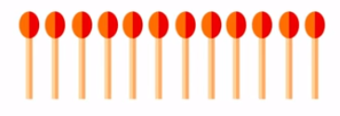
Matches game
Win the game :
Don’t be the last to take a match
12 matches
Each player can take 1, 2 or 3 matches

Slide 6
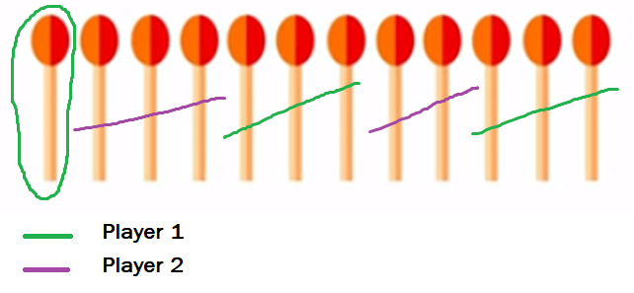
Matches game
Here player 1 is the loser
Win the game :
Don’t be the last to take a match
12 matches
Each player can take 1, 2 or 3 matches

Slide 7
Matches game
Win the game :
Don’t be the last to take a match
Deterministic game
Easy to know how to play in order to win when you start the game

Slide 8
Implementation in Python
Random artificial intelligence
Trained artificial intelligence
1000 games
Accumulation of negative or positive experiences
Modification of exploration and exploitation part over the games

Slide 9
Implementation in Python
Random artificial intelligence
Trained artificial intelligence
Results :
Trained artificial intelligence will start the game randomly
Win 95% of the time
Could win 100% of the time if she starts all the games
Notes:
Artificial intelligence trained to win
Understand how to play and win while starting the game
When it doesn’t start the game, it have to adapt itself to the other artificial intelligence which play randomly
Even it can’t start the game every time, it win 95% of the time
So it learned by itself how to play in order to win
It is the reinforcement learning

Slide 10
Conclusion
Artificial intelligence (agent) able to learn by herself to do some tasks
Adapts its actions to have reward
Goal : maximize rewards in an environment
Concept of exploration and exploration part very important

