Slide 1

GANs : Generative Adversarial Networks A short Introduction

Slide 2



BUT FIRST: GMM Gaussian Mixture Models
$$p\left(x\right)$$
Thanks!
Prof. Joaquín González Rodríguez
UAM
$$x$$

Slide 3
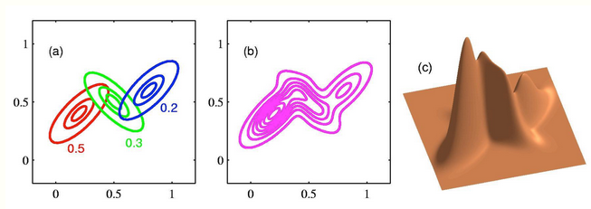
BUT FIRST: GMM Gaussian Mixture Models
Stanford CS 228: Probabilistic Graphical Models
https://ermongroup.github.io/cs228-notes/learning/latent/

Slide 4
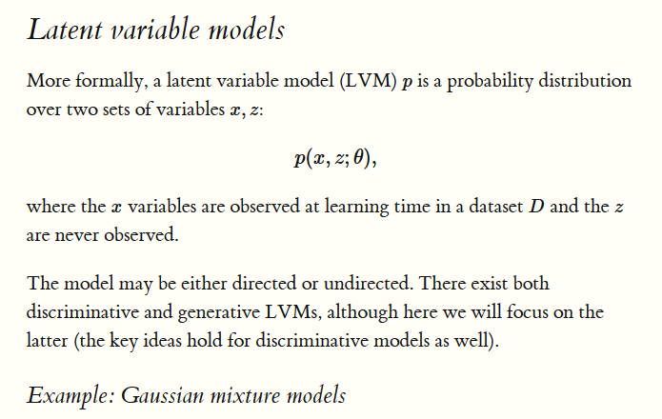
Stanford CS 228: Probabilistic Graphical Models
https://ermongroup.github.io/cs228-notes/learning/latent/

Slide 5
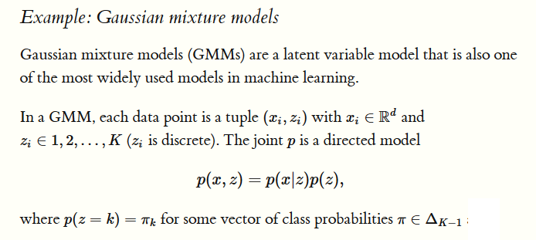
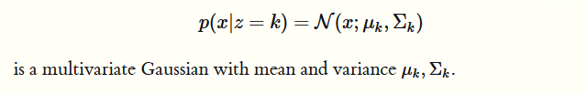
Stanford CS 228: Probabilistic Graphical Models
https://ermongroup.github.io/cs228-notes/learning/latent/

Slide 6
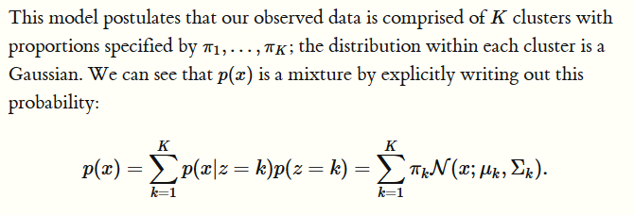

Stanford CS 228: Probabilistic Graphical Models
https://ermongroup.github.io/cs228-notes/learning/latent/

Slide 7

Stanford CS 228: Probabilistic Graphical Models
https://ermongroup.github.io/cs228-notes/learning/latent/
Ian Goodfellow: Generative Adversarial Networks (NIPS 2016 tutorial)
Missing samples, next frame, high-resolution, image to image,…

Slide 8
BUT FIRST: GMM Gaussian Mixture Models
We can see and open in Google Colab:
https://jakevdp.github.io/PythonDataScienceHandbook/05.12-gaussian-mixtures.html

Slide 9
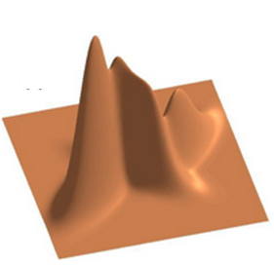
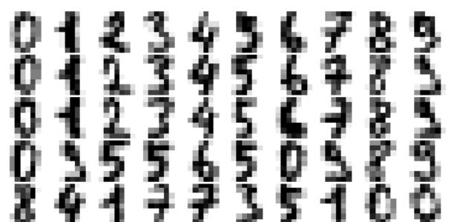

Example: GMM for Generating New Data: handwritten digits
8x8 pixels = 64
GMM
110 Comp.
PCA
41
8x8 pixels = 64
Inverse
PCA
41
GENERATE
https://jakevdp.github.io/PythonDataScienceHandbook/05.12-gaussian-mixtures.html

Slide 10
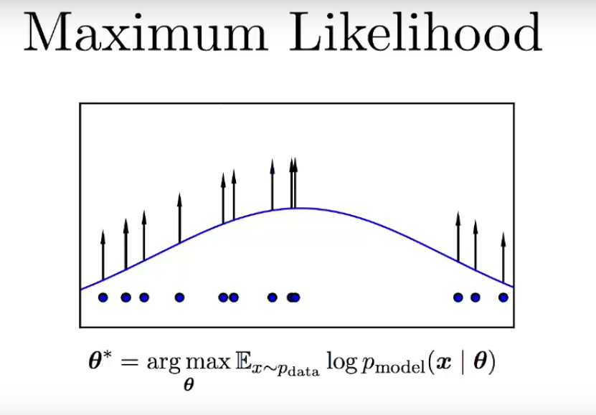
Ian Goodfellow: Generative Adversarial Networks (NIPS 2016 tutorial)

Slide 11
GANs : Generative Adversarial Networks A short Introduction
Some references:
Introductory guide to Generative Adversarial Networks (GANs) and their promise! https://www.analyticsvidhya.com/blog/2017/06/introductory-generative-adversarial-networks-gans/
Ian Goodfellow: Generative Adversarial Networks (NIPS 2016 tutorial)
https://www.youtube.com/watch?v=HGYYEUSm-0Q
Just for fun:
https://www.youtube.com/watch?v=deyOX6Mt_As

Slide 12
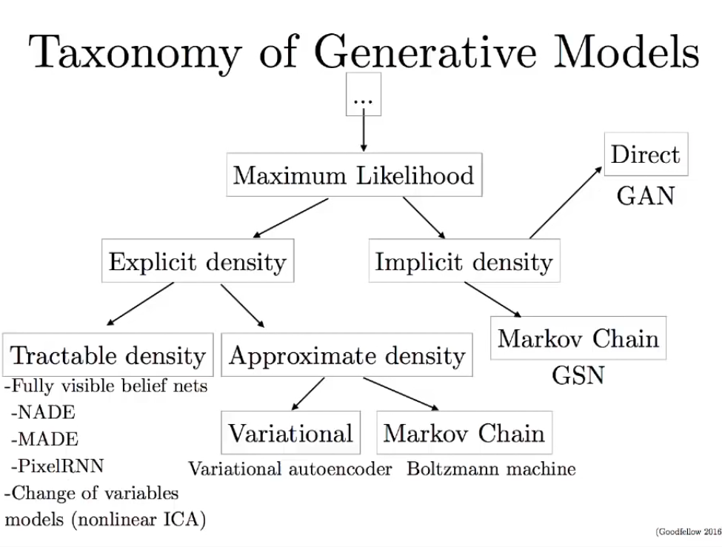

Slide 13
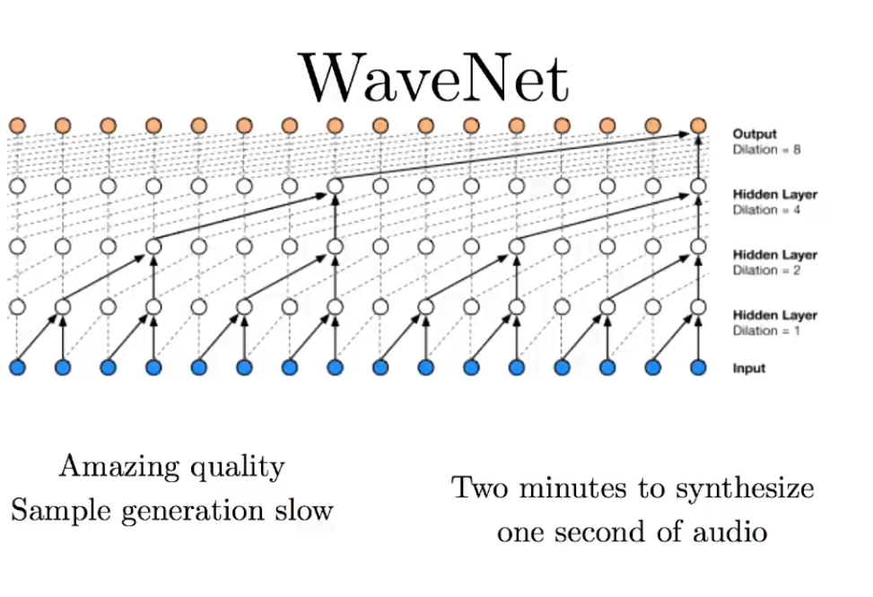
Example: Fully Visible

Slide 14
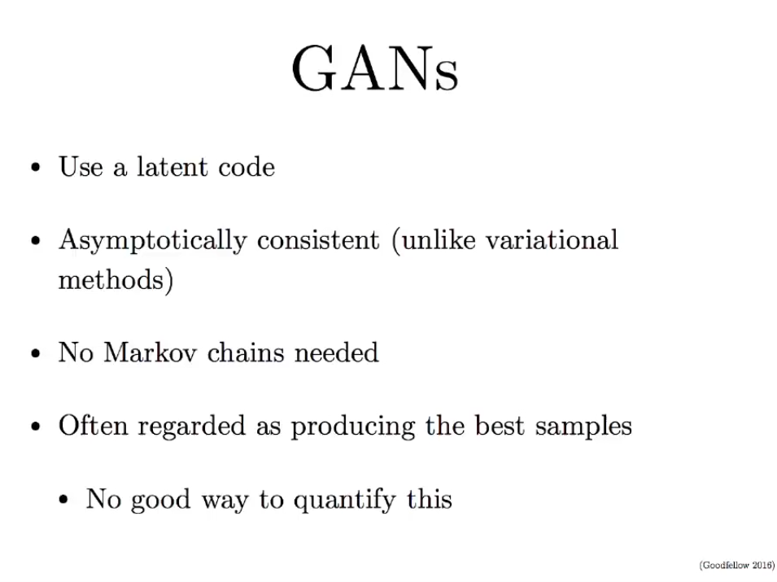

Slide 15
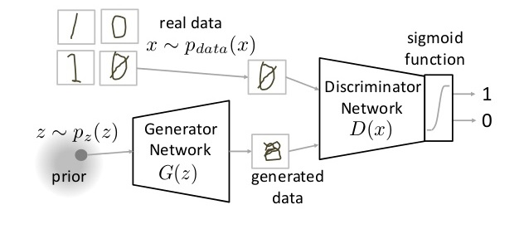

Slide 16
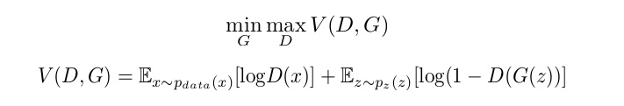
GAN Training: minimax game
The first term is entropy that the data from real distribution (pdata(x)) passes through the discriminator (D(x)). The discriminator tries to maximize this to 1.
The second term is entropy that the data from random input (p(z)) passes through the generator, which then generates a fake sample which is then passed through the discriminator to identify the fakeness (D(G(z))). In this term, discriminator tries to maximize it to 0.
So overall, the discriminator is trying to maximize our function V.
On the other hand, the task of generator is exactly opposite, i.e. it tries to minimize the function V

Slide 17
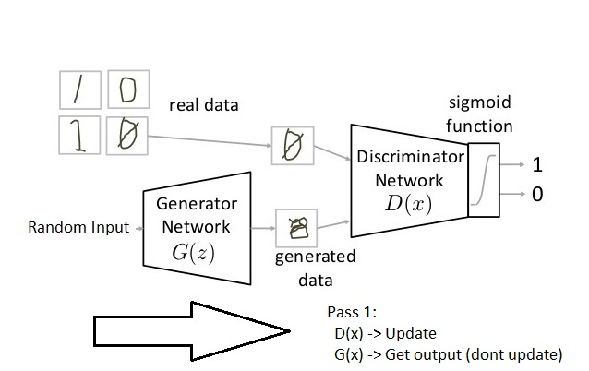
Pass 1:
Train discriminator and freeze generator (freezing means setting training as false. The network does only forward pass and no backpropagation is applied)

Slide 18
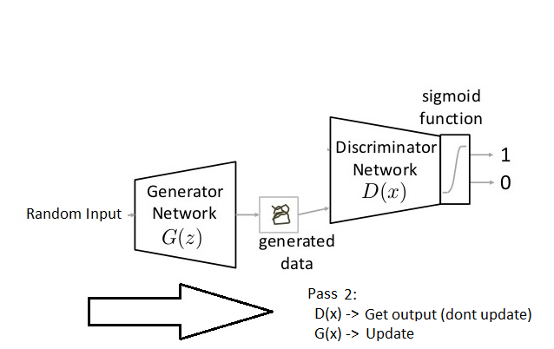
Pass 1:
Train generator and freeze discriminator

Slide 19
GANs : Generative Adversarial Networks A short Introduction
See a simple example:
https://github.com/MasterMSTC/GenerativeGAN
MSTC_GAN_simple.ipynb

