Slide 1
Google Cloud
Prof. Eduardo López Gonzalo
eduardo.lopez@upm.es
Prof. Luis A. Hernández Gómez
luisalfoso.hernandez@upm.es

Slide 2





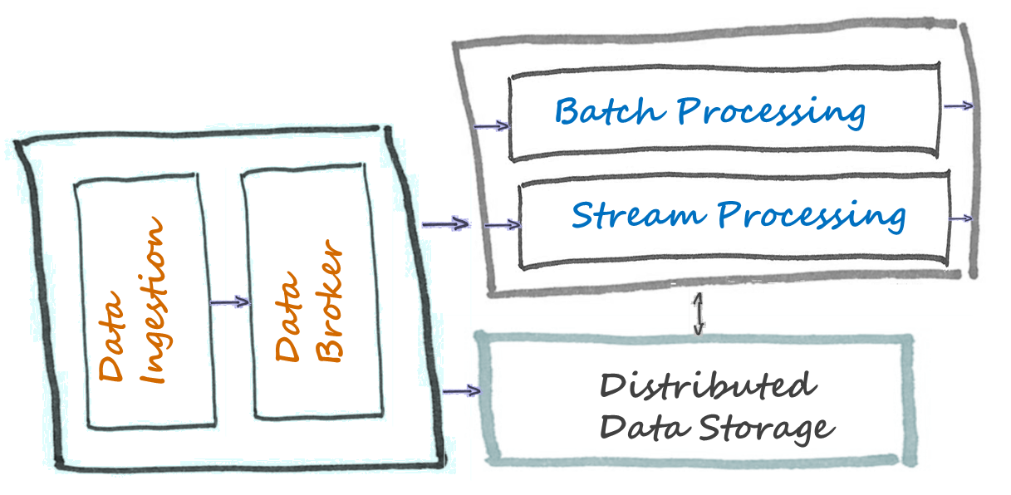

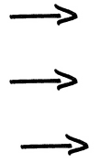
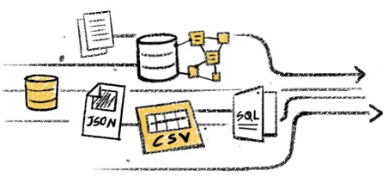
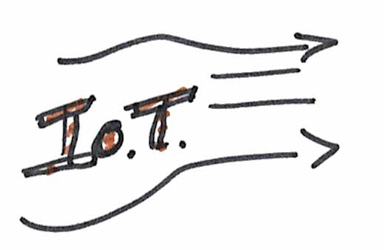




Big Data Architecture
Data Sources
Business Intelligence
Visualization
Analytics
Data Customers

Slide 3

Access with my Gmail account
https://github.com/naranjja/gcp-jupyter-sql
It can be very useful to outsource processing to the cloud as it allows for easy horizontal and vertical scaling.
Google Cloud Platform has all the necessary infrastructure to run Jupyter Notebooks in the cloud,
from creating a clusterized server configuration of notebooks,
to reading and writing data to a database based on Cloud SQL.

Slide 4
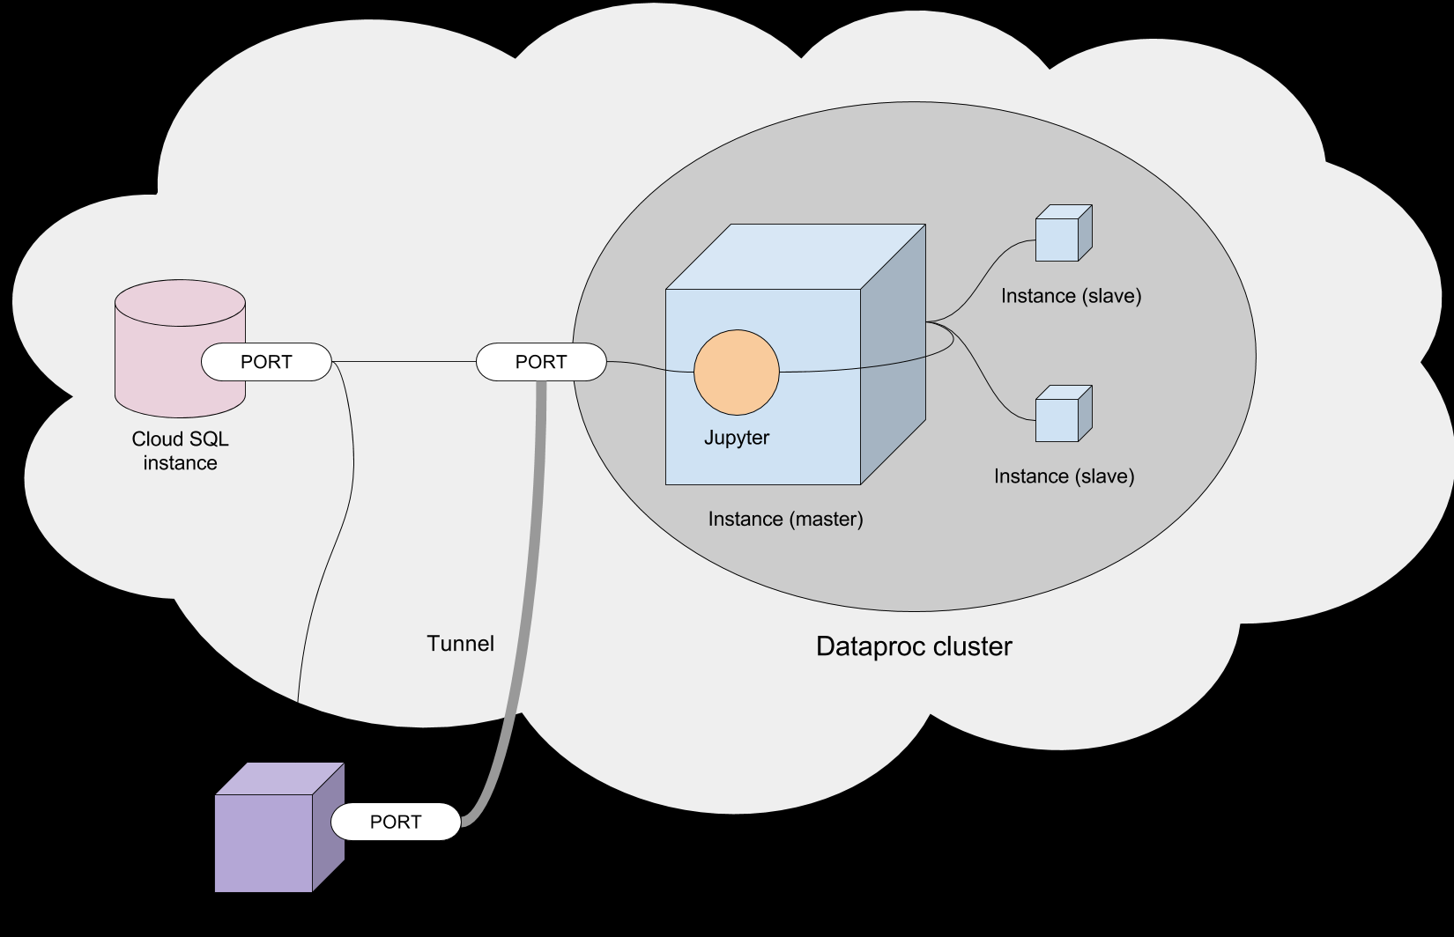

Slide 5
Access with my/your Gmail account
https://console.cloud.google.com/education

Slide 6
Setup project
In this session we will open and learn Google Cloud CONSOLE
You should also try: download and install Google Cloud SDK.
Once installed, the gcloud command should be usable from any command prompt with an up-to-date PATH variable.

Slide 7
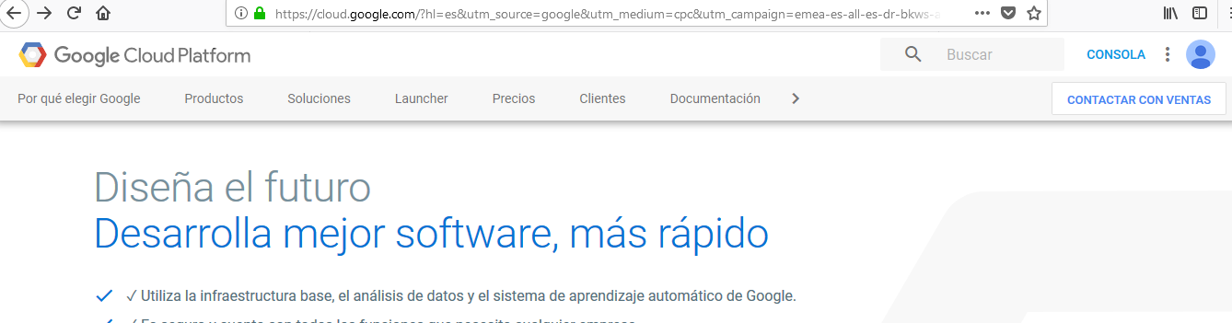
Access with your Gmail account

Slide 8
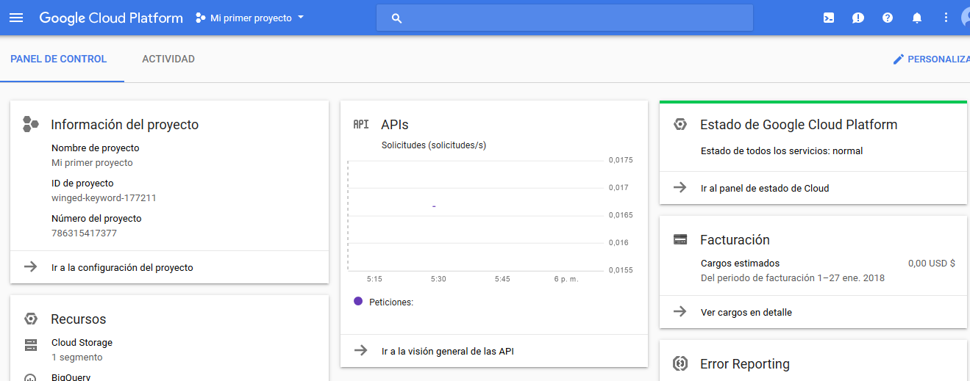
https://towardsdatascience.com/running-jupyter-notebook-in-google-cloud-platform-in-15-min-61e16da34d52

Slide 9
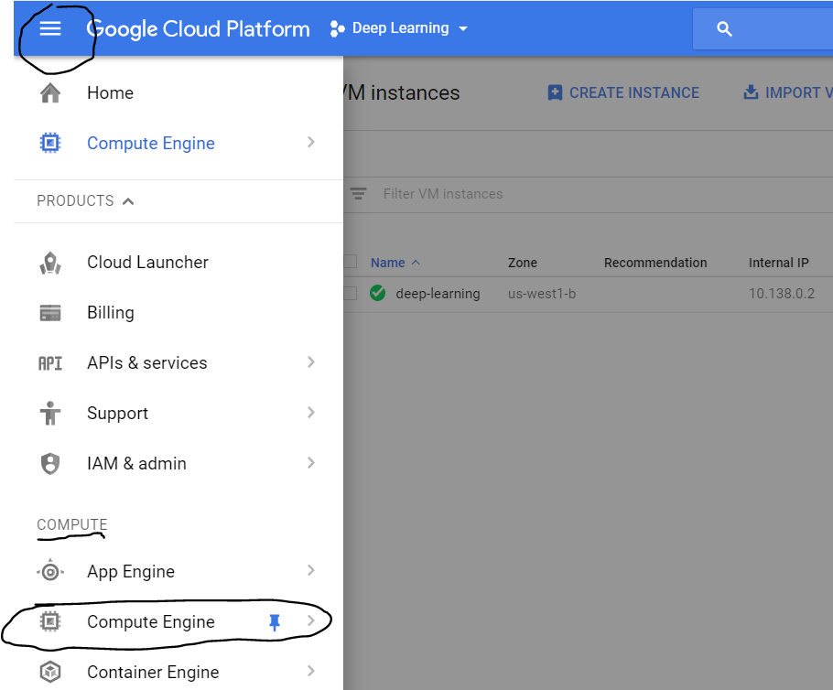
https://towardsdatascience.com/running-jupyter-notebook-in-google-cloud-platform-in-15-min-61e16da34d52
Step 3 : Create a VM instance
Click on the three lines on the upper left corner, then on the compute option, click on ‘Compute Engine’

Slide 10
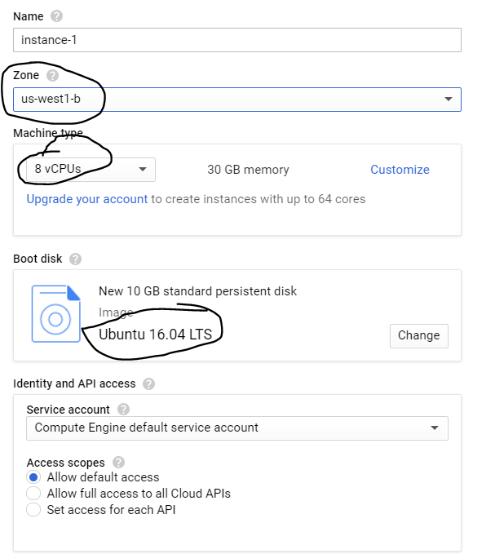
This region is important if you need GPUs

Slide 11
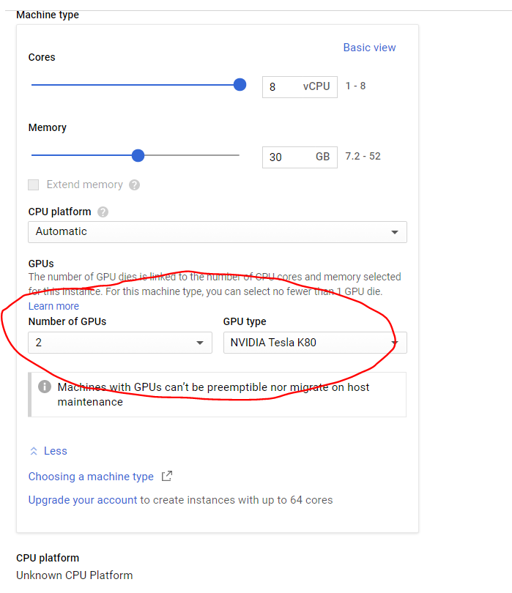
If you click on ‘customize’, you will be able to find options for using GPUs. You can choose between 2 NVIDIA GPUs
Don’t do it!!
We will discuss why…

Slide 12
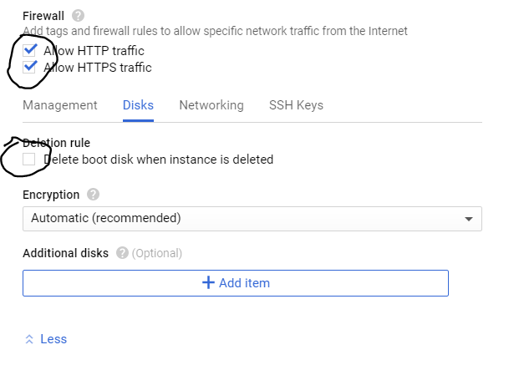

Slide 13
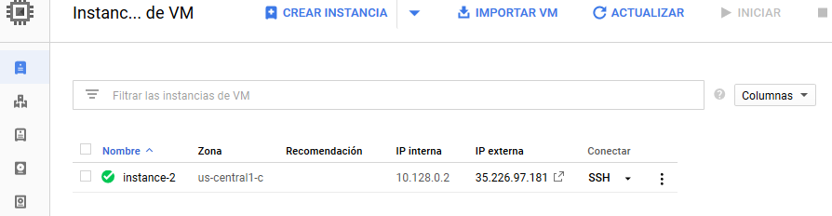
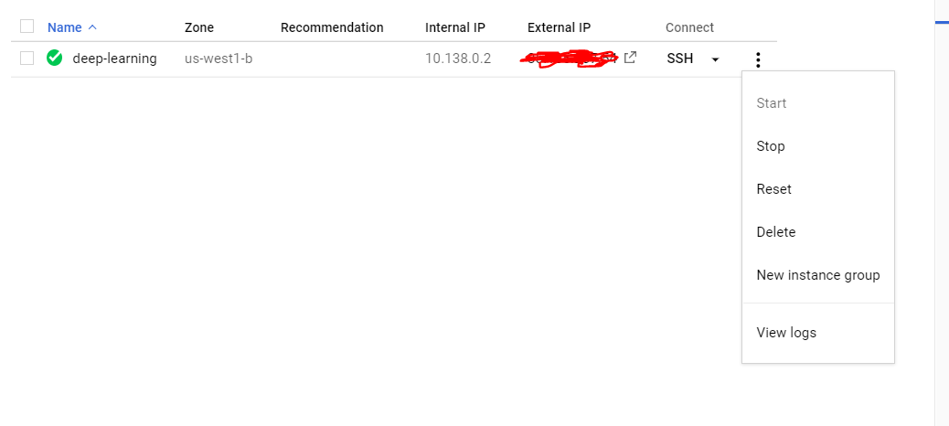
IMPORTANT : DON’T FORGET TO STOP YOUR GPU INSTANCE AFTER YOU ARE DONE BY CLICKING ON THE THREE DOTS ON THE IMAGE ABOVE AND SELECTING STOP. OTHERWISE GCP WILL KEEP CHARGING YOU ON AN HOURLY BASIS.

Slide 14
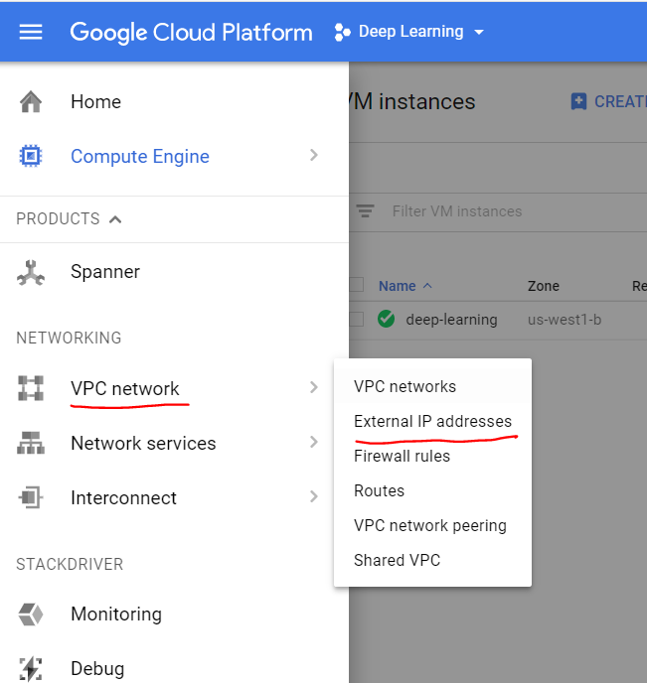
FOLLOW THIS LINK:
https://towardsdatascience.com/running-jupyter-notebook-in-google-cloud-platform-in-15-min-61e16da34d52
Step 4: Make external IP address as static

Slide 15
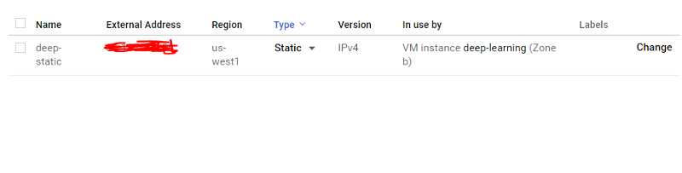

Slide 16
Step 5: Change the Firewall setting

Slide 17
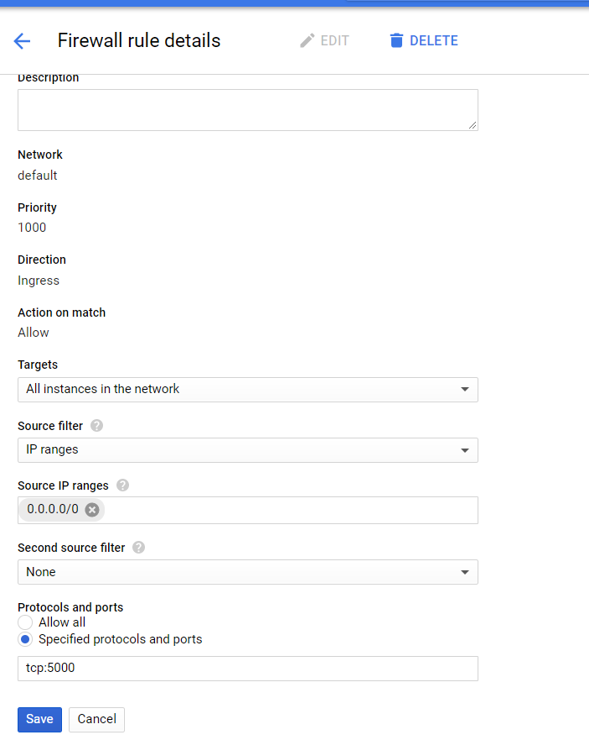
Step 5: Change the Firewall setting
Create a new firewall rule:
Name : ruletcp5000

Slide 18
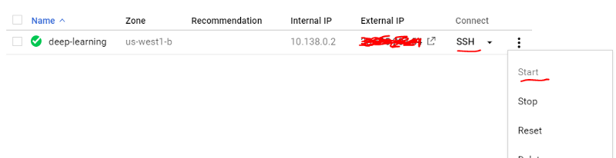
Step 6: Start your VM instance

Slide 19
Step 7 : Install Jupyter notebook and other packages
This next step has already been done for you in another Computer Engine

Slide 20
Step 9 : Launching Jupyter Notebook
Connect using SSH through CONSOLE

Slide 21
Make you me! :
> sudo su lahg235
Change directory:
> cd /home/lahg235
Then start jupyter-notebook
jupyter-notebook --no-browser --port=5000

Slide 22
Connect to jupyter from your laptop using the External IP
http:\\<external IP>:5000

Slide 23
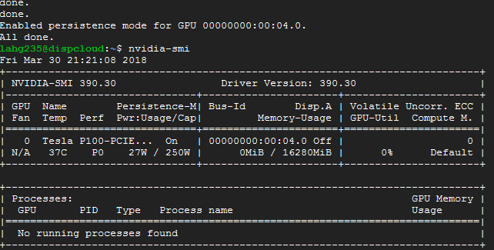
Open another connection using SSH through CONSOLE
You can check that GPU is installed (and used… nvidia-smi –l 5)

Slide 24
After install check:
nvidia-smi

Slide 25
Access with my Gmail account
https://towardsdatascience.com/running-jupyter-notebook-in-google-cloud-platform-in-15-min-61e16da34d52
https://github.com/naranjja/gcp-jupyter-sql
The following are instructions to run a (Python 3, Anaconda3) Jupyter Notebook Server
using Google Cloud Platform's Dataproc (for clusterized processing) or Compute Engine (for normal processing),
as well as Cloud SQL for storing data.

Slide 26
Step 7 : Install Jupyter notebook and other packages
In your SSH terminal, enter
sudo wget https://repo.continuum.io/archive/Anaconda3-5.0.0.1-Linux-x86_64.sh
sudo apt-get install bzip2
bash Anaconda3-5.0.0.1-Linux-x86_64.sh
check if conda registered to path by running the conda command.
If not recognized, add to path manually:
source ~/.bashrc

Slide 27
Anaconda path
export PATH=~/anaconda3/bin:$PATH
sudo nano ~/.bashrc
go down to the last line in the file and add
export PATH=~/anaconda3/bin:$PATH
then Ctrl+X and then enter
source ~/.bashrc

Slide 28
INSTALL Anaconda3 to have JUPYTER: More details of previous step
From: https://github.com/naranjja/gcp-jupyter-sql
sudo wget https://repo.continuum.io/archive/Anaconda3-5.0.0.1-Linux-x86_64.sh
NOTE: You can always visit the Anaconda archive to get any version's URL.
Proceed to install Anaconda3 (install bzip2 to be able to decompress some Anaconda3 installation files):
sudo apt-get install bzip2
bash Anaconda3-5.0.0.1-Linux-x86_64.sh
NOTE: Do not run sudo bash for the installation, as it will be installed elsewhere.
NOTE: During the installation, you will be asked if you want to add Anaconda3 to the PATH variable (albeit in very quirky wording). Type yes to this step when prompted.
Check if installation is successful by running the ls command and checking that the anaconda3 folder is present. Then, check if conda registered to path by running the conda command. If not recognized, add to path manually:
source ~/.bashrc

Slide 29
Step 8: Access Jupyter using tunnels with ngrok (I)
(see https://stackoverflow.com/questions/18300263/how-to-use-ipython-notebook-with-ngrok )
Open SSH and install ngrok
wget https://bin.equinox.io/c/4VmDzA7iaHb/ngrok-stable-linux-amd64.zip
sudo apt-get install unzip
unzip -o ngrok-stable-linux-amd64.zip

Slide 30
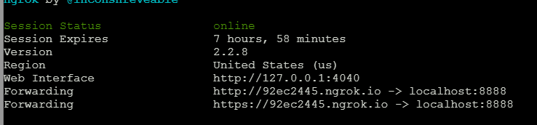
Step 8: Access Jupyter using tunnels with ngrok (II)
(see https://stackoverflow.com/questions/18300263/how-to-use-ipython-notebook-with-ngrok )
In one SSH console launch
jupyter notebook
(“normal “ on port 8888)
In another SSH run:
./ngrok http 8888
… and use the link! To connect jupyter

Slide 31
ATTENTION — FOR THE LOVE OF GOD! DO NOT FORGET TO STOP THE VM INSTANCE!!

