Slide 1
Google Cloud Dataproc
What is Cloud Dataproc?
Cloud Dataproc is a fast, easy-to-use, low-cost and fully managed service that lets you run the Apache Spark and Apache Hadoop ecosystem on Google Cloud Platform.

Slide 2
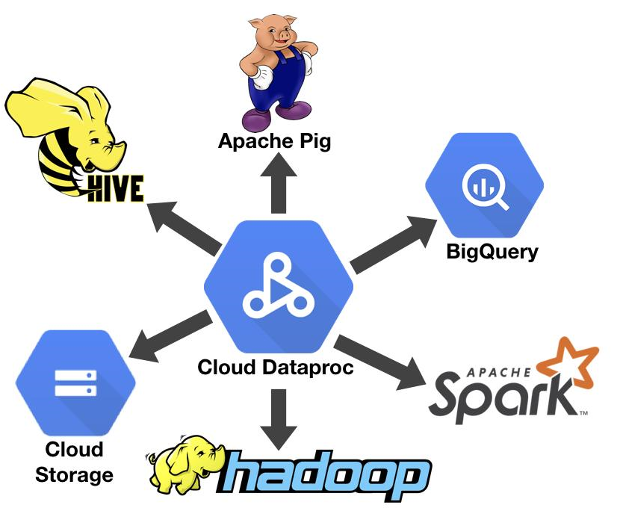

Slide 3
What is Cloud Dataproc?
Low cost — Cloud Dataproc is priced at only 1 cent per virtual CPU per hour.
preemptible instances have lower compute prices
Super fast — it can take from five to 30 minutes to create Spark and Hadoop clusters
Integrated — BigQuery, Cloud Storage, Cloud Bigtable, Stackdriver Logging, and Stackdriver Monitoring
For example, you can use Cloud Dataproc to effortlessly ETL terabytes of raw log data directly into BigQuery for business reporting.
Managed — Use Spark and Hadoop clusters without the assistance of an administrator or special software.
Simple and familiar — You don’t need to learn new tools so you can be productive faster.

Slide 4
Create a Cluster - DataProc Follow
https://www.youtube.com/watch?v=6DD-vBdJJxk
Cloud Dataproc : clusters Apache Spark & Apache Hadoop
1 master (2VCPU 32Gb Disk) + N=5 workers (1VCPU 32GPU)
Options:
See image versión
Allow http traffic
Initialization options
gs://dataproc-initialization-actions/jupyter/jupyter.sh
Once running try:
Pyspark
hadoop fs –ls /user

Slide 5
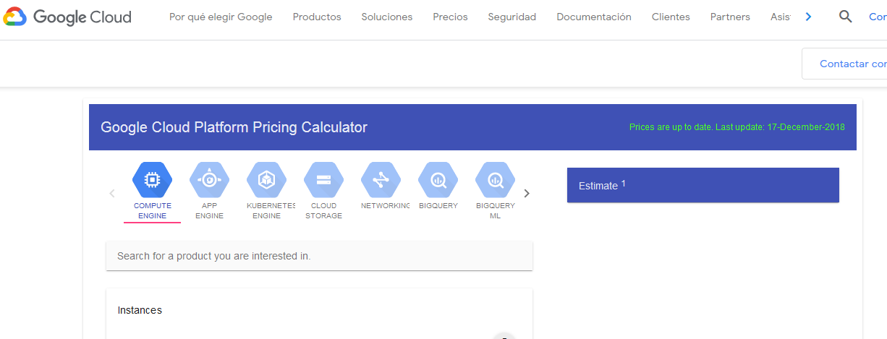
https://cloud.google.com/products/calculator/

Slide 6
Connect to Cluster:
https://www.youtube.com/watch?v=6DD-vBdJJxk
https://cloud.google.com/dataproc/docs/tutorials/jupyter-notebook
https://cloud.google.com/dataproc/docs/concepts/accessing/cluster-web-interfaces
Open SSH and install ngrok
wget https://bin.equinox.io/c/4VmDzA7iaHb/ngrok-stable-linux-amd64.zip
sudo apt-get install unzip
unzip -o ngrok-stable-linux-amd64.zip

Slide 7
Connect to Cluster:
With ngrok
https://www.youtube.com/watch?v=6DD-vBdJJxk
You can Access:
hadoop : ngrok http 8088
Jupyter : ngrok http 8123
YARN ResourceManager | 8088 | http://master-host-name:8088
HDFS NameNode | 9870* | http://master-host-name:9870
https://cloud.google.com/dataproc/docs/concepts/accessing/cluster-web-interfaces

