Slide 1
Google Cloud
Prof. Eduardo López Gonzalo
eduardo.lopez@upm.es
Prof. Luis A. Hernández Gómez
luisalfoso.hernandez@upm.es

Slide 2

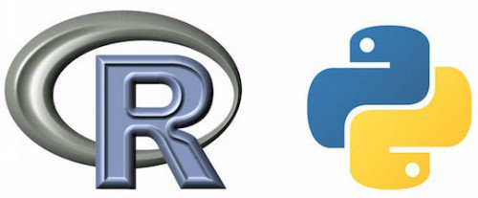



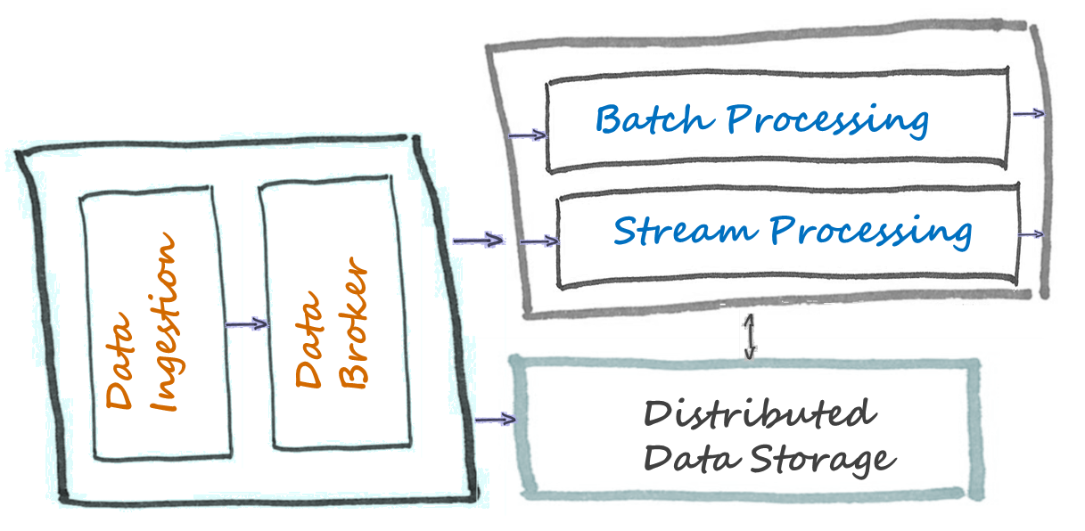

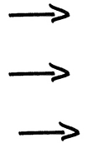
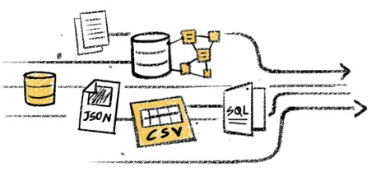
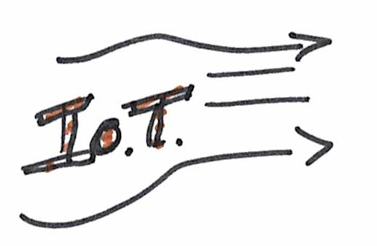




Big Data Architecture
Data Sources
Business Intelligence
Visualization
Analytics
Data Customers

Slide 3

Access with my Gmail account
https://github.com/naranjja/gcp-jupyter-sql
It can be very useful to outsource processing to the cloud as it allows for easy horizontal and vertical scaling.
Google Cloud Platform has all the necessary infrastructure to run Jupyter Notebooks in the cloud,
from creating a clusterized server configuration of notebooks,
to reading and writing data to a database based on Cloud SQL.

Slide 4
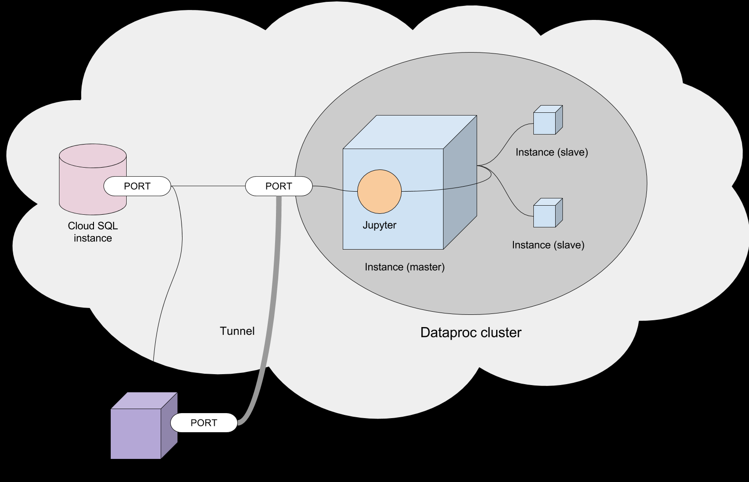

Slide 5
Access with my/your Gmail account
https://console.cloud.google.com/education

Slide 6
Setup project
In this session we will open and learn Google Cloud CONSOLE
You should also try: download and install Google Cloud SDK.
Once installed, the gcloud command should be usable from any command prompt with an up-to-date PATH variable.

Slide 7
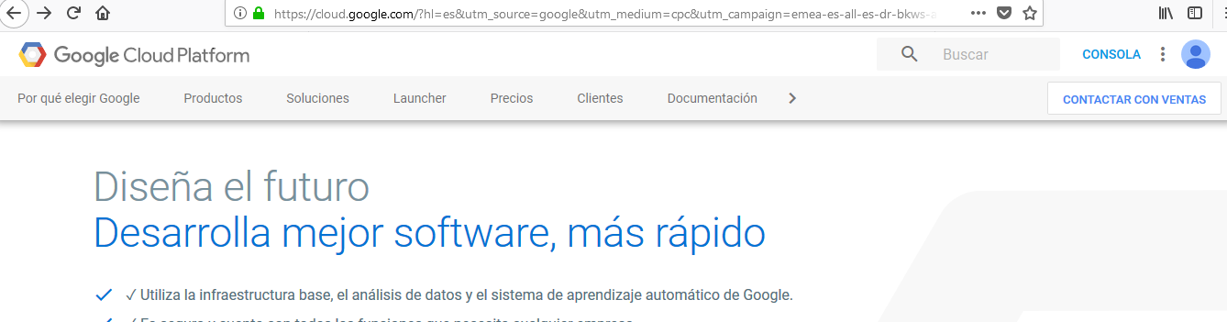
Access with your Gmail account

Slide 8
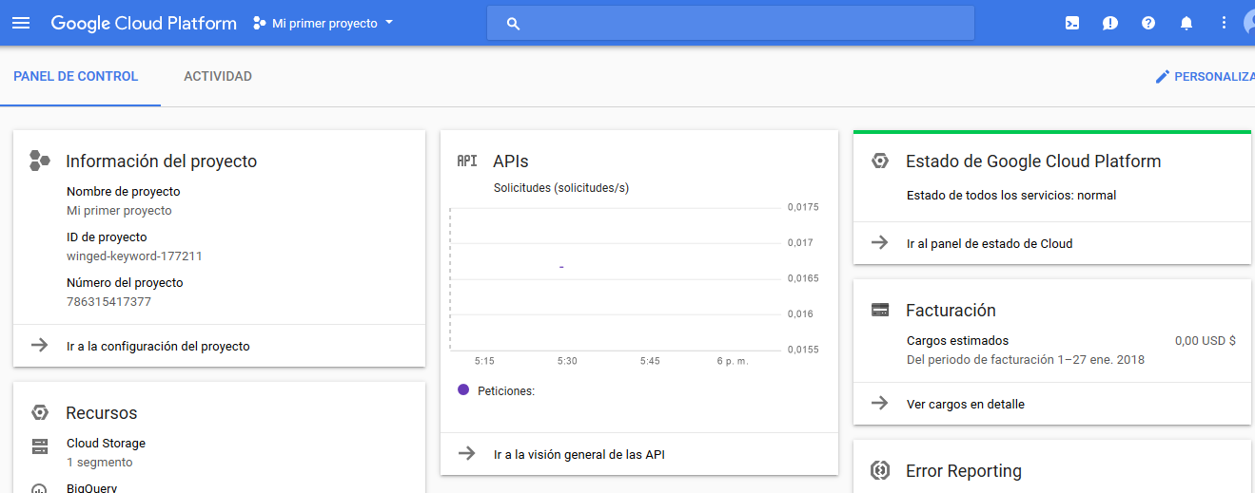
https://towardsdatascience.com/running-jupyter-notebook-in-google-cloud-platform-in-15-min-61e16da34d52

Slide 9
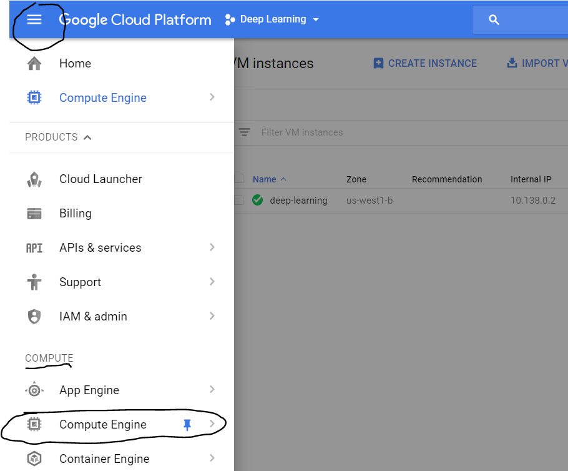
https://towardsdatascience.com/running-jupyter-notebook-in-google-cloud-platform-in-15-min-61e16da34d52
Step 3 : Create a VM instance
Click on the three lines on the upper left corner, then on the compute option, click on ‘Compute Engine’

Slide 10
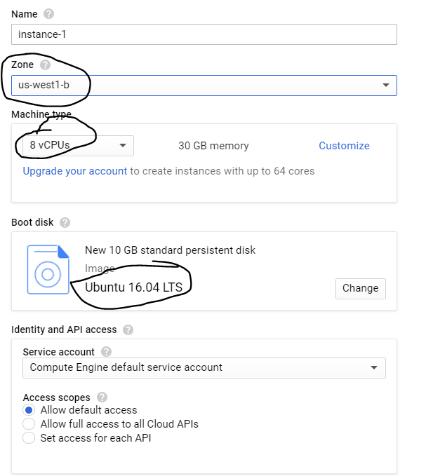
This region is important if you need GPUs

Slide 11
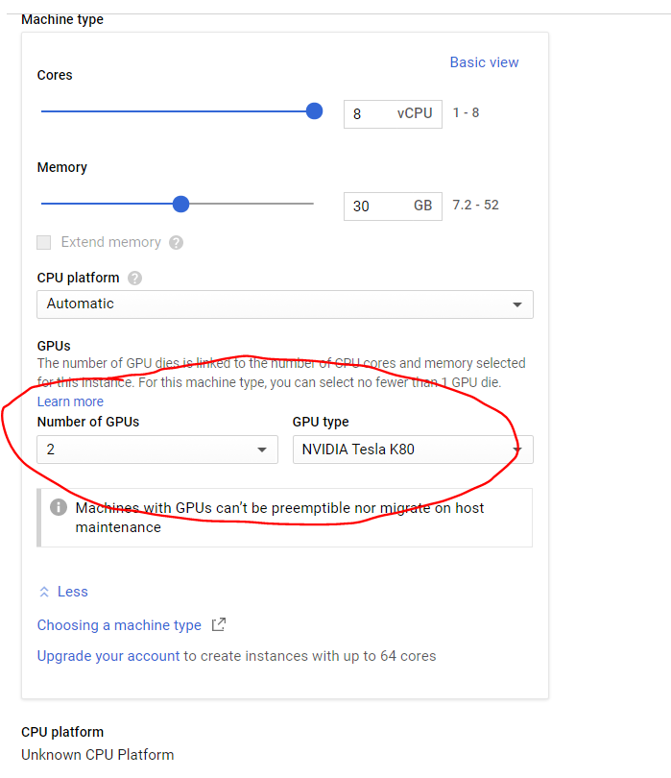
If you click on ‘customize’, you will be able to find options for using GPUs. You can choose between 2 NVIDIA GPUs
Don’t do it!!
We will discuss why…

Slide 12
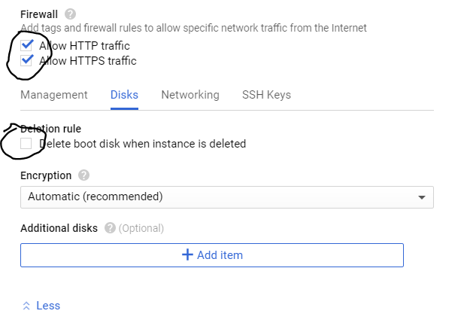

Slide 13
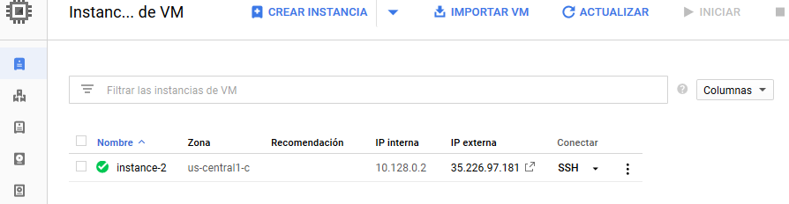
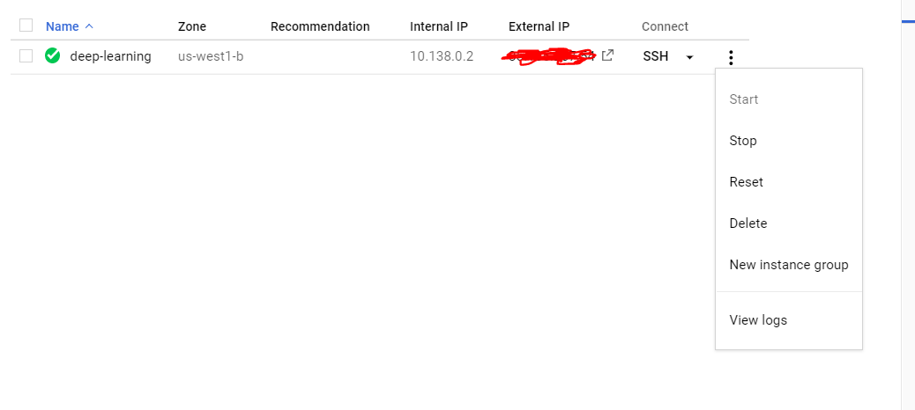
IMPORTANT : DON’T FORGET TO STOP YOUR GPU INSTANCE AFTER YOU ARE DONE BY CLICKING ON THE THREE DOTS ON THE IMAGE ABOVE AND SELECTING STOP. OTHERWISE GCP WILL KEEP CHARGING YOU ON AN HOURLY BASIS.

Slide 14
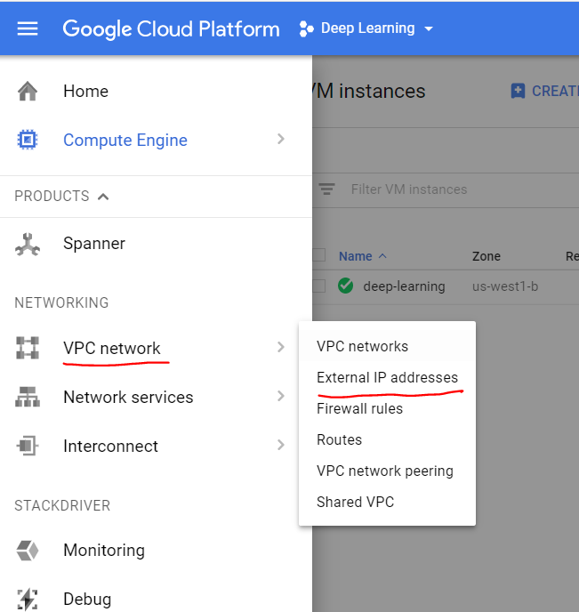
FOLLOW THIS LINK:
https://towardsdatascience.com/running-jupyter-notebook-in-google-cloud-platform-in-15-min-61e16da34d52
Step 4: Make external IP address as static

Slide 15
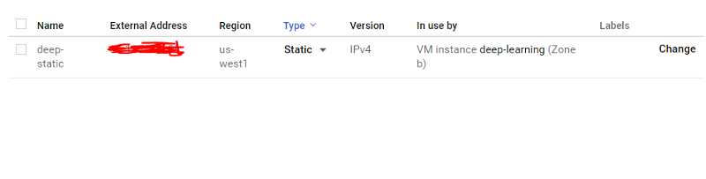

Slide 16
Step 5: Change the Firewall setting

Slide 17
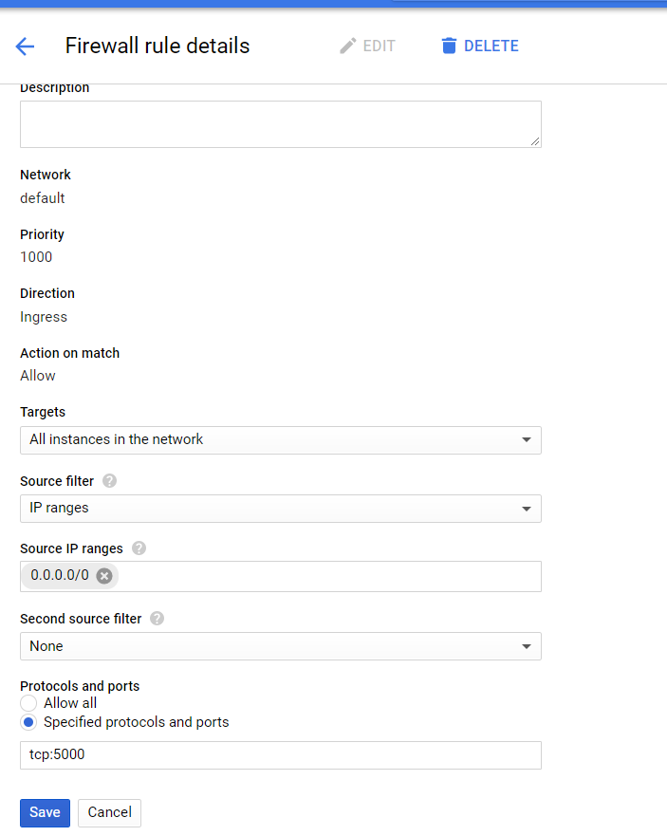
Step 5: Change the Firewall setting
Create a new firewall rule:
Name : ruletcp5000

Slide 18
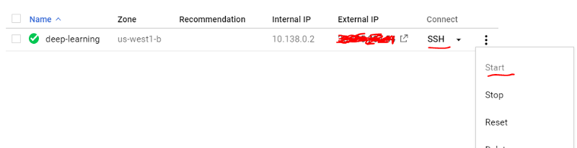
Step 6: Start your VM instance

Slide 19
Step 7 : Install Jupyter notebook and other packages
This next step has already been done for you in another Computer Engine

Slide 20
Step 9 : Launching Jupyter Notebook
Connect using SSH through CONSOLE

Slide 21
Make you me! :
> sudo su lahg235
Change directory:
> cd /home/lahg235
Then start jupyter-notebook
jupyter-notebook --no-browser --port=5000

Slide 22
Connect to jupyter from your laptop using the External IP
http:\\<external IP>:5000

Slide 23
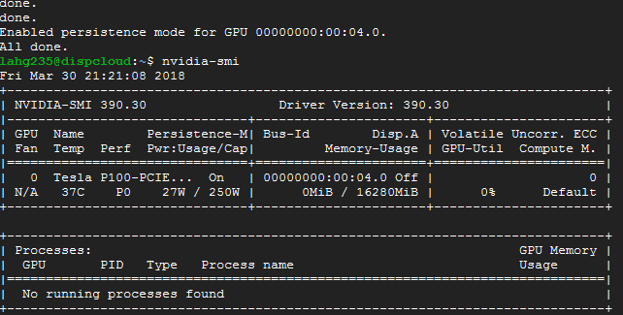
Open another connection using SSH through CONSOLE
You can check that GPU is installed (and used… nvidia-smi –l 5)

Slide 24
After install check:
nvidia-smi

Slide 25
Access with my Gmail account
https://towardsdatascience.com/running-jupyter-notebook-in-google-cloud-platform-in-15-min-61e16da34d52
https://github.com/naranjja/gcp-jupyter-sql
The following are instructions to run a (Python 3, Anaconda3) Jupyter Notebook Server
using Google Cloud Platform's Dataproc (for clusterized processing) or Compute Engine (for normal processing),
as well as Cloud SQL for storing data.

Slide 26
Step 7 : Install Jupyter notebook and other packages
In your SSH terminal, enter
sudo wget https://repo.continuum.io/archive/Anaconda3-5.0.0.1-Linux-x86_64.sh
sudo apt-get install bzip2
bash Anaconda3-5.0.0.1-Linux-x86_64.sh
check if conda registered to path by running the conda command.
If not recognized, add to path manually:
source ~/.bashrc

Slide 27
Anaconda path
export PATH=~/anaconda3/bin:$PATH
sudo nano ~/.bashrc
go down to the last line in the file and add
export PATH=~/anaconda3/bin:$PATH
then Ctrl+X and then enter
source ~/.bashrc

Slide 28
INSTALL Anaconda3 to have JUPYTER: More details of previous step
From: https://github.com/naranjja/gcp-jupyter-sql
sudo wget https://repo.continuum.io/archive/Anaconda3-5.0.0.1-Linux-x86_64.sh
NOTE: You can always visit the Anaconda archive to get any version's URL.
Proceed to install Anaconda3 (install bzip2 to be able to decompress some Anaconda3 installation files):
sudo apt-get install bzip2
bash Anaconda3-5.0.0.1-Linux-x86_64.sh
NOTE: Do not run sudo bash for the installation, as it will be installed elsewhere.
NOTE: During the installation, you will be asked if you want to add Anaconda3 to the PATH variable (albeit in very quirky wording). Type yes to this step when prompted.
Check if installation is successful by running the ls command and checking that the anaconda3 folder is present. Then, check if conda registered to path by running the conda command. If not recognized, add to path manually:
source ~/.bashrc

Slide 29
Step 8: Set up the VM server
Open up a SSH session to your VM. Check if you have a Jupyter configuration file:
ls ~/.jupyter/jupyter_notebook_config.py
If it doesn’t exist, create one:
jupyter notebook --generate-config

Slide 30
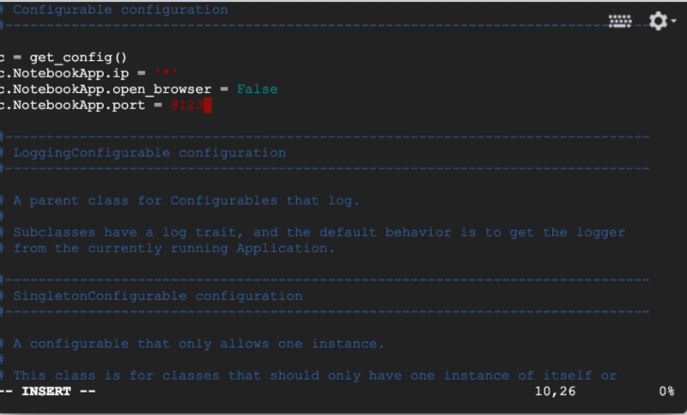
Modify jupyter_notebook_config.py
c = get_config()
c.NotebookApp.ip = '*'
c.NotebookApp.open_browser = False
c.NotebookApp.port = 5000

Slide 31
Step 9 : Launching Jupyter Notebook
jupyter-notebook --no-browser --port=<PORT-NUMBER>
jupyter-notebook --no-browser --port=5000

Slide 32
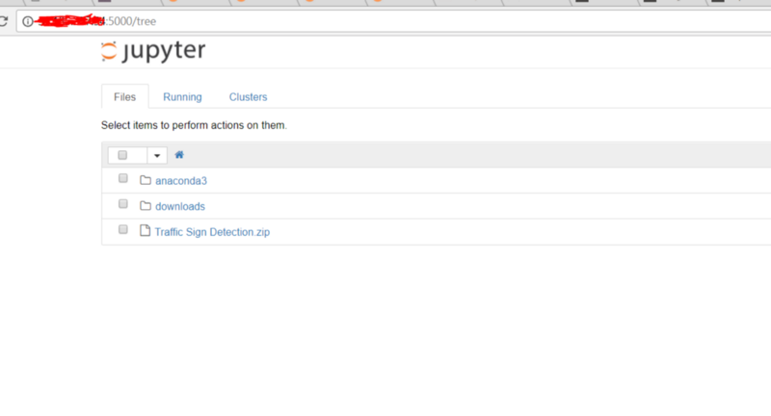
Now to launch your jupyter notebook in your laptop, just type the following in your browser:
http://<External Static IP Address>:<Port Number>

Slide 33
ATTENTION — FOR THE LOVE OF GOD! DO NOT FORGET TO STOP THE VM INSTANCE!!

Slide 34
Connecting to Jupyter
CONECTING USING SSH TUNNEL

Slide 35
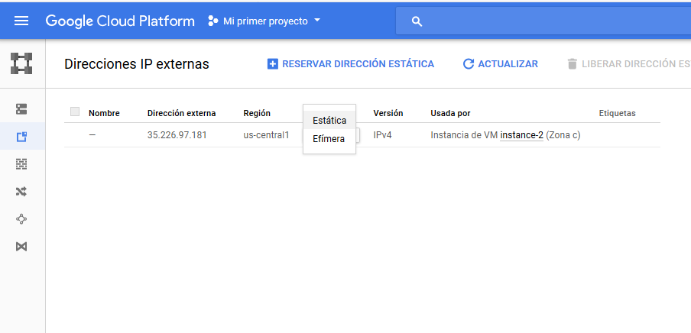
OTHER WAYS!!
Setup SSH tunnel to instance
Following now https://github.com/naranjja/gcp-jupyter-sql
Exposing the Compute Engine instance's port
Go to the External IP Addresses list page and make the Compute Engine instance's IP static.

Slide 36
jupyter notebook --ip=0.0.0.0 --port=8888 --no-browser
Creating the tunnel
Thus far, you have Jupyter running on a Google Cloud instance, on port 8888. Now, we need to tunnel this port to another port, we will use local port 2222 to interface with remote port 8888.
Run a new command prompt, or the included Google Cloud SDK Shell and connect to the instance again using SSH. This time, passing a flag to create the tunnel:
gcloud compute ssh [INSTANCE_NAME] --zone [ZONE] --ssh-flag="-L" --ssh-flag="2222:localhost:8888“
gcloud compute ssh --ssh-flag="-X" lahg235@dispcloud --project peak-empire-194914 --zone us-central1-c --ssh-flag="-L" --ssh-flag="2222:localhost:8888“

Slide 37
https://github.com/MUIT-TSA

Slide 38
If you want you should connect as lahg235 otherwise you have to install ….
gcloud compute ssh --ssh-flag="-X" lahg235@dispcloud --project peak-empire-194914 --zone us-central1-c --ssh-flag="-L" --ssh-flag="2222:localhost:8888“
Connect as your local user!
gcloud compute ssh dispcloud --project peak-empire-194914 --zone us-central1-c --ssh-flag="-L" --ssh-flag="2222:localhost:8888“

Slide 39
gcloud compute ssh --ssh-flag="-X" lahg235@dispcloud --project winged-keyword-177211 --zone us-central1-c --ssh-flag="-L" --ssh-flag="2222:localhost:8888“
winged-keyword-177211
gcloud compute ssh --ssh-flag="-X" lahg235@cloudacoustics1 --project acousticsupm1 --zone us-central1-c --ssh-flag="-L" --ssh-flag="2222:localhost:8888“
https://cloud.google.com/compute/docs/instances/connecting-to-instance?hl=es

Slide 40
gcloud compute ssh --ssh-flag="-X" lahg235@dispcloud --project winged-keyword-177211 --zone us-central1-c
gcloud compute --project "peak-empire-194914" ssh --zone "us-c
entral1-c" "lahg235@dispcloud"
Updating project ssh metadata.../

Slide 41
gcloud compute ssh instance-3 \
--project winged-keyword-177211 \
--zone us-central1-c \
-- -L 5901:localhost:5901
2222 is the local port you're listening on.
8888 is the remote port you're connecting to.
gcloud compute ssh instance-3 --project winged-keyword-177211 --zone us-central1-c -- -L 5901:localhost:5901

Slide 42
You must identify what drivers are appropriate for your images. Drivers are not installed by default on public images. Read installing GPU drivers for details.
https://cloud.google.com/compute/docs/gpus/add-gpus#install-gpu-driver
https://medium.com/google-cloud/using-a-gpu-tensorflow-on-google-cloud-platform-1a2458f42b0
Sudo bash cudainstall.sh

Slide 43
#!/bin/bash
echo "Checking for CUDA and installing."
# Check for CUDA and try to install.
if ! dpkg-query -W cuda-8-0; then
# The 16.04 installer works with 16.10.
curl -O https://developer.download.nvidia.com/compute/cuda/repos/ubuntu1604/x86_64/cuda-repo-ubuntu1604_8.0.61-1_amd64.deb
dpkg -i ./cuda-repo-ubuntu1604_8.0.61-1_amd64.deb
apt-get update
apt-get install cuda-8-0 -y
fi
# Enable persistence mode
nvidia-smi -pm 1

Slide 44
After install check:
nvidia-smi

Slide 45
PROBLEMA: con cudnn:
He tenido que instalar cudnn-8.0-linux-x64-v6.0.tgz
LuegoTF con Python 6 da error, pero funciona: instalar anaconda Python 3.5!!
pip3 uninstall tensorflow-gpu
pip3 install --upgrade tensorflow-gpu==1.4

Slide 46
OpenAI & Keras-RL
Open AI
Keras-RL

Slide 47
OpenAI & Keras-RL: SHARING X11 through SSH in Google Cloud
Create a Compute Engine: example
4 CPU 15GB
1GPU Tesla P100
Ubuntu 16.04

Slide 48
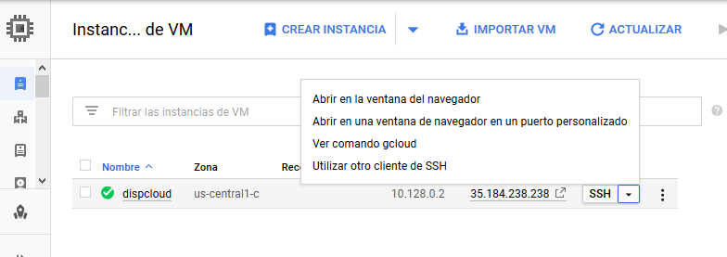
OpenAI & Keras-RL: SHARING X11 through SSH in Google Cloud
Connect using Google Cloud SKD Shell
… you can see the command in:

Slide 49
OpenAI & Keras-RL: SHARING X11 through SSH in Google Cloud
Letting Ubuntu bash on Windows 10 run ssh -X to get a GUI environment on a remote server
https://unix.stackexchange.com/questions/12755/how-to-forward-x-over-ssh-to-run-graphics-applications-remotely?answertab=votes#tab-top
https://stackoverflow.com/questions/25521486/x11-forwarding-from-debian-on-google-compute-engine

Slide 50
apt-get install build-essential
Cmake
Y luego pip install Atari-py
https://cloud.google.com/solutions/connecting-securely
https://github.com/EN10/CartPole
https://stackoverflow.com/questions/42605769/openai-gym-atari-on-windows/44345972#44345972

Slide 52
gcloud compute ssh --ssh-flag="-X" lahg235@dispcloud --project winged-keyword-177211 --zone us-central1-c
gcloud compute --project "peak-empire-194914" ssh --zone "us-c
entral1-c" "lahg235@dispcloud"
Updating project ssh metadata.../

Slide 53
gcloud compute ssh instance-3 \
--project winged-keyword-177211 \
--zone us-central1-c \
-- -L 5901:localhost:5901
2222 is the local port you're listening on.
8888 is the remote port you're connecting to.
gcloud compute ssh instance-3 --project winged-keyword-177211 --zone us-central1-c -- -L 5901:localhost:5901

Slide 54
Transfer files to Google Cloud Compute Engine
https://cloud.google.com/compute/docs/instances/transfer-files
gcloud compute scp [LOCAL_FILE_PATH] [INSTANCE_NAME]:~/
where:
[LOCAL_FILE_PATH] is the path to the file on your workstation.
[INSTANCE_NAME] is the name of your instance.
You can also copy files from an instance to your local workstation by reversing the source and destination variables. The following example copies a file from your instance to your workstation.
gcloud compute scp [INSTANCE_NAME]:[REMOTE_FILE_PATH] [LOCAL_FILE_PATH]
where:
[INSTANCE_NAME] is the name of the instance.
[REMOTE_FILE_PATH] is the path to the file on your instance.
[LOCAL_FILE_PATH] is the path where you want to put the file on your workstation.

Slide 55
Copy from Windows to VM:
gcloud compute scp c:\tmp\reinforcement.ipynb lahg235@dispcloud:./ --project "peak-empire-194914" --zone "us-central1-c“
Copy from VM to Windows
gcloud compute scp lahg235@dispcloud:./test.py c:\tmp --project "peak-empire-194914" --zone "us-central1-c”
Las ultimas comillas a veces dan error, borrarlas en la consola y volverñas a escribir!
pip3 uninstall tensorflow-gpu
pip3 install --upgrade tensorflow-gpu==1.4
He tenido que instalar cudnn-8.0-linux-x64-v6.0.tgz
LuegoTF con Python 6 da error, pero funciona: instalar anaconda Python 3.5!!

Slide 56
Copy from Windows to VM:
gcloud compute scp C:\MUIT_TSA\VOCALES_CORTADAS.zip lahg235@cloudacoustics1:./ --project "acousticsupm1" --zone "us-central1-c“
Las ultimas comillas a veces dan error, borrarlas en la consola y volverñas a escribir!

Slide 57
https://medium.com/google-cloud/graphical-user-interface-gui-for-google-compute-engine-instance-78fccda09e5c
Ubuntu 14
sudo apt-get update
sudo apt-get install gnome-core
Install a Virtual Desktop using VNC
Now we need a VNC server to interact with desktop environment. I am using vnc4server, you can install your favorite one:
sudo apt-get install vnc4server
Start the vnc server, You’ll then be prompted to create and verify a new password:
Vncserver
If you’d like to use Windows the instances already come with support for RDP (Remote Desktop Protocol) so you don’t need any extra steps
https://www.itzgeek.com/how-tos/linux/centos-how-tos/install-xrdp-on-centos-7-rhel-7.html

Slide 58
build-essential
If everything went fine your VNC server is now running and listening on port 5901. You can verify this with netcat from the Google Compute Engine instance:
$ nc localhost 5901
RFB 003.008
We now need to kill the session we just created and make a tweak to the startup script for VNCServer to make it work properly. If we don’t perform this step then all we will see is a grey cross-hatched screen with an “X” cursor and/or a grey screen with a Terminal Session, depending on the Ubuntu version. Not very useful!
So, type the following command to kill the session:
vncserver -kill :1
https://stackoverflow.com/questions/31312965/using-gui-for-vm-instance-created-in-google-compute-engine
https://cloud.google.com/solutions/connecting-securely
https://github.com/EN10/CartPole
https://stackoverflow.com/questions/42605769/openai-gym-atari-on-windows/44345972#44345972

Slide 59
Now open the file we need to edit:
Vim / nano .vnc/xstartup
Important: The modifications we need to make to this file depend on the version of Ubuntu we’re using so make sure you are using Ubuntu 14.04 LTS
#!/bin/sh
# Uncomment the following two lines for normal desktop:
unset SESSION_MANAGER
# exec /etc/X11/xinit/xinitrc
#[ -x /etc/vnc/xstartup ] && exec /etc/vnc/xstartup
#[ -r $HOME/.Xresources ] && xrdb $HOME/.Xresources
#xsetroot -solid grey
#vncconfig -iconic &
#x-terminal-emulator -geometry 80x24+10+10 -ls -title "$VNCDESKTOP Desktop" &
#x-window-manager &
metacity &
gnome-settings-daemon &
gnome-panel &

Slide 60
Installing a VNC client
There’s many options available, my favorite one is RealVNC Viewer.
Install one but don’t try to connect to your server just yet: it will fail as the firewall rules don’t allow it.

Slide 61
http://cects.com/ssh-local-and-remote-port-forwarding-with-vnc/

Slide 62
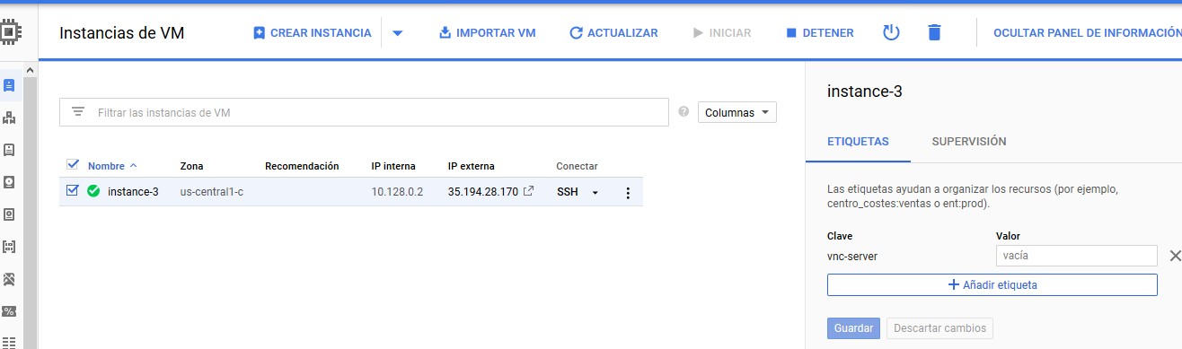
Open the firewall
First step is to tag our instance as a vnc-server, for that go to the VM description page and click on “add tags”

Slide 63
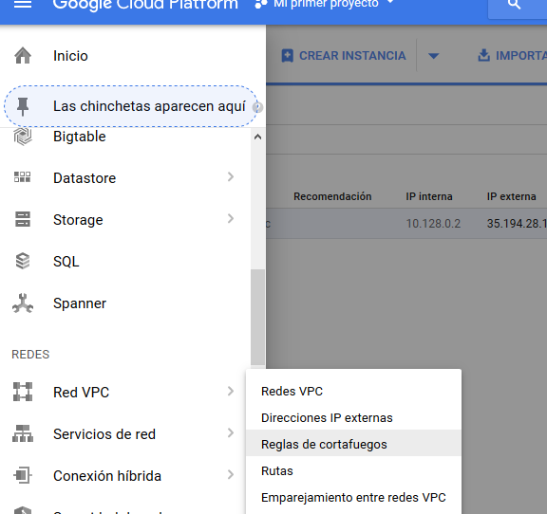
Then go to Red VPC … Firewall Rules

Slide 64
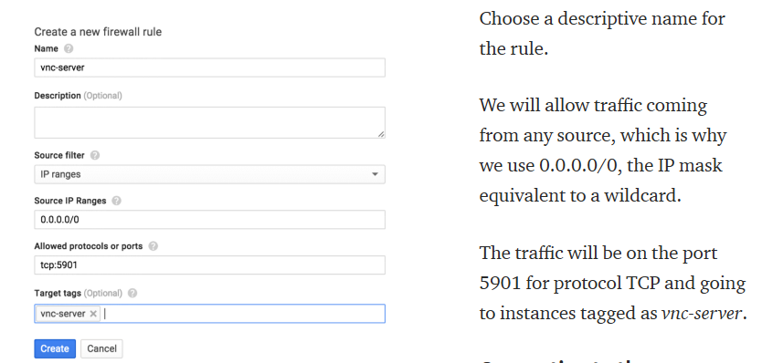
Then go to Red VPC … Firewall Rules

Slide 65
CHECK: Connecting to the VNC server
First, start the vncserver again on the VM by:
vncserver
Now make sure that the connection is now allowed by the firewall:
nc 104.197.91.140 5901
RFB 003.008

Slide 66
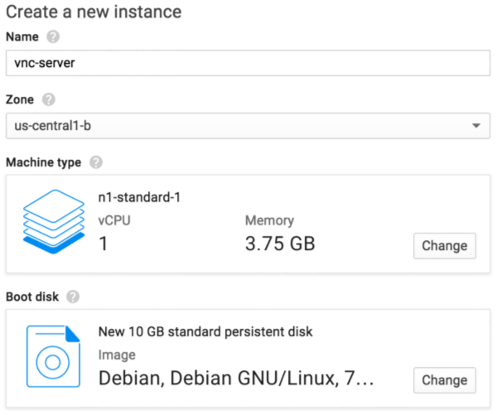
Your desktop on Google Cloud Platform
VNC on Google Compute Engine instances
https://medium.com/google-cloud/linux-gui-on-the-google-cloud-platform-800719ab27c5
If you’d like to use Windows the instances already come with support for RDP (Remote Desktop Protocol) so you don’t need any extra steps.

Slide 67
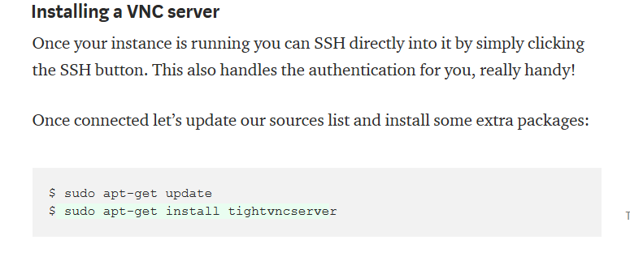

Slide 68
INSTALL A desktop environment
a) If you like Gnome and are not in a hurry:
$ sudo apt-get install aptitude tasksel
$ sudo tasksel install gnome-desktop --new-install
…. 5 minutes…
Setting up the VNC server
Now that our instance has a desktop environment let’s make it accessible via VNC. Start the vncserver, and follow the directions to create a password
$ vncserver

Slide 69
Setting up the VNC server
Now that our instance has a desktop environment let’s make it accessible via VNC.
Start the vncserver,
and follow the directions to create a password
$ vncserver

Slide 70
Note: this password will grant access to your instance, so make it strong.
If everything went fine your VNC server is now running and listening on port 5901. You can verify this with netcat from the Google Compute Engine instance:
$ nc localhost 5901 RFB 003.008
For later use download netcat fro windows

Slide 71
Installing a VNC client
There’s many options available, my favorite one is RealVNC Viewer.
Install one but don’t try to connect to your server just yet: it will fail as the firewall rules don’t allow it.

Slide 72
Using BigQuery
Setting up BigQuery is much easier than Cloud SQL because it does not require to create an instance. Simply run a new command prompt, or the included Google Cloud SDK Shell and create a dataset:
bq mk [DATASET_NAME]
Uploading some CSV
To upload a CSV, it is only required to call the load command and specify the insertion details within the folder that contains the CSV file:
bq load --autodetect [DATASET_NAME].[TABLE_NAME] [CSV_FILE_NAME]
NOTE: If the CSV is too large and the connection must be kept alive for too long, it's better to use Google Cloud Storage for staging and then load the CSV from there. See the next section for details.

Slide 73
(Optional) Using Cloud Storage as intermediary
Creating bucket
Run a new command prompt, or the included Google Cloud SDK Shell, and create the bucket which will store the CSV file(s):
gsutil mb gs://[BUCKET_NAME]/
Uploading CSV to Cloud Storage
Navigate to the folder that contains the CSV file, and execute the following command (where BUCKET_NAME refers to the name of the bucket which will receive the file):
gsutil -o GSUtil:parallel_composite_upload_threshold=150M cp [CSV_FILE_NAME] gs://[BUCKET_NAME]/
Loading CSV from Cloud Storage to BigQuery
Run the following command to load the CSV from the bucket to BigQuery:
bq load --autodetect [DATASET_NAME].[TABLE_NAME] gs://[BUCKET_NAME]/[CSV_FILE_NAME]

Slide 74
https://cloud.google.com/blog/big-data/2017/11/using-apache-spark-with-tensorflow-on-google-cloud-platform
Google Cloud Platform offers managed services for both:
Apache Spark, called Cloud Dataproc,
and TensorFlow, called Cloud ML Engine.
Both of these services deliver the power of their respective open-source frameworks in a managed environment, letting you focus on the data science while we worry about the operations.

Slide 75
https://cloud.google.com/ml-engine/docs/getting-started-training-prediction
Create a TensorFlow trainer and validate it locally.
Run your trainer on a single worker instance in the cloud.
Run your trainer as a distributed training job in the cloud.
Optimize your hyperparameters by using hyperparameter tuning.
Deploy a model to support prediction.
Request an online prediction and see the response.
Request a batch prediction

Slide 76
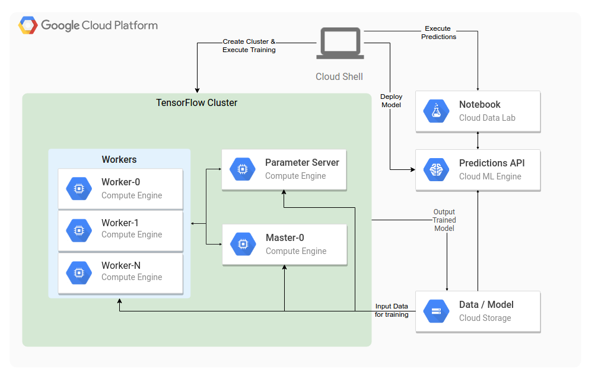
https://cloud.google.com/solutions/running-distributed-tensorflow-on-compute-engine

Slide 77
Pre-installed Images with Spark SPARK
https://cloud.google.com/dataproc/docs/tutorials/bigquery-sparkml
Info on images
https://cloud.google.com/dataproc/docs/concepts/versioning/dataproc-versions

Slide 78
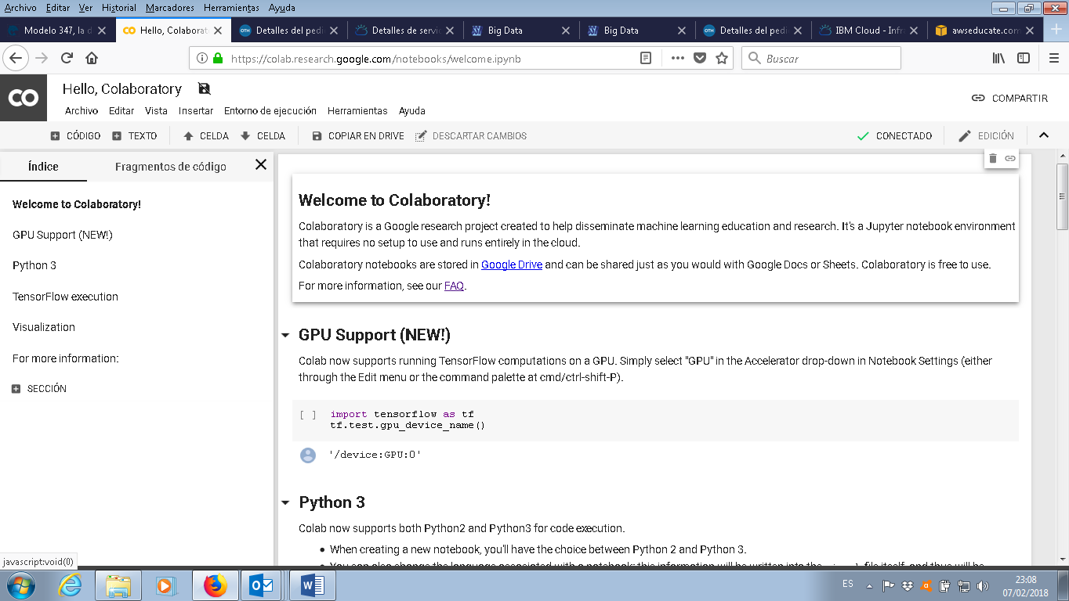
Explore new GOOGLE COLABORATOTY
with TensorFlow and GPU support!
Thanks Daniel Tapia!

