Slide 1
Machine Learning Lab

Slide 2
Linear Regression in R
We will study 3.4 The Marketing Plan following 3.6 Lab: Linear Regression in text book:
An Introduction to Statistical Learning with Applications in R. Gareth James, Daniela Witten, Trevor Hastie and Robert Tibshirani. Springer, 2013.
Suppose that we are statistical consultants hired by a client to provide advice on how to improve sales of a particular product.
The Advertising data set consists of the sales of that product in 200 different markets, along with advertising budgets for the product in each of those markets for three different media: TV, radio, and newspaper.
You can research by yourself on an important area:
Marketing attribution

Slide 3
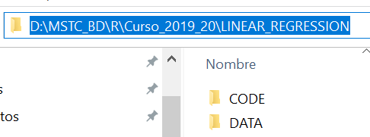
Working space
Prepare a Working space such as:

Slide 4
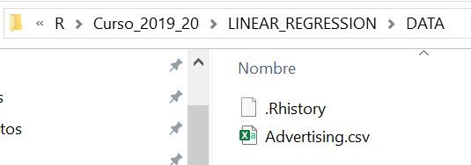
Working space
Copy the file Advertising.csv (in Moodle) to DATA directory:

Slide 5
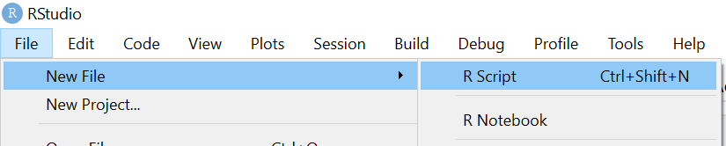
Open Rstudio and create a new R Script File called:
MLLB_LinearRegresion_Advertising.R
Save it to CODE directory

Slide 6
If you get lost, please follow:
https://github.com/MasterMSTC/MLLB
WORKING_MLLB_LinearRegresion_Advertising.R

Slide 7
# List objects in this session
list=ls()
# remove all (memory clean)
rm(list=ls())
# Set YOUR Working directory to DATA
setwd("D:/MSTC_BD/R/Curso_2019_20/LINEAR_REGRESSION/DATA")

Slide 8
#Read the csv file into Advertising
Advertising=read.csv("Advertising.csv")
# Check that a new R object is listed
ls()
What type of object is Advertising ?

Slide 9
# you can also fix to see it (remember to close for continuing)
fix(Advertising)
Do you know how to create scatter plots to inspect the relevance of each variable ?
Can you also inspect the relationships between variables?

