Slide 1
Building Deep Learning
models for NLP
Carlos Rodríguez Abellán
MSc in Signal Theory and Communications
ETSIT - UPM
3rd / 10th April

Slide 2
Index
Introduction
What is NLP?
General Pipeline
Challenges
State-of-the art
Projects
Preprocessing
Word embeddings
Language modelling
Machine translation

Slide 3
Introduction What is Natural Language Processing?
Natural Language Processing (NLP) is a subfield of Artificial Intelligence that is focused on enabling computers to understand and process human languages (audio, text, sign …)
NLP is important for scientific, economic, social, and cultural reasons. Language underlies the main ways of communications (news, social media, videos…), we talk with others using a (or a few) language and we express our sentiments and feelings by text/voice, among many other cases.

Slide 4
Introduction NLP tasks

Slide 5
Introduction NLP tasks
Document classification
Text normalization
POS tagging
Named entity extraction
Machine translation
Language generation
Automatic Speech Recognition
Sentiment analysis
Trend analysis
Spelling corrector
Automatic summarization
Social media analysis
Virtual assistants
Semantic similarity

Slide 6
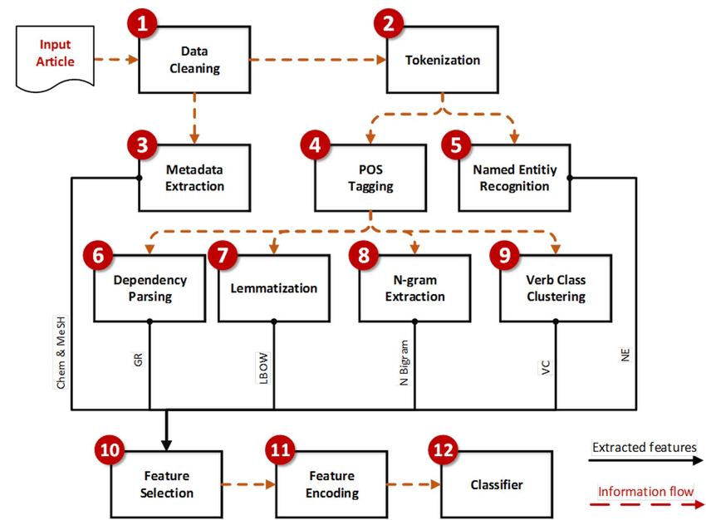
Introduction NLP general pipeline
source: https://www.researchgate.net/figure/The-NLP-pipeline-for-automatic-classification-of-document-abstracts-Chem-Chemical_fig1_314225820

Slide 7
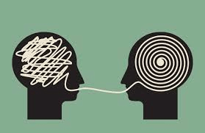
Introduction NLP challenges
Misspellings
Multiple intents in one utterance
Polysemy
Context understanding
False positives
Not enough data
Mainly unsupervised
Evaluation
Differences between languages

Slide 8
Introduction NLP state-of-the-art
Better unsupervised char/word/sentence representation models (BERT, ELMo, GPT-2, ...)
New ANN topologies (transformers, transformers, …) and pretrained models
More and more complex ANN arquitectures by combining other simpler or by using, e. g., VAEs, GANs, etc.
Available open source frameworks (pre-trained models, stanford core nlp, …)
Huge amount of available data (social media, news, chats, audio transcriptions, corpus, …)
Virtual assistants and chatbots in a wide range of sectors

Slide 9
Projects
Time to have fun

