Slide 1
Word Embeddings
(also known as word vectors)
https://nlpforhackers.io/word-embeddings/
Bag Of Words Model (BoW)
Just keep counts of the words from the vocabulary.
We don’t know anything about the words semantics
Very sparse vectors most of the time
N-grams (language model, not embeddings)
Probabilistic language model for predicting the next item in such a sequence in the form of a (n − 1)–order Markov model

Slide 2
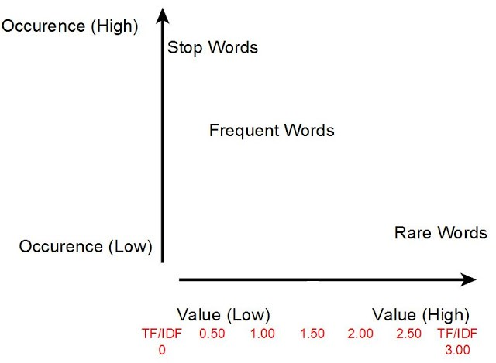
https://towardsdatascience.com/introduction-to-word-embeddings-4cf857b12edc
TF-IDF Transform
TF-IDF vectors
In simpler terms, words that occur a lot but everywhere should be given very little weighting or significance. We can think of this as words like the or and in the English language. They don’t provide a large amount of value.
However, if a word appears very little or appears frequently, but only in one or two places, then these are probably more important words and should be weighted as such.
Again, this suffers from the downside of very high dimensional representations that don’t capture semantic relatedness.

Slide 3
Word Embeddings
(also known as word vectors)
Topic Modeling Algorithms
Topic modeling is a form of dimensionality reduction.
Rather than representing a text T in its feature space as {Word_i: count(Word_i, T) for Word_i in V}, we can represent the text in its topic space as {Topic_i: weight(Topic_i, T) for Topic_i in Topics}. Notice that we’re using Topics to represent the set of all topics.
The most popular ones include
LDA – Latent Dirichlet Allocation – Its foundations are Probabilistic Graphical Models
LSA or LSI – Latent Semantic Analysis or Latent Semantic Indexing – Uses Singular Value Decomposition (SVD) on the Document-Term Matrix. Based on Linear Algebra
NMF – Non-Negative Matrix Factorization – Based on Linear Algebra

Slide 4
Word Embeddings
(also known as word vectors)
https://nlpforhackers.io/word-embeddings/
Embedding layer that is trained via backpropagation
As we saw in our Keras Example:
word embeddings can also be derived via an embedding layer that is trained via backpropagation along with the rest of the network.
Using already computed word vectors is called pretraining.

Slide 5
Word Embeddings
(also known as word vectors)
https://nlpforhackers.io/word-embeddings/
Word2Vec Algorithm
This is the most popular algorithm for computing embeddings
In its simplest form, the neural network can learn what is the next word after a given input node. Obviously, the results will be rather simplistic. We need more information about the context of a word in order to learn good embeddings.

Slide 6
Word Embeddings
(also known as word vectors)
https://nlpforhackers.io/word-embeddings/
Word2Vec Algorithm
CBOW (Continuous Bag-Of-Words) is about creating a network that tries to predict the word in the middle given some surrounding words: [W[-3], W[-2], W[-1], W[1], W[2], W[3]] => W[0]
Skip-Gram
is the opposite of CBOW, try to predict the surrounding words given the word in the middle: W[0] => [W[-3], W[-2], W[-1], W[1], W[2], W[3]]

Slide 7
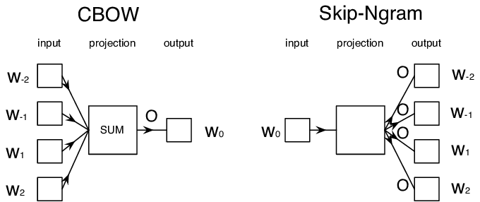

Slide 8
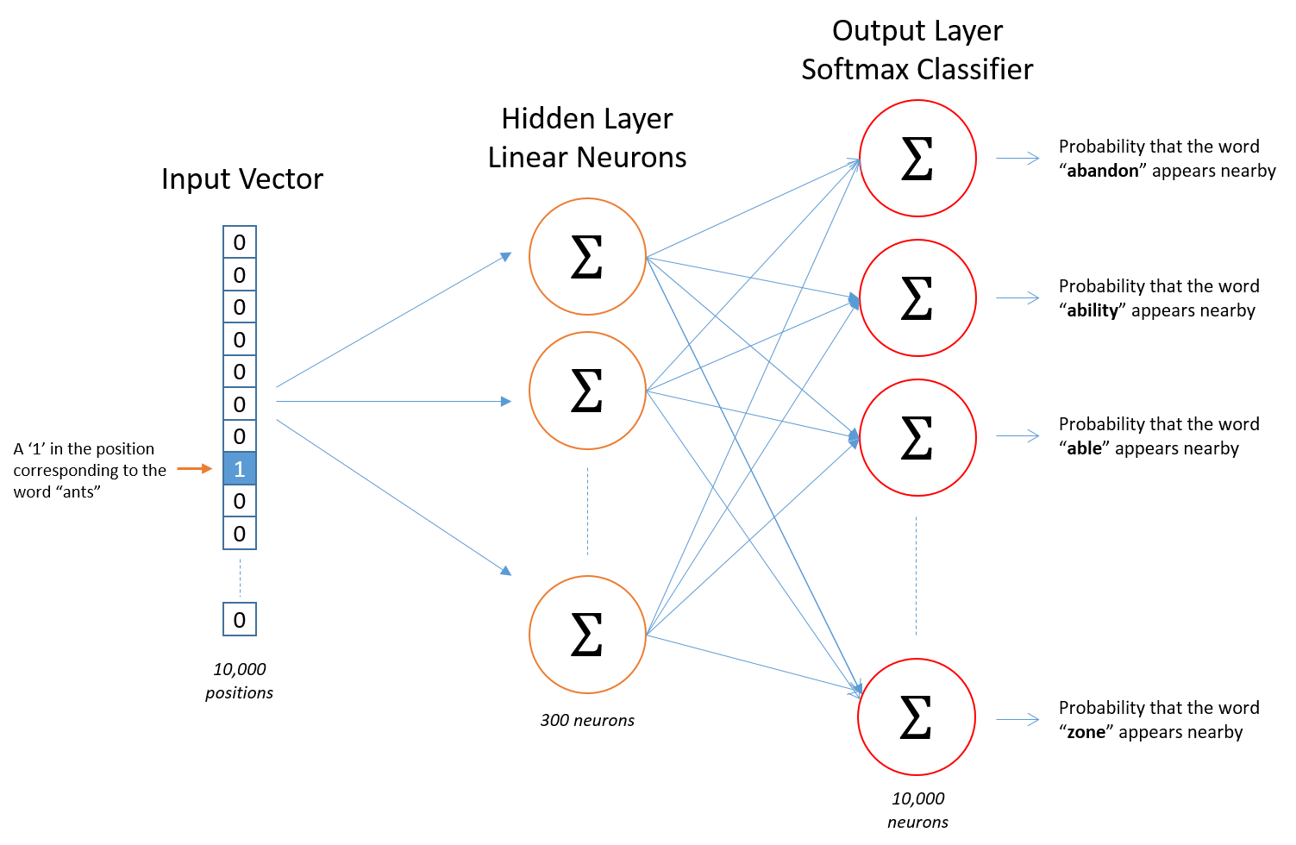
Word2Vec
Sampled
Softmax
https://www.youtube.com/watch?v=BD8wPsr_DAI
OHE

Slide 9
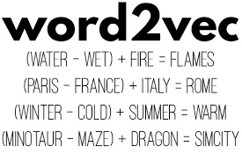
Word2Vec
https://ronxin.github.io/wevi/

Slide 10
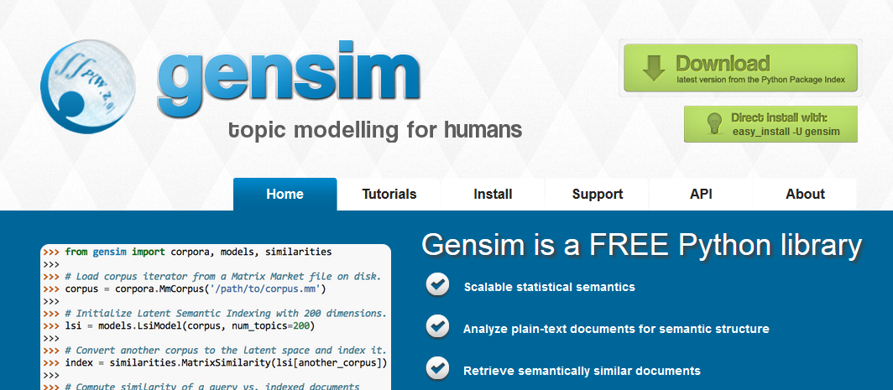
https://radimrehurek.com/gensim/index.html

Slide 11
NLP Libraries in Python

Slide 12
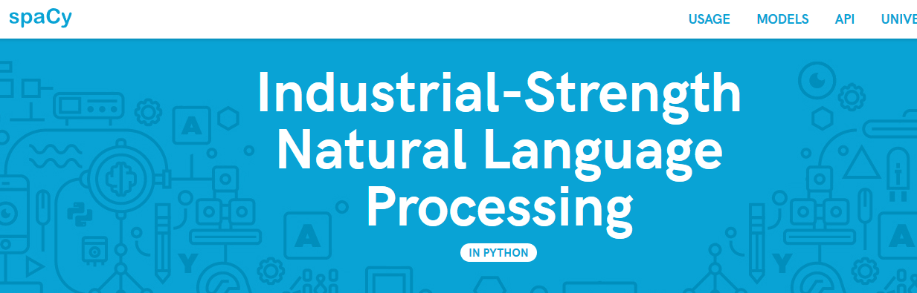
https://spacy.io/

Slide 13
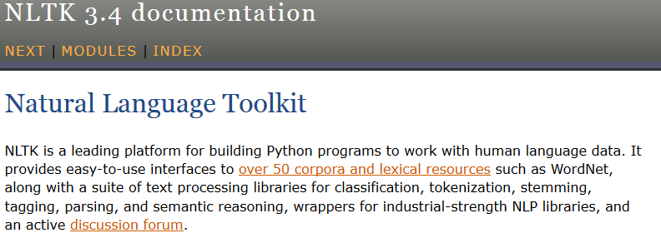
https://www.nltk.org/

