Slide 1
Predictive and Descriptive Learning

Slide 2
Collaborative Filtering Algorithms (brief intro)
Given a list of users and items, and user-item interactions, predict user behavior
Key idea: Use only user-item interactions to predict behavior
iTunes Genius
Contrast with content-based filtering, which builds a model for each item
e.g. Pandora hires musicologists to characterize songs, built the Music Genome

Slide 3
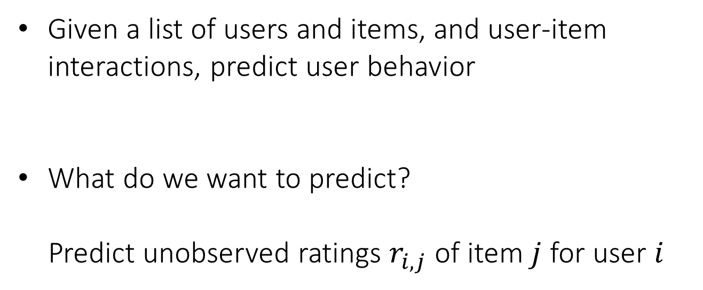
Collaborative Filtering Algorithms (brief intro)
Given a list of users and items, and user-item interactions, predict user behavior
What do we want to predict?
Predict unobserved ratings $r_{i,j}$ of item $j$ for user $i$

Slide 4
Collaborative Filtering Algorithms (brief intro)
Based on partially observed matrix: Predict unobserved entries
“Will user i like movie j?”
movies
2
1
4
5
5
4
?
1
3
3
5
2
4
?
5
3
?
4
1
3
5
2
1
?
4
1
5
5
4
users
2
?
5
?
4
3
3
1
5
2
1
3
1
2
3
4
5
1
3
3
3
?
5
2
?
1
1
5
2
?
4
4
1
3
1
5
4
5
1
2
4
5
?

Slide 5
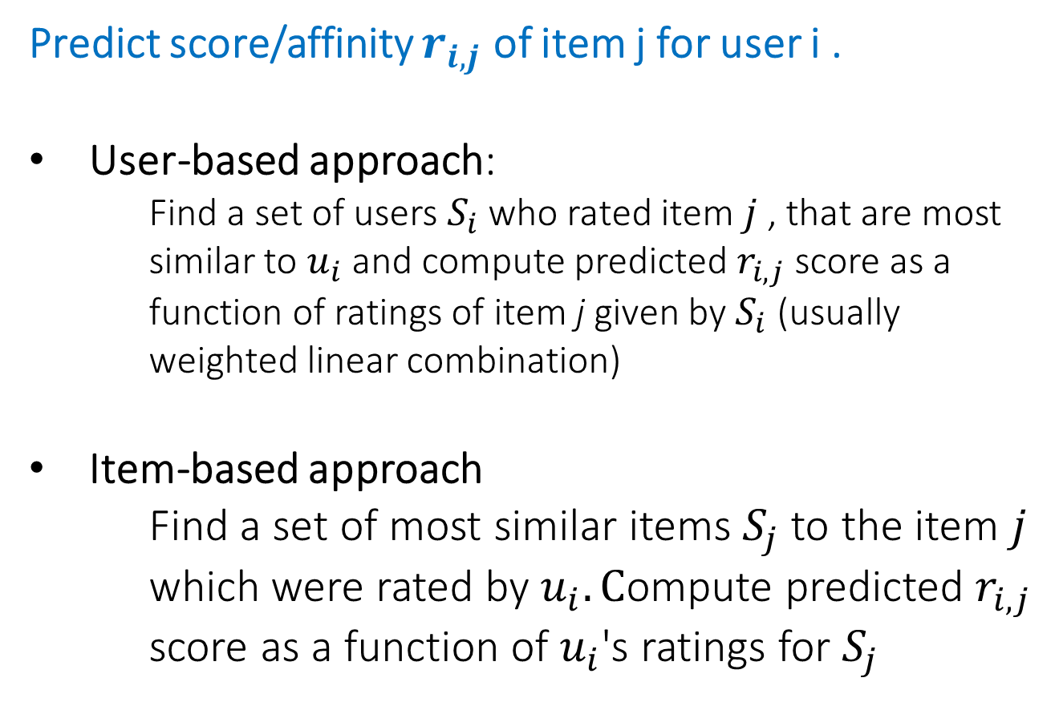
Collaborative Filtering Algorithms (brief intro)
Predict score/affinity $r_{i,j}$ of item j for user i .
User-based approach:
Find a set of users $S_{i}$ who rated item $j$ , that are most similar to $u_{i}$ and compute predicted $r_{i,j}$ score as a function of ratings of item j given by $S_{i}$ (usually weighted linear combination)
Item-based approach
Find a set of most similar items $S_{j}$ to the item $j$ which were rated by $u_{i}. C$ompute predicted $r_{i,j}$ score as a function of $u_{i}$'s ratings for $S_{j}$

Slide 6
Collaborative Filtering Algorithms (brief intro)

Slide 7
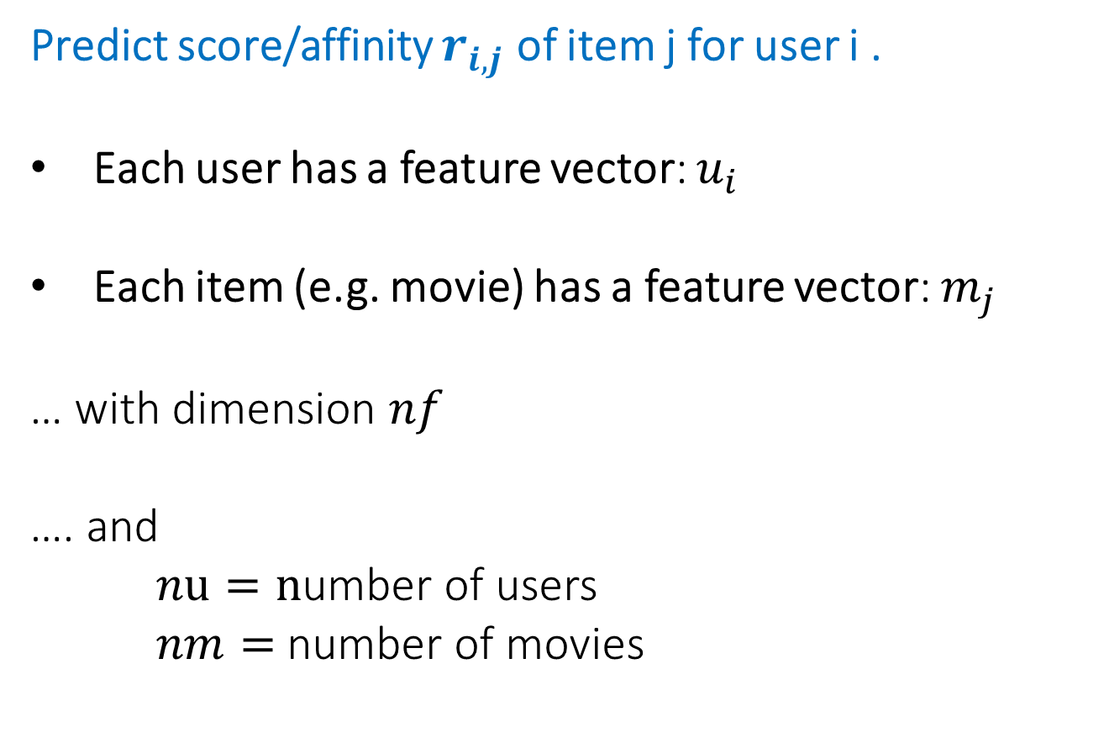
Collaborative Filtering Algorithms (brief intro)
Predict score/affinity $r_{i,j}$ of item j for user i .
Each user has a feature vector: $u_{i}$
Each item (e.g. movie) has a feature vector: $m_{j}$
… with dimension $nf$
…. and
$nu=n$umber of users
$nm=$number of movies

Slide 8
Collaborative Filtering Algorithms (brief intro)
Problem: How to describe items with factors?
Solution: Learn latent representation using the SVD
Caveat: We don't learn semantic interpretations of the factors, just the numerical representations of the users/items
However, for each factor, we can see which items have high/low scores, and assign human interpretations to that factor
This is what Netflix does for movies, in their recommendation system (example factors: "Strong Female Lead", "Cerebral Suspense")

Slide 9
Collaborative Filtering Algorithms (brief intro)
Limitations of SVD method for Collaborative Filtering
SVD can only be applied if we know all the user-item ratings
e.g. Netix Prize - only 1% of ratings given
SVD is only able to minimize the (squared) Frobenius norm loss - may not be appropriate
SVD is very slow for a large, dense user-item matrix

