Slide 1
Predictive and Descriptive Learning

Slide 2
Sources:
Visualising MNIST dataset with manifold learning
https://www.linkedin.com/pulse/visualising-mnist-dataset-manifold-learning-vijayasaradhi-indurthi/
Dong Wang
Unsupervised LearningCSLT ML Summer Seminar (9)
Bengio and Lecun’s NIPS15 Tutoring
Fei Wang
Distance Metric Learning in Data Mining
https://www.youtube.com/watch?v=NEaUSP4YerM

Slide 3
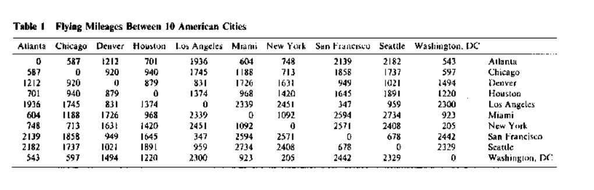
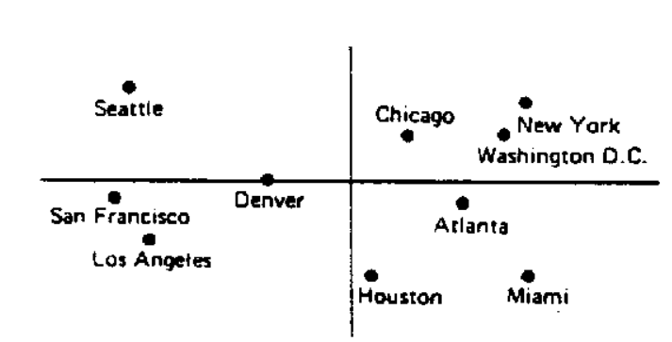

Multidimensional scaling
Also known as Principal Coordinates Analysis
Takes an input matrix giving dissimilarities between pairs of items
Outputs a coordinate matrix whose configuration minimizes a loss function, e.g., stree:

Slide 4
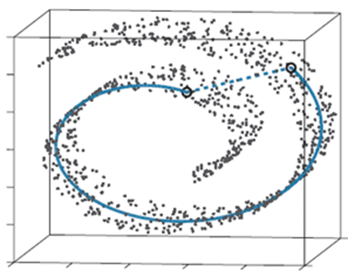

Slide 5
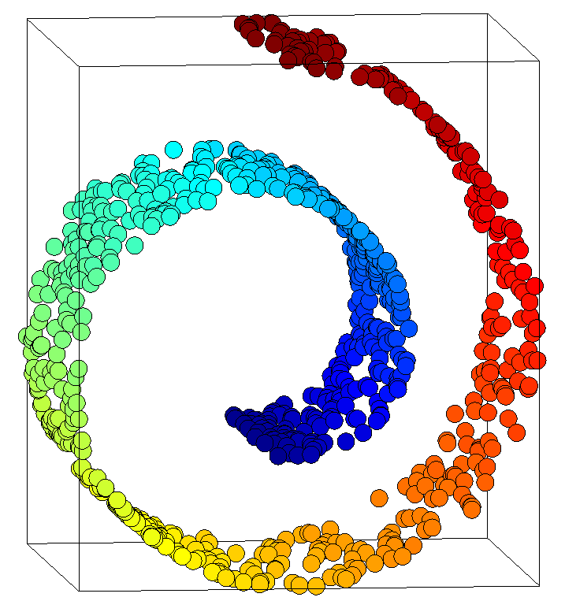
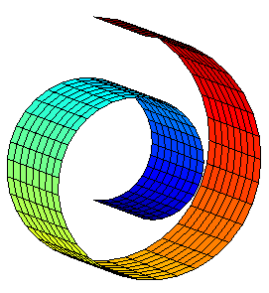
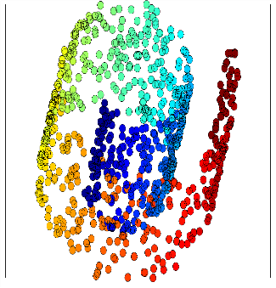
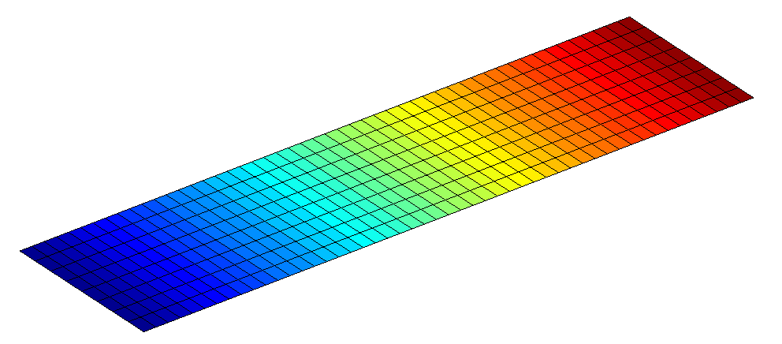
Linear model is not sufficient
x
Both PCA and MDS are global linear, relying on eigen decomposition: covariance matrix for PCA and centered proximity matrix for MDS.
PCA
Manifold Learning-Dimensionality Reduction

Slide 6
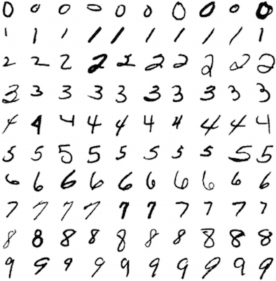
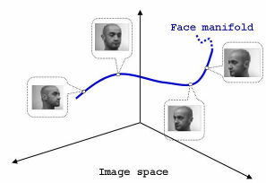
Nonlinear manifold
Most of data are in nonlinera manifold

Slide 7
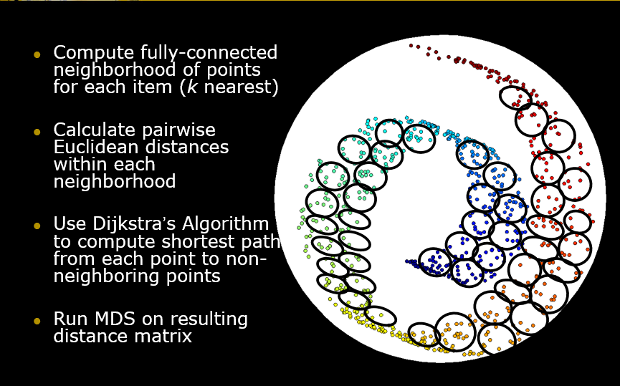
ISOmap

Slide 8
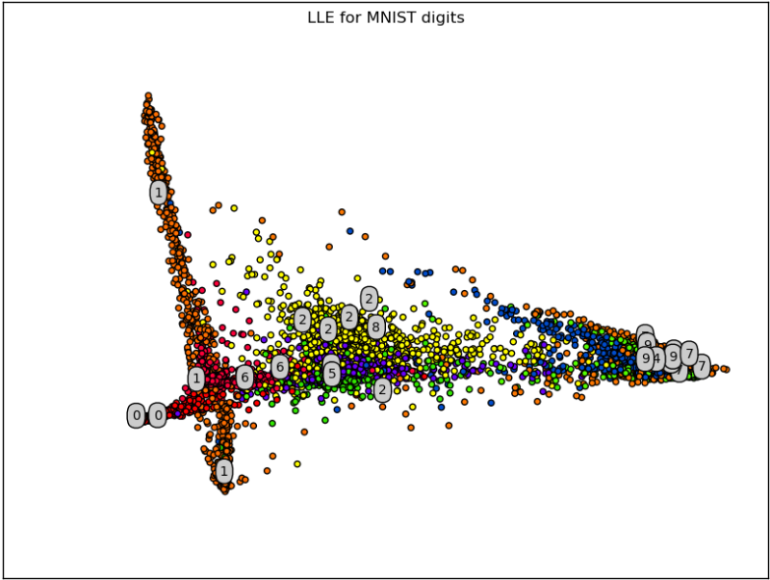
LLE: Local linear Embedding seeks a lower-dimensional projection of the data which preserves distances within local neighborhoods.
It can be thought of as a series of local Principal Component Analyses which are globally compared to find the best non-linear embedding.

Slide 9
t-SNE t-distributed Stochastic Neighbor Embedding
Define the distribution on the orginal space
Define the distribution on the projection space
Let the distributions in the two spaces close to each other

Slide 10
t-SNE

Slide 12
More approaches to model manifolds (thanks Dani!) http://projector.tensorflow.org/
Autoencoders
Bottlenecks
GAN: Generative Adversarial Networks

Slide 13
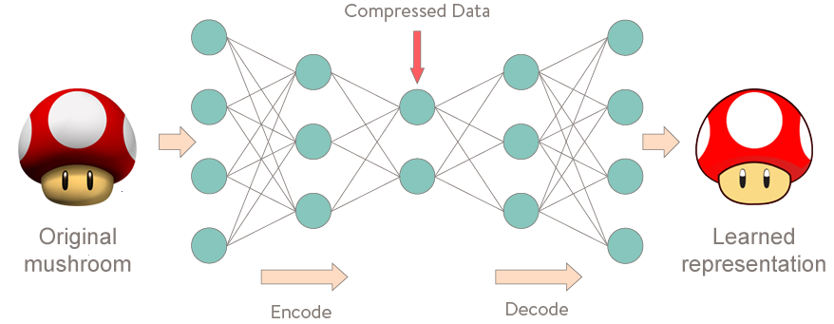
Autoencoders

Slide 14
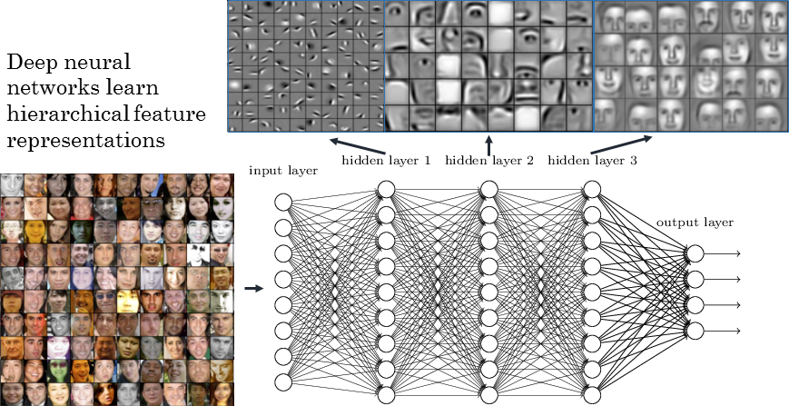
Bottleneck

Slide 15
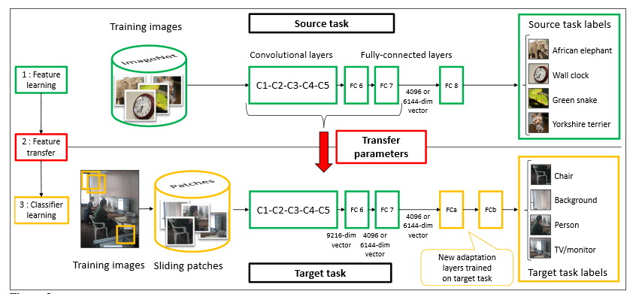
Bottleneck (transfer learning?)

Slide 16
GAN: Generative Adversarial Networks: An Overview
Creswell, Antonia, et al. "Generative Adversarial Networks: An Overview." arXiv preprint arXiv:1710.07035 (2017).

Slide 17
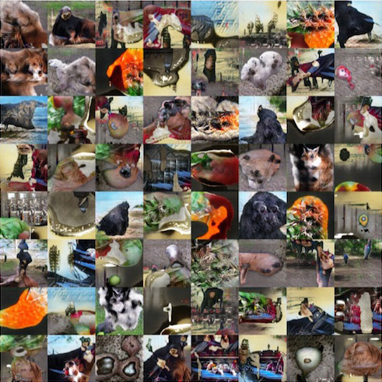

Slide 18
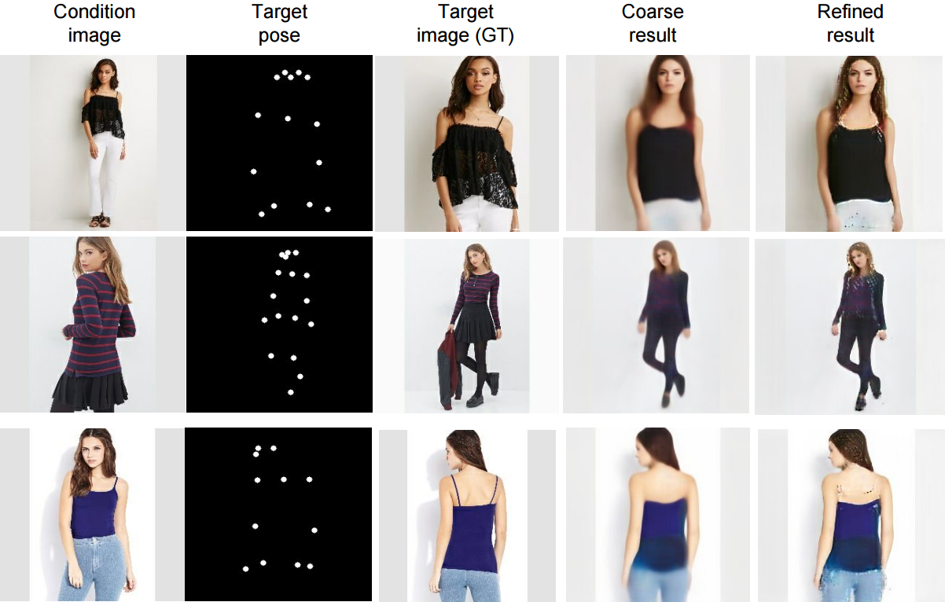
Pose Guided Person Image Generation (May 2017)
Liqian Ma, Qianru Sun, Xu Jia, Bernt Schiele, Tinne Tuytelaars, Luc Van Gool

