Slide 1
Predictive & Descriptive Learning Machine Learning Lab
Final Project
Eduardo López & Luis Hernández

Slide 2
PRDL & MLlab Final Project
TABLE of CONTENTS:
Introduction:
Churn Prediction: what is it? Why is it important?...
State-of-the Art: you must include [REFS]
Web sites, papers, etc,…
https://archive.org/stream/IJETR032280/IJETR032129_djvu.txt
Project Structure: (description of this document)
Dataset : Orange Telecoms Churn Dataset
…

Slide 3
PRDL & MLlab Project
Most important targets:
Define the Problem you are addressing
Methodological Approach - see CONTENTS (I)

Slide 4
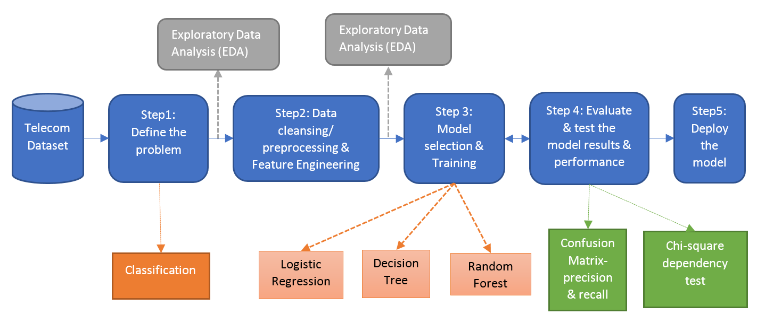
PRDL & MLlab Project
CONTENTS (I):
Methodological Approach

Slide 5
PRDL & MLlab Project
CONTENTS (II):
Exploratory Data Analysis
Feature analysis
Descriptive Learning:
PCA
Clustering (User’s segmentation)

Slide 6
PRDL & Mllab Project
CONTENTS (III):
Churn Prediction
Fitting Interpretable Models for Exploratory Data Analysis
Logistic Regression case
Machine Learning algorithms:
Simple Logistic Regression
Model assessment
Linear Models:
Logistic Regression, LDA, QDA,…

Slide 7
PRDL & MLlab Project
CONTENTS (IV):
Non-linear Machine Learning algorithms:
Tress, RF, Bagging, Boosting
SVM
Deep Learning
Computational languages and environments:
R
Python
Spark: PySpark, SparkR,…
Results
Discussion
Conclusions

Slide 8
Orange Telecom Churn Dataset
Orange Telecom Churn Dataset
Consists of cleaned customer activity data (features), along with a churn label specifying whether the customer canceled their subscription or not.
The data can be fetched from BigML's S3 bucket, churn-80 and churn-20. The two sets are from the same batch, but have been split by an 80/20 ratio.
churn-80 will be used for training and cross-validation purposes,
churn-20 will be used for final testing and model performance evaluation.
Similar large-dataset in :http://www.vincentlemaire-labs.fr/kddcup2009/
https://mapr.com/blog/churn-prediction-pyspark-using-mllib-and-ml-packages/

Slide 9
Orange Telecoms Churn Dataset
Churn in Telecom dataset
https://bigml.com/user/francisco/gallery/dataset/5163ad540c0b5e5b22000383
By the way…. Machine Learning as a Service
We can comment BigML-like initiatives:
https://predicsis.ai/blog/2015/9/29/machine-learning-wars-amazon-ml-vs-google-api-vs-bigml-vs-predicsis-api

Slide 10
In AWS
https://aws.amazon.com/es/blogs/ai/predicting-customer-churn-with-amazon-machine-learning/
State: the US state in which the customer resides, indicated by a two-letter abbreviation; for example, OH or NJ
Account Length: the number of days that this account has been active
Area Code: the three-digit area code of the corresponding customer’s phone number
Phone: the remaining seven-digit phone number
Int’l Plan: whether the customer has an international calling plan: yes/no
VMail Plan: whether the customer has a voice mail feature: yes/no
VMail Message: presumably the average number of voice mail messages per month
Day Mins: the total number of calling minutes used during the day
Day Calls: the total number of calls placed during the day
Day Charge: the billed cost of daytime calls
Eve Mins, Eve Calls, Eve Charge: the billed cost for calls placed during the evening
Night Mins, Night Calls, Night Charge: the billed cost for calls placed during nighttime
Intl Mins, Intl Calls, Intl Charge: the billed cost for international calls
CustServ Calls: the number of calls placed to Customer Service
Churn?: whether the customer left the service: true/false
In RED : not in these csv…

Slide 11
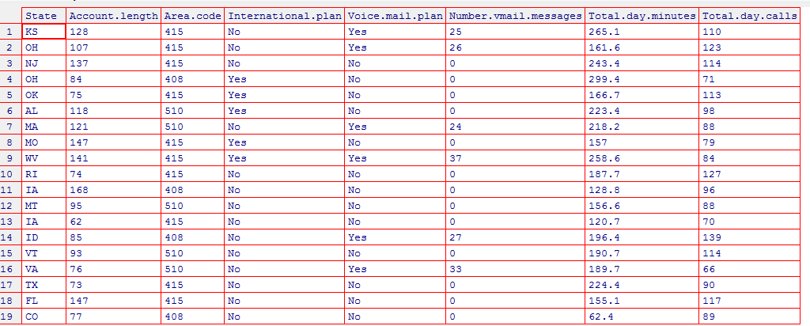
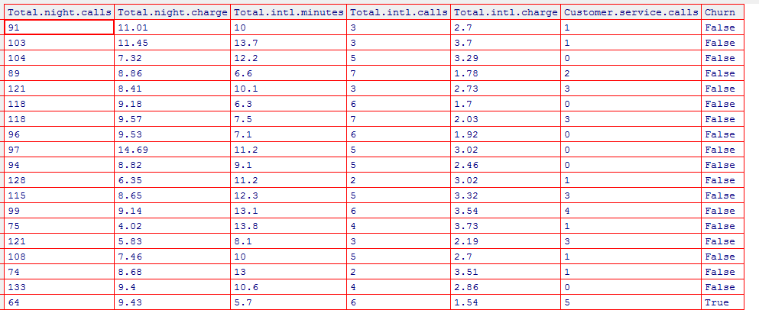
Exploratory Analysis
file_train ='churn-bigml-80.csv'
CV_data <- read.csv(file_train, header=TRUE, sep=",")
fix(CV_data)

Slide 12
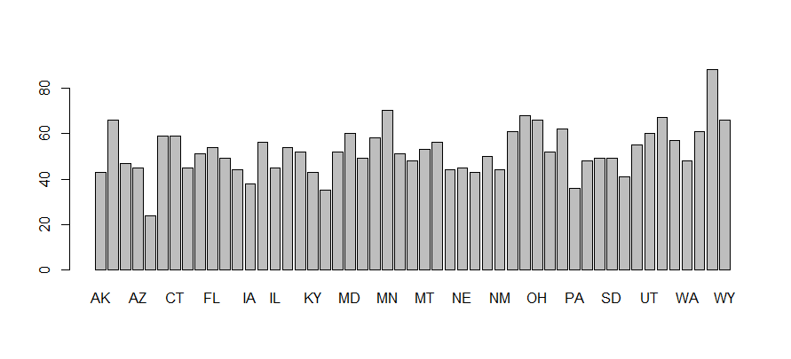
# Number states
List_States=unique(CV_data$State)
List_States2=levels(CV_data$State)
length(List_States)
51
and number users per state
barplot(summary(CV_data$State))

Slide 13
# Number states
List_States=unique(CV_data$State)
List_States2=levels(CV_data$State)
length(List_States)
51
and number users per state
barplot(summary(CV_data$State))

Slide 14
# Analyze number of churns per State
TT=tapply(CV_data$State, CV_data$Churn, summary)
# Look for a better way for plotting...
windows()
par(mfrow=c(3,1))
barplot(TT$True,col=c("red"))
barplot(TT$False,col=c("darkblue"))
barplot(TT$True/(TT$True+TT$False),col=c("green"))
dev.off()

Slide 15
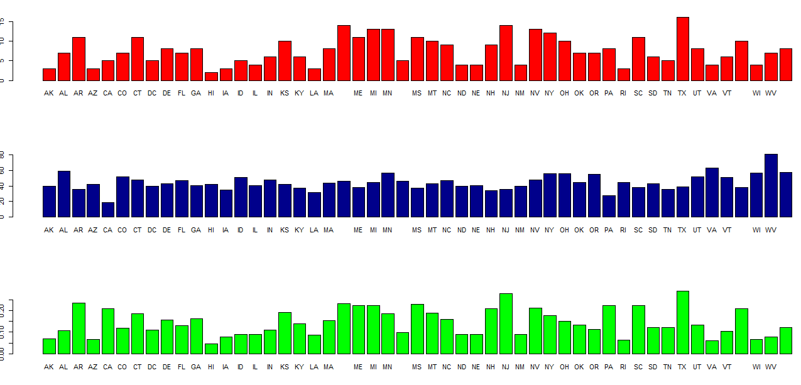
Some states higher churn rates than others…

Slide 16
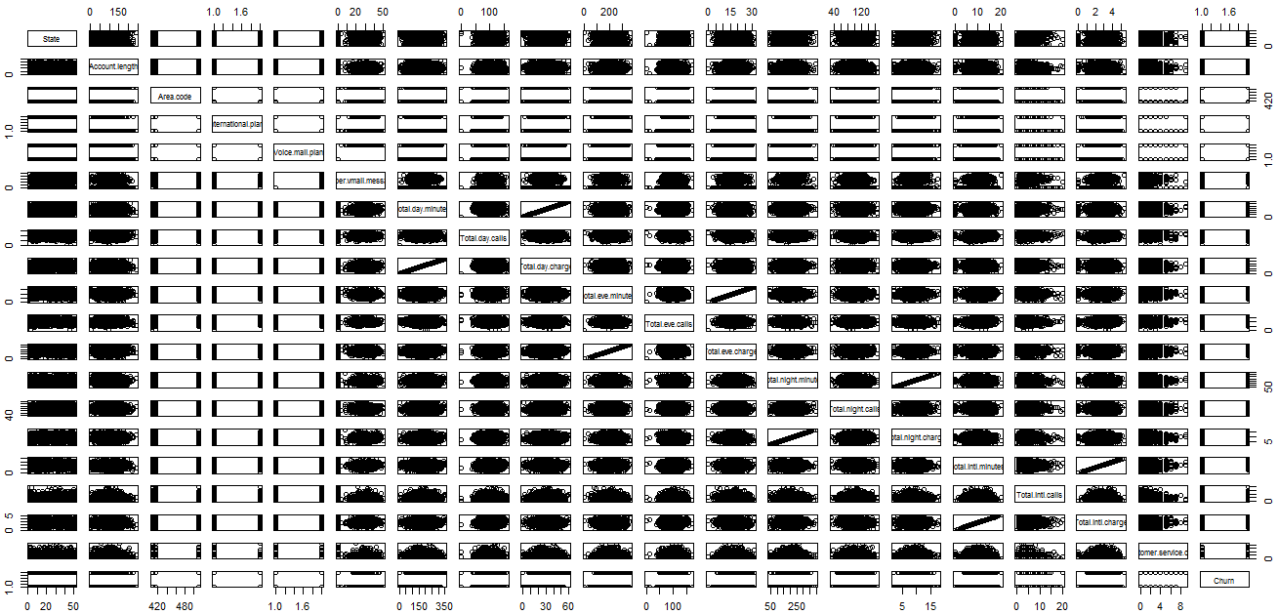
# Scater plots
pairs(CV_data)
High “linearity” between some features…

Slide 17
High “linearity” between some features…
As expected between minutes and charge
# so we will remove
#'Total.day.charge',
#'Total.eve.charge',
#'Total.night.charge',
#'Total.intl.charge'
# So we will remove from data
# …using “set” from data.table library
library(data.table)
set(CV_data, j = c('State',
'Area.code',
'Total.day.charge',
'Total.eve.charge',
'Total.night.charge',
'Total.intl.charge') , value = NULL)
State and Area Code “linearity” also dropped-out as they
are categorical… BUT they should be used!!

Slide 18
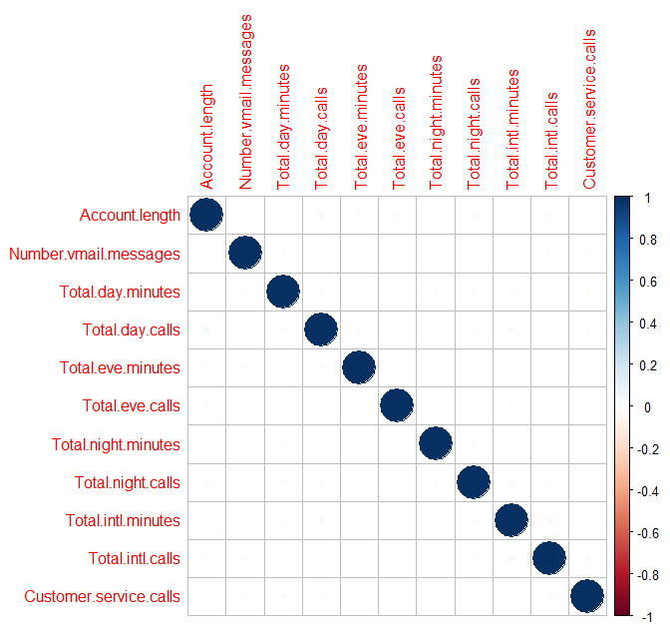
We can analyze correlations…. BUT as we are working in a Classification problem better analyze discriminative power of features …
library(corrplot)
# after removing factors
M <- cor(CV_data[c(-2,-3,-14)])
corrplot(M, method="circle")
Very Small correlation coeffs

Slide 19
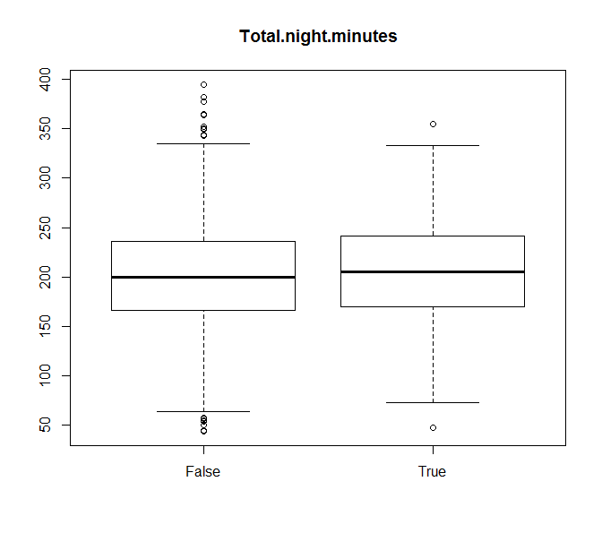
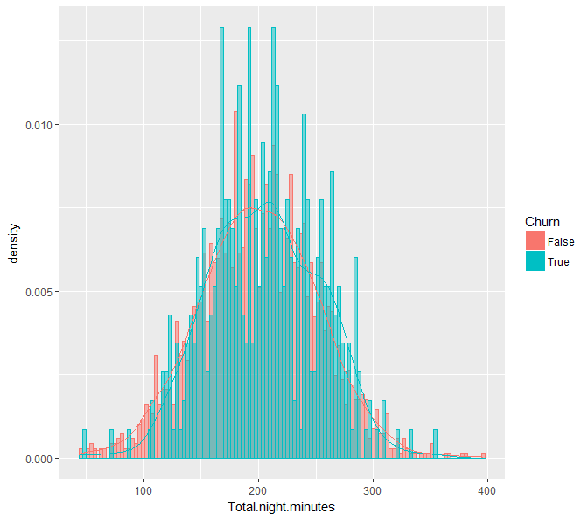
Discrimination can be studied using: boxplot, class-histograms, …

Slide 20
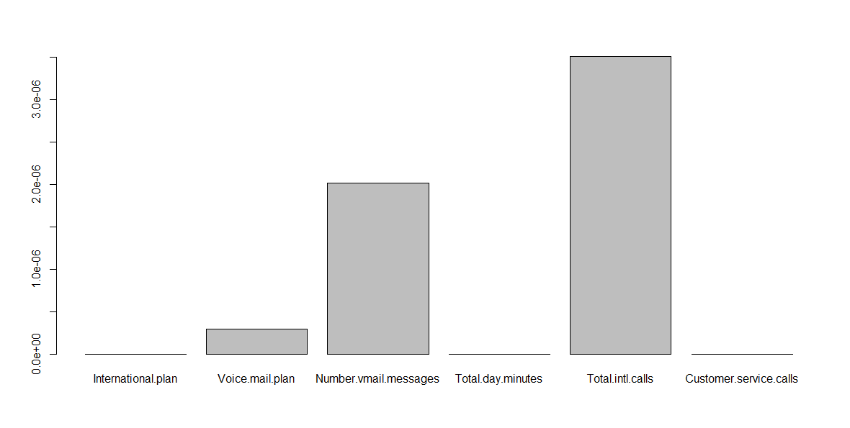
Studying discriminant power using statistical tests…
kruskal.test(Total.night.minutes ~ Churn, data = CV_data)
Kruskal-Wallis chi-squared = 2.8035, df = 1, p-value = 0.09406
Apply for all features and find the more discriminant ones: 14th is Churn
P_values=apply(CV_data[,-14], 2, function(x) kruskal.test(x,CV_data[,14])$p.value)
barplot(P_values[P_values<=.00001])

Slide 21
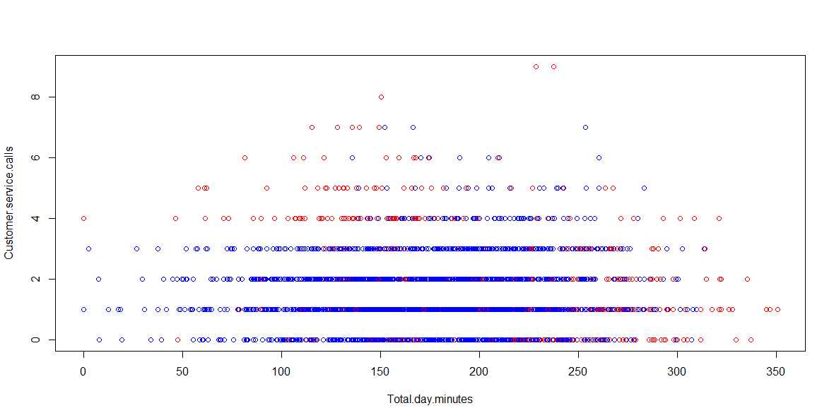
# scatter plot between two features in different colors per class
attach(CV_data)
plot(Total.day.minutes, Customer.service.calls, col=c("blue","red")[Churn])

Slide 22
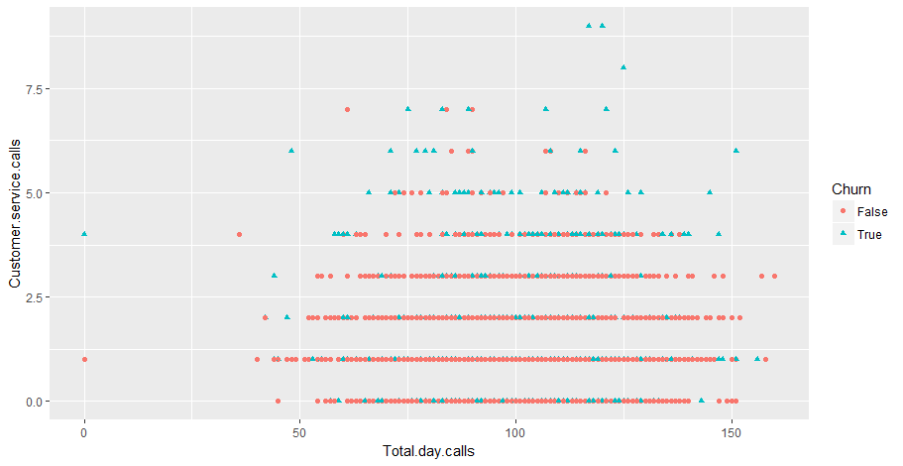
qplot(Total.day.calls, Customer.service.calls, colour = Churn, shape = Churn, data = CV_data)

Slide 23
# Other ways to inspect discrimination power
#dplyr: A Grammar of Data Manipulation
#A fast, consistent tool for working with data frame
# like objects, both in memory and out of memory.
library(dplyr)
group_by(CV_data, Churn) %>%
summarise(
count = n(),
mean = mean(Customer.service.calls, na.rm = TRUE),
sd = sd(Customer.service.calls, na.rm = TRUE),
median = median(Customer.service.calls, na.rm = TRUE),
IQR = IQR(Customer.service.calls, na.rm = TRUE)
)
Churn count mean sd median IQR
<fctr> <int> <dbl> <dbl> <dbl> <dbl>
1 False 2278 1.453029 1.152125 1 1
2 True 388 2.206186 1.882536 2 3

Slide 24
CONCLUSIONS TO EXPLORATORY ANALYSIS
…your conclusions here:
Ready for some “possible” effect of the relevant features…
Customer calls: malfunctioning
International calls: promotions?
… these could be supported by some pre-existing analysis, reports, references, etc.. (search them…)
DON’T FORGET considering also FEATURE ENGINEERING

Slide 25
PRDL & MLlab Final Project
CONTENTS (III):
Churn Prediction
Fitting Interpretable Models for Exploratory Data Analysis
Logistic Regression case
Machine Learning algorithms:
Simple Logistic Regression
Model assessment
Linear Models:
Logistic Regression, LDA, QDA,…

Slide 26
Next Step: Model Selection

Slide 27
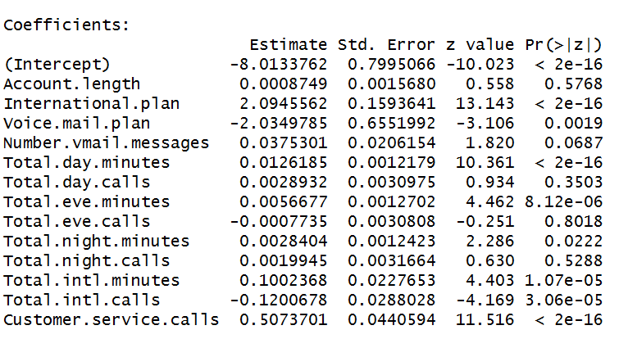

# Fitting a Logistic Regression Model (glm binomial) on the training data using ALL features
glm.fit=glm(Churn ~ . ,data=CV_data,family=binomial)
INTERPRETABLE MODELS
Analyze:
Relevant predictors
Sign (+ , -)

Slide 28
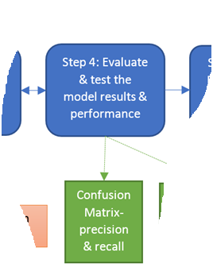
Next Step: Model Selection

Slide 29
# TRAIN ERROR
Confusion Matrix & Classification ERROR
# Basic Confusion matrix en MCE with Threshold 0.5
glm.pred=rep ("False" ,2666)
glm.pred[glm.probs >.5]="True"
table(glm.pred ,Churn)
mean(glm.pred==Churn)
Churn
glm.pred False True
False 2214 302
True 64 86
MCE = 0.8627157

Slide 30
Churn
glm.pred False True
False 2214 302
True 64 86
MCE = 0.8627157
Predicting always FALSE
Churn
glm.pred False True
False 2278 388
MCE = 0.8544636

Slide 31
# TEST ERROR
first prepare test data in a similar way as training data
glm.probs =predict (glm.fit ,final_test_data , type="response")
Churn
glm.pred False True
False 552 77
True 20 18
MCE = 0.8545727
Predicting always FALSE
Churn
glm.pred False True
False 572 95
MCE = 0.8575712

Slide 32
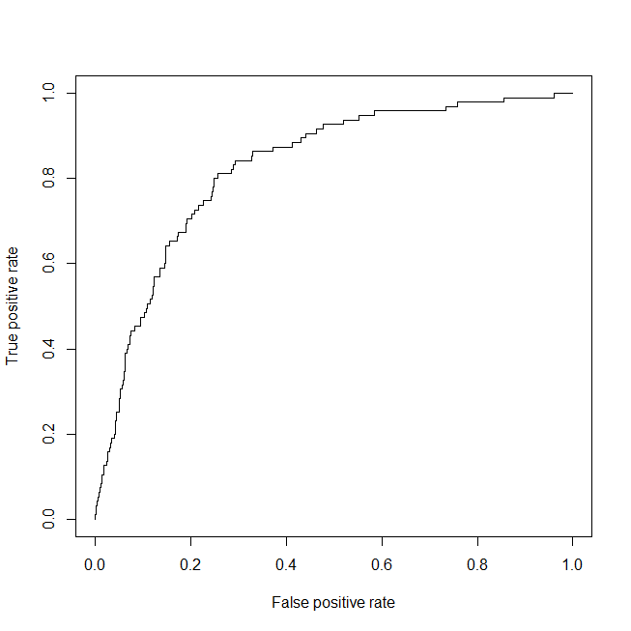
# TEST ERROR using ROC, DET and other assessment metrics
AUC = 0.83

Slide 33
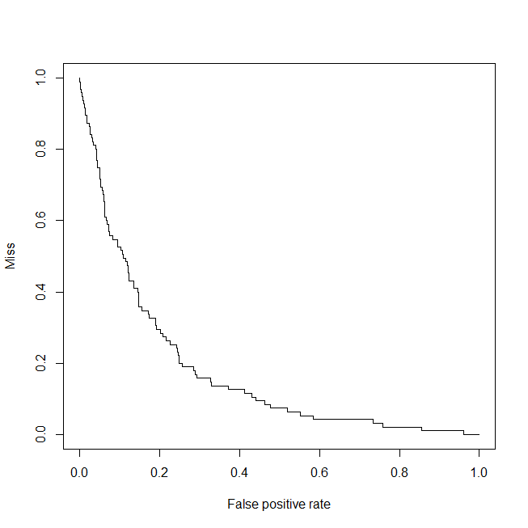
# DET “like” !
EER= 0.23

Slide 34
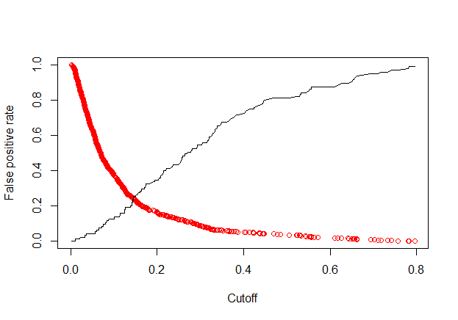
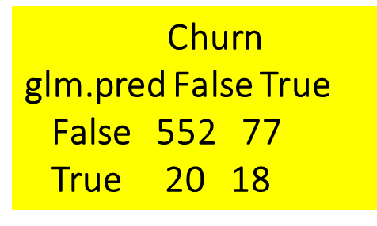
# TEST ERROR
false positive rate & miss (false negative) as function of Threshold
RED
Miss
EER= 0.23
FPR = 20/(552+20) = 0.03496503
FNR=MISS= 77/(77+18) 0.8105263
Threshold
0.5
TPR = 18/(77+18) = 0.19 = Sensitivity=Recall

Slide 35

# TEST ERROR: study other metrics
For Th = 0.5
Precision = 0.4736842
Recall : Sensitivity: TPR: = 0.19
F1 = 0.2706767
The F₁ score is the harmonic average of the precision and recall, where an F₁ score reaches its best value at 1 (perfect precision and recall) and worst at 0.
TPR = 18/(77+18) = 0.19 = Sensitivity=Recall
PPV = Precision = 18/(18+20)=0.47

Slide 36
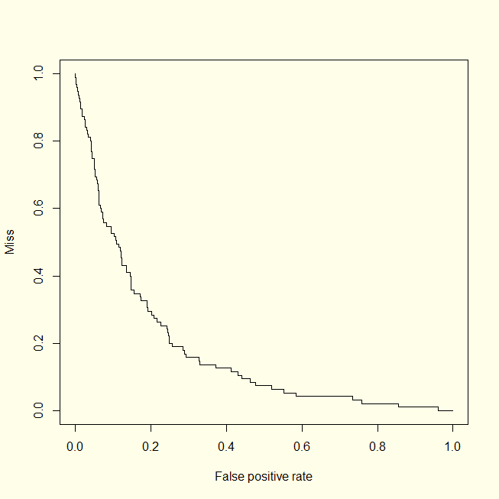
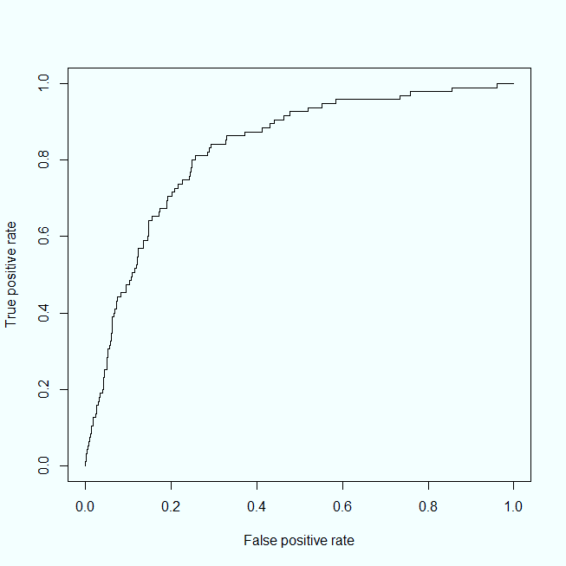
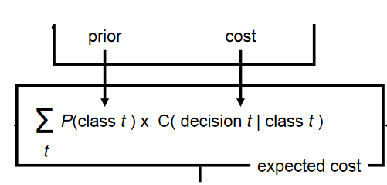
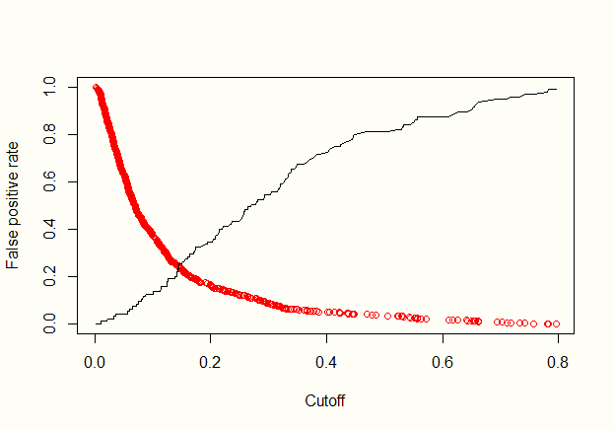


Optimum working point ?
X?
X?
X?

Slide 37
PRDL & MLlab Final Project
CONTENTS (III):
Churn Prediction
Fitting Interpretable Models for Exploratory Data Analysis
Logistic Regression case
Machine Learning algorithms:
Simple Logistic Regression
Model assessment
Comparing Linear Models:
Logistic Regression, LDA, QDA,…

Slide 38
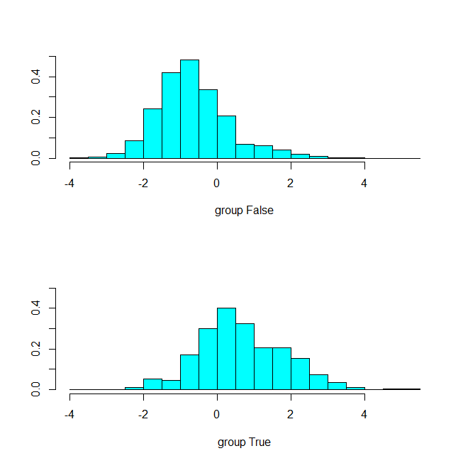
# TEST ERROR: compare LR, LDA , QDA,… kNN…
# TRY LDA LDA is part of MASS library
library (MASS)
lda.fit=lda(Churn ∼ . ,data=CV_data)
lda.fit
plot(lda.fit)
lda.predict=predict (lda.fit , final_test_data)
lda.pred=rep("False" ,667)
lda.pred[lda.predict$posterior[,2] >.5]="True"
table(lda.pred ,final_test_data$Churn)

Slide 39
# TEST ERROR: compare LR, LDA , QDA,… kNN…
# Quadratic Discriminant Analysis
qda.fit=qda(Churn ∼ . ,data=CV_data)
qda.predict=predict (qda.fit , final_test_data)

Slide 40
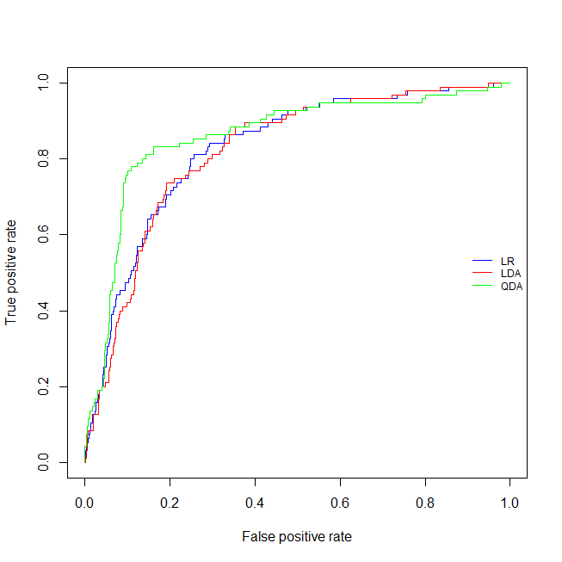
# TEST ERROR: compare LR, LDA , QDA,… kNN…

Slide 41
Let’s try using Cross-Validation
The boot library includes cv.glm() for cross-validation
# ...you should concatenate CV_data and final_test_data
# For Logistic Regression
# https://stats.stackexchange.com/questions/77094/cost-function-in-cv-glm-for-a-fitted-logistic-model-when-cutoff-value-of-the-mo
library(boot)
mycost <- function(r, pi = 0) mean(abs(r-pi) > 0.5)
glm.fit=glm(Churn ~ . ,data=CV_data,family=binomial)
# Leave-one-out
cv.err =cv.glm(CV_data , cost=mycost , glm.fit)
cat('LOOV Estimated Classification ERROR' ,cv.err$delta)
# K-fold cross-validation k=10
cv.err =cv.glm(CV_data , cost=mycost , glm.fit, K=10)
cat('k-fold CV Estimated Classification ERROR' ,cv.err$delta)
LOOV Estimated Classification ERROR 0.1391598 0.1391301
k-fold K=10 CV Estimated Classification ERROR 0.1406602 0.1407349

Slide 42
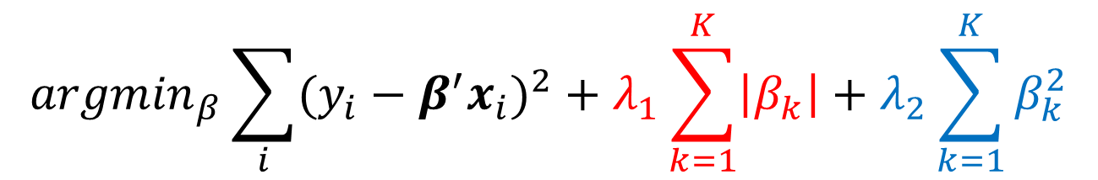
Cross-Validation for Ridge Regression and Lasso
library(glmnet)
Implements
Elastic Net: Combination of Ridge and LASSO
$${argmin}_{β}\sum_{i}{{(y_{i}−β^{′}x_{i})}^{2}}+λ_{1}\sum_{k=1}^{K}{\left|β_{k}\right|}+λ_{2}\sum_{k=1}^{K}{β_{k}^{2}}$$

Slide 43
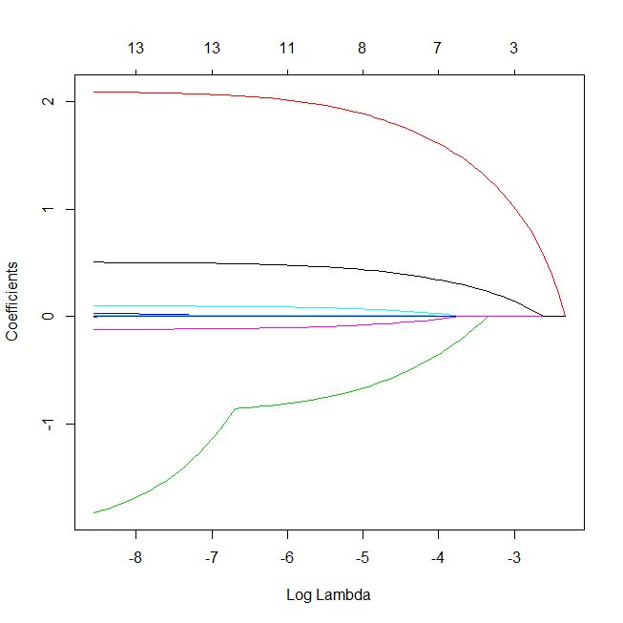
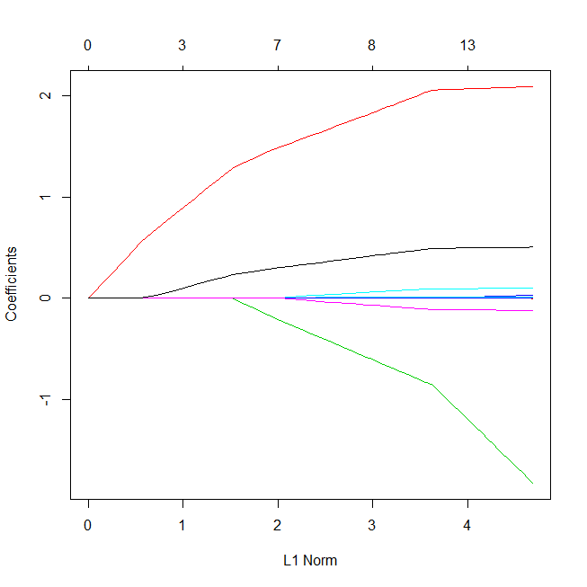
# alpha = 0 for ridge regression / 1 for lasso
glmmod <- glmnet(as.matrix(CV_data[c(-14)]),
Churn, alpha=1, family="binomial")
plot(glmmod, xvar="lambda")
plot(glmmod)

Slide 44
# Search for a grid of lambdas
lambdas <- 10^seq(1, -3, by = -.1)
# …using Cross-validation and different eval measures…
cv.glmmod <- cv.glmnet(as.matrix(CV_data[c(-14)]),
as.factor(Churn),nfolds=10,
lambda = lambdas,
alpha=1, family="binomial",
type.measure="auc")

Slide 45
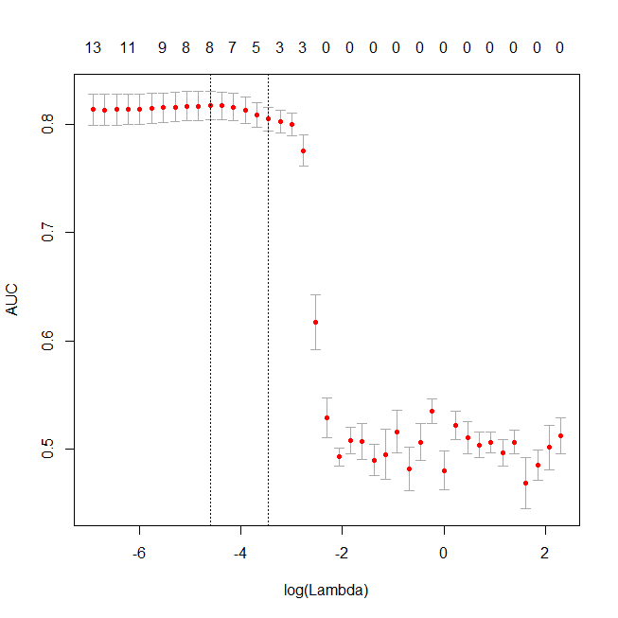
plot(cv.glmmod)
8 features
(Intercept) -5.5311330812
Account.length .
International.plan 1.7949016711
Voice.mail.plan -0.5653239554
Number.vmail.messages .
Total.day.minutes 0.0098953273
Total.day.calls .
Total.eve.minutes 0.0029308939
Total.eve.calls .
Total.night.minutes 0.0004810834
Total.night.calls .
Total.intl.minutes 0.0572328126
Total.intl.calls -0.0605628439
Customer.service.calls 0.4067470146

Slide 46
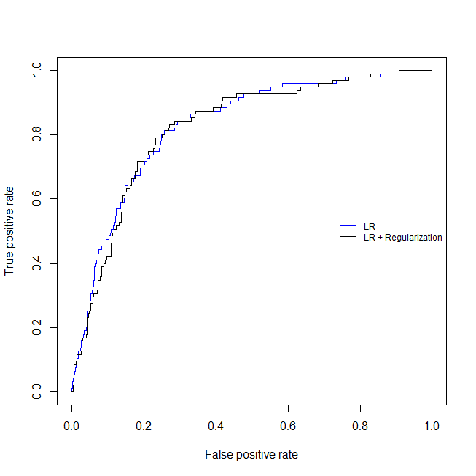
# PERFORMANCE using TEST ERROR
No significant difference…

Slide 47
PRDL & MLlab Project
CONTENTS (V):
Results
Discussion
Conclusions
ANEX I: Tools and development environments (MLlab)
Include a short description of tools you have used and for what purposes…
ANEX II: Summary of Theoretical Knowledge (Predictive & Descriptive Learning)
Detail ALL the Theoretical Knowledge you have used
ANEX III: Team activities (only for Projects with several authors)

Slide 48
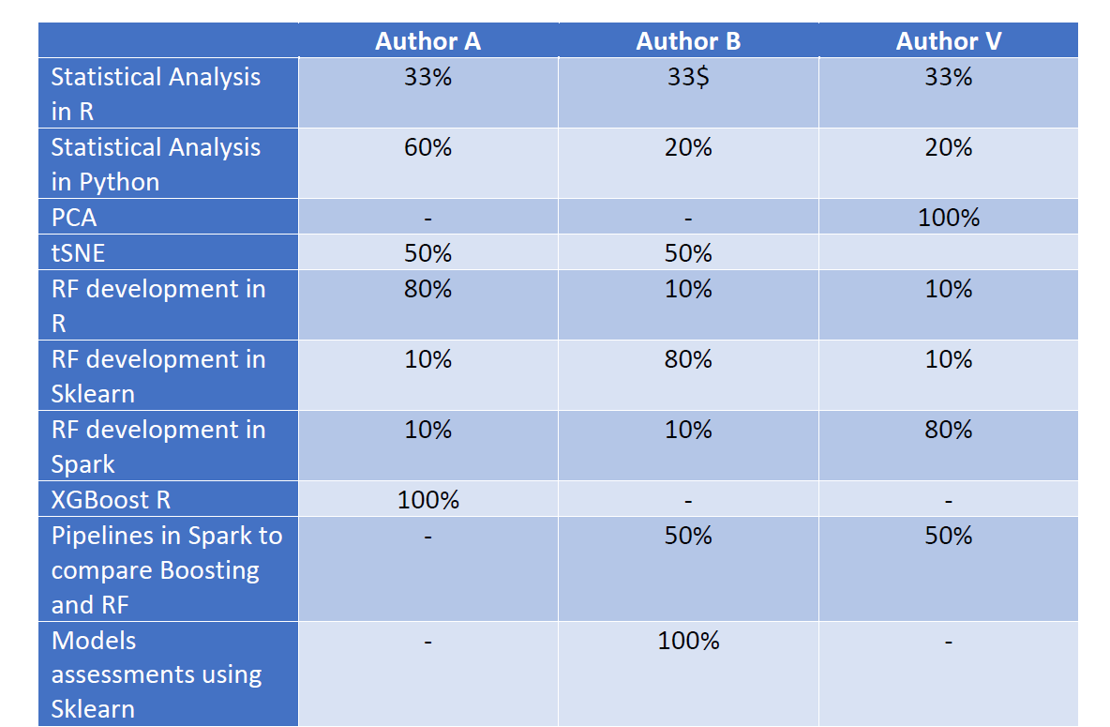
PRDL & MLlab Project
CONTENTS (VI):
ANEX III: Team activities (only for Projects with several authors)

