Slide 1
Predictive and Descriptive Learning

Slide 2
Introduction to Machine Learning
What and Why?
Types of machine learning

Slide 3
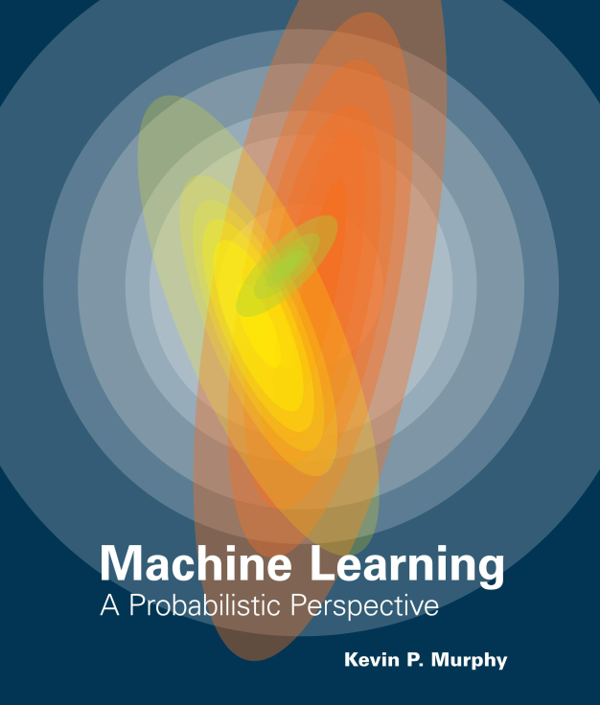
Introduction to Machine Learning
What and Why?
Types of machine learning
Murphy, Kevin P. Machine learning: a probabilistic perspective. MIT press, 2012.

Slide 4
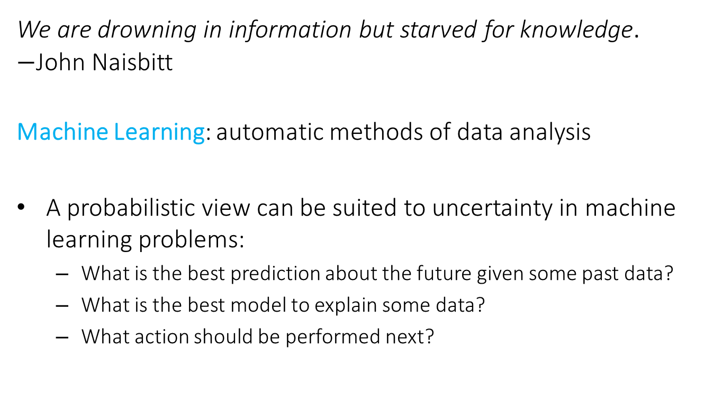
Introduction to Machine Learning What and Why?
We are drowning in information but starved for knowledge. $−$John Naisbitt
Machine Learning: automatic methods of data analysis
A probabilistic view can be suited to uncertainty in machine learning problems:
What is the best prediction about the future given some past data?
What is the best model to explain some data?
What action should be performed next?

Slide 5
Introduction to Machine Learning What and Why?
Thus we will study the most used and widely applicable machine techniques from a probabilistic view.
This is fundamental ingredient in the training of a modern data scientist providing a solid base for its use on a wide range of applications in science and industry.
The course will start presenting simple machine learning techniques in order to grasp the more sophisticated ones.
Through examples and use cases we will see how important is to accurately assess the performance of a method.
You will also acquire solid criteria on what could be best model for a given data and task.

Slide 6
Introduction to Machine Learning
What and Why?
Types of machine learning
Murphy, Kevin P. Machine learning: a probabilistic perspective. MIT press, 2012.

Slide 7
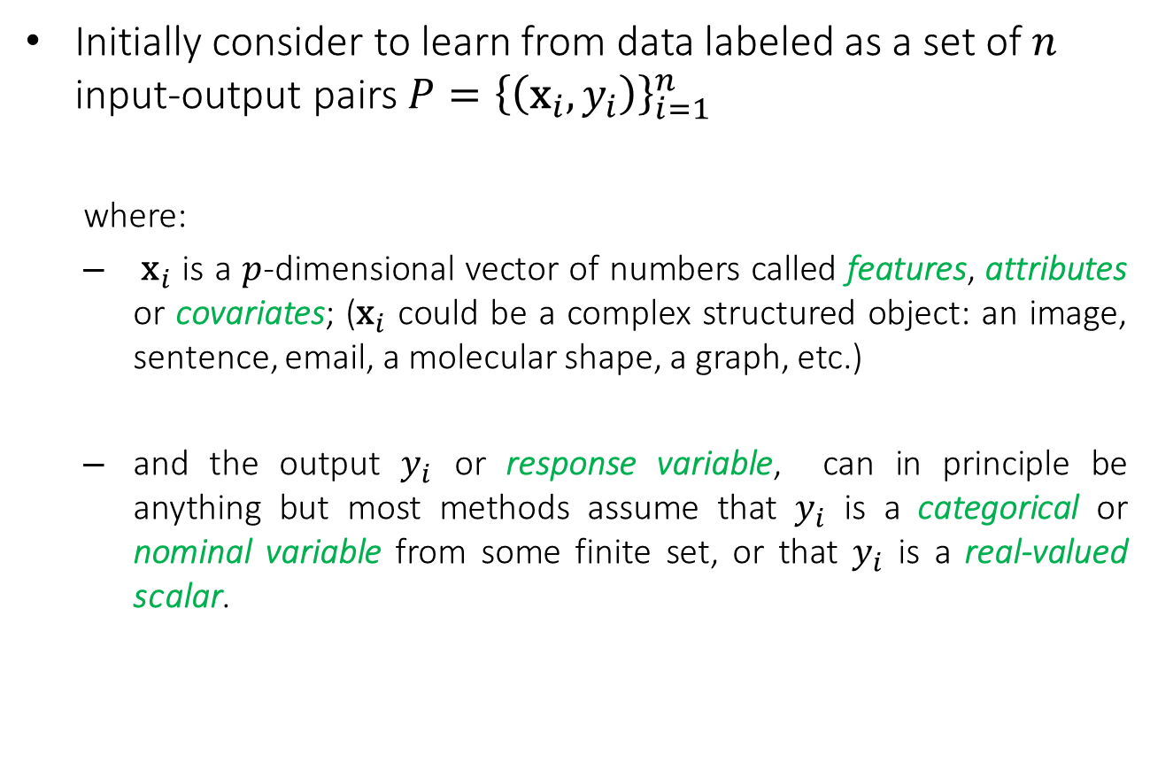
Introduction to Machine Learning Types of machine learning
Initially consider to learn from data labeled as a set of $n$ input-output pairs $P={\left\{\left({\text{x}}_{i},y_{i}\right)\right\}}_{i=1}^{n}$
where:
${\text{x}}_{i}$ is a $p$-dimensional vector of numbers called features, attributes or covariates; (${\text{x}}_{i}$ could be a complex structured object: an image, sentence, email, a molecular shape, a graph, etc.)
and the output $y_{i}$ or response variable, can in principle be anything but most methods assume that $y_{i}$ is a categorical or nominal variable from some finite set, or that $y_{i}$ is a real-valued scalar.

Slide 8
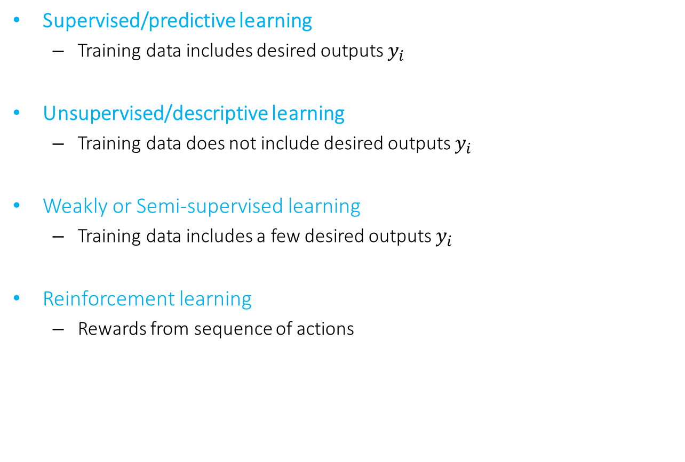
Introduction to Machine Learning Types of machine learning
Supervised/predictive learning
Training data includes desired outputs $y_{i}$
Unsupervised/descriptive learning
Training data does not include desired outputs $y_{i}$
Weakly or Semi-supervised learning
Training data includes a few desired outputs $y_{i}$
Reinforcement learning
Rewards from sequence of actions
In this course we will only study supervised/predictive learning and unsupervised/descriptive learning; reinforcement learning is covered in a subsequent course in the second semester.

Slide 9
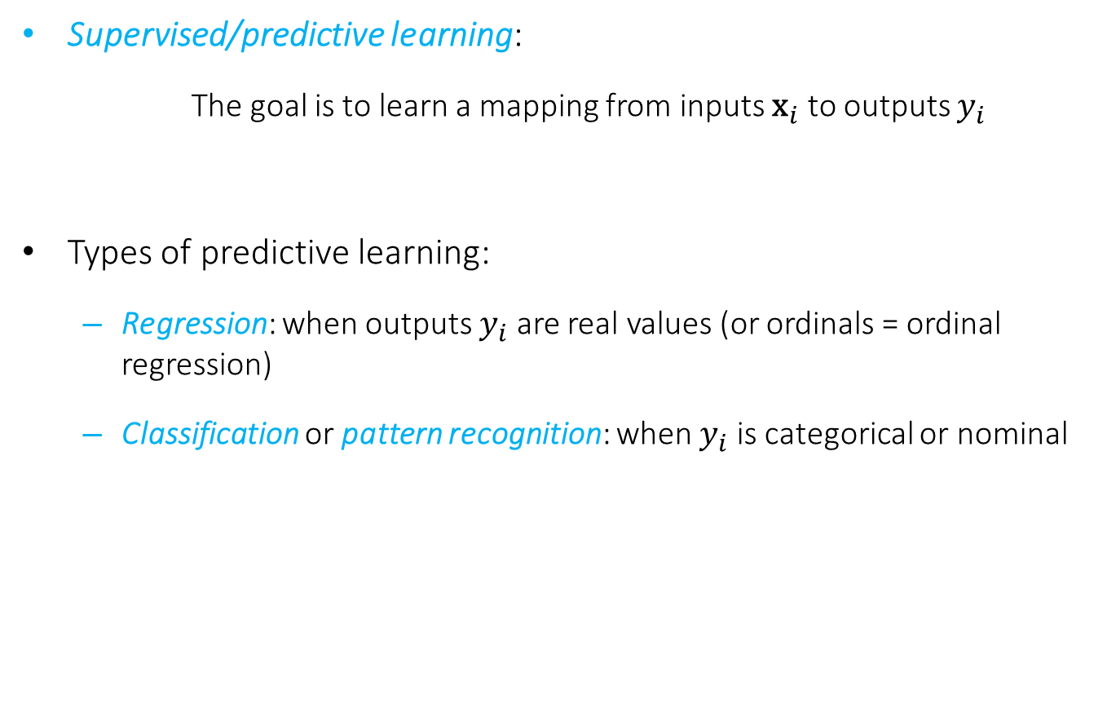
Introduction to Machine Learning Types supervised/predictive learning
Supervised/predictive learning:
The goal is to learn a mapping from inputs ${\text{x}}_{i}$ to outputs $y_{i}$
Types of predictive learning:
Regression: when outputs $y_{i}$ are real values (or ordinals = ordinal regression)
Classification or pattern recognition: when $y_{i}$ is categorical or nominal

Slide 10
Introduction to Machine Learning Supervised/predictive learning
Objectives of Supervised/predictive learning
On the basis of the training data we would like to:
Accurately predict unseen test cases.
Understand which inputs affect the outcome.
Assess the quality of our predictions and inferences.

Slide 11
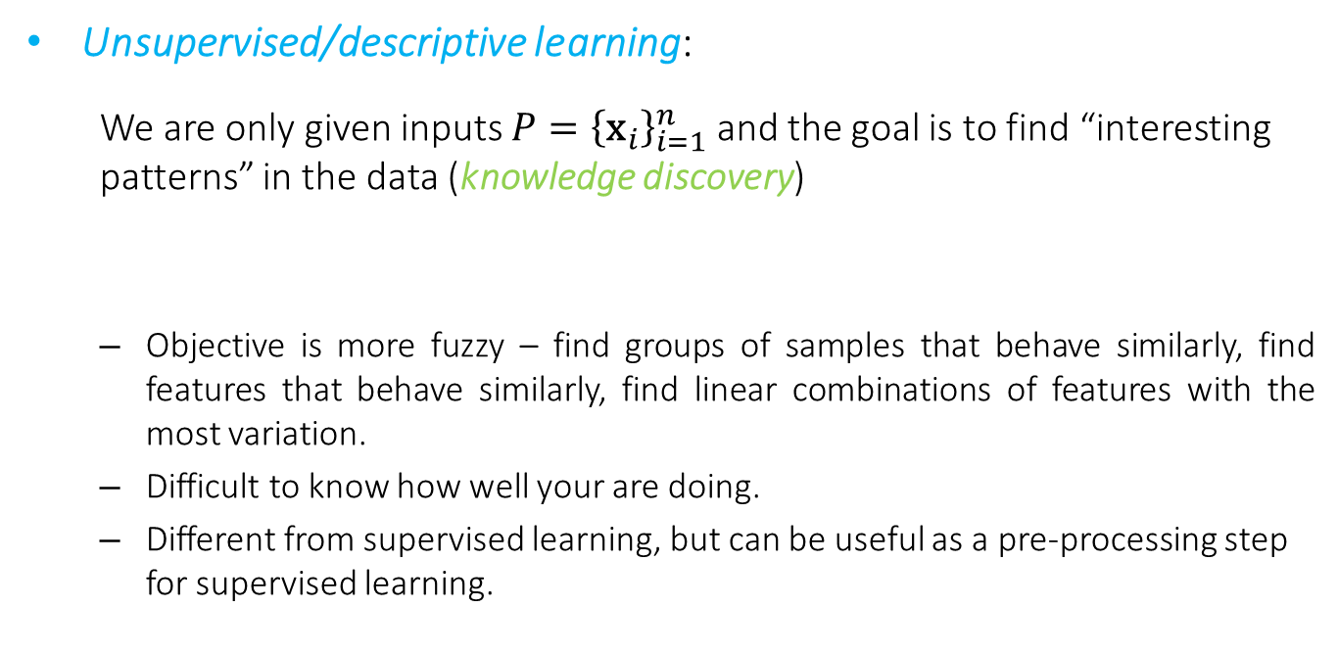
Introduction to Machine Learning Unsupervised/descriptive learning
Unsupervised/descriptive learning:
We are only given inputs $P={\left\{{\text{x}}_{i}\right\}}_{i=1}^{n}$and the goal is to find “interesting patterns” in the data (knowledge discovery)
Objective is more fuzzy – find groups of samples that behave similarly, find features that behave similarly, find linear combinations of features with the most variation.
Difficult to know how well your are doing.
Different from supervised learning, but can be useful as a pre-processing step for supervised learning.

Slide 12
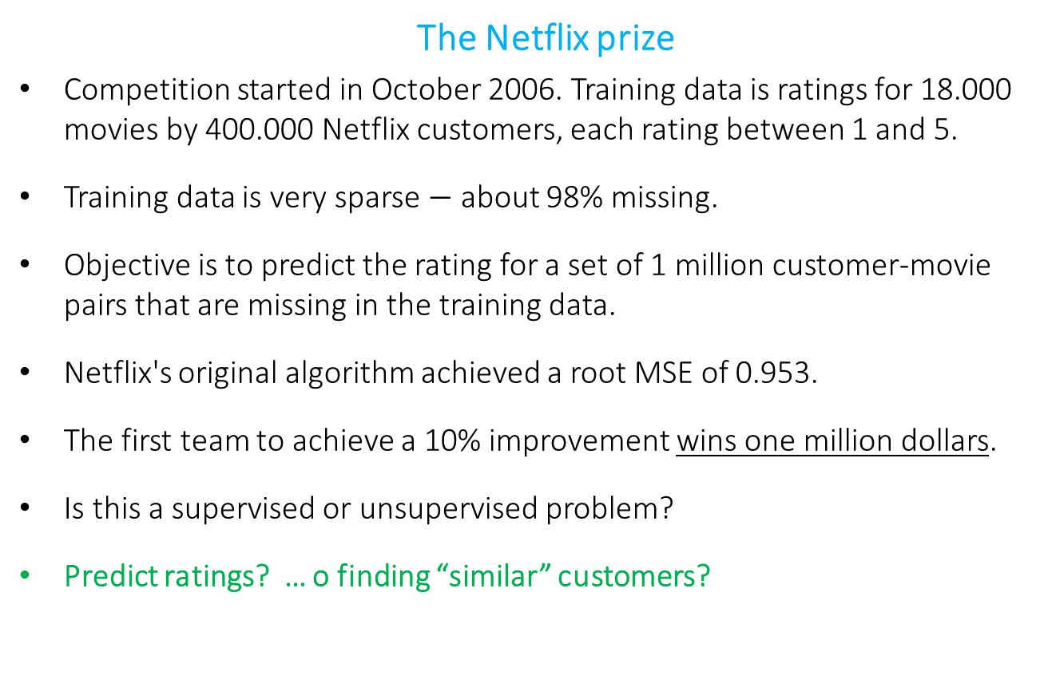
Introduction to Machine Learning
The Netflix prize
Competition started in October 2006. Training data is ratings for 18.000 movies by 400.000 Netflix customers, each rating between 1 and 5.
Training data is very sparse $−$ about 98% missing.
Objective is to predict the rating for a set of 1 million customer-movie pairs that are missing in the training data.
Netflix's original algorithm achieved a root MSE of 0.953.
The first team to achieve a 10% improvement wins one million dollars.
Is this a supervised or unsupervised problem?
Predict ratings? … o finding “similar” customers?

Slide 13
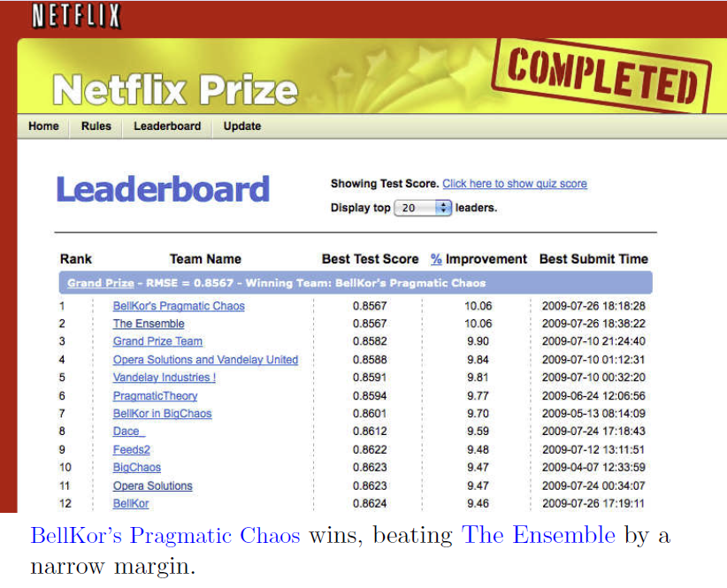
Introduction to Machine Learning

Slide 14
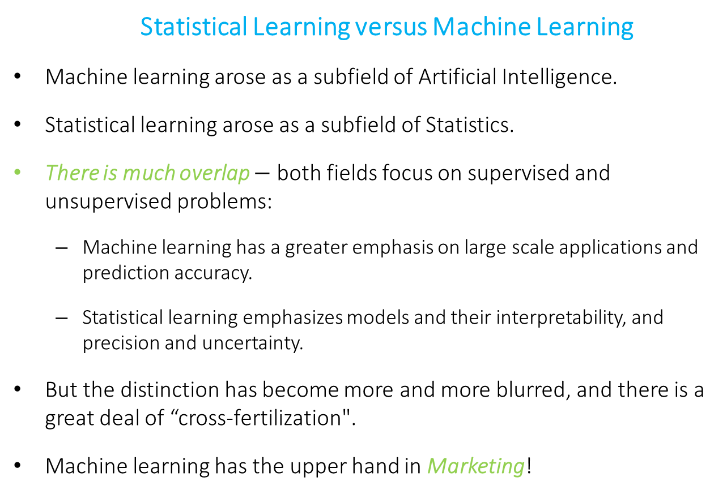
Introduction to Machine Learning
Statistical Learning versus Machine Learning
Machine learning arose as a subfield of Artificial Intelligence.
Statistical learning arose as a subfield of Statistics.
There is much overlap $−$ both fields focus on supervised and unsupervised problems:
Machine learning has a greater emphasis on large scale applications and prediction accuracy.
Statistical learning emphasizes models and their interpretability, and precision and uncertainty.
But the distinction has become more and more blurred, and there is a great deal of “cross-fertilization".
Machine learning has the upper hand in Marketing!

Slide 15
Predictive and Descriptive Learning Course Description (I)
In this course we introduce main principles of supervised and unsupervised learning to understand the ideas behind the most used and widely applicable techniques for regression, classification and clustering
Methodological issues such as model assessment and selection, and overfitting are discussed putting special emphasis on presenting and discussing each technique through the analysis of practical use cases.
The predictive or supervised techniques include:
Linear regression, logistic regression, generalized linear models,…
K-nearest neighbor classifier,
classification and regression trees,
ensemble methods (Bagging, Random Forests and Boosting),
and kernel methods and Support Vector Machines.
The descriptive or unsupervised techniques include: principal components analysis and clustering methods (k-means and hierarchical clustering)

Slide 16
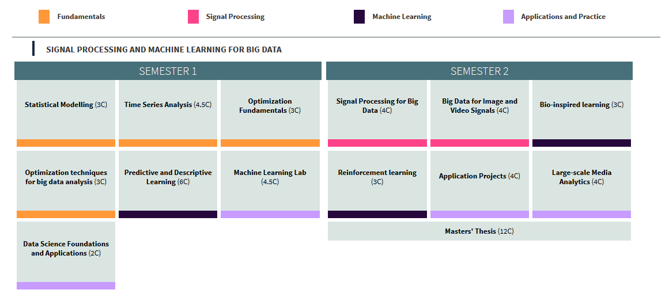
Predictive and Descriptive Learning Course Description (II)
Statistical Modelling and Optimization Techniques for Big Data courses provide enriched background to this course
This course is strongly linked to Machine Learning Lab were we study complementary use cases and experiments for large-scale scenarios.

Slide 17
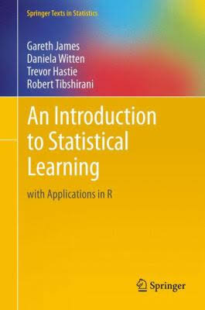
Textbook
“Most text and figures in this presentation are taken from "An Introduction to Statistical Learning, with applications in R" (Springer, 2013) with permission from the authors: G. James, D. Witten, T. Hastie and R. Tibshirani "
From January 1st, 2014, an electronic version of this book is available for free from the instructors' websites.

Slide 18
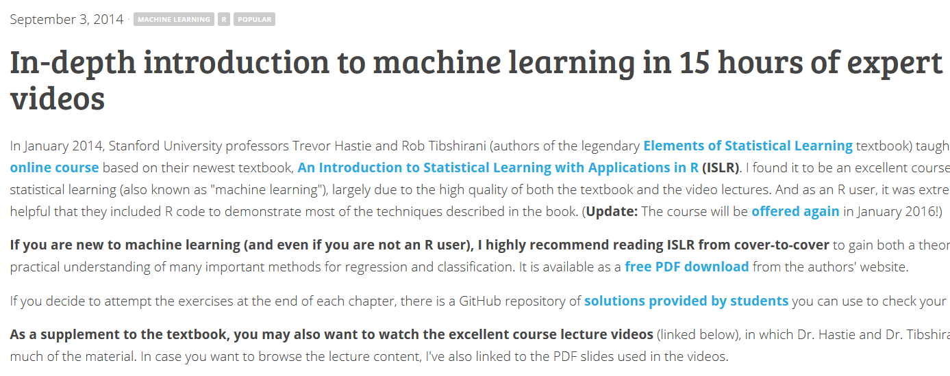
On-line course
Some slides and figures are from the on-line course:
In-depth introduction to machine learning in 15 hours of expert videos
You can access the original material and follow author’s videos at:
http://www.r-bloggers.com/in-depth-introduction-to-machine-learning-in-15-hours-of-expert-videos/
http://www.dataschool.io/15-hours-of-expert-machine-learning-videos/

Slide 19
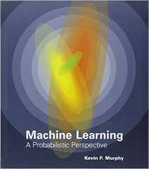
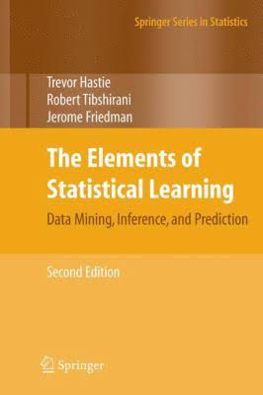
Bibliography
Murphy, Kevin P. Machine learning: a probabilistic perspective. MIT press, 2012.
Hastie, Trevor, Tibshirani, Robert and Friedman, Jerome. The Elements of Statistical Learning Data Mining, Inference, and Prediction, Second Edition. Springer Series in Statistics, 2009.
Konstantinos Koutroumbas, Sergios Theodoridis. Pattern Recognition, 4th Edition. Academic Press, 2008.
Rajaraman, Anand, and Jeffrey D. Ullman. Mining of massive datasets. Vol. 77. Cambridge: Cambridge University Press, 2012.
Bekkerman, Ron, Mikhail Bilenko, and John Langford, eds. Scaling up machine learning: Parallel and distributed approaches. Cambridge University Press, 2011.

Slide 21

Deep Learning
Learn the whole
Machine Learning context
On line:
www.deeplearningbook.org
Deep Learning courses
Prof. Hung-yi Lee National Taiwan University (NTU) Taipei

Slide 22
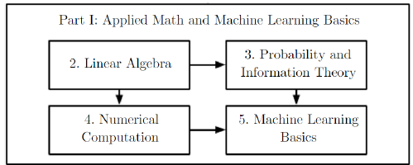
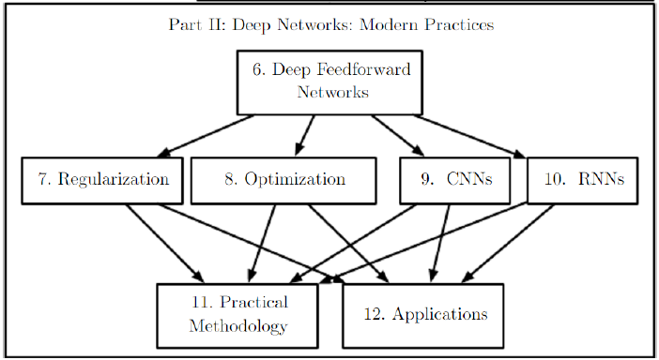

Slide 23
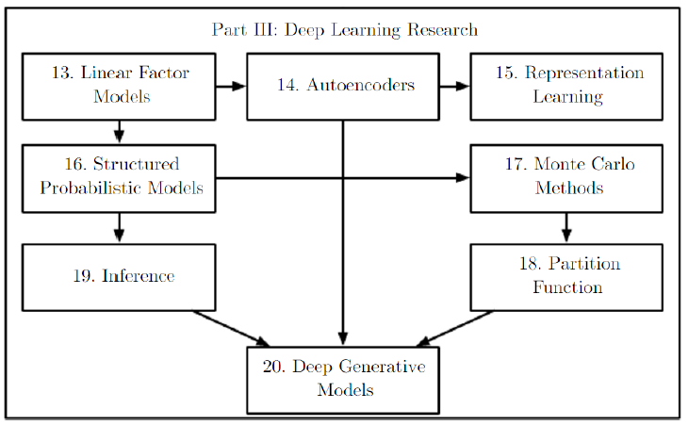

Slide 24
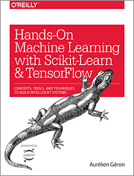
Recommended by our students
(Carlos Alcaraz)

